Slide 1
BIRD FLU
AHMED ABDULLAHI
MICROBIOLOGY
15/SCI05/005
Mcb 311
Introductory virology

Slide 2
TABLE OF CONTENT
WHAT IS BIRD FLU
TYPES OF THE BIRD FLU
WHAT ARE THE SYMPTOMS OF BIRD FLU
WHAT CAUSES BIRD FLU
PATHOGENICITY OF BIRD FLU
WHAT ARE BIRD FLU RISK FACTORS
HOW IS BIRD FLU DIAGNOSED
WHAT IS THE TREATMENT FOR BIRD FLU
HOW IS BIRD FLU PREVENTED

Slide 3
WHAT IS BIRD FLU
Bird flu, also called avian influenza, is a viral infection that can infect not only birds, but also humans and other animals . Most forms of the virus are restricted to birds.
H5N1 is the most common form of bird flu. it is deadly to birds and can easily affect humans and other animals that come in contact with a carrier. According to the world Health Organization, H5N1 was first discovered in humans in 1997 and has killed nearly 60 percent of those infected.
Currently, the virus is not known to spread through human to human contact. Still, some experts worry that H5N1 may pose a risk of becoming a pandemic threat to humans.

Slide 4
TYPES OF BIRD FLU
They are divided into subtypes on the basis of two proteins on the surface of the virus which are Hemagglutinin (HA) and Neuraminidase (NA).
There are 18 known HA subtypes and 11 known NA subtypes. Many combination of HA and Na proteins are possible. Similarly the ‘H5N1’(avian influenza virus that affects both man and aves) virus has an HA5 protein and an NA1 protein
The bird flu virus can classified as highly pathogenic avian influenza(HPAI) and low pathogenicity avian influenza(LPAI) based on molecular characteristics of the virus and the ability of the virus to cause disease and mortality in chicken. Infection of poultry with HPAI virus can cause severe disease with high mortality rates.
Avian influenza rarely infect people. The most frequently identified subtypes of avian flu that have caused human infections are H5,H7 and H9

Slide 5
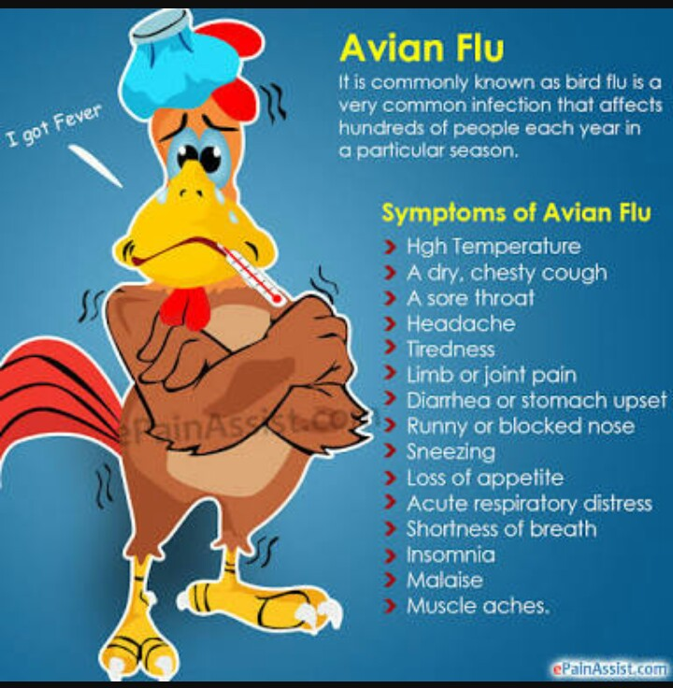
SYMPTOMS OF BIRD FLU

Slide 6
WHAT CAUSES BIRD FLU
Bird flu is a viral infection which is caused by a virus. It can be transmitted to humans through contact with infected bird feces, nasal secretions or secretions from the mouth or eyes.

Slide 7
PATHOGENICITY OF BIRD FLU
Various factors are thought to be involved in the pathogenesis of bird flu and a combination of these factors most likely determines the extent of the tissue out come.
The role of dysregulation of cytokines and chemokines has been studied extensively and may be one of the key mechanisms in the pathogenesis of Bird flu, in addition to injury resulting from viral replication. Other factors such as up regulation of tumor necrosis factor related apoptosis inducing ligand(TRAIL) and reduced cytotoxicity of CD8 lymphocytes are also believed to be involved in the pathogenesis, although their exact roles are less clear at present

Slide 8
WHAT ARE BIRD FLU RISK FACTOR
You may have a greater risk of contracting Bird flu if you are
A poultry farmer
A traveler visiting affected areas
Exposed to infected birds
Someone who eats undercooked poultry or eggs
A healthcare worker caring for infected patients
A household member o an infected
A household member of an infected person

Slide 9
HOW IS BIRD FLU DIAGNOSED
Bird flu can be diagnosed by a test called influenza A/H5 virus real time RT-PCR primer and probe set. It can offer preliminary results in only fours. However, the test isn’t widely available.
Doctors may also perform the following test to look for the presence of the virus that causes bird flu:
Auscultation( a test that detects abnormal breath sounds)
White blood cell differential
Nasopharyngeal culture
Chest X ray
Additional tests can be done to assess the functioning of the heart, kidney and liver.

Slide 10
WHAT IS THE TREATMENT FOR BIRD FLU
Different types of bird flu can cause different symptoms. As a result, treatments may vary.
In most cases, treatment with antiviral medication such as oseltamivir (Tamiflu) or zanamivir (Relenza) can help cure disease. The medication must be taken within 48 hours after symptoms first appear.

Slide 11
HOW IS BIRD FLU PREVENTED
Bird flu can be prevented by getting flu shots in order not to get a human strain of influenza. If a person develops both the avian flu and human flu at the same time, it create a new and possible deadly form of the flu.
However, risk of getting bird flu can be minimize by avoiding:
Open-air markets
Contact with infected birds
Undercooked poultry
Practicing of good hygiene

Slide 12
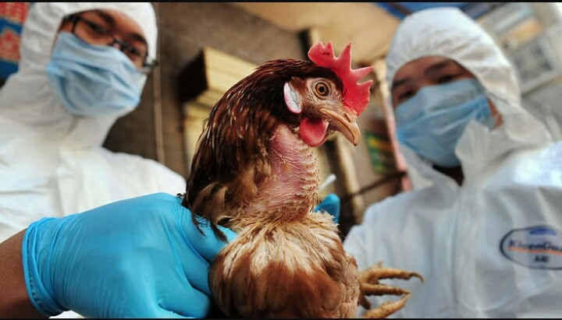
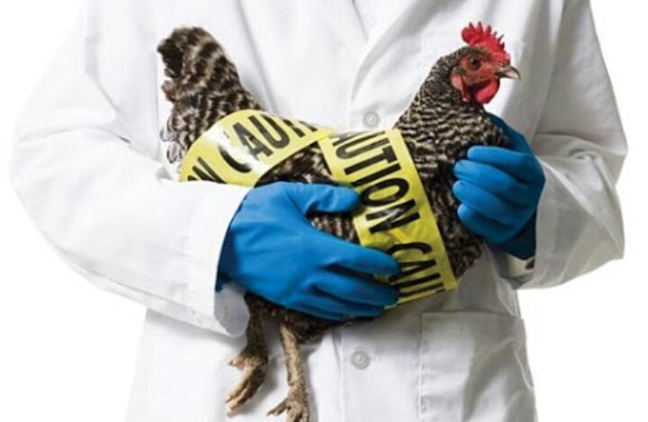
THANK YOU
THE END
THE END

