Slide 1
A SEMINAR PRESENTATION BY HEZEKIAH DEBORAH MATRIC NO: 15/SCI05/010 ON THE MEDICAL IMPORTANCE OF VIRUSES USING A VIRUS COMMON IN AFRICA AS A CASE STUDY
VIRAL DISEASE; HEPATITIS A

Slide 2
WHAT IS HEPATITIS?
Hepatitis refers to an inflammatory condition of the liver. It is commonly caused by a viral infection. There are 5 types of hepatitis; A,B,C,D and E.
Causes of Hepatitis
Drugs
Toxins
Alcohol
Viral infections
Other infections (parasites, bacteria)
Physical damage

Slide 3
THE LIVER
The liver is a large, reddish-brown, glandular organ located in the upper right side of the abdominal cavity.
Functions
Stores sugar needed for energy
Absorbs good nutrients
Breaks down poisons and drugs
Makes important protein that builds new tissues' and repair broken tissues
Produces bile, which helps remove waste from the body

Slide 4
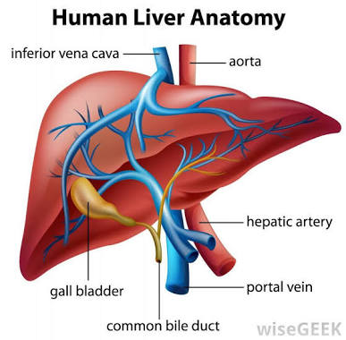

Slide 5
HEPATITIS TERMS
Acute hepatitis: short term hepatitis. The body’s immune system clears the virus from the body within 6 months.
Chronic hepatitis: long term hepatitis. The infection lasts longer than 6 months.

Slide 6
HEPATITIS A
what is hepatitis A?
Hepatitis A is an infection, that causes liver disease and inflammation of the liver. It is caused by hepatitis A virus (HAV).
This is an acute type of hepatitis which usually requires no treatment.
Epidemic jaundice described as Hippocrates.

Slide 7
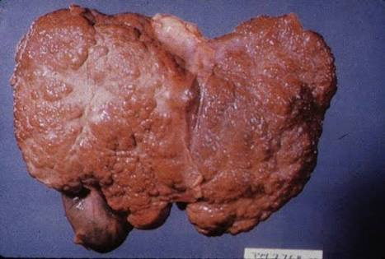
Diagram
Good and infected liver
Infected liver

Slide 8
HISTORY
.HAV is referred to as one of the oldest diseases known to mankind by the WHO.
. It was discovered in 1973 by Steven.M.Feinstone s a non enveloped, spherical, positive stranded RNA virus.

Slide 9
HEPATITIS A VIRUS
Picornavirus (RNA)
Humans are the only natural host
Stable at low PH
Inactive by high temperature, formalin, chlorine.
Naked RNA virus
Difficult to grow in cell culture

Slide 10
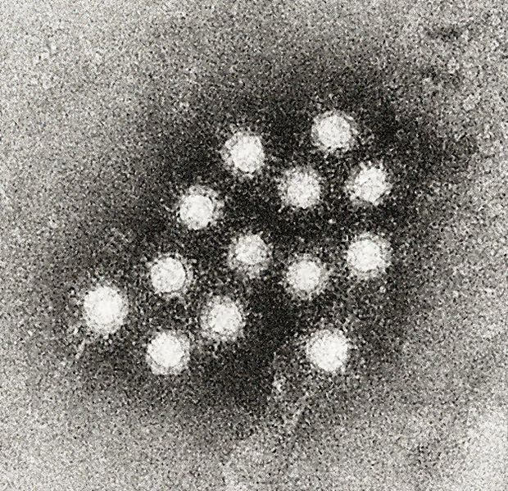
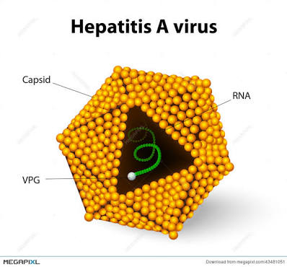
HEPATITIS A VIRUS

Slide 11
VIRUS CLASSIFICATION
Group: group IV [(+)ssRNA
Order: Picornavirales
Family: Picornaviridea
Genus: Hepatovirus
Species: Hepatovirus A

Slide 12
WHAT TYPE OF DISEASE IS IT?
Hepatitis A is a viral liver disease, classified as hepatovirus; which is a small, non enveloped, symmetrical RNA virus.

Slide 13
EPIDEMOLOGY
Globally, systematic HAV infections are believed to occur around 1.5 million people in a year.
In 2010, acute Hepatitis A resulted in 102,ooo deaths which is slightly up from 99,000 in 1990
Hepatitis is much common in countries with undeveloped sanitation systems.
HAV is common in developing
Nations of Africa, Asia, and central
And south America.

Slide 14
Geographic distribution
Areas with high level of infection
Areas with intermediate level of infection
Areas with low level of infection.

Slide 15
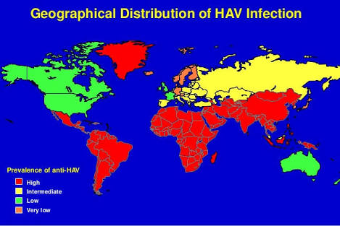

Slide 16
PATHOGENESIS
After ingestion, the HAV survives gastric acid, moves to the small intestine and reaches the liver via the portal vein
Replicates in hepatocyte cytoplasm
Once mature, the HAV travels through sinusoids and enters bile canaliculi, released into the small intestine and systematic circulation, excreted in faeces.

Slide 17
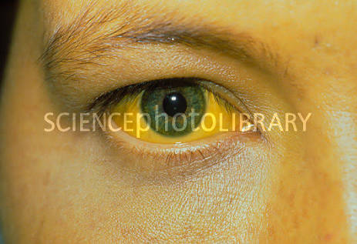
SYMPTOMS
Pale stool
Jaundice (yellowing of the skin or eyes)

Slide 18
Other symptoms include
Nausea
Loss of appetite
Vomiting
Fatigue
Fever
Dark urine
Stomach pain
Side pain

Slide 19
Clinical features
Asymptomatic (2 years old)
Symptomatic (5 and older to about 8 weeks)
Cholestasis (jaundice last more than 10 weeks )
Acute liver failure (within 4 weeks)

Slide 20
HEPATITIS A VIRUS TRANSMISSION
FAECAL ORAL ROUTE
Close person contact (e.g., household contact, sex contact, child day care centres).
Contaminated food or water (eg. Infected food handlers, raw shellfish)
PARENTAL ROUTE
Stage of viremia
Mode of minor importance
SEXUAL TRANSMISSION
Occurs in homo sexual men
Oral anal contact

Slide 21
Laboratory diagnosis
Acute infection is diagnosed by the detection of HAV-IgM in serum by EIA
Past infection i.e. immunity is determined by the detection by HAV-IgG by EIA
Cell culture- difficult and takes up to 4 weeks, not routinely performed.
DIRECT DETECTION – EM, RT-PCR of faeces. Can detect illness earlier than serology but rarely performed.

Slide 22
COMPLICATIONS OF HEPATITIS A
In extreme cases, hepatitis a can lead to acute liver failure. This complication is most common in older adults and people who already have chronic liver disease. Very rarely a liver transplant is required.

Slide 23
TREATMENT
There is no specific treatment, but supportive therapy
This includes;
Avoiding alcohol
Rest, with time off work
Taking over the counter (OTC) pain relievers if needed

Slide 24
PREVENTION
Improved sanitation
Food safety
Immunization- vaccination
Natural immunity

Slide 25
CONTROL MEASURES
THE SPREAD OF HEPATITIS CAN BE REDUCED BY;
Adequate supplies of safe drinking water
Proper disposal of sewage with communities
Personal hygiene practices such as regular hand-washing with safe water

Slide 26
THANK YOU FOR LISTENING.

