Slide 1
DENGUE VIRUS
PRESENTATION BY:
IBRAHIM KAULA IBRAHIM JR

Slide 2
DENGUE VIRUS (DENV)
Dengue virus is the cause of dengue fever. It is a mosquito-borne single positive stranded RNA virus of the family flaviviridae, and the genus flavivirus.

Slide 3
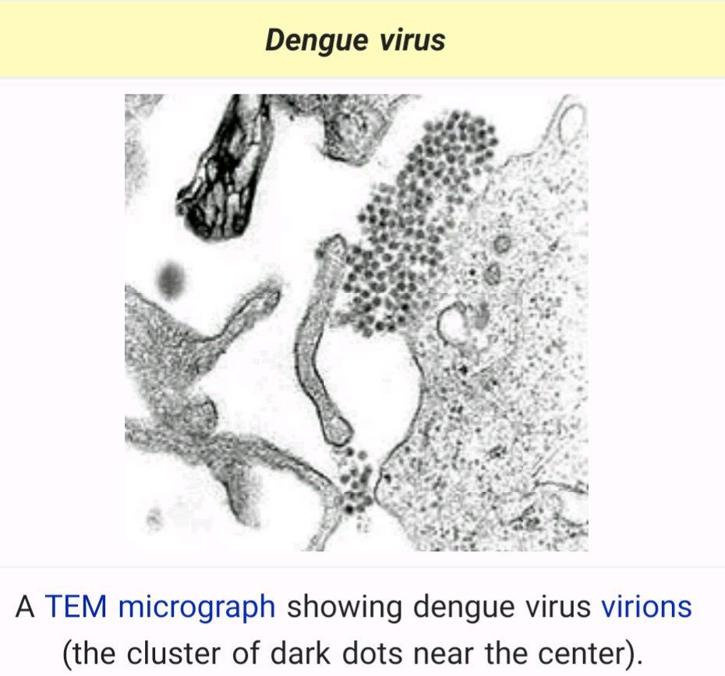

Slide 4
THE DISEASE
Dengue is found in tropical and sub tropical climates worldwide, mostly in urban and semi urban areas.
People of all ages who are exposed to infected mosquitoes can get the dengue fever. The disease occurs most often during the rainy season in areas with high number of infected mosquito
Only infected mosquitoes transmits the virus. The virus is transmitted to human through the bite of an infected female mosquito.
The incubation period is 3-14 days and the period of illness is 3-7 days.

Slide 5
A person with the virus is not contagious.

Slide 6
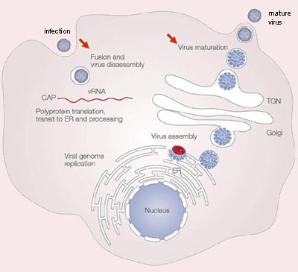

Slide 7
VIRUS CLASSIFICATION
Dengue virus is classified under the group IV(+ssRNA).
Family: flaviviridae
Genus: flavivirus
Species: dengue virus

Slide 8
MECHANISM OF INFECTION
Dengue virus envelope protein binds to a cellular receptor.
Dengue virus then undergoes endocytosis.
Uncoating occurs in the cytoplasm.
Host translational machinery(ribosomes) translates the (+)ssRNA into a single polypeptide

Slide 9
Cellular and viral proteinases cleave the polypeptide into 10 proteins (E, M, C and 7 non-structural/enzymatic proteins) while embedded on the ER membrane.
After RNA synthesis, RNA replication then occurs
Assembly occurs on intracellular membranes which bud into the ER therefore giving it room for maturation.
Egress occurs via exocytosis.

Slide 10
SIGNS AND SYMPTOMS
The disease manifests as a sudden onset of severe headache, chills, pain upon moving the eyes, and low backache. Painful aching in the legs and joints occurs during the first hours of illness. The temperature rises quickly as high as 40° C, with relative low heart rate (bradycardia) and low blood pressure (hypotension). The dengue rash is characteristically bright red petechiae and usually appears first on the lower limbs and the chest . The glands (lymph nodes) in the neck and groin are often swollen. In some patients, it spreads to cover most of the body.

Slide 11
There may also be gastritis with some combination of associated abdominal pain, nausea, vomiting, or diarrhea. Some cases develop much milder symptoms which can be misdiagnosed as influenza, chikungunya, or other viral infection when no rash is present. The classic dengue fever lasts about six to seven days, with a smaller peak of fever at the trailing end of the disease. Clinically, the platelet count will drop until the patient's temperature is normal.

Slide 12
RECOGNITION OF THE FEVER
- Sudden onset of high fever - Severe headache (mostly in the forehead) - Pain behind the eyes which worsens with eye movement - Body aches and joint pains - Nausea or vomiting

Slide 13
TREATMENT
People who suffer from dengue fever have no risk of death but some of them develop Dengue Hemorrhagic Fever (DHF) or Dengue Shock Syndrome (DSS). In some of these cases death can occur. If a clinical diagnosis is made early, a health care provider can effectively treat DHF using fluid replacement therapy. Adequately management of DHF generally requires hospitalization.

Slide 14
Aspirin, Brufen and non-steroidal anti-inflammatory drugs should be avoided as these drugs may worsen the bleeding tendency associated with some of these infections. Patients may receive paracetamol preparations to deal with these symptoms if dengue is suspected. Doctors should be very careful when prescribing medicines. Any medicines that decrease platelets should be avoided.

Slide 15
Traditional treatment is also used in tackling dengue fever, especially in Asia where the virus is tackled with the use of herbs on patients.
In Philippines dengue patients use tawa-tawa herbs and sweet potato tops juice to increase the platelets counts and revived the patients. These are traditional treatments and are often not based on scientific medicine research.

Slide 16
PREVENTION
There are no specific medications to treat dengue, and there is no vaccine commercially available against dengue. Therefore, prevention is the most important step to reduce the risk of dengue infection. There are several ways of prevention:
Mosquito control by either larval control and adult mosquito control.
Reduce mosquito bites, especially during daylight hours.

Slide 17
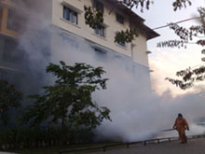
Dengue prevention through mosquito control and insect repellent

Slide 18
CONTROL MEASURES
The spread of dengue fever can be prevented by:
Personal actions to reduce contact with mosquitoes; people can reduce the risk of mosquitoes entering their homes by using windows and doors. Also, wearing of long pants and long sleeved shirts can reduce mosquito bites when spending time outdoors.

Slide 19
Chemical control of dengue mosquitoes; use of insecticides is recommended in situations during dengue virus epidemic.
Biological method; fishes are introduced in a water body(ponds, and other large container habitats) to feed on the mosquito larvae.

