Slide 1
SEMINAR PRESENTATION BY EREBANMEN ENIMIEN RACHAEL MATRIC NO: 15/SCIO5/008 ON MEDICAL IMPORTANCE OF VIRUSES
VIRAL DISEASE: EBOLA VIRUS

Slide 2
WHAT IS EBOLA VIRUS
Ebola is a serious and deadly virus transmitted by animals and humans. It was initially detected in 1976 in Sudan and the Democratic Republic of Congo. Researchers named the disease after the Ebola River. Until recently, Ebola appeared in Africa only.
Although the Ebola virus has been present for more than 35 years, the largest outbreak began in West Africa in March 2014.

Slide 3
WHERE IS THE EBOLA VIRUS FOUND IN NATURE?
There have been 33 Ebola outbreaks since 1976, but the 2014 outbreak in West Africa is by far the largest. The virus has infected thousands of people and killed more than half of them. It started in Guinea and spread to Sierra Leone, Liberia, and Nigeria.

Slide 4
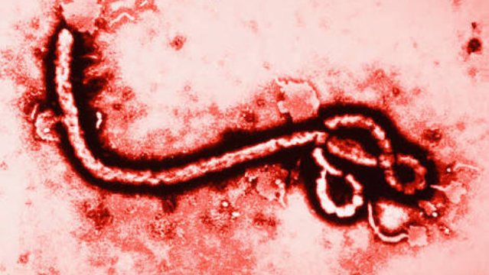
CLASSIFICATION
Class: Class v – ssRNA negative-strand viruses
Order: Mononegavirales
Family: Filoviridae
Genus: Ebolavirus
Species: Zaire ebolavirus
Sudan ebolavirus
Reston ebolavirus
Bundibugyo ebolavirus
Tai Forest ebolavirus (Ivory Coast ebola)
Microscopic view of Ebola virus

Slide 5
TYPES OF DISEASES
Inflammation of the liver and eyes.
Jaundice.

Slide 6
INFECTION
You get Ebola from a person who has the virus, and only while he or she has symptoms. People pass it to others through their body fluids. Blood, stool, and vomit are the most infectious, but semen, urine, sweat, tears, and breast milk also carry it.
To get Ebola, you’d have to get these fluids in your mouth, nose, eyes, genitals, or a break in your skin. You could also pick it up from items that have fluids on them, like needles or sheets.

Slide 7
EARLY SYMPTOMS
During the incubation period, (2 to 21 days)
Symptoms includes:
- Arthritic pain
- Backache (low-back pain)
- Chills
- Diarrhea
- Fatigue
- Fever
- Headache
- Malaise (general feeling of being unwell)
- Nausea
- Sore throat
- Vomiting

Slide 8
LATE SYMPTOM
Late symptoms include:
Bleeding from eyes, ears, and nose
Bleeding from the mouth and rectum (gastrointestinal bleeding)
Depression
Eye inflammation (conjunctivitis)
Genital swelling (labia and scrotum)
Increased feeling of pain in skin
Rash over the entire body that often contains blood (hemorrhagic)
Roof of the mouth looks red
Seizures, coma, delirium.
As many as 90% of patients die from the disease. Patients usually die from shock rather than from blood loss

Slide 9
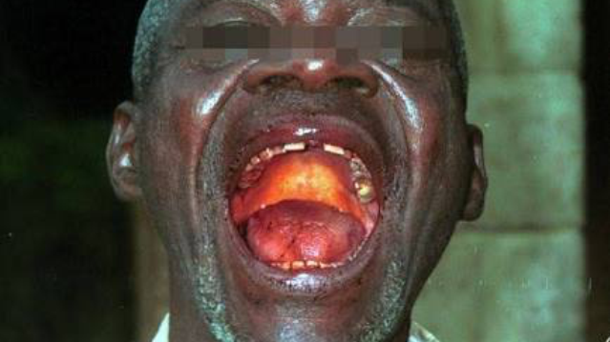
SYMPTOMS OF THE EBOLA VIRUS

Slide 10
TREATMENT
There is no approved medicine or vaccine to treat or prevent Ebola.
Since there aren’t any drugs to fight the virus, health care teams treat the person’s symptoms and offer basic support care. They are:
- Keep the person hydrated with fluids through an IV.
- Treat any other infections they have.
- Give oxygen.
- Maintain their blood pressure.
A person’s survival depends on how well his immune system works. The sooner he gets medical care, the better the chances he’ll recover.

Slide 11
HOW YOU WON’T GET EBOLA
You cannot get Ebola from casual contact, like sitting next to an infected person. Air, food, and water do not carry the virus. But kissing or sharing food or a drink with someone who has Ebola could be a risk, since you might get his saliva in your mouth.

Slide 12
PREVENTION
The best way to avoid Ebola is to stay away from areas where the virus is common. If you are in an outbreak area:
- Avoid infected people, their body fluids, and the bodies of anyone who has died from the disease.
- Avoid contact with wild animals like bats and monkeys, and their meat.
- Wash your hand often.
after you leave the area, watch for changes in your health for 21 days, and get medical help right away if you have any symptoms.

Slide 13
CONTROLLING AN OUTBREAK
Trained public health workers find every person who might have had contact with an infected person. They watch each of those people for 21 days. If someone shows signs of Ebola, health care teams test them, and keep them away from others. Then the workers track down everyone that person came in contact with as well.

Slide 14
AFTER EBOLA
Ebola survivors have certain proteins, called antibodies, in their blood that may protect them from the same strain of the virus for 10 years or more.
Its rare, but Ebola virus can stay in semen for 3 months after a man recovers, so he should avoid sex or use a condom to keep from infecting others. The virus can stay in breast milk for 2 weeks after recovery, so women shouldn’t breastfeed during that time.

Slide 15
ISOLATION

Slide 16
PRECAUTIONS
Precautions may include wearing of protective clothing such as masks, gloves, gowns, and googles.
Using infection control measures such as complete equipment sterilization and routine use of disinfectant.
Isolating patients with Ebola from contact with unprotected persons.

Slide 17
THANKS FOR LISTENING.

