Slide 1
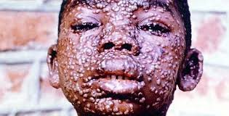
A PRESENTATION ON SMALLPOX
BY ADEKUNLE JUMOKE DOLAPO
MICROBIOLOGY
300LEVEL
15/SCI05/002

Slide 2
TABLE OF CONTENT
INTRODUCTION
WHAT CAUSES SMALLPOX
VIRUS CLASSIFICATION
TYPE OF DISEASE
ROUTE OF INFECTION
PATHOGENICITY OF THE VIRUS
SYMTOMS
TREATMENT
PREVENTION
CONTROL MEASURE

Slide 3
INTRODUCTION
Smallpox was a skin disease, which was gotten from Variola virus the disease was likely to have emerged in human populations about 10,000 Bc. The earliest credible evidence of smallpox was found in the Egyptian mummies of people who died some 3000 years ago.
Americans and Australia, were rapidly decimated and weaken by smallpox( along with other introduced diseases) during periods of initial foreign contact, which helped pave the way for conquest and colonization. During the 18th century the disease killed an estimated 400,000 Europeans each year, including five reigning monarchs, and was responsible for a third blindness. Between 20and 60% of all those infected and over 80% of infected children died from the disease.

Slide 4
Over the years at least seven religious deities have been specifically dedicated to smallpox, such as the god sopono in the Yoruba religion.
In Hindu goddess of smallpox, Sitala Mata was worshipped in the temples throughout the country.

Slide 5
WHAT CAUSES SMALLPOX
Smallpox is caused by a poxvirus called Variola( Poxviridea family of viruses, genus Orthopoxvirus). Variola is a relatively large virus that contains double-stranded DNA. The virus can be found in large numbers in many organs( skin, kidneys, spleen, liver and other organs) of infected people. Death occurs because of overwhelming toxaemia, thought to be due to immune complexes trying to react to the large number of viral particles. Variola infection only occurs in humans, which was helpful in eradicating the disease. There are two strains called variola major and variola minor( also known as alastrim). As implied by the names, variola major is more likely to cause serious disease and death than variola minor

Slide 6
HISTORICAL HIGHLIGHTS
6th century- increased trade with china and Korea introduces smallpox into japan
7th century- Arab expansion spreads smallpox into northern Africa, Spain, and Portugal
11th century- crusades further spread smallpox in Europe.
15th century- Portuguese occupation introduces smallpox into part of eastern Africa
16th century- European colonization and the African slave trade import smallpox into the Caribbean and central and south America.
17th century- European colonization imports smallpox into north America.
18th century-exploitation by great Britain introduces smallpox into Australia

Slide 7
IN AFRICA
One of the oldest record of smallpox in Africa is associated with elephant war circa AD 568, when after the fighting siege in mecca. Ethiopian troops contracted the disease which they carried with them back to Africa. Arab ports in coastal towns in Africa likely contributed to the importation of smallpox into Africa, as early as the 13th century, though no records exist until the 16th century.
The slave trade continued to spread smallpox to the entire continent, with raiders pushing farther along caravan routes in search of slaves. The effect of smallpox could be seen along caravan routes, and those who were not infected either waiting to board or on board ship

Slide 8
STILL IN AFRICA
Smallpox in Angola was likely introduced shortly after Portuguese's settlement of the area in 1484. the 1864 epidemic killed 25000inhibitors, one third of the total population in that same in area in 1713, an outbreak occurred in south Africa, after a ship from India docked at cape town, bringing infected laundry ashore. A second outbreak occurred in 1755, again affecting both and white population suffered and whole clans of the Hottentot tribe were wiped out.

Slide 9
VIRUS CLASSIFICATION
Smallpox is a double stranded DNA.
Subfamily- Chordopoxvirinae
Family- Poxviridae, which includes cowpox virus
Genus – Orthoproxvirus, diseases- cowpox, vaccinnia, smallpox, monkey pox

Slide 10
TYPES OF DISEASE- SMALLPOX
Smallpox is a contagious disease caused by variola virus.
There were two common and two rare forms of smallpox. The two common forms were known as variola minor and Variola major.
Variola minor was a less fatal type of smallpox. The centre's for disease control and prevention( CDC) estimate that only one percent of those infected died. However, it was less common than variola major. The CDC estimates 90 percent of small pox cases were variola major. Historically, this type of smallpox killed 30 percent of those infected. Variola major is the lethal strain, whole variola minor is not a lethal.
The two rare forms of smallpox were known as haemorrhagic and magliant. Both of these rare forms of smallpox carried a very high fatality, others include ordinary and modified

Slide 11
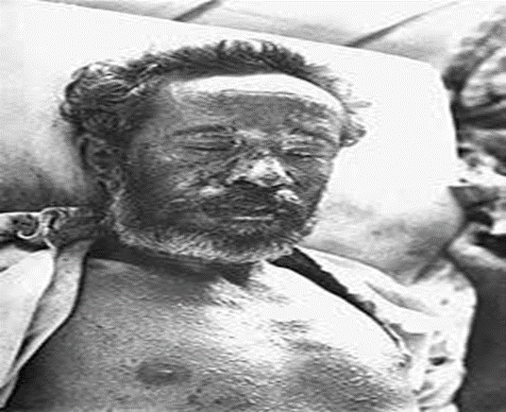
The two rare forms of smallpox were known as haemorrhagic and magliant. Both of these rare forms of smallpox carried a very high fatality, others include ordinary and modified.
A man with severe haemorrhagic-type
smallpox
Haemorrhagic smallpox caused organs to leak blood into the mucous membranes and skin.
Malignant smallpox lesions did not develop into pustules or pus-filled bumps on the skin. Instead, they remind soft and flat throughout the entire illness.

Slide 12
ROUTE OF INFECTION
Mode of transmission of smallpox is directly from person to person. Large, infectious droplets of saliva are expelled during coughing or sneezing and then inadvertently inhaled by another person. This usually requires close face-to-face contact and is similar to the way that mumps, measles and influenza are spread. On average, a single individual would infect approximately 60% of their household contacts. Infected objects, such as used silverware or heavily contaminated bedding, may carry sufficient numbers of organisms to infect another person if improperly handled, although this route of transmission is much less common. Physical contact with a smallpox pustule or crusted scab may also transmit the virus. The virus has been found to survive in scabs for many years; however, encased in the form, it is not considered to represent a significant infectious risk.
Body fluids are also infectious, and care is needed in the disposal of clinical waste.

Slide 13
PATHOGENICITY OF THE VIRUS
Smallpox is transmitted to the host via infection by the variola virus. The point of entry for the injection typically resides in the respiratory mucosa although the virus may enter through the skin. Upon infection the virus rapidly advances to the nearby lymph nodes. Following the third or fourth day of infection the virus enters the blood and spreads to the bone marrow, sleep and additional lymph nodes. Following the eight day to the twelfth day of virus in the blood fever and toxaemia occurs. At this point the virus is localized in the blood vessels of the dermis as well s the fourteenth oral mucosa which leads to initial enanthen and exanthema.

Slide 14
By day the host is infectious and large amounts of virus are located in the kidneys, liver, spleen, lymph nodes, and bone marrow. Skin lesions inlay develop from dilation of capillaries in the dermis as well as the swelling of endothelial cell vessel walls. These lesion spread to epidermis where cells become swollen eventually increasing in size to the point of membrane bursting. Following vesicular lesion pus accumulates as a result accumulation of polymorph nuclear cells into the vesicle. The pus eventually dissipates leading to scabbing of the legions. Death usually results from overwhelming toxaemia most likely due to circulating

Slide 15
immune complexes. Secondary infections can also induce a long-term effect such as encephalitis, blindness, and arthritis.
The variola virus is a rather large, rectangular shaped, double-stranded DNA pathogen. Unique from other DNA viruses, variola virus replicates in the cytoplasm of the parasitized host cells. Smallpox is capable of solely infecting humans and does not exist in a carrier state

Slide 16
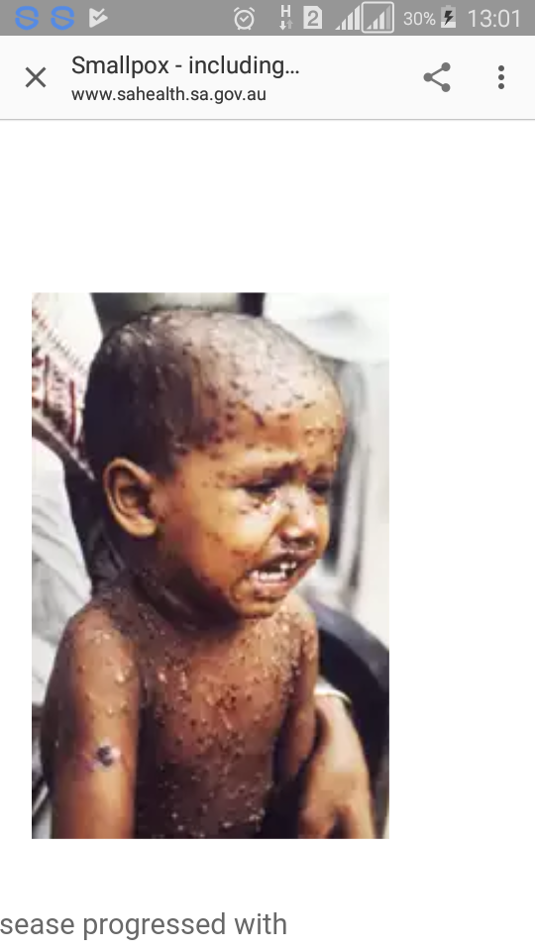
SYMPTOMS
Sudden onset of high fever which may be recurrent
Malaise( general feeling of unwellness)
Sever headache
Backache
Abdominal pain
Vomiting
Diarrhoea
Wide spread skin rash- flat spots which change into raised bumps then firm fluid filled blisters which then scab

Slide 17
TREATMENT
Smallpox vaccination within three days of exposure will prevent or significantly lessen the severity of smallpox symptoms mass. Vaccination four to seven days after exposure can offer some protection from disease or may modify the severity of disease. Ventilator assistance, wound care and infection control are other means apart from vaccination for the treatment of smallpox. Flat and haemorrhagic types of smallpox can be treated with fluid resuscitation.
No drug is currently approved for the treatment of smallpox

Slide 18
PREVENTION
One of the best ways to prevent smallpox is through vaccination. The vaccine is made from a virus called Vaccinia
Exclude people with small pox from childcare, preschool, school and work from the start of the illness until all scabs have disappeared and they have been advised by a chief of quarantine
Stay away and keep your children away from anyone who might have smallpox
Do not touch a skin area where someone had a smallpox vaccine placed
Health care measures which includes creation and use of special teams of healthcare and public health workers

Slide 19
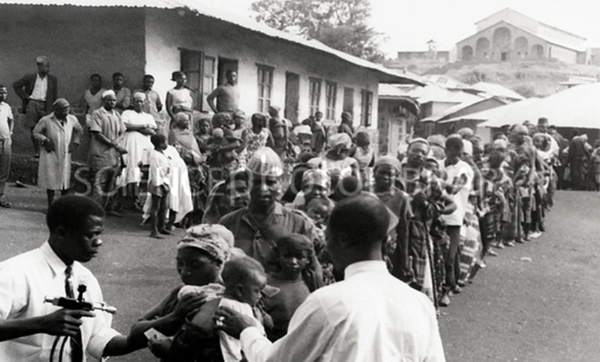
Smallpox eradication. Line of villagers waiting to be vaccinated against smallpox and measles during the smallpox eradication and measles
control program during the campaign in 1960s and 1970s in Banso, Cameroon, Africa in 1969

Slide 20
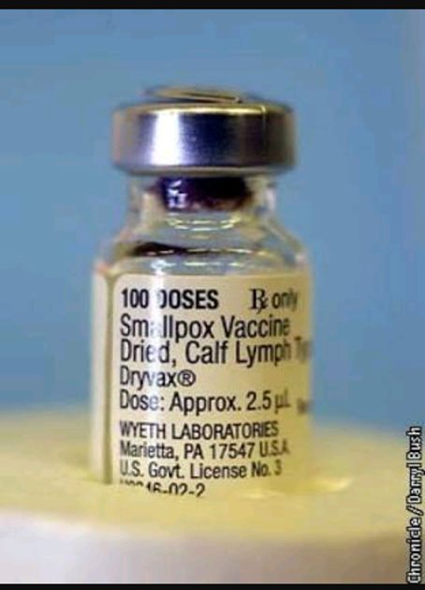
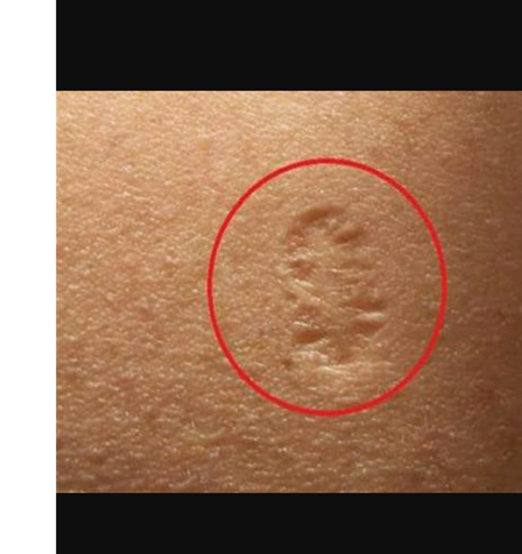
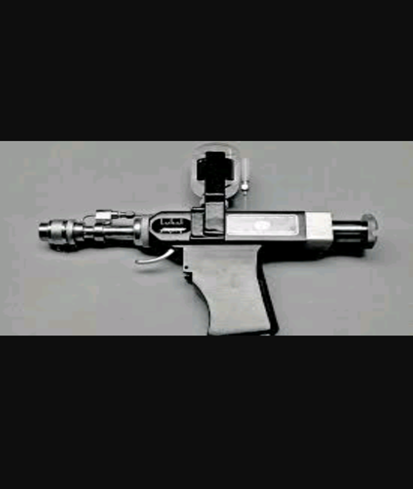

Slide 21
CONTROL MEASURES
Complications should be monitored for treated
Corneal lesions may be treated with topical idoxueidine
The fluid and electrolyte balance should be monitored and maintained to avoid dehydration
Skin care should be instituted
Good nutritional support should be maintained
Medications should be given for fever and pain.

Slide 22
CONCLUSION
Smallpox was one of the most terrifying disease in history. Today, however we do not live in fear of it because smallpox no longer exists in the wild.
In 1979, after an intensive and very effective worldwide vaccination campaign, smallpox was declared eradicated. This means that smallpox virus is no longer circulating anywhere in the world.
Dr Edward Jenner introduced the first successful vaccine to be developed in 1796.
In 1980 the world health organization ( WHO) assembly declared smallpox eradicated, and no case of naturally occurring smallpox have happened since.

Slide 23
THANKS FOR LISTENING

