Slide 1
SEMINAR REPORT ON: HERPES SIMPLEX VIRUS(HSV) BY:
ADEKUNLE OLUWATOMISIN .E.
15/SCI05/003
DEPARTMENT: MICROBIOLOGY

Slide 2
TABLE OF CONTENTS
INTRODUCTION
VIRUS CLASSIFICATION
TYPE OF DISEASE
ROUTE OF INFECTION
PATHOGENICITY OF THE VIRUS
COMMON SITES
IMAGES
STRUCTURES
SYMPTOMS
TREATMENT AND CONCLUSION
CONTROL MEASURES
CONCLUSION

Slide 3
INTRODUCTION
Herpes Simplex is a viral disease caused by the Herpes Simplex virus. Herpes simplex virus 1 and 2 (HSV-1 and HSV-2), also known as human herpesvirus 1 and 2 (HHV-1 and HHV-2), are two members of the herpesvirus family, Herpesviridae, that infect humans.Both HSV-1 (which produces most cold sores) and HSV-2 (which produces most genital herpes) are ubiquitous and contagious. They can be spread when an infected person is producing and shedding the virus.
In simple terms, herpes simplex 1 is most commonly known as a "cold sore", while herpes simplex 2 is the one known by the public as "herpes", or "genital herpes".
HSV can also spread to the eyes, causing a condition called herpes keratitis. This can cause symptoms such as eye pain, discharge, and a gritty feeling in the eye.

Slide 4
VIRUS CLASSIFICATION
Herpes virus belong to the virus;
Group: Group I (dsDNA)
Order: Herpesvirales
Family: Herpesviridae
Subfamily: Alphaherpesvirinae,which is a taxonomic subfamily that can reproduce.
Genus: Simplexvirus
Species: Herpes simplex virus 1(HSV-1) and Herpes simplex virus 2( HSV-2).

Slide 5
TYPE OF DISEASE
HSV-2 which is also known as a genital herpes is often classified as a Sexually Transmitted Disease(STD). It causes a disease known as Herpes genitalis
Likewise the HSV-2, HSV-1 commonly causes sores and blisters around the mouth which may have been contacted through kissing an infected person or sharing utensils like plates, spoons, and cups with an infected person unknowingly. It causes a disease known as Herpetic gingivostomatitis and Herpes labialis

Slide 6
ROUTE OF INFECTION
Herpes simplex virus are both neurotropic and neuroinvasive viruses.
A neurotropic virus is capable of causing harm to the nerve cells while the neuroinvasive virus is capable of entering the nerve cells which would later lead to an infection
When these viruses are able to invade the nervous system, they engage in a constant battle with the antibodies and weaken them inorder to be able to carry out their harmful replication which brings about infection to the nerve cells and the body in general.
Both viruses may be transmitted vertically during childbirth. However, the risk of infection transmission is minimal if the mother has no symptoms or exposed blisters during delivery. The risk is considerable when the mother is infected with the virus for the first time during late pregnancy.

Slide 7
PATHOGENICITY OF THE VIRUS
Man is the only natural host to HSV, the virus is spread by contact, the usual site for the implantation is skin or mucous membrane.
Herpes labialis/cold sores: Caused mainly by HSV-1, there have been reported cases caused by HSV-2. Primary infections with HSV-1 are acquired usually in childhood and may be asymptomatic or subclinical. Symptomatic primary infections present mainly as gingivostomatitis, with fever, sore throat, fetor oris, anorexia, cervical adenopathy, and mucosal edema and vesicular and ulcerative painful lesions involving the buccal mucosa, tongue, gums, and pharynx. Ulcers heal without scarring within 2-3 weeks. Recurrent infections have generally milder symptoms and clinical course.
Genital herpes: It is a sexually transmitted disease. Genital herpes is caused mainly by HSV-2, although HSV-1 has become as common as HSV-2 in primary genital infections in developed countries. Primary genital herpes is characterized by formation of multiple, bilateral, painful, and extensive genital ulcers, which heal without scarring within 12 days.

Slide 8
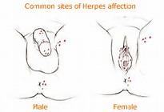
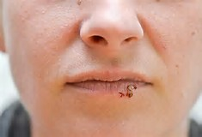
Common sites
The HSV-1 primary site is the mouth, tongue, and in rare conditions the eyes.
This is the site for the HSV-2 type

Slide 9
IMAGES

Slide 10
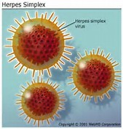
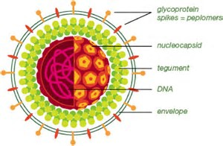
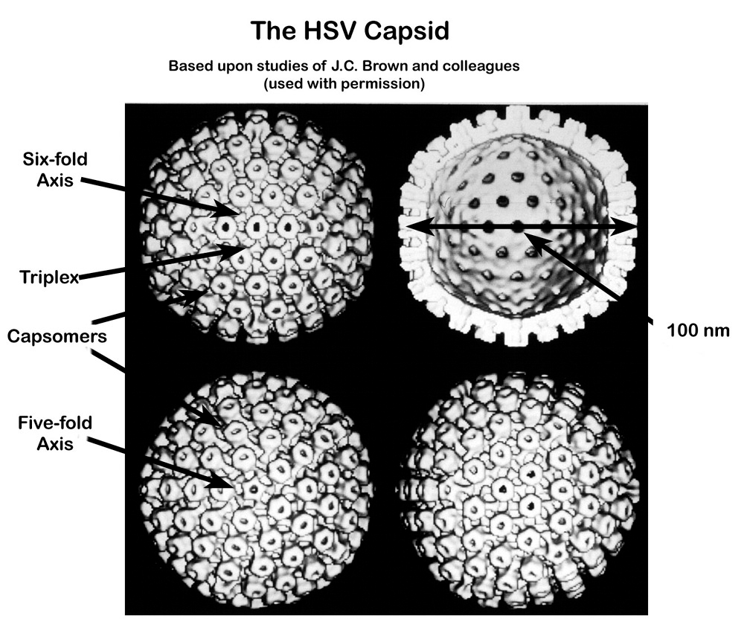
STRUCTURE
They are 120-300 nm in diameter and consist of a linear, double stranded DNA genome enclosed within an icosahedral capsid,surrounded by a phospholipid rich envelope. The lipid envelope is derived from the nuclear envelope of the infected cell

Slide 11
SYMPTOMS
Blisters that break open and form small ulcers, fever, swollen lymph nodes. This are the common symptoms associated with the HSV-1 infection.
Most people with HSV-2 do not realize that they are infected.
Many people infected with HSV-2 display no physical symptoms—individuals with no symptoms are described as asymptomatic or as having subclinical herpes.
When symptomatic, the typical manifestation of a primary HSV-1 or HSV-2 genital infection is clusters of inflamed papules and vesicles on the outer surface of the genitals resembling cold sores.

Slide 12
TREATMENT AND PREVENTION
Treatment: Antivirals may reduce asymptomatic shedding; asymptomatic genital HSV-2 viral shedding is believed to occur on 20% of days per year in patients not undergoing antiviral treatment, versus 10% of days while on antiviral therapy.
Prevention: Going for regular check ups at the clinic to know if one infected so as to carry out proper action if the virus is present.
Use of condoms.
Blood tests looking for antibodies to HSV-1 and HSV-2 can also help diagnose these infections. This is especially helpful when there are no sores present.
Abstinence.
Avoid sharing cutleries and always know the status of your partner.

Slide 13
CONTROL MEASURES
Infected people should be quarantined inorder to prevent the virus from spreading rapidly.

Slide 14
CONLUSION
There is currently no cure for this virus. Treatment focuses on getting rid of sores and limiting outbreaks.
It is possible that your sores will disappear without treatment. However, your doctor may determine you need one or more of the following medications:
acyclovir
famciclovir
Valacyclovir
People who become infected with HSV will have the virus for the rest of their lives. Even if it does not manifest symptoms, the virus will continue to live in an infected person’s nerve cells.

