Slide 1
A SEMINAR PRESENTATION: MEDICAL IMPORTANCE OF VIRUSES ON A VIRUS DISEASE COMMON TO AFRICA CHICKEN POX BY EJIBUNU NAZIRAT ADEREWA 15/SCI05/007 MICROBIOLOGY

Slide 2
Table of content
Introduction
Virus classification
Type of disease
Route of infection
Pathogenicity of the virus
Symptoms
Treatment and Prevention
Control measures
conclusion

Slide 3
INTRODUCTION
Chickenpox is a vial infection that causes an itchy rash of spots all over the body and flu-like symptoms.
Chickenpox is a very contagious infection caused by the Varicella-zoster virus. It mainly affects kids, but adult can get it too. This virus also can cause a painful skin rash called shingles (herpes zoster)later in life.
Chickenpox is believed to have been first described by Giovanni Filippo during the 1500s in Italy. In the 1600s, and English physician named Richard Morton gave the name chickenpox to what he thought was milder from smallpox. It is believed that in the 1700s, William Heberden, was the first physician to prive that chicken pox was actually different from smallpox.
Chickenpox is an airborne disease which spreads easiky through the coughs and sneezes of an infected person.

Slide 4
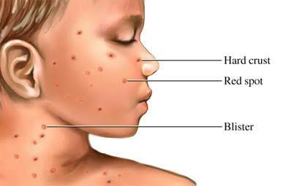
Photo of chicken pox: How to Recognize the Rash

Slide 5
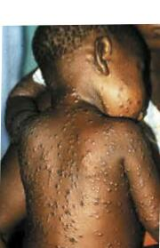
How Chicke pox looks like

Slide 6
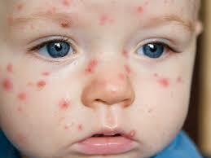

Slide 7
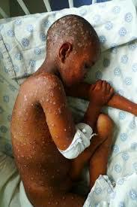

Slide 8
VIRAL CLASSIFICATION
Varicella zoster virus or varicella-zoter virus is one of eight herpes viruses known to infect humans.
Scientific name: Human herpesvirus 3
Rank: Species
Higher classification: Varicello virus

Slide 9
TYPE OF DISEASE
Chicken pox is a highly contagious disease caused by the Varicella-zoster virus (VZV), a type of herpes virus.
It generally strikes children younger than 15

Slide 10
ROUTE OF INFECTION
The virus is transmitted by airborne viral particles shed from the skin of an infected person. The new host breathes in the viru, which enters the mucous membrane in a person’s respiratory tract and begins to spread without its envelop from cell to cell. The virus invades T-cells of the blood and those T-cell carry the virus to the skin. There, the virus can recreate its envelop because the top layer of the skin lacks the endosomal pathway that removes glycoproteins from the envelop.

Slide 11
PATHOGENICITY OF THE VIRUS
Varicella- Zoster virus has an incubation period of about 10- 21days and is most contagious through physical contact a few days before symptoms occur.
During this incubation period, the virus spreads to the lymph nodes, the liver and the lungs. This process is known as primaryviremia.
As the incubation period pregresses, the virus makes its way to the skin via bouth CD4+ and CD8+ T cells, initiating secondary viremia.
As the infection progresses, small skin vesicles filled with pus and infected cell particles form on the skin surface. These lesions are the ‘pox’ of chickenpox.

Slide 12
SYMPTOMS
Feeling tired and generally unwell
A high temperature(fever) of 38C (100.4F) or over
Feeling sick
Headache
Aching, painful muscles
Loss of appetite
Itching
Sore throat
Swollen lymph nodes
Vomiting
Dehydration
Diarrhea

Slide 13
TREATMENT
Treatment involves keeping the person as comfortable as possible. Here are things to try:
Avoid scratching or rubbing the itchy area. Keep figernails short to avoid damaging the skin from scratching.
Wear cool, light, loos bedclothes. Avoid wearing rough clothings, particularly wool, over an itchy area.
Take lukewarm baths using little soap and rinse thoroughly. Try a skin soothing oatmeal or cornstarch bath.
Apply a soothing moisturizer after bathing to soften and cool the skin.
Avoid prolonged exposure to excessive heat and humidity.
Try over the counter hydrocortisone cream on itchy areas.

Slide 14
PREVENTION
Stay away from school or work
Avoid contact with people at risk
Clean and wask regularly
Chickenpox vaccination
Keeo your immune system strong
Talk to your doctor about aniviral drugs

Slide 15
CONTROL MEASURES
Isolation of persons with the virus
Vaccinate persons without evidence of immunity
Disinfect your house and hands
Notification.

Slide 16
CONCLUSION
Chickenpox is a common illness that mainly affects children and causes an itchy spotty rash .
Most children will catch chickenpox at some point. It can also occur in adult who didnt have it when they were a child.
Anyone can get chickenpox.

Slide 17
THANKS FOR LISTENING.

