Slide 1
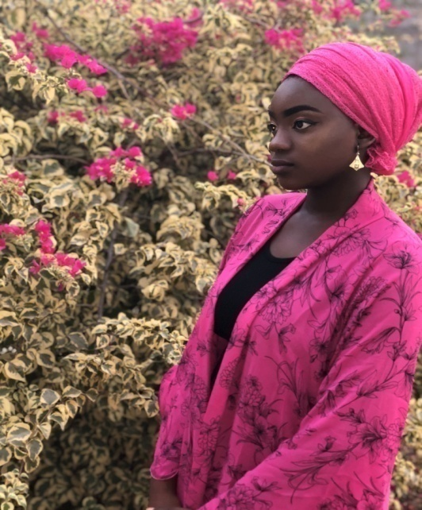
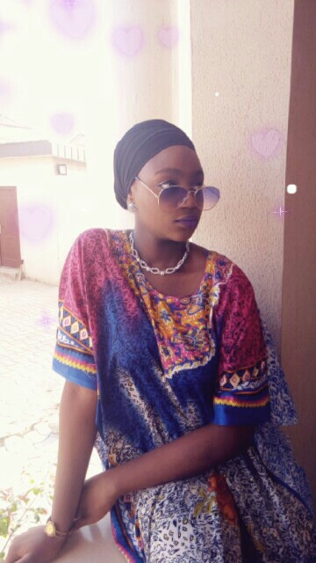
HAPPY BIRTHDAY!!!
AISHA NANA
So many years ago, in a little village of Egbira, there was heard, a cry of a very cute, pretty and most beautiful girl….
HER NAME IS AISHA!!!

Slide 2
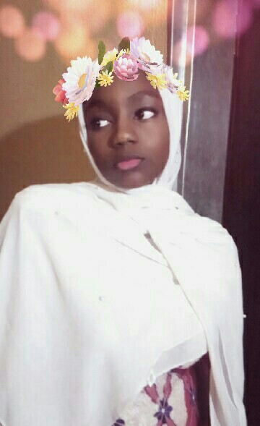
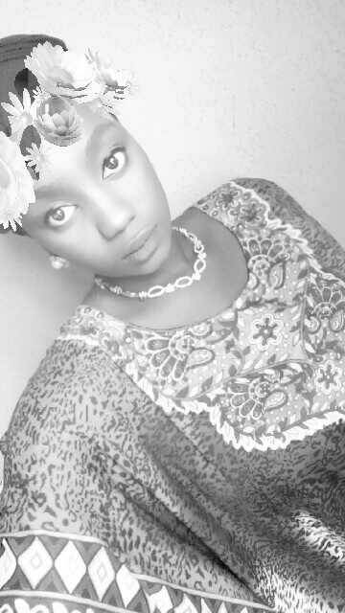
DO U KNOW AISHA!!!!
SHE IS ONE VERY FUNNY, I MEAN VERY FUNNY PERSON, THAT MAKES U WELL UP IN TEARS WITH HER GIST

Slide 3
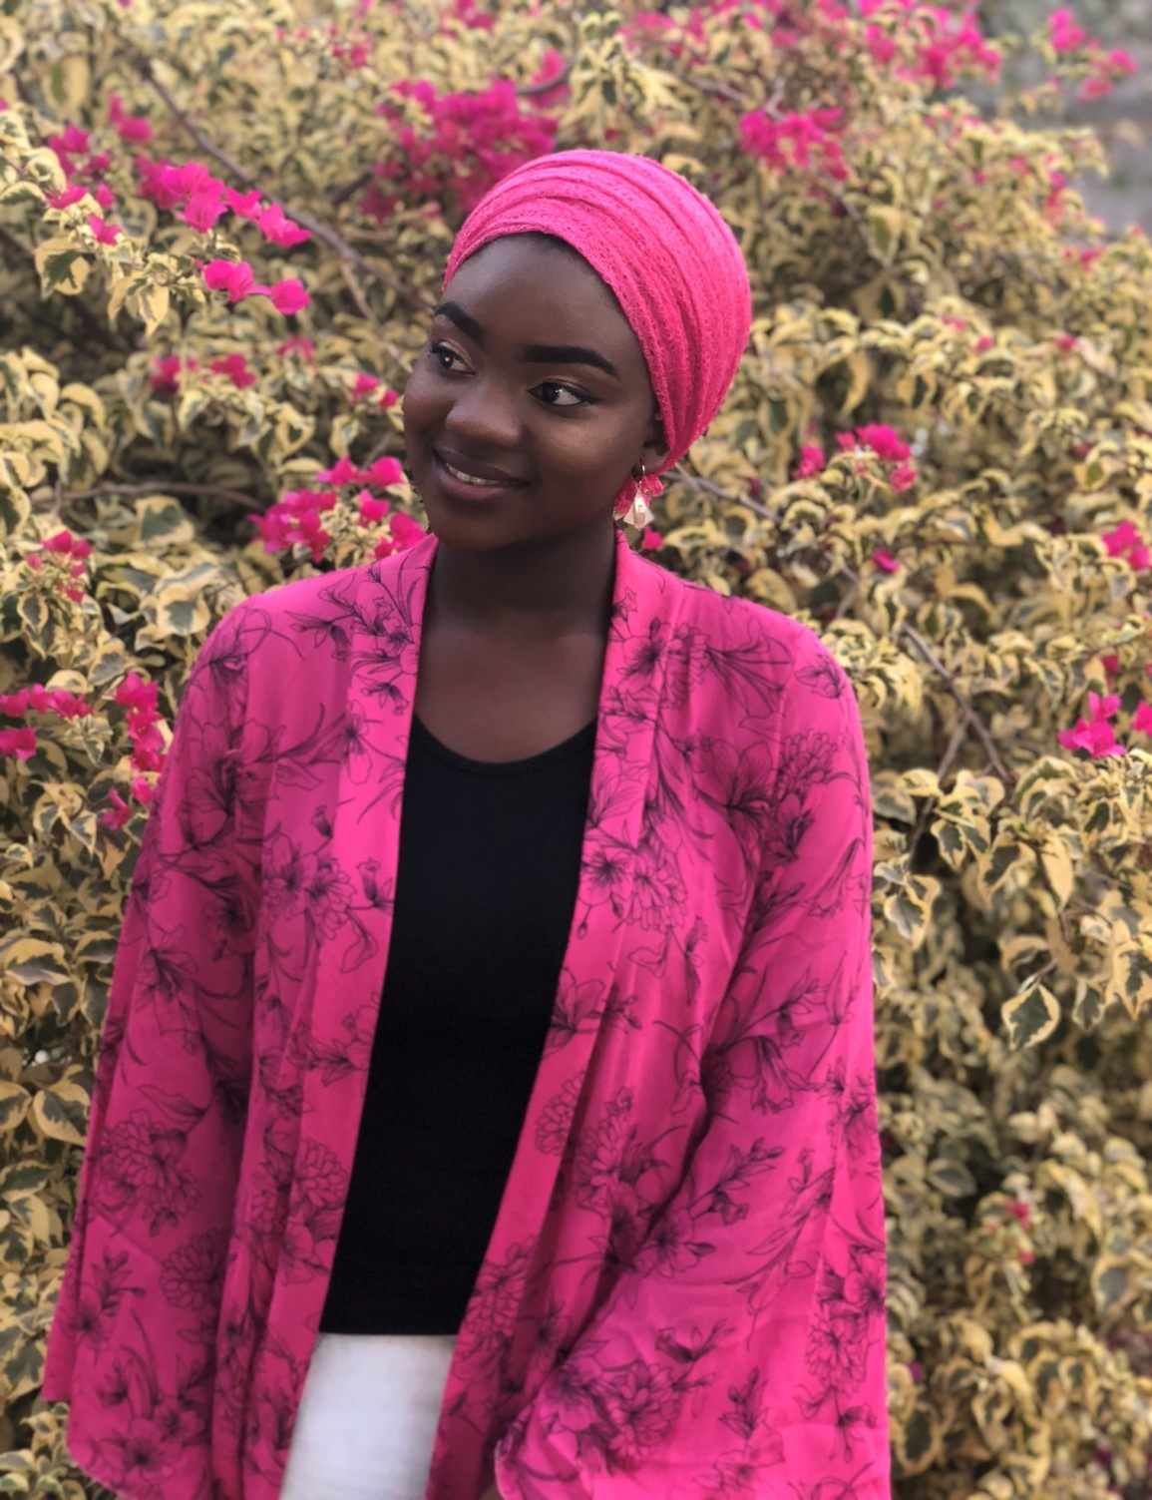

Slide 4
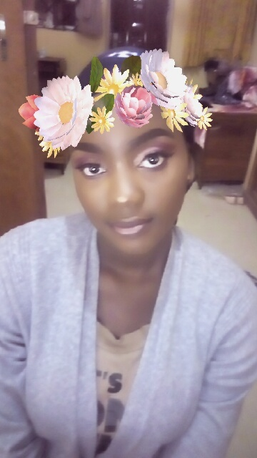


Slide 5
ENJOY THIS DAY TO THE FULLEST…..
POP CHAMPAIGNE…
BREAK BOTTLES, BUT NOT ON PEOPLE’S HEAD….
Blessed fatimah fareedah cares!!!!

Slide 6
WE LOVE U !!!!!!!!!!!
MY LUV FOR THIS BAE EHN…..
ON THIS SPECIAL DAY, WE WISH U ALL THE GOOD THINGS IN LIFE…
MORE MONEY TO YOUR BANK ACCOUNT….
MORE BEAUTY TO THAT YOUR CUTE FACE…..
MORE INTELLIGENCE TO THAT BRAIN…
MORE JOKES FROM U TO US….

