Slide 1
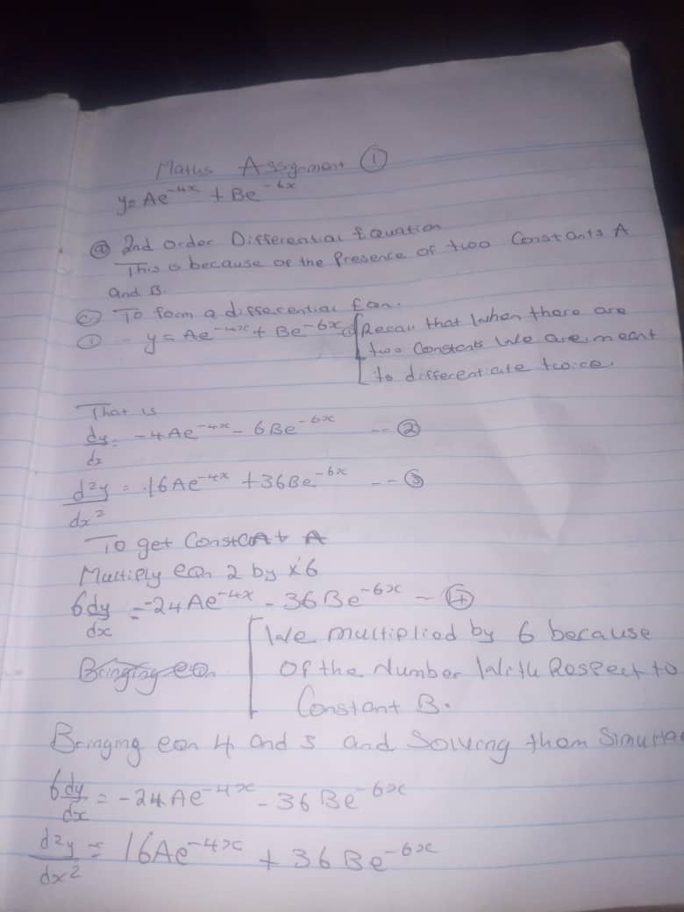
NAME: UMOESSIEN,EMEMOBONG DAVID MAT NO:17/ENGO1/029 DEPT : CHEMICAL ENGINEERING

Slide 2
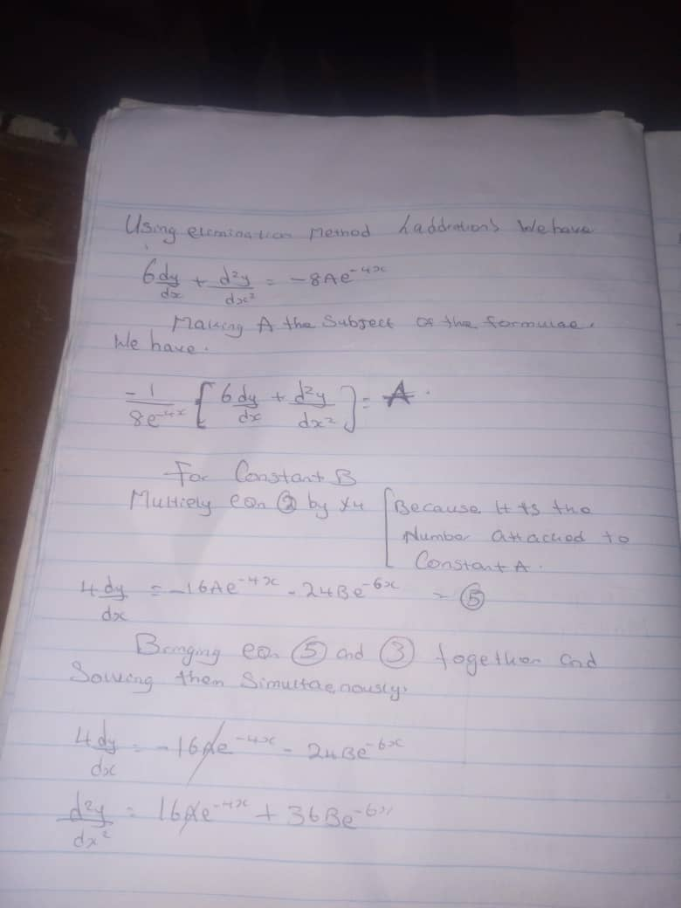

Slide 3
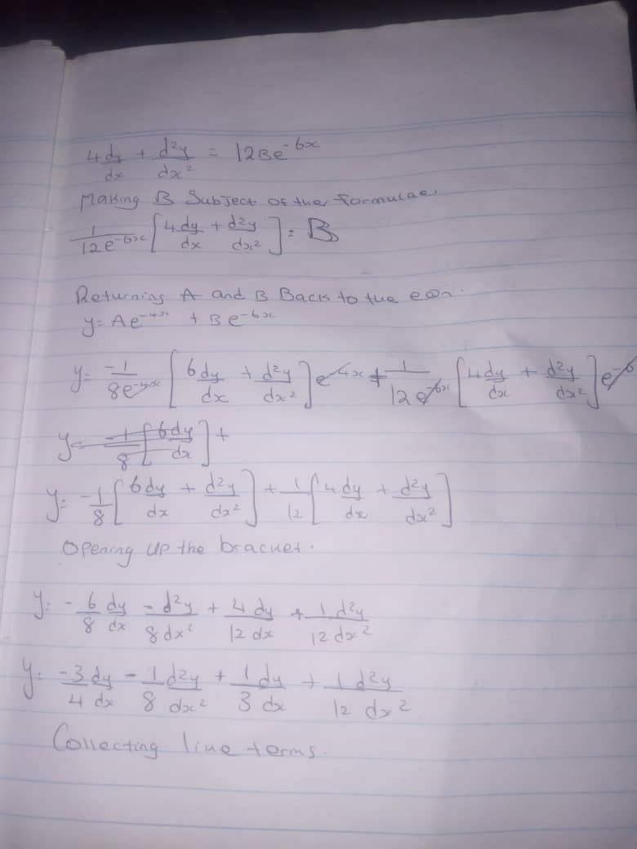

Slide 4
