Slide 1
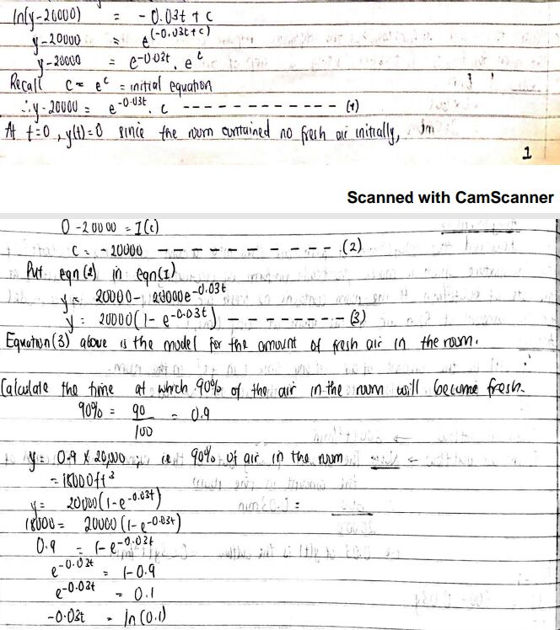

Slide 2
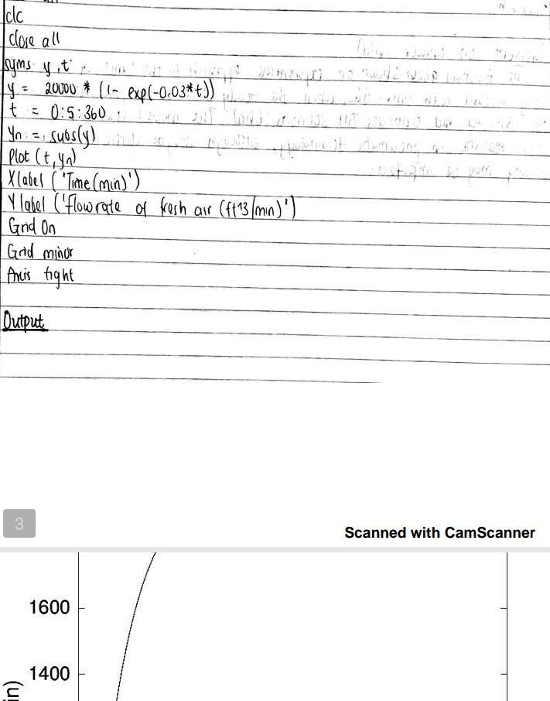

Slide 4
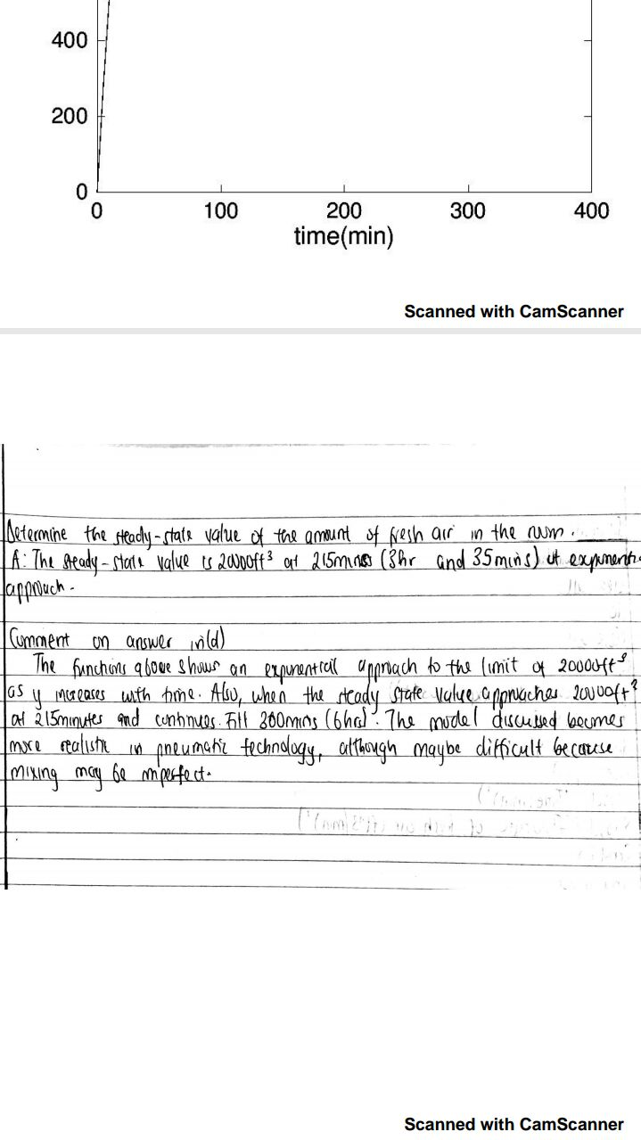
James evidence 17/eng06/049 Mechanical engineering

Slide 5
