Slide 1
NAME : UMOESSIEN, EMEMOBONG DAVID MATRIC NO: 17/ENGO1/029 DEPT: CHEMICAL ENGINEERING

Slide 2
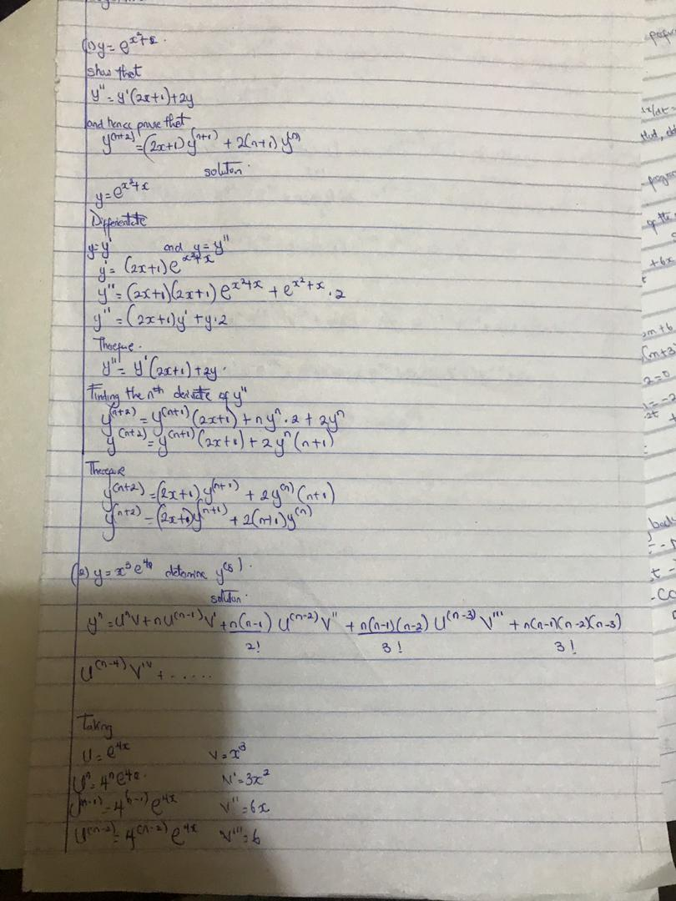

Slide 3
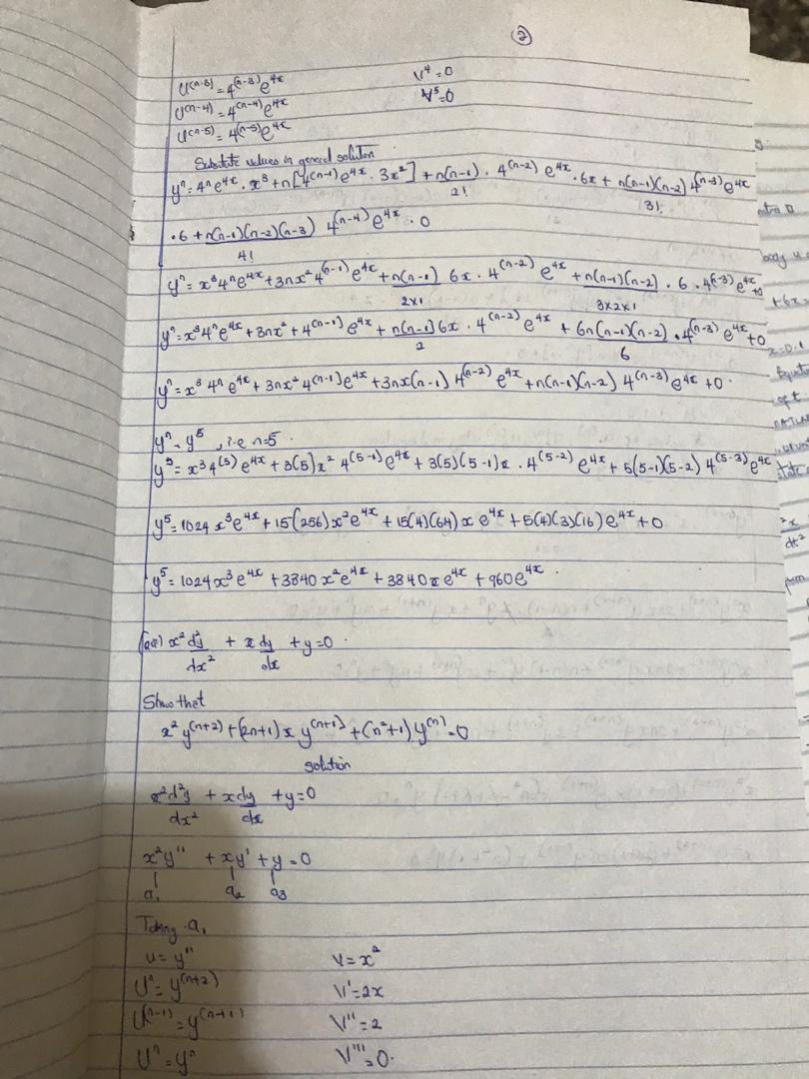

Slide 4
