Slide 1
Mbam Oguzie
Mechatronics Engineering
17/ENG05/021

Slide 2
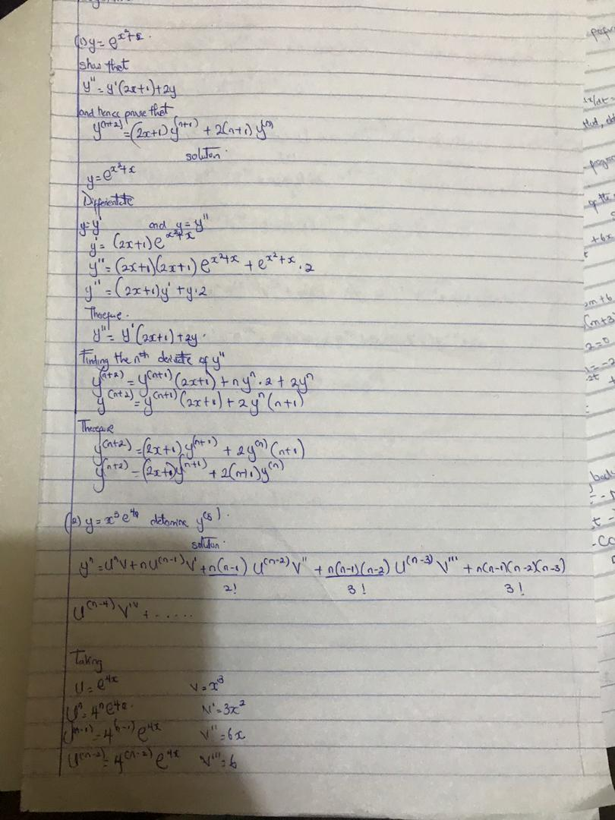

Slide 3
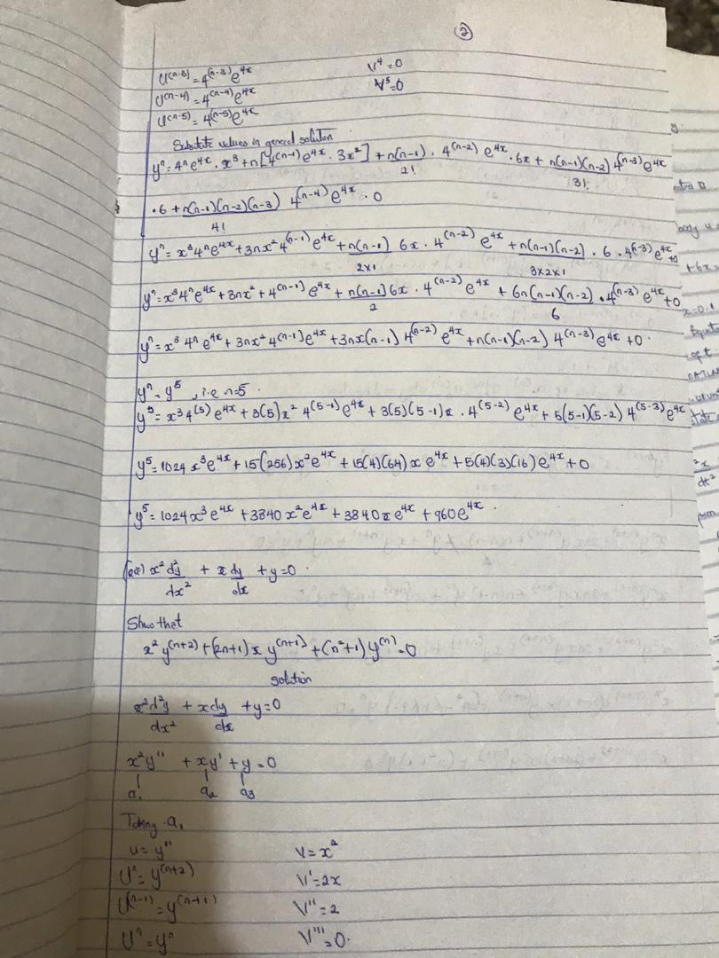

Slide 4
