Slide 1
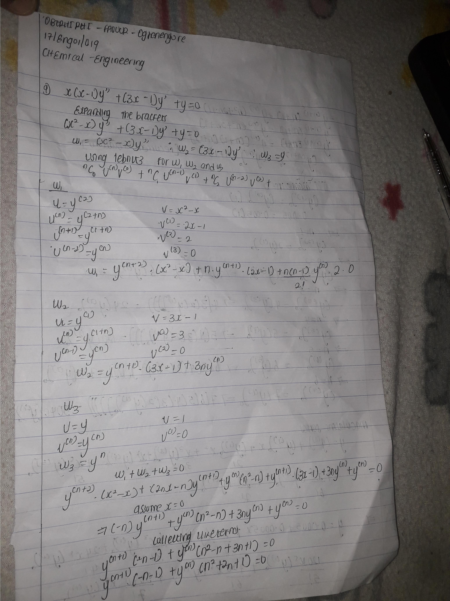

Slide 5
OBERHIRHI FAVOUR OGHENENYORE
17/01/019
CHEMICAL ENGINEERING

