Slide 1
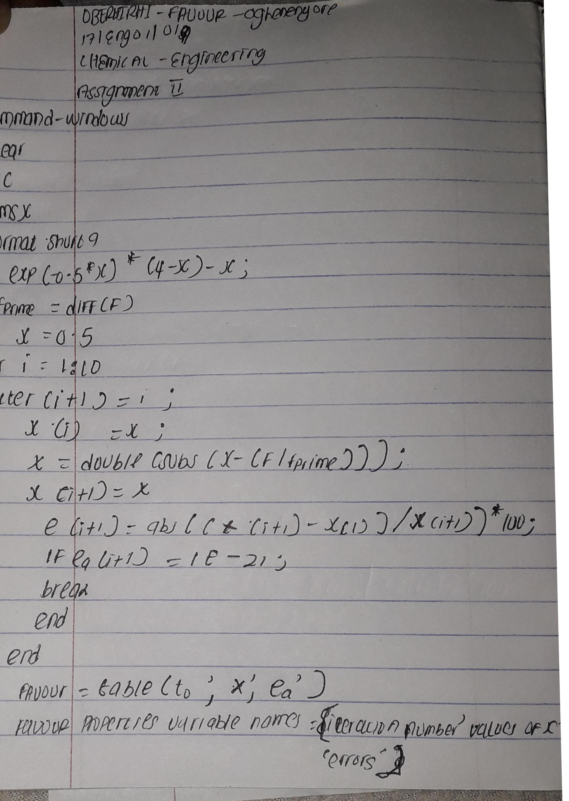

Slide 2
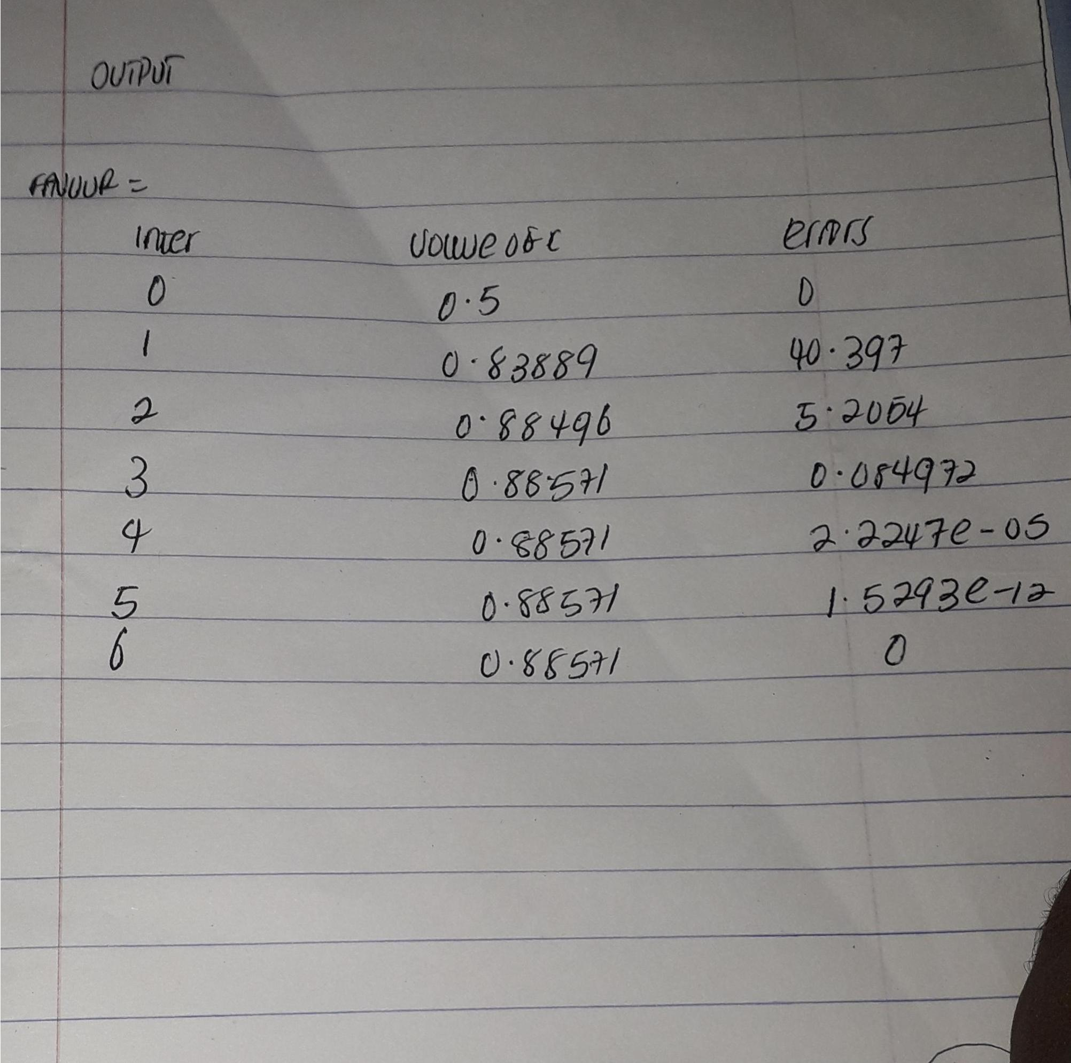

Slide 3
OBERHIRHI FAVOUR OGHENENYORE
17/ENG01/019
CHEMICAL ENGINEERING

