Slide 1
THE ASSESSMENT OF OCCUPATIONAL HAZARDS AND DEVELOPMENT OF ENGINEERING EQUIPMENT TO SUPPORT HEALTH WORKERS AGAINST COVID-19.
BY IDE ALEXIUS AZIBANYE COMPUTER ENGINEERING
17/ENG02/032

Slide 2
Table of Contents
WHAT IS COVID-19?
How it spreads
Occupational hazards associated with COVID-19
Development of engineering equipment’s to support health workers against COVID-19
Conclusion.

Slide 3
WHAT IS COVID-19?
Coronavirus disease 2019 (COVID-19) is an infectious disease caused by severe acute respiratory syndrome coronavirus 2 (SARS-CoV-2). The disease was first identified in December 2019 in Wuhan, the capital of China's Hubei province, and has since spread globally, resulting in the ongoing 2019–20 coronavirus pandemic. Common symptoms include fever, cough and shortness of breath. Other symptoms may include fatigue, muscle pain, diarrhea, sore throat, loss of smell and abdominal pain. While the majority of cases result in mild symptoms, some progress to viral pneumonia and multi-organ failure. As of 8 April 2020, more than 1.45 million cases have been reported in more than 200 countries and territories, resulting in more than 83,500 deaths More than 308,000 people have recovered.

Slide 4
CORONA VIRUS
Since first being recorded late last year in China, the Covid-19 coronavirus has spread around the world, and been declared a pandemic by the World Health Organization. By early spring, Europe had become the worst-affected region, with Italy and Spain particularly hard hit. However, differences in testing mean that the number of cases may be understated for some countries.
It is most contagious during the first three days after onset of symptoms, although spread may be possible before symptoms appear and in later stages of the disease. The time from exposure to onset of symptoms is typically around five days, but may range from two to 14 days. The standard method of diagnosis is by real-time reverse transcription polymerase chain reaction (rRT-PCR) from a nasopharyngeal swab. The infection can also be diagnosed from a combination of symptoms, risk factors and a chest CT scan showing features of pneumonia.
The virus is mainly spread during close contact and by small droplets produced when those infected coughs, sneeze or talk. These droplets may also be produced during breathing; however, they rapidly fall to the ground or surfaces and are not generally spread through the air over large distances. People may also become infected by touching a contaminated surface and then their face. The virus can survive on surfaces for up to 72 hours.

Slide 5
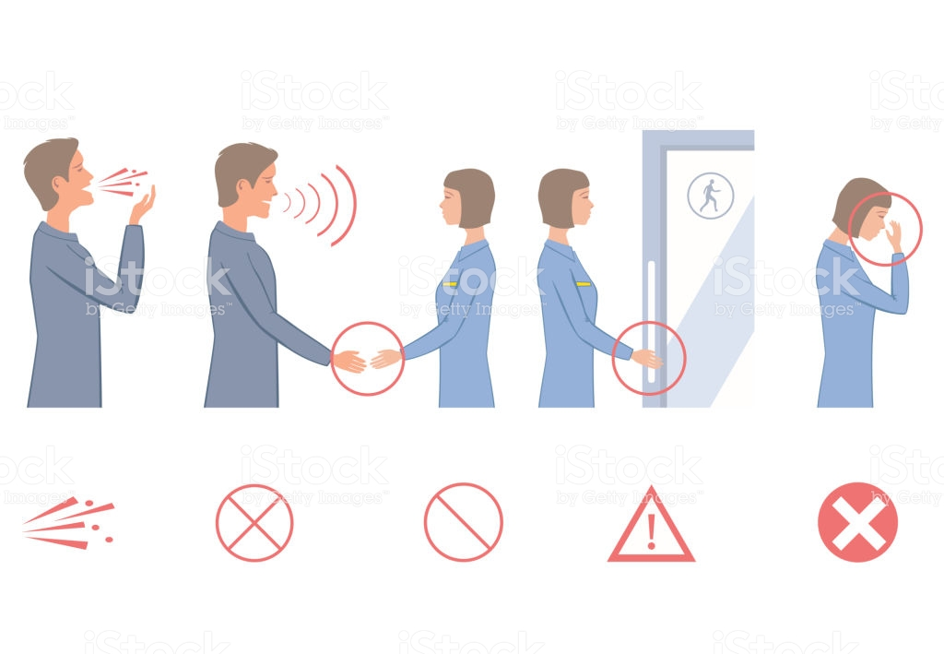
ITS TRANSMISSION
The virus is most contagious when people are symptomatic; while spread may be possible before symptoms appear, this risk is low. The European Centre for Disease Prevention and Control (ECDC) says while it is not entirely clear how easily the disease spreads, one person generally infects two to three others.
Some details about how the disease is spread are still being determined. The WHO and the US Centers for Disease Control and Prevention (CDC) say it is primarily spread during close contact and by small droplets produced when people cough, sneeze or talk; with close contact being within 1–3 m (3 ft 3 in–9 ft 10 in). A study in Singapore found that an uncovered cough can lead to droplets travelling up to 4.5 meters (15 feet). A second study, produced during the 2020 pandemic, found that advice on the distance droplets could travel might be based on old 1930s research which ignored the protective effect and speed of the warm moist outbreath surrounding the droplets; it advised that droplets can travel around 7–8 meters.

Slide 6
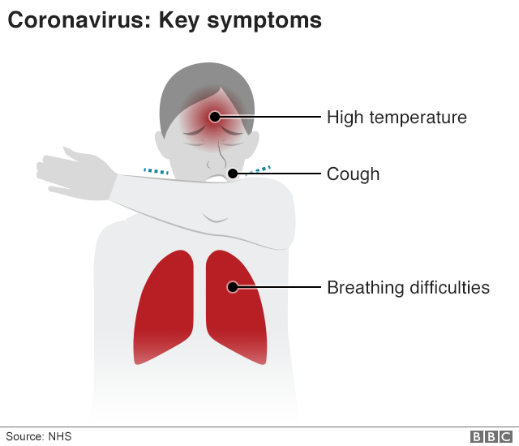
SYMPTOMS OF THE VIRUS
•COUGH
•FEVER
•TIREDNESS
•DIFFICULTY BREATHING (SEVERE CASES)

Slide 7
SAFETY PRECAUTIONS
STAY home as much as you can
Keep safe distance
WASH hands often
COVER your cough
SICK? Call ahead.

Slide 8
A major underlying factor affecting the effective management of the covid-19 is the fear it brings to the community; people fear being isolated which is understandable as human beings if not anything are social creatures and the thought of one or a loved one being taken away with no assurance that he might ever see their family is disheartening to say the least and thus people then refuse to report any strange symptoms they find of the COVID-19.

Slide 9
Occupational Hazards associated with COVID-19

Slide 10
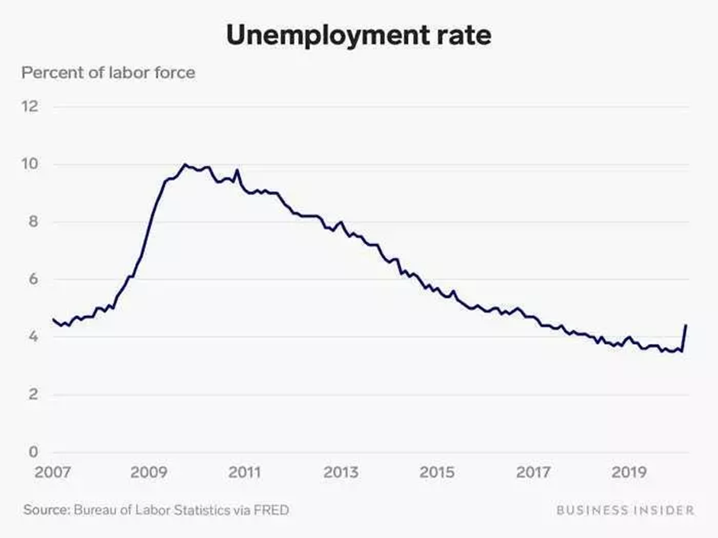
The virus outbreak is in no small way affecting the various occupation in the world. Humans are forced to retreat at their homes and stay indoors at the expense of their career and that in turn might pose a threat to one’s economy.
As cases increased and required health care, health care workers (HCWs) were next recognized as another high-risk group to acquire this infection. In a case series of 138 patients treated in a Wuhan hospital, 40 patients (29% of cases) were HCWs. Among the affected HCWs, 31 (77.5%) worked on general wards, 7 (17.5%) in the emergency department, and 2 (5%) in the intensive care unit (ICU). There was apparently a super-spreader patient encountered in the hospital, who presented with abdominal symptoms and was admitted to the surgical department. This patient infected >10 HCWs in the department [7]. China’s Vice-Minister at the National Health Commission said that 1716 health workers had been infected in the country as of Tuesday 11 February 2020, among whom 6 have died.

Slide 11
Development of engineering equipment’s to support health workers against COVID-19
During an outbreak there are always risk associated with the control of the outbreak, most often than not these risks pose a greater threat to the medical practitioners. They are tasked with the preservation of human live and thus they must treat those who are infected, and this can sometimes lead to them getting infected. But there are ways which computer engineering can help a to reduce those risk.

Slide 12
THESE ARE;
1. By the creation of safety AI’s one can help limit the risk taken by doctors and surgeon as these AI’s can monitor patients’ vitals and alert the doctors of any abnormalities detected.

Slide 13
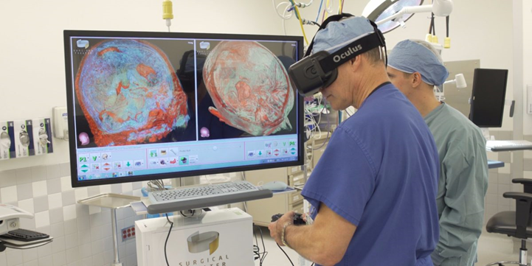
2. Using high-tech scanners and VR (virtual reality) doctors will be able to project Data from the scanners and view it without having to be in contact with the patient (Therefore also decreasing possibility of transmission). This will also enable patients and doctors to effectively communicate and even clearly describe and show the patient the exact problem without having to break down the complexity.

Slide 14
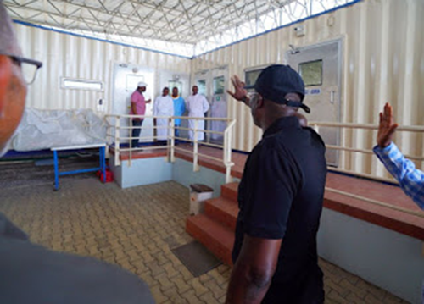
3. Creating high tech containment facilities these patients can effectively be kept in proper isolation thus reducing the risk of it spreading, these patients can be monitored within closed walls and effectively the health workers will be safer and protected from the virus.

Slide 15
4. Creation of software that can be specifically used to detect the virus, or rather disturbances in the human system, as we all know there are devices that are capable of detecting the heart rate and blood pressure of humans, and these are readily available to the public for purchase, by implementing software that can use a mobile phones built-in sensors, or create a device and an specially detect the deadly virus and make is consumer available, can drastically decrease fear and uncertainness of the public towards having the virus, and they can easily forward the results of the test to their personal or Nearest Public Doctor.

Slide 16
CONCLUSION
In Conclusion in such a difficult time as this firstly, we must endeavor to stay safe at all times, and avoid public gatherings, and we must also this free to boost out thinking and problem solving capabilities, for this will not only make us better engineers but will also benefit the society in general from our innovations and ideas. An Engineer is always analyzing and problem solving.

Slide 17
THE END

