Slide 1
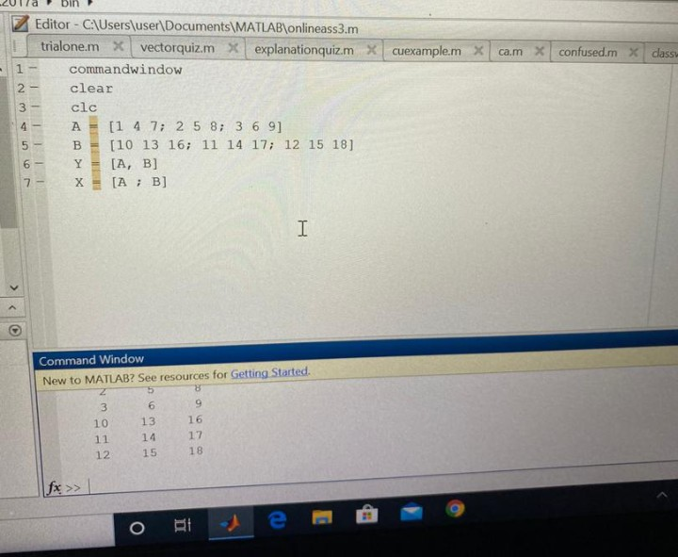

Slide 2
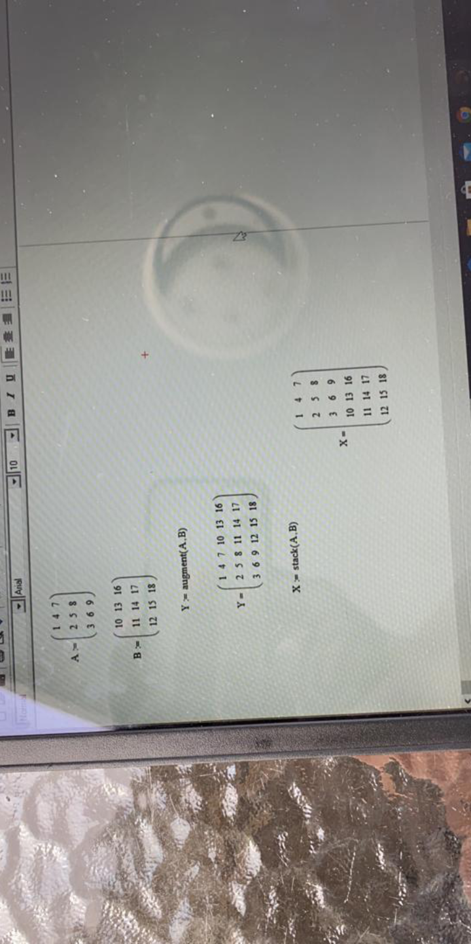

Slide 3
NAME: Tunde-Adetula Simisoluwa
MATRIC NO: 18/ENG08/022
DEPARTMENT: Biomedical engineering

