Slide 1
CRITICAL ASSESSMENT OF LEGAL IMPLICATIONS AND ECONOMIC IMPACT OF LOCK DOWN OF ACTIVITIES IN NIGERIA
PHILIP LYDIA
17/ENG07/019

Slide 2
INTRODUCTION
NIGERIAN citizens are currently at an elevated risk of contracting Coronavirus, and many scientists all over the world have been thrown into the turmoil of finding the cure to this widespread epidemic. Businesses worldwide have also been forced to a halt due to the challenges of the spread of the virus, including interruptions to supply chains and challenges in meeting contractual obligations. With no end to the outbreak in sight, businesses must know, understand and consider their options in order to mitigate their risk exposure.

Slide 3
LITERATURE REVIEW
This report looks at possible economic impacts and what actions may be required to minimize disruptions on the poor and vulnerable. The first part looks at short term actions, whereas the second will look at possible medium to longer term developments.
In the short term there is likely to be a sharp drop in domestic consumer demand in most developing countries.

Slide 4
Demand for food, medical assistance and other essential items may rise, but this would be more than offset by lower demand for non-essential goods such as apparel and various services.
Lower overall domestic consumer demand will have a negative impact on production and employment. The drop in consumer demand may have a lower effect in manufacturing, where companies could, if they have access to credit, build up stocks of finished goods rather than reduce production and lay off staff. However, the effects on the small-scale services sector are likely to be dramatic.
The severity and duration of the short term demand and supply impacts depends on the measures various governments take to contain the spread of the virus.

Slide 5
Although there are still many uncertainties about how the pandemic will develop, it is clear that private support mechanisms may not be able to fully cope. Moreover, such mechanisms tend to be relatively weak in rural areas as the scattered nature of the population makes it difficult to reach effected people.
To complement private initiatives, the Government will need to mobilize its own institutional machinery, particularly those with presence in rural areas. These include police stations, health clinics and agriculture/livestock offices which could provide logistic bases to reach the rural poor with medical assistance, as well as income and food support.

Slide 6
METHODOLOGY Strategies for coping with the health and economic effects of the COVID-19 pandemic
While the relatively low number of cases on the continent so far is good news, African policymakers should not be complacent. They should instead use this window of opportunity to take decisive steps to protect their citizens and economies from the pandemic.

Slide 7
To achieve these goals, we recommend a three-step approach
Contain the spread of the virus.
Swiftly treat identified cases.
Cushion the economy from the effects of the pandemic.

Slide 8
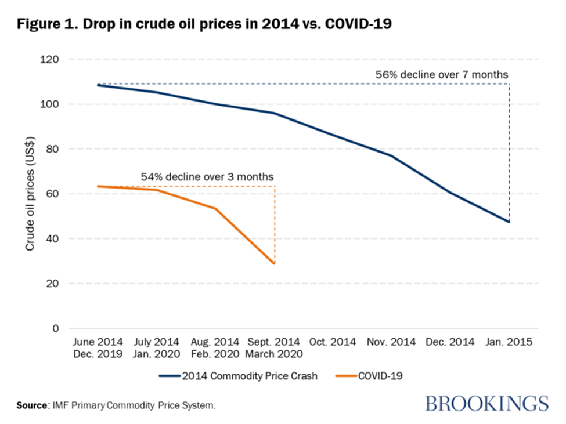
PLATE 1

Slide 9
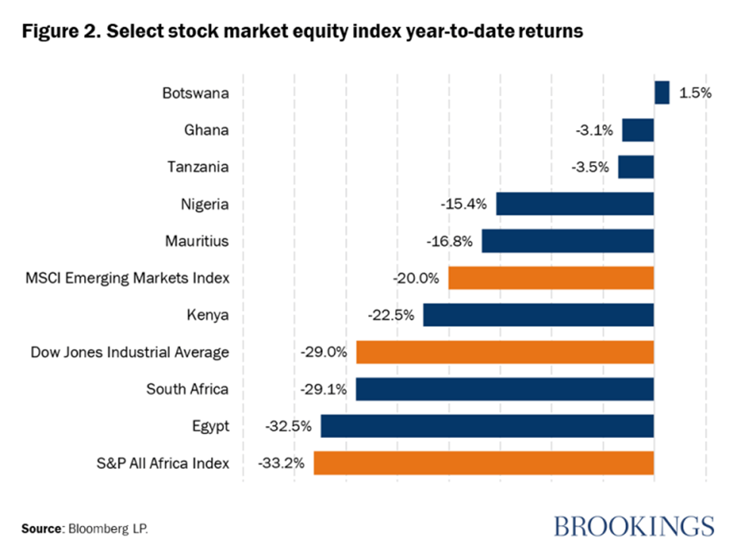
PLATE 2

Slide 10
CONCLUSION
The USA and countries in Europe should also step up their level of assistance outside their borders. One way to quickly and effectively do this has been suggested by Imran Khan, the Prime Minister of Pakistan: – cancel, or at least reschedule, some of the debt of developing countries affected by the pandemic. Debt repayment takes a large proportion of public expenditures. At this time, this money would be far better spent at helping people survive the crisis.

