Slide 1
DICK IDUBAMO RUTH
17/SMS06/016
WORLD CULTURE AND FESTIVALS

Slide 2
Thursday 21 May
World Day for Cultural Diversity for Dialogue and Development 2020.
Why is it Important?
World Day for Cultural Diversity for Dialogue and Development is to help people learn about the importance of cultural diversity and harmony. World Day for Cultural Diversity for Dialogue and Development is a chance for people to celebrate cultural diversity and harmony.

Slide 3
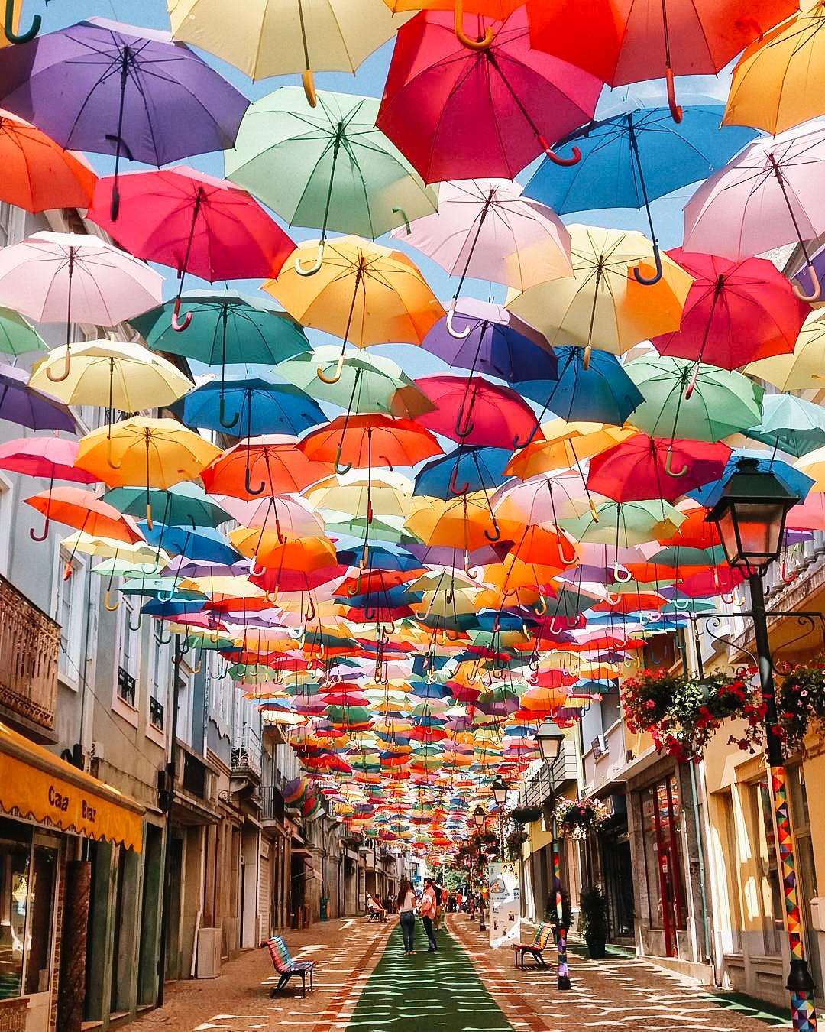
Águeda, Portugal
Águeda’s streets get a bright uplift in the month July, as colorful umbrella canopies line the streets of this town. From the 7th of July through the 29th, visitors and locals can expect art installations, performances and tons of street art as the festival AgitÁgueda takes place.

Slide 4
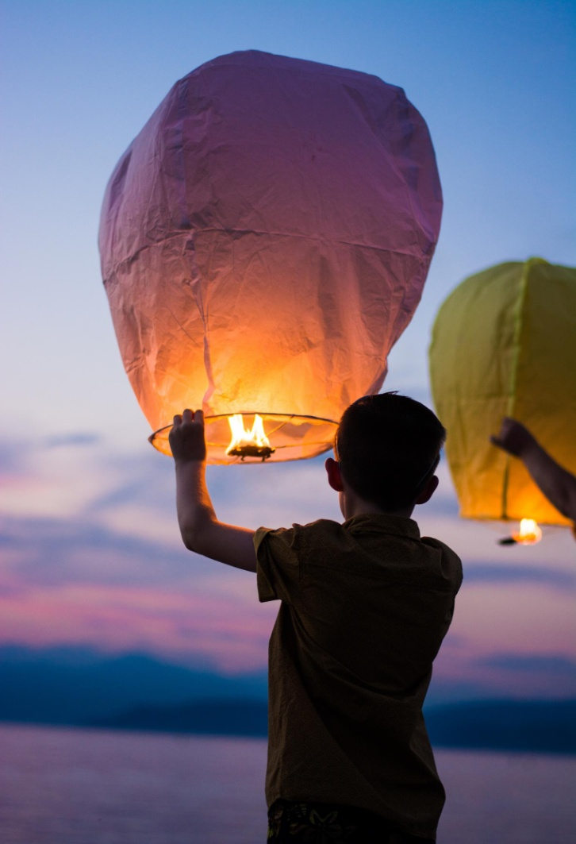
Thailand
The skies of Chiang Mai are set aglow as thousands of lanterns are released throughout the city during the Yi Peng Lantern Festival. This citywide gathering takes place on the evening of the full moon on the 12th month of the Thai lunar calendar (usually November) and is often celebrated alongside Loy Krathong during three days of parades, markets, candle lightings and more.

Slide 5
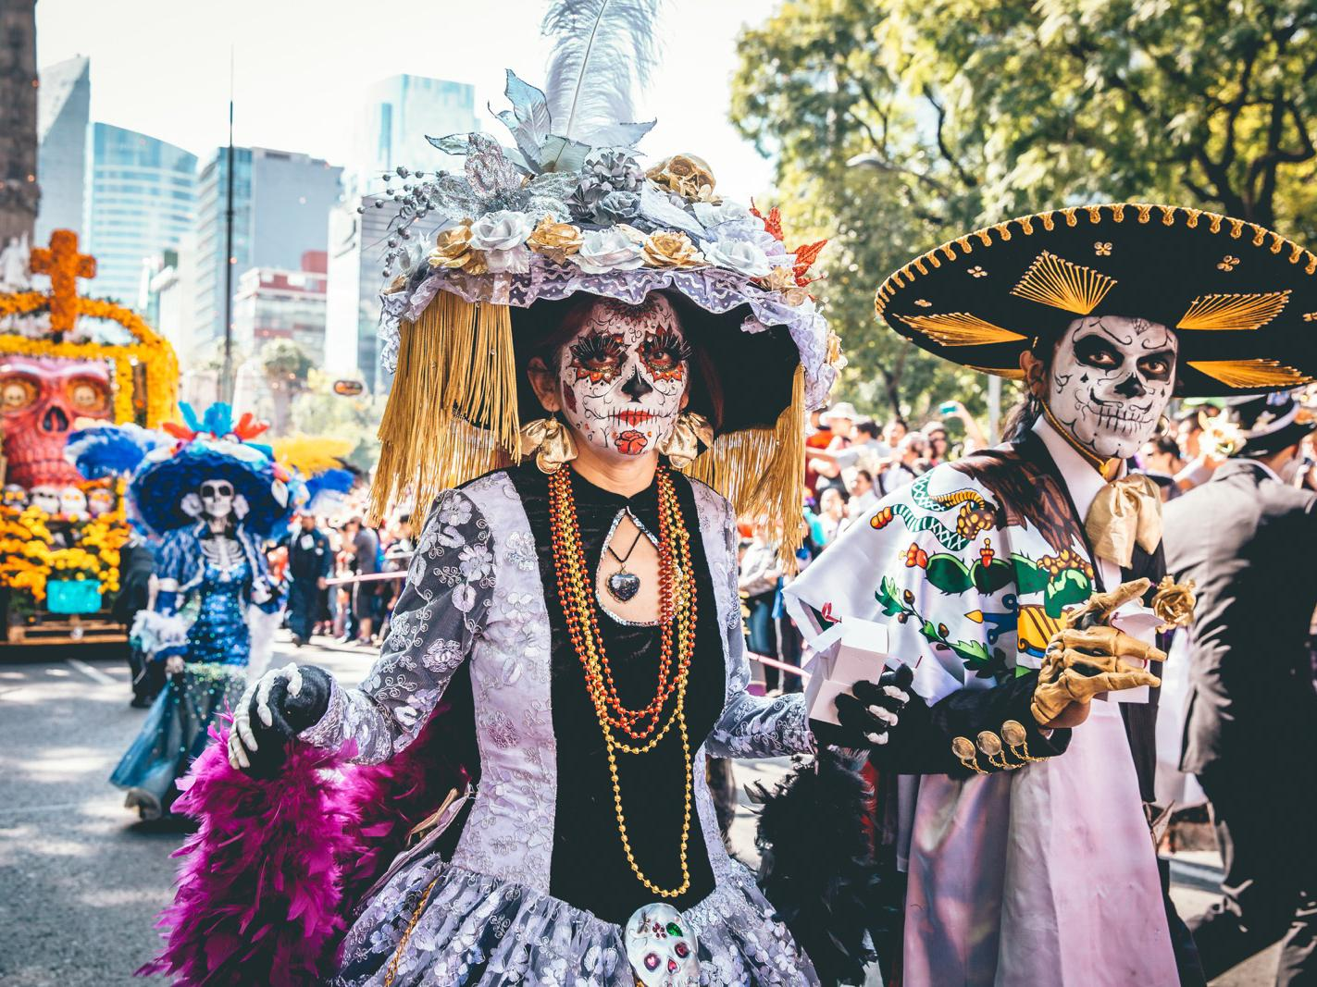
Mexico
Celebrating the lives of loved ones who’ve passed away is at the core of this Mexican tradition. But the colorful, marigold-filled altars and graveside flower installations combined with parades and Aztec rituals that are meant to bring the spirits to life for the day feel anything but somber. Día de los Muertos, which takes place on November 2, brings families and friends out in big groups, many donning traditional skeleton makeup and colorful costumes.

Slide 6
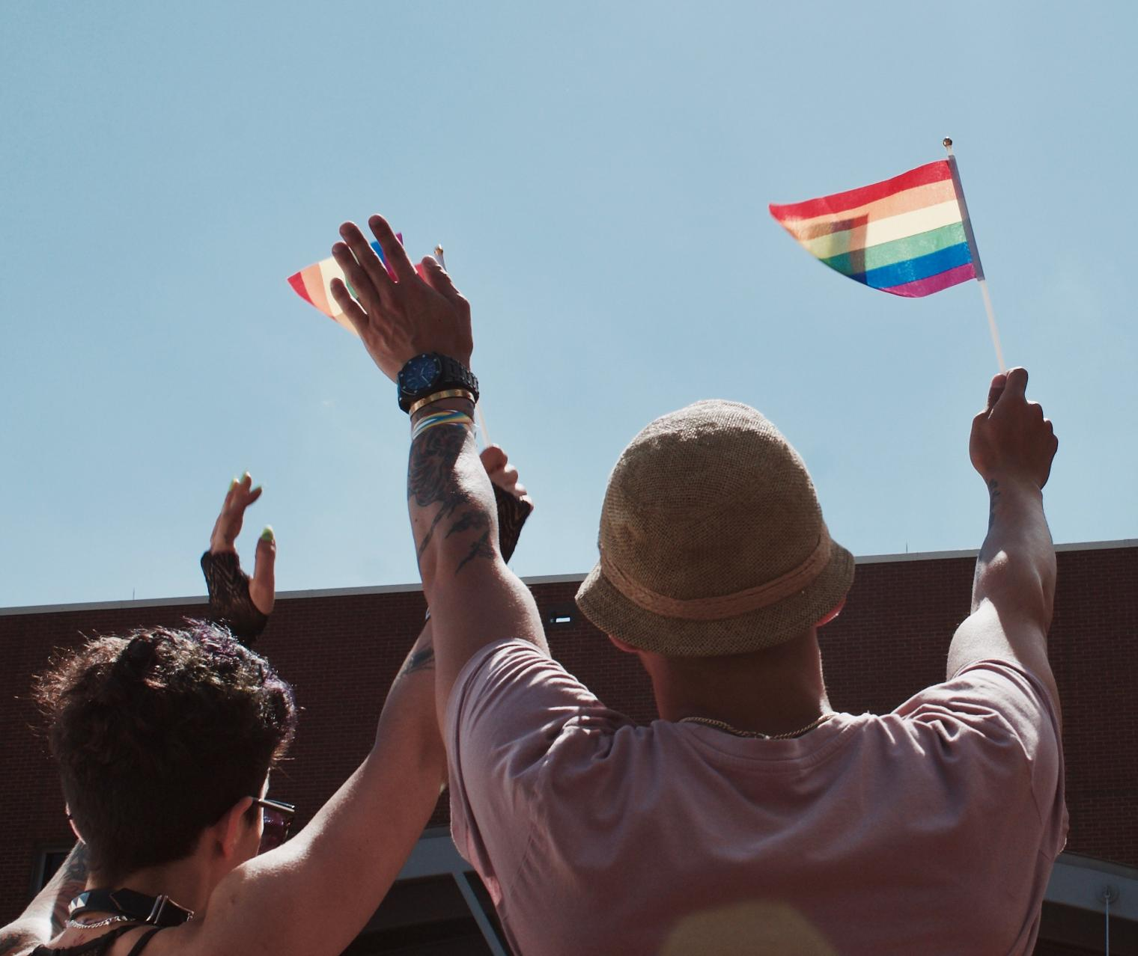
San Francisco, California
San Francisco’s Pride is a boisterous, wild, loud and ridiculously fun party. Packed with characters and buzzing with energy, this weekend-long celebration of pride includes one of the oldest and largest LGBTQIA parades in the world. Nothing like a get together of a hundred thousand people to boost your energy levels!

Slide 7
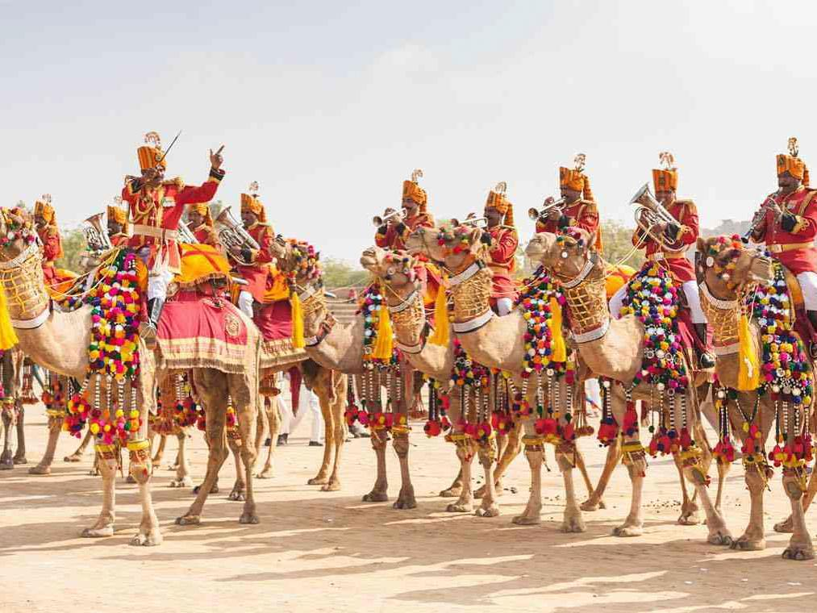
India
Three days before the full moon of February, people travel in groups to the Thar Desert in the Sam Sand Dunes to celebrate Jaisalmer Desert Festival. Over the course of three days, the remote desert landscape comes to life with performances, folk music and local lore being passed from generation to generation.

Slide 8
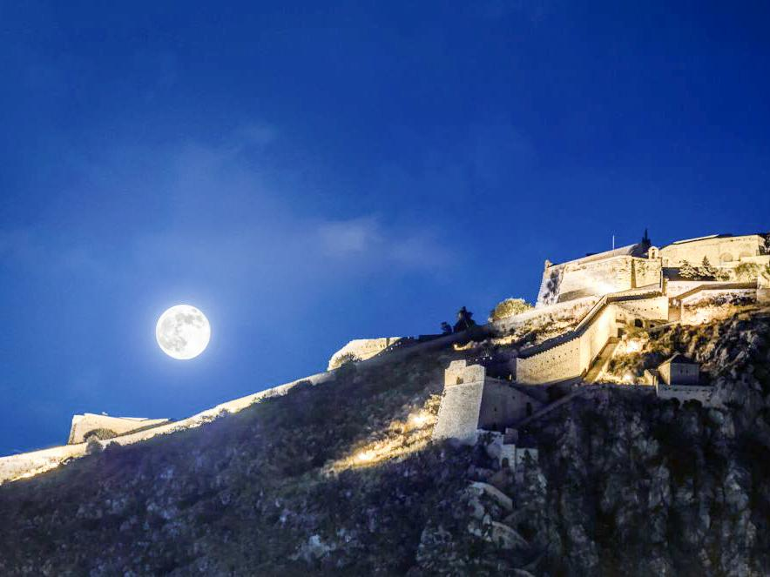
Greece
Greece’s full moon festival falls in August every year and visitors flock to some of the biggest historic sites – like Acropolis and the Roman Agora – for performances through the night. Events usually start a day or two before the full moon and include theatrical performances, poetry readings, concerts and more in over a hundred archaeological sites, monuments and museums throughout the country.

Slide 9
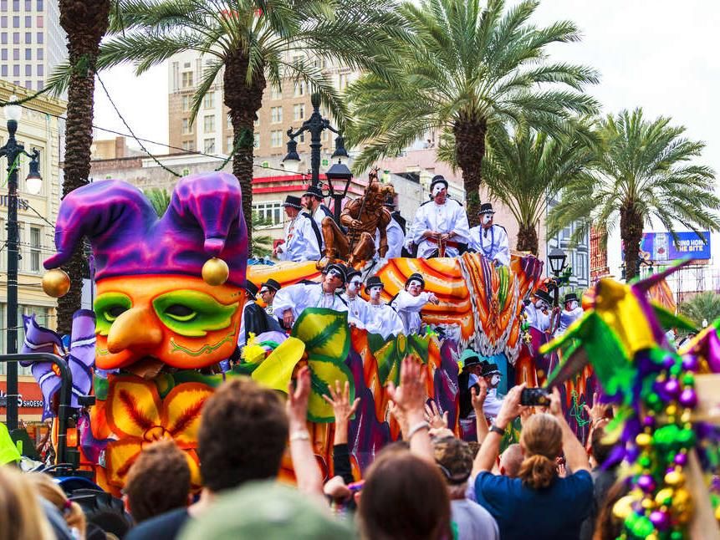
New Orleans, Louisiana
You probably have an idea of Mardi Gras being an all-out boozefest on Bourbon Street, but locals will tell you this New Orleans celebration is deeply rooted in tradition and is really all about the gathering of family and friends of all ages. Mardi Gras season begins January 6th with the bacchanalian celebrations of Twelfth Night and continues through to the day before Ash Wednesday. The biggest parades of the season, and the biggest parties, are in the two weeks leading up to Mardi Gras Day which brings people of all ages and costumes together at parades, bars, formal balls and more.

