Slide 1
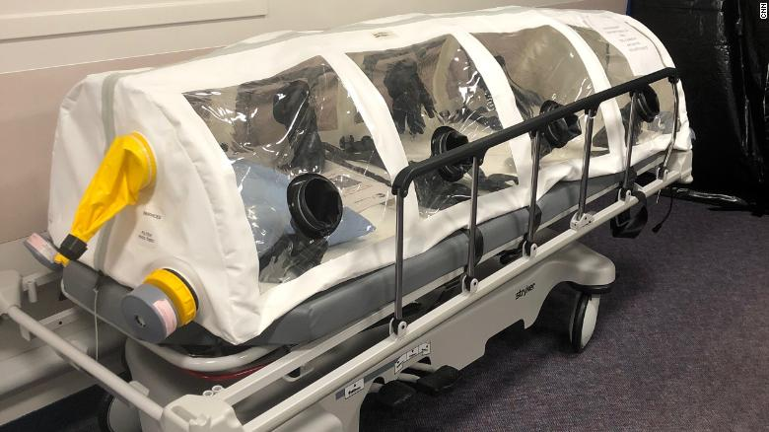
ENGINEERING STRATEGIES FOR HANDLING COVID-19 FOR ENVIRONMENTAL HEALTH AND ECONOMICS SUSTAINABILITY
PREPARED BY:
EMEROLE CHINAEME
MECHATRONICS ENG
17/ENG05/012
This Photo by Unknown Author is licensed under CC BY-NC-ND

Slide 2
INTRODUCTION
LITERATURE REVIEW
Environment health
Economic Sustainability
ANALYSIS OF RESULT
CONCULSION AND RECOMMEDATION

Slide 3
INTRODUCTION
Coronavirus disease (COVID-19) is an infectious disease caused by a newly discovered coronavirus.
Most people infected with the COVID-19 virus will experience mild to moderate respiratory illness and recover without requiring special treatment. Older people, and those with underlying medical problems like cardiovascular disease, diabetes, chronic respiratory disease, and cancer are more likely to develop serious illness.
The best way to prevent and slow down transmission is be well informed about the COVID-19 virus, the disease it causes and how it spreads. Protect yourself and others from infection by washing your hands or using an alcohol-based rub frequently and not touching your face

Slide 4
ENVIRONMENT HEALTH
With basic mathematical models, Mechatronics research Engineers can begin to forecast the progression of diseases and understand the effect of interventions on disease spread. With more complex models, we can start to answer questions about how to efficiently allocate limited resources or tease out the consequences of public health interventions, like closing pubs and banning gatherings. Therefore safeguarding the environmental and public health of individuals ,organization and government
This Photo by Unknown Author is licensed under CC BY-SA

Slide 5
ECONOMIC SUSTAINABILTY
Mechatronics Engineers have assisted Doctors by gathering resources and building open-source tools and equipment to help Doctors survive and tackle coronavirus. Initial focus = PPE mask shortage.

Slide 6
ANALYSIS OF RESULT
Well the result to be analyzed is yet to come because it will take place when the number of cases subside and economical production begins to stabilize again
For what we know so far, the action taken by the mechatronics engineers is still ongoing that is in Manufacturing of ventilator and test kit has lead to awareness and fast recoveries of this case .
We are looking forward to ways to completely solve and mitigate further cases of COVID-19.

Slide 7
conculsion
In conclusion, we will ensure that the problem is solved and the virus is properly managed to the best of our abilities as Mechatronics engineers. By the grace of God, we will triumph.

