Slide 1
ENGINEERING LAW AND MANAGERIAL ECONOMICS FOR INFRASTRUCTURAL DEVELOPMENT IN NIGERIA: CHALLENGES AND WAY FORWARD
PREPARED BY IKEBUJO DELIGHT NKEMJIKA,
17/ENG06/043

Slide 2
WHAT IS ENGINEERING LAW?
Before we define engineering law we must first note that it contains two key words;
Engineering: Engineering is the use of scientific principles to design and build machines, structures, and other items, including bridges, tunnels, roads, vehicles, and buildings.^{[1]} The discipline of engineering encompasses a broad range of more specialized fields of engineering, each with a more specific emphasis on particular areas of applied mathematics, applied science, and types of application
Law: Law is commonly understood as a system of rules that are created and enforced through social or governmental institutions to regulate conduct,^{[2]} although its precise definition is a matter of longstanding debate.^{[3][4][5]} It has been variously described as a science^{[6][7]} and the art of justice.^{[8][9][10]} State-enforced laws can be made by a collective legislature or by a single legislator, resulting in statutes, by the executive through decrees and regulations, or established by judges through precedent, normally in common law jurisdictions.

Slide 3
WHICH BRINGS US BACK TO……..
Engineering law refers to the application of laws applying to the practice of professional engineering. Engineering law is the study of how ethics and legal frameworks should be adopted to ensure public safety surrounding the practice of engineering. California law defines engineering as the professional practice of rendering service or creative work requiring education, training and experience in engineering sciences and the application of special knowledge of the mathematical, physical and engineering sciences in such professional or creative work as consultation, investigation, evaluation, planning or design of public or private utilities, structures, machines, processes, circuits, buildings, equipment or projects, and supervision of construction for the purpose of securing compliance with specifications and design for any such work^{[1]}. By comparison Ontario lists safeguarding of life and public welfare in its definition. Ontario law defines engineering as the act of planning, designing, composing, evaluating, advising, reporting, directing or supervising that requires the application of engineering principles and concerns the safeguarding of life, health, property, economic interests, the public welfare or the environment, or the managing of any such act^{[2]}

Slide 4
WHAT IS MANAGERIAL ECONOMICS?
Managerial economics deals with the application of the economic concepts, theories, tools, and methodologies to solve practical problems in a business. In other words, managerial economics is the combination of economics theory and managerial theory. It helps the manager in decision-making and acts as a link between practice and theory.^{[1]} It is sometimes referred to as business economics and is a branch of economics that applies microeconomic analysis to decision methods of businesses or other management units.

Slide 5
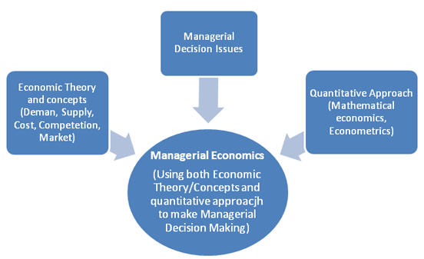

Slide 6
CHALLENGES OF ENGINEERING IN NIGERIA
In most private and government establishments in Nigeria, engineering personnel are assumed to know all. A mechanical engineer can be employed to do the work of an electrical engineer, computer engineer, civil engineer, e.t.c at the same time instead of seeking out the services of engineering specialists in these other areas or fields of engineering.
Most engineering establishments ever since they were commissioned have not been upgraded, thereby not able to meet up with the present-day demand.
Non-engineers carrying out engineering contracts using engineering credentials: most engineering contractors carry out engineering projects using engineering credentials of engineering professionals in order to win or secure engineering contracts.

Slide 7
Most engineering projects in the country are carried out using the fifty percent rule, thereby eating the capital and not the profit that is, contractors giving even more than fifty percent of the total cost of a project to some corrupt government officials and politicians before actually embarking on a project and in most cases, since the remaining part of the money will not be enough to do the job, the project may not be carried out and if it is carried out at all, it is usually sub-standard or abandoned.
The attitude of the government towards research and development hinders research opportunities in research institutions and universities. The government considers research and development projects to costly, therefore, universities and other tertiary institution are not given funds for it.

Slide 8
THE CHALLENGES OF INFRASTRUCTURE DEVELOPMENT IN NIGERIA
- Lack of Visionary Leaders: Visionary leaders are the builders of a new dawn, working with imagination, insight, and boldness. They present a challenge that calls forth the best in people and brings them together around a shared sense of purpose
- Demand and supply: Due to poor performances of most past leaders in the area of infrastructure provision, the desire for infrastructure development overwhelms the provision. Unfortunately, over 70% of the federal roads are in bad state of repair. In the area of housing, Nigeria requires about 17 million housing units and 60 trillion naira in order to meet its housing needs.

Slide 9
- Procurement Method: The procurement methods being adopted are prone to criticisms. The Public Finance Initiatives, especially the Concession Method and Public/Private Partnership (PPP) are questionable and seems to mortgage others who are not part of the arrangement to the scheme’s future.
- Corruption: Corruption does not only raise the price of infrastructure, it can also reduce the quality of, and economic returns from, infrastructure investment. The corruption in Nigeria is very high and unbearable for effective infrastructural development.

Slide 10
WHAT ARE THE WAYS FORWARD FOR INFRASTRUCTURAL DEVELOPMENT?
Division of labor: Engineering professionals in different fields should be employed in all engineering departments in both public and private sectors, so that jobs can be given to engineers in his/her specific area of study. In summary, there should be division of labor.
Just as the ministry of health is governed by a medical practitioner and the office of the attorney general is occupied by a lawyer, the offices of the ministers and commissioners of works and housing, energy, transportation, and environment should be run by engineers.
Existing engineering facilities and infrastructure should be upgraded to the present-day state-of-art facilities in order to meet up with present day demand.

Slide 11
Routine maintenance work should be carried out regularly after the commission of a project. This will increase the life span of such infrastructure and facilities.
Engineers should be disciplined and avoid non-engineers using them to achieve their selfish aim.
The pay package of engineers in Nigeria should be commensurate with their counterparts in Europe and America, so that they will not be tempted to eat the capital of any projects.
Government should make money available for engineering research and development, in order for the country to advance technologically.

Slide 12
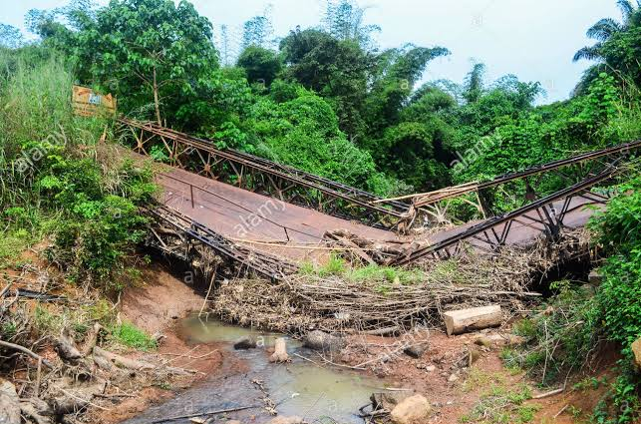
CONCLUSION
In conclusion, if the following measures are followed, Nigeria as a nation can move from a place filled with infrastructures like the one below

Slide 13
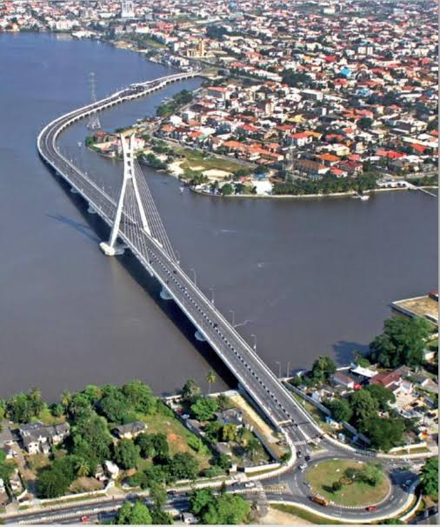
To the one below.

Slide 14
THANK YOU…..

