Slide 1
TOPIC: OPERATION, MAINTENANCE AND MANAGEMENT OF ENGINEERING EQUIPMENT FOR SUSTAINABLE DEVELOPMENT IN NIGERIA
ADEYEMO OLIVE INIOLUWA
17/ENG05/003
MECHATRONICS ENGINEERING.

Slide 2
TABLE OF CONTENT
CHAPTER 1: Introduction
Sustainable Environment And Why?
CHAPTER 2: Challenges and prospects for sustainable development
CHAPTER 3: Principles to Guide Engineers.
CHAPTER 4: Conclusion.

Slide 3
CHAPTER1
INTRODUCTION
Who is an Engineer?
An engineer is a person who uses scientific knowledge to design, construct, and maintain engines and machines or structures such as roads, railways, and bridges. An engineer is a person who repairs mechanical or electrical devices. They send a service engineer to fix the disk drive.nes and machines or structures such as roads, railways, and bridges. An engineer is a person who repairs mechanical or electrical devices. They send a service engineer to fix the disk drive.

Slide 5
CHAPTER 2
CHALLENGES FACED AND PROSPECTS
Often, mechanical, electronic and software engineers in many companies are in different locations of the company. Better still, in some cases, they may be in the same building or the same office but the chances are they live in different worlds, speaking different languages and therefore cannot effectively communicate with each other when it comes to product design or problem solving. Simply because they come from different backgrounds knowing remarkably little about other related disciplines. For instance, when the Mechanical engineers design a system they pass it over to the Electrical/Electronic engineers to design and fit the control systems and they, in turn, pass it over to the Software engineers to write the control program. This serial and disjointed engineering practice result in producing an un-optimized product or solution.
To overcome these difficulties, Mechatronics evolves as a trans-disciplinary approach to solving engineering problem based on open communication systems and concurrent practices, with the overall benefit of designing and providing better engineering products and services.
WHY DO WE NEEED EQUIPMENTS?
As engineers who advance every day, we must have specific tools to ensure better work and efficiency of our work so as to produce a good job. Does one see a farmer without a hoe or A Teacher without books? The same as for an engineer, tools and equipment are very key to get a job done easier and faster. No tools means no work for engineers. And no job for engineers means no sustainable and efficient development in the environment or in this case country. So as to get this government can also be of help because they hold a higher percent of the world’s financial services.

Slide 6
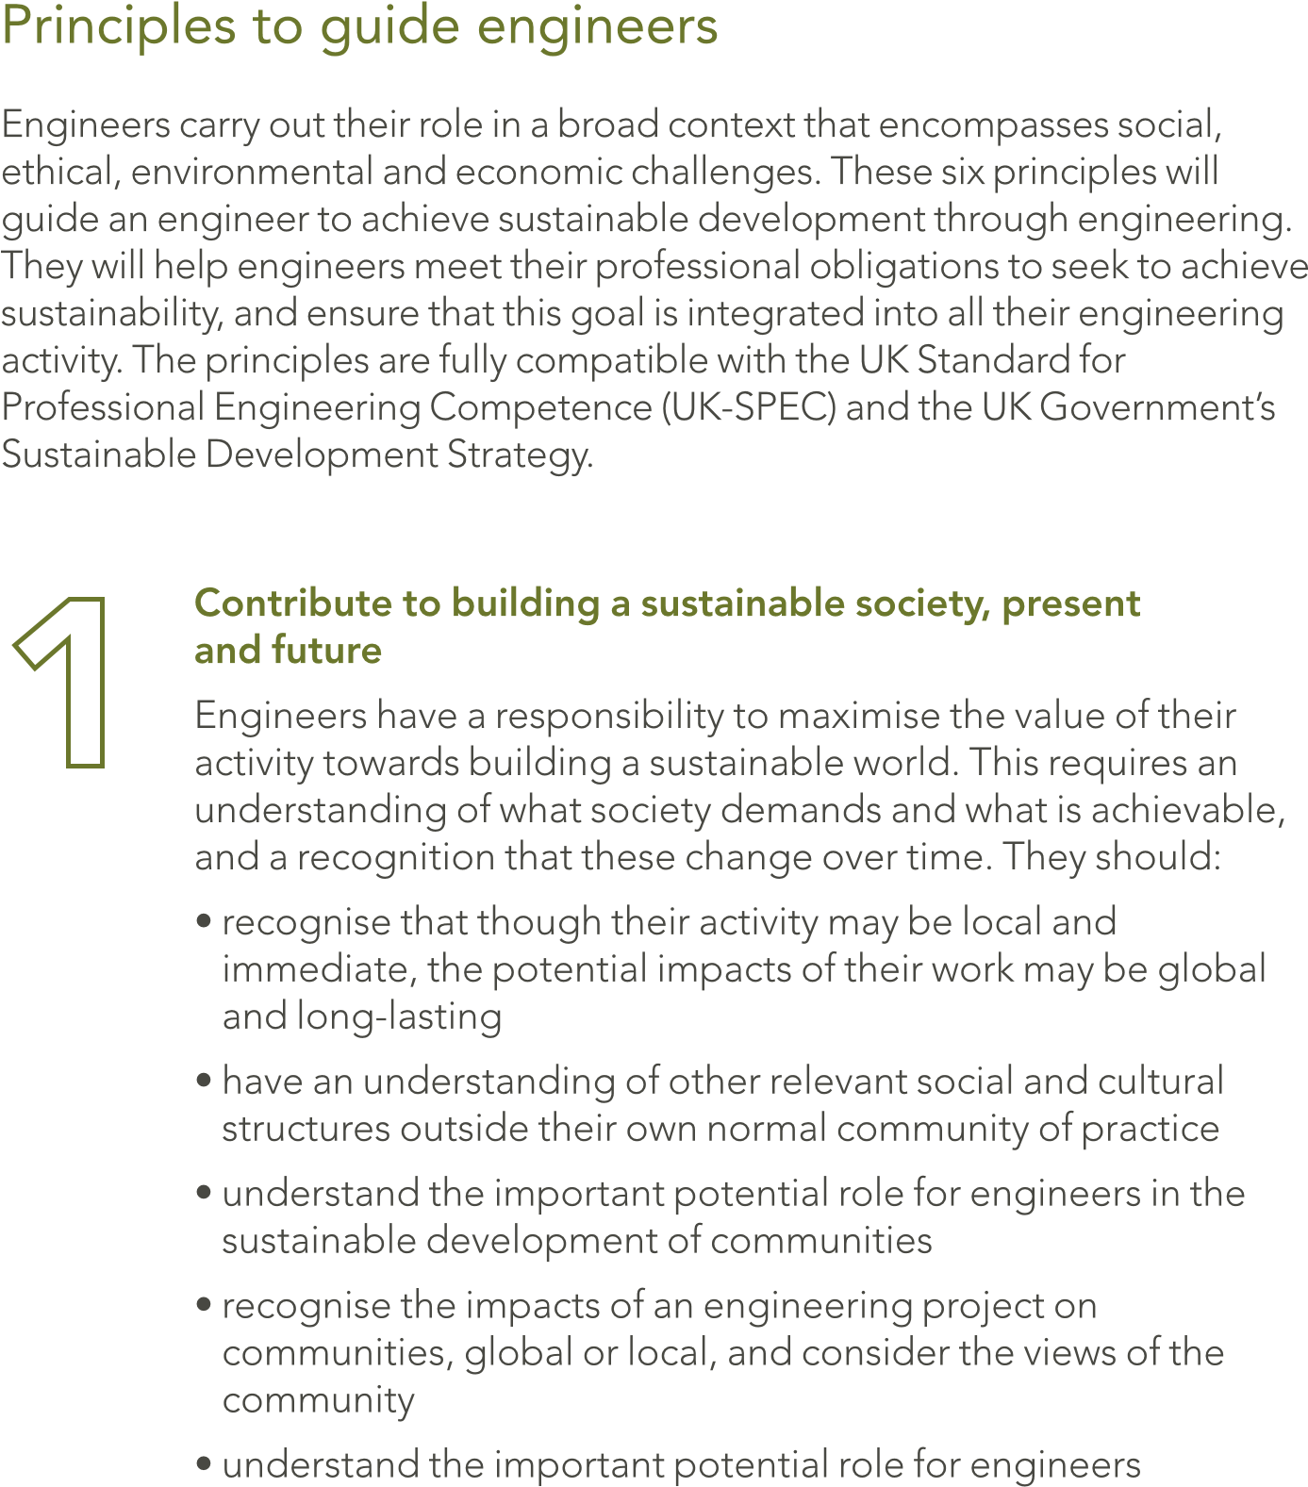
CHAPTER 3
PRINCIPLES TO GUIDE ENGINEERS

Slide 7
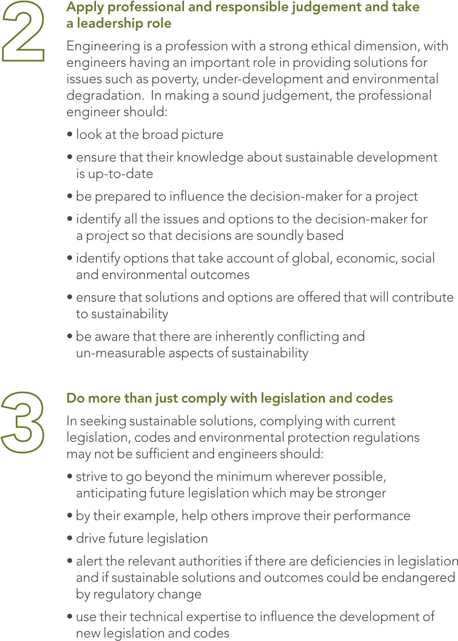

Slide 8
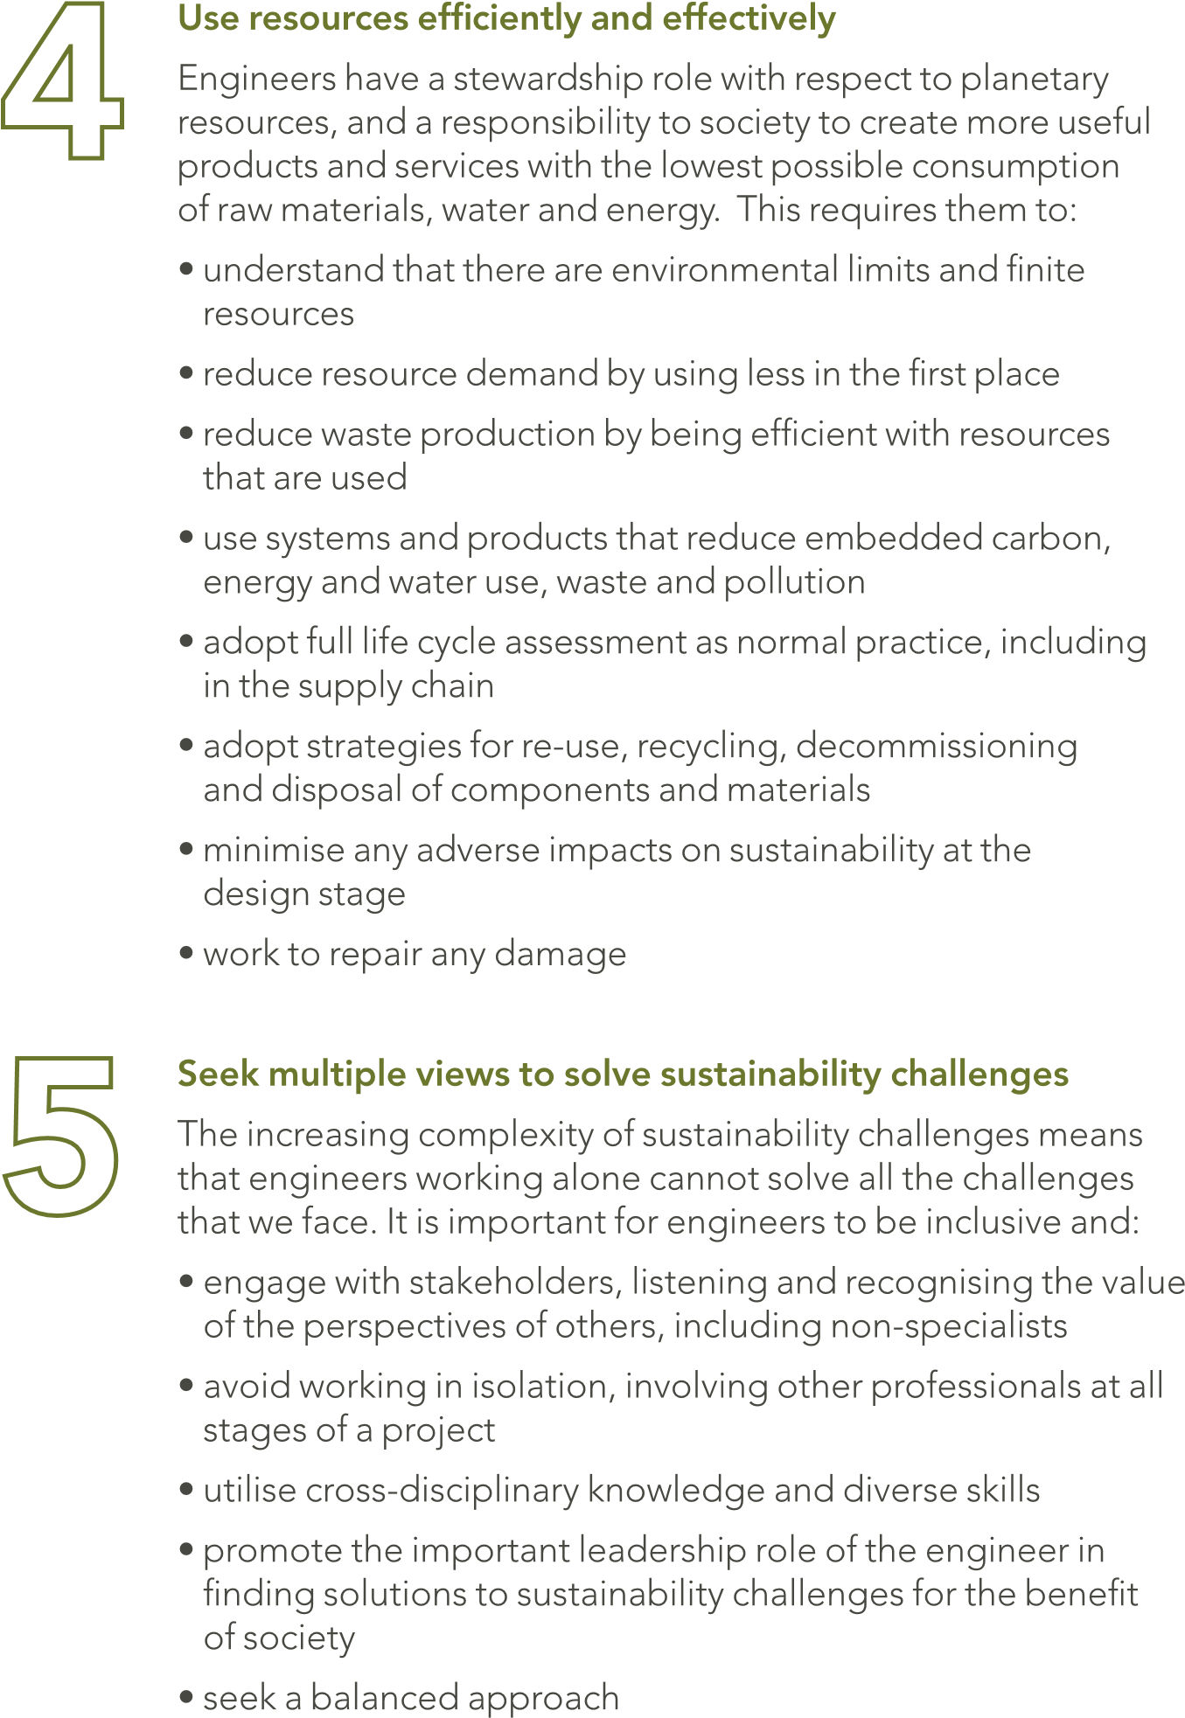

Slide 9
CHAPTER 4
CONCLUSION
Technology has remained one of the most essential ingredients to attaining national development and self-sufficiency. Nowadays, the trend in manufacturing and services has shifted to the use of automated and intelligent production plants, which is mechatronics. This has been recognized early enough by many countries (such as China, India, Thailand, Singapore, Malaysia, among others) that were classified as developing countries some few years back, but most of which are today providing Hi-Tec products and services to the so called industrialized nations of yester years. For the simple reason that they embraced technological transformation at the appropriate time act swiftly. It is still not late for Nigeria to take dressing from these countries. The benefits of establishing mechatronics education in Nigeria are numerous. Sustainability is referred to both explicitly and implicitly in several Engineering Council documents, including the UK Standard for Professional Engineering Competence (UK-SPEC), The Accreditation of Higher Education Programmes and Guidelines for Institution Codes of Conduct, which can be found in UK-SPEC. Many Professional Engineering Institutions produce materials related to sustainability, some of which were referred to in the preparation of this guidance.

Slide 10
THANK YOU

