Slide 1
WELCOME TO MY PRESENTATION
NAME: KUNDE SHARON SEPINEN
MATRIC NUMBER: 17/ENG03/032
COURSE NAME: ENGINEEERING LAW
COURSE CODE: ENG 384

Slide 2
TOPIC FOR THE PRESENTATION
DESIGN OF INNOVATIVE AND AUTOMATED RESPIRATORY BUILDINGS FOR PATIRNTS AND HEALTH WORKERS AGAINST CORONA VIRUS DISASE OUTBREAK

Slide 3
INTRODUCTION
Engineering
Civil engineering
Design of a building
Innovation
Disease outbreak
Automated respiratory disease
Health workers

Slide 4
COVID-19(CORONA VIRUS)
Meaning
Symptoms
Preventive measures

Slide 5
DESCRIPTION OF COVID 19
Origin of covid-19
Shape of the virus
How it affects humans

Slide 6
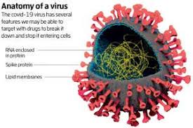
DIAGRAMS OF COVID-19
Covid-19 Virus And Its Components
Shape of COVID-19 Virus
Anatomy of COVID-19

Slide 7
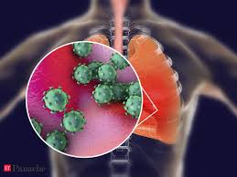
How corona virus affects humans
Effect of the virus in the human body
Corona virus in the human lungs

Slide 8
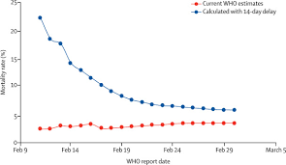
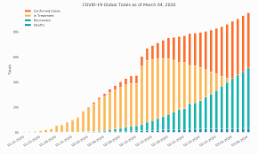
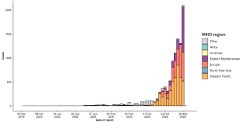
STATISTICAL DATA OF CORONAVIRUS CASES ACROSS THE WORLD
Corona virus cases in the world
Corona virus cases in Nigeria
Chart of corona virus cases in the world
Bar graph representing corona virus cases in the world by WHO
Graph

Slide 9
AUTOMATED DEVICES USED IN TREATING RESPIRATORY DISEASES
Automated oxygen delivery device
Automated breathing metabolic simulator
Oxygen concentrator
Nebulizer
Oxygen tank

Slide 10
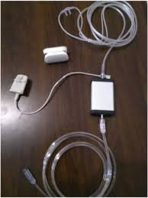
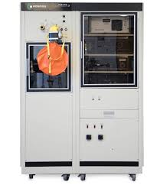
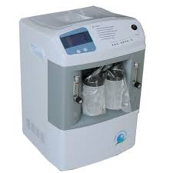
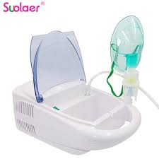
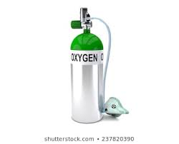
DIAGRAMS OF THE AUTOMATED DEVICES
Nebulizer
Oxygen concentrator
Automated breathing metabolic stimulator
Automated oxygen delivery device
Oxygen Tank

Slide 11
Building automation
Building automation is the automatic centralized control of a building heating, ventilation, air conditioning, lightening, and other systems through a building management system, reduction in energy consumption and operating costs, and improved life cycle of utilities.

Slide 12
DESIGN OF AUTOMATED BUILDINGS
Applied computing
Arts and humanity
Architecture( buildings)
Computer aided designs
Physical sciences and engineering
engineering
Computer aided design

Slide 13
Automated respiratory building design
the design of an automated respiratory building requires three stages
Stage 1: definition and planning
Stage 2: preparation of schematic design development
Stage 3: bidding, construction, licensing and evaluation

Slide 14
ADVANTAGES OF AUTOMATED RESPIRATORY BUILDINGS
Optimization of the documentation of the COVID-19 patients encounters
Improving communication of information to physicians
Reduction of errors
Reduction of paper
Improvement of access to patients information
Forming a data repository for further research
Improving reimbursement of services rendered to patients

Slide 15
Role of civil engineers
The role of civil engineers in helping the treatment of the COVID-19 and reduction of risk for health workers is to construct these automated respiratory buildings in order to make it easier for the health workers and also enhance quick recovery of infected people.

Slide 16
CONCLUSION
Corona virus is a deadly disease and as such serious measures need to be put in place to help in the treatment of this virus and help reduce risk of health workers since they are very prone to infection. Thus the design of an automated respiratory system is necessary

