Slide 1
ASSESSMENT OF OCCUPATIONAL HAZARDS AND DEVELOPMENT OF ENGINEERING EQUIPMENT TO SUPPORT HEALTH WORKERS AGAINST COVID-19
NAME: ADEBOYE CALEB
DEPARTMENT: MECHATRONICS
MATRIC NO: 17/ENG05/001

Slide 2
AIM
This presentation aims to explain the assessment of occupational hazards and development of engineering equipment to support health workers against covid-19.

Slide 3
Occupational Hazards Caused By Covid-19
1. shutting down of shops
2. people not been able to work
3. student not been able to go to school
4. humans cant come in contact with one and another.

Slide 4
planning assessment
COVID-19 outbreaks can have several effects within the workplace. Workers may be absent from work due to becoming sick, needing to care for others, or from fear of possible exposure. Patterns of commerce may change, both in terms of what goods are demanded, and the means of acquiring these goods (such as shopping at off-peak hours or through delivery or drive-through services). Lastly, shipments of items from geographic areas severely affected by COVID-19 may be interrupted.[1]:6

Slide 5
An infectious disease preparedness and response plan can be used to guide protective actions. Plans address the levels of risk associated with various worksites and job tasks, including sources of exposure, risk factors arising from home and community settings, and risk factors of individual workers such as old age or chronic medical conditions. They also outline controls necessary to address those risks, and contingency plans for situations that may arise as a result of outbreaks.

Slide 6
Infectious disease preparedness and response plans may be subject to national or subnational recommendations. Objectives for response to an outbreak include reducing transmission among staff, protecting people who are at higher risk for adverse health complications, maintaining business operations, and minimizing adverse effects on other entities in their supply chains. The disease severity in the community where the business is located affects the responses taken

Slide 7
HAZARD CONTROL
The hierarchy of hazard controls is a framework widely used in occupational safety and health to group hazard controls by effectiveness. Where COVID-19 hazards cannot be eliminated, the most effective controls are engineering controls, followed by administrative controls, and lastly personal protective equipment. Engineering controls involve isolating employees from work-related hazards without relying on worker behavior, and can be the most cost-effective solution to implement.

Slide 8
Administrative controls are changes in work policy or procedures that require action by the worker or employer. Personal protective equipment (PPE) is considered less effective than engineering and administrative controls, but can help prevent some exposures. All types of PPE must be selected based upon the hazard to the worker, properly fitted as applicable (e.g., respirators), consistently and properly worn, regularly inspected, maintained, and replaced, as necessary, and properly removed, cleaned, and stored or disposed of to avoid contamination.

Slide 9
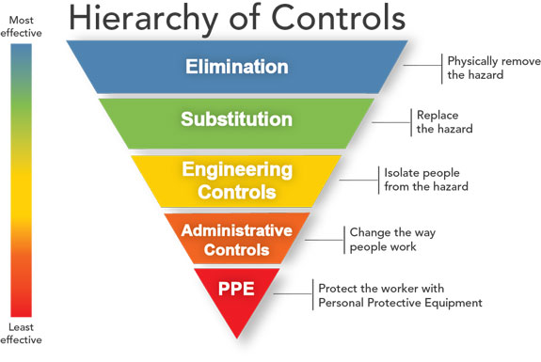

Slide 10
Workplace hazard controls for COVID-19 are the application of occupational safety and health methodologies for hazard controls to the prevention of coronavirus disease 2019 (COVID-19). The proper hazard controls in the workplace depend on the worksite and job task, based on a risk assessment of sources of exposure, disease severity in the community, and risk factors of individual workers who may be vulnerable to contracting COVID-19.

Slide 11
According to the U.S. Occupational Safety and Health Administration (OSHA), lower exposure risk jobs have minimal occupational contact with the public and other coworkers, for which basic infection prevention measures are recommended, including hand washing, encouraging workers to stay home if they are sick, respiratory etiquette, and maintaining routine cleaning and disinfecting of the work environment.

Slide 12
Personal Equipment For Covid-19
Precautions must be taken to minimise the risk of virus transmission, especially in healthcare settings when performing procedures that can generate aerosols, such as intubation or hand ventilation.[141] For healthcare professionals caring for people with COVID-19, the CDC recommends placing the person in an Airborne Infection Isolation Room (AIIR) .
CDC outlines the specific guidelines for the use of personal protective equipment (PPE) during the pandemic. The recommended gear includes:

Slide 13
Respirator or facemask
Gown
Medical gloves
Eye protection
When available, respirators (instead of facemasks) are preferred. N95 respirators are approved for industrial settings but the FDA has authorised the masks for use under an Emergency Use Authorisation (EUA).

Slide 14
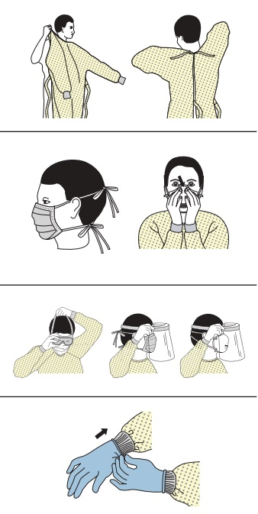

Slide 15
Conclusion
There are lots of measures that employers must take in their workplaces within the scope of Occupational Health and Safety regulations against the Coronavirus which shows its effect all over the world. In addition, if it is determined that the employee is caught with Coronavirus epidemic due to the work being carried out by the employer, this situation will be accepted as a work accident and the employer’s responsibility will also arise.

