Slide 1
DEVELOPMENT OF ENVIRONMENTAL HEALTH, ENGINEERING FACILITIES, PUBLIC HEALTH SYSTEMS FOR TACKLING COVID-19 PANDEMIC
A PRESENTATION BY
IKPEAMA JOHN CHIEMEZIEM
17/ENG04/031
ELECTRICAL/ELECTRONICS
Notes:
INTRODUCTION

Slide 2
INTRODUCTION
WHAT IS COVID-19
Corona-virus disease (COVID-19) is an infectious disease caused by a new virus.
The disease causes respiratory illness (like the flu) with symptoms such as a cough, fever, and in more severe cases, difficulty breathing. You can protect yourself by washing your hands frequently, avoiding touching your face, and avoiding close contact (1 meter or 3 feet) with people who are unwell. It originated from wuhan a city in China and was first detected on the 31st of December 2019. The outbreak was declared a Public Health Emergency of International concern on the 30th of January 2020. Corona-virus disease spreads primarily through contact with an infected/ unwell person(s) when they cough, sneeze or through fecal contamination.

Slide 3
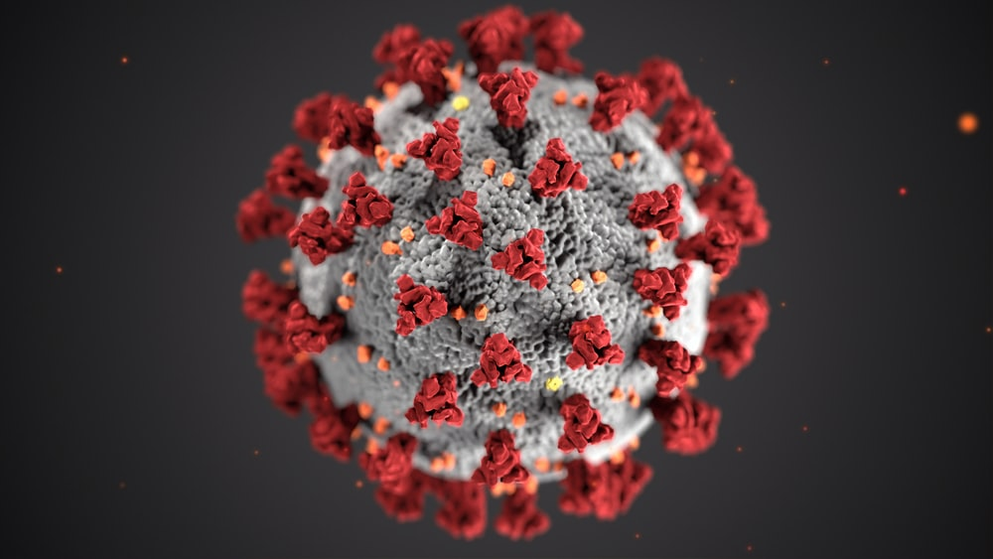

Slide 4
SYMPTOMS OF COVID-19
The symptoms of the virus include;
Cough
Fever
Tiredness
Difficulty breathing (respiratory issues ).

Slide 5
WAYS OF TACKLING COVID-19
Adequate Power Supply: In a country like Nigerian where the power supply is too limited, preventing the virus might be a problem. Say for instance a Health Centre or Hospital with victims of the virus who have respiratory issues and depend on ventilators or power-respirators would likely have difficulty breathing when the power-supply is out which could lead to death. In this kind of period, the electricity distribution companies could help in preventing the spread or reduce casualties by sustaining power supply not only in hospitals but homes too.

Slide 6
Waste Management: this involves/ includes the collection, transport and disposal of waste, together with monitoring and regulation of the waste management process. Like many respiratory viruses, including flu, Covid-19 can be spread in tiny droplets released from the nose and mouth of an infected person as they cough, when an infected person coughs or sneezes and by chance uses his/her hands to dispose of household waste the virus would most likely be passed onto the waste bag (maybe in a polythene nylon bag). Where the engineer comes in place i.e. the waste engineer is to educate people/household on the disposal of waste products with hand gloves or hands washing after disposing a waste and also incineration of waste products. They should ensure regular environmental check on landfills.

Slide 7
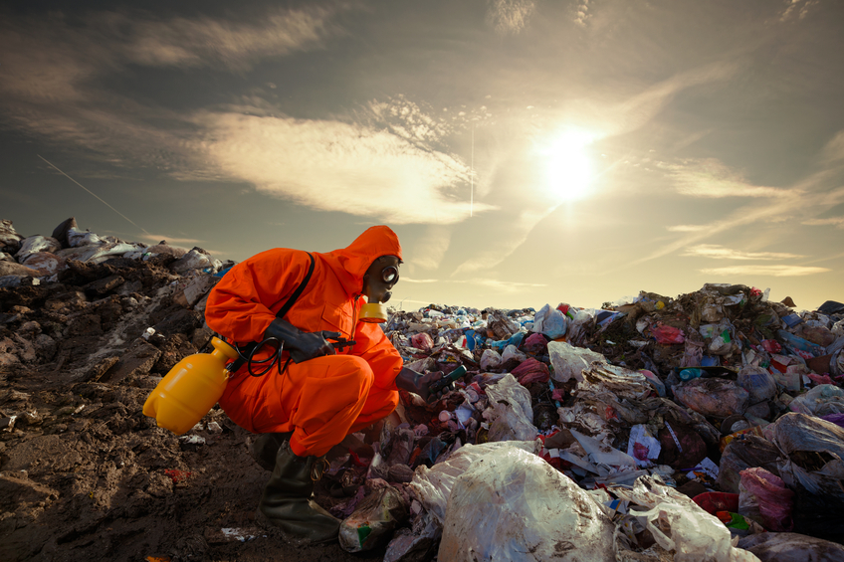

Slide 8
Water Treatment: this involves the process of improving the quality of water to make it fit/acceptable for a specific end-use. Treating water used by the public could go a long way in helping curb the spread of corona-virus. This can be done by using the following water treatment chemicals;
Chlorine.
Chlorine dioxide.
Muriatic acid.
Soda ash or Sodium bicarbonate.
Algaecide.
The following process involves professionals from some Engineering fields such as the chemical Engineering, Water Engineering, Environmental Engineering and hydraulic Engineering.

Slide 9
Water Treatment: this involves the process of improving the quality of water to make it fit/acceptable for a specific end-use. Treating water used by the public could go a long way in helping curb the spread of corona-virus. This can be done by using the following water treatment chemicals;
Chlorine.
Chlorine dioxide.
Muriatic acid.
Soda ash or Sodium bicarbonate.
Algaecide.
The following process involves professionals from some Engineering fields such as the chemical Engineering, Water Engineering, Environmental Engineering and hydraulic Engineering.

Slide 10
Production of Medical Equipments/Kits: Most hospitals you find nowadays use equipments or devices constructed by Engineers. They go a long way in making medical treatments and diagnoses easy. These Equipments are used in diagnosing patients with this virus. Examples of Engineering produced equipments used in tackling the corona-virus are;

Slide 11
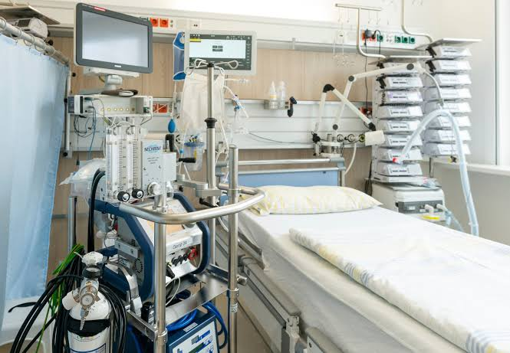
Ventilator: a ventilator is a machine that provides mechanical ventilation by moving breathable air into and out of the lungs, to deliver breaths to a patient who is physically. In cases whereby the victim or carrier of the virus experiences difficulty in breathing, he/she could be assisted by a ventilator to aid in breathing.

Slide 12
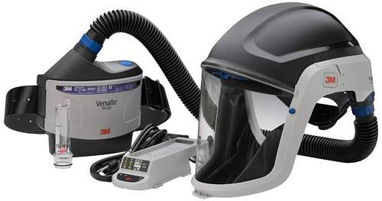
Power, air-purifying Respirators (PAPR): this is a type of personal protective equipment used to safeguard a person(s) against contaminated air. The device consist of a respirator in the form of a hood, or full-face mask, which takes ambient air that is contaminated with one or more type of pollutant or pathogens, actively removes(filters) a sufficient proportion of these hazards, and then delivers the clean air to the user’s face and/or mouth. This could assist health workers in preventing uncontaminated air from entering the body.

Slide 13
Construction of more hospitals or isolation centre’s: This can be achieved by putting work force on ground. Due to limited time and rising toll of the virus, hospitals would have increase in patients (those affected by the virus and those without the virus) which could result in low space, inadequate equipment to go round. This is where the engineer comes in, engineers could help build new hospitals, including by designing and manufacturing buildings using offsite construction. This would be very helpful and aid in curbing the spread of the virus.

Slide 14
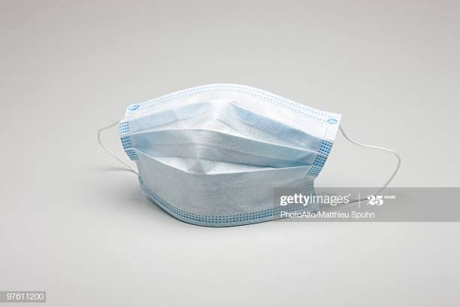
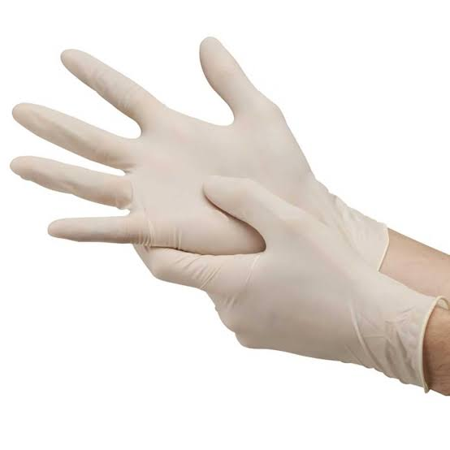
Always put on your face-mask while in public or Gatherings
Put on your gloves if a hand sanitizer is not available

Slide 15
STAY HOME. SAVE LIVES
Help stop the spread of Coronavirus
STAY home as much as you can
KEEP a safe distance
WASH hands often
COVER your mouth while coughing
SICK? Visit your nearest hospital

