Slide 1
ASSESSMENT OF OCCUPATIONAL HAZARDS AND DEVELOPMENT OF ENGINEERING FACILITIES, EQUIPMENT, SENSORS AND PUBLIC HEALTH SYSTEMS FOR TACKLING COVID – 19 PANDEMIC
NAME: ASITA OBONISO
DEPARTMENT: MECHATRONICS ENGINEERING
MATRICULATION NUMBER: 17/ENG06/014
DATE: 2ND OF APRIL 2020

Slide 2
OCCUPATIONAL HAZARD

Slide 3
TYPES OF OCCUPATIONAL HAZARDS
Biological hazards
Chemical hazards
Physical hazards
Psychosocial hazards

Slide 4
Biological hazards: Biological hazards or biohazards are biological substances that threaten the health of human beings and other living organisms.
Chemical hazards: Chemical hazards are occupational hazards that expose people to chemicals in their workplace.
Physical hazards: Physical hazards may be factors, agents, or circumstances that can cause harm without or with contact.
Psychosocial hazards: Psychosocial hazards are occupational hazards that affect employees’ psychological health.

Slide 5
COVID-19(CORONAVIRUS DISEASE 2019)
Coronavirus is a biological hazard and can be contacted at the work place. This is the main reason why people are asked to work from home.
COVID-19 is an infectious disease caused by severe acute respiratory syndrome. The disease was first identified in December 2019 in Wuhan, the capital of China’s Hubei province, and has since spread globally, resulting in the on going 2019-20 coronavirus pandemic. Common symptoms include fever, cough and shortness of breath. Other symptoms may include fatigue, muscle pain, diarrhoea, sore throat, loss of smell and abdominal pain. While the majority of cases result in mild symptoms, some progress to viral pneumonia and multi-organ failure. As of 8 April 2020, more than 1.44 million cases have been reported in more than 200 countries and territories, resulting in more than 82,900 deaths. More than 307,000 people have recovered

Slide 7
A Picture of a Corona Virus
Respiratory droplets, produced when a man is sneezing

Slide 8
How engineering is helping to battle COVID-19
Design and manufacture respiratory equipment
Provide personal protective equipment (PPE)
Build temporary hospitals or donate materials

Slide 9
SENSORS USED TO DETECT CORONA VIRUS
Thermometer gun
Thermal infrared cameras
Wearable monitoring temperature device

Slide 10
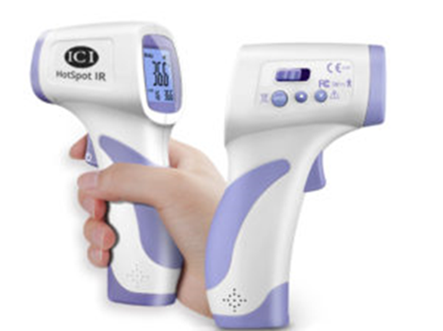

Slide 11
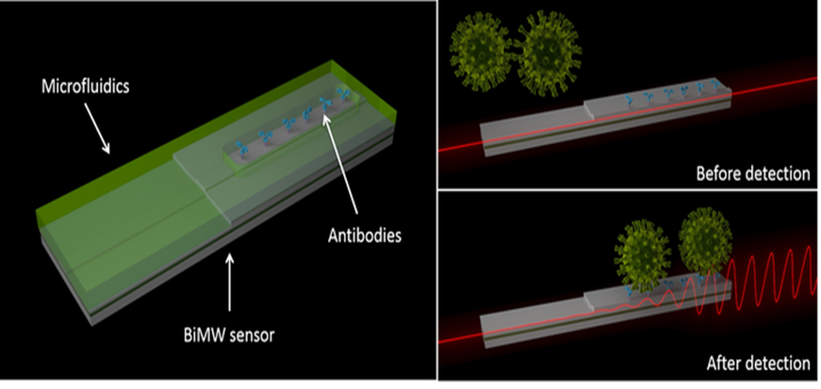
RESULTS
A new laser-based bimodal waveguide interferometer sensor detects coronavirus via changes in the sensor's evanescent light field.

Slide 12
RECOMMENDATION
sensors that can be operated at home like through phone applications should be created to detect the virus from the house to avoid the spread also smaller and cheaper ventilators should be created to help the masses of corona virus patients so that the need for building temporary hospitals would not arise or would be at a minimal rate.

Slide 13
CONCLUSION
Occupational hazards are risks accepted as consequences of a particular occupation.
There several types of occupational hazards but in this document it was more focused on biological hazard because coronavirus 2019 otherwise known as COVID-19 is a biological hazard. COVID-19 is an infectious disease caused by severe acute respiratory syndrome. The disease was first identified in December 2019 in Wuhan, the capital of China’s Hubei province, and has since spread globally, resulting in the on going 2019-20 coronavirus pandemic.
It can be spread through many ways that’s why social distancing has been encouraged in order to stop the spread of the disease.
The engineering industries are being encouraged to gear up and innovate as it tackles COVID-19. They can design, fabricate and manufacture equipment and facilities to help in curbing the virus.

