Slide 1
DEVELOPMENT OF ENVIRONMENTAL HEALTH ENGINEER FACILITIES, EQUIPMENT, SENSORS AND PUBLIC HEALTH SYSTEMS FOR TACKLING COVID-19 PANDEMIC PREPARED BY OJEIKERE OHIKHATEEME .O. 17/ENG04/051

Slide 2
What started as an epidemic mainly limited to China then, now has become a truly global pandemic. There have now been over 1,018,948 confirmed cases and 53,211 deaths, according the John Hopkins University Covid-19 dashboard. Also more than 1,018,948 people have been infected with the novel virus, with significant outbreaks in the US, Italy and Spain, and 2,921 deaths in the UK, which collates information from national and international health authorities. The disease has been detected in more than 200 countries and territories, with Italy, the US and Spain experiencing the most widespread outbreaks outside of China. In the UK, there have been 33,718 confirmed cases and 2,921 deaths as of April 2.
The Chinese government responded to the initial outbreak by placing Wuhan and nearby cities under a de-facto quarantine encompassing roughly 50 million people in Hubei province. This quarantine is now slowly being lifted, as authorities watch to see whether cases will rise again. The US is now the new epicenter of the Covid-19 outbreak, becoming the first country to surpass China's total confirmed cases. As of April 3, the country has 245,573 confirmed infections and 6,058 deaths. In Italy, where the death toll surpassed that of China on March 19, the government took the unprecedented step of extending a lockdown to the entire country, shutting cinemas, theatres, gyms, discos and pubs and banning funerals and weddings. In the UK, the government has shut schools, pubs, restaurants, bars cafés and all non-essential shops.

Slide 3
On March 23, prime minister Boris Johnson put the UK under lockdown saying that police will now have the power to fine people who gather in groups of more than two or who are outside for non-essential reasons. People with the main coronavirus symptoms – a fever or dry cough – are required to stay at home for seven days while households in which at least one person is displaying symptoms should quarantine themselves for 14 days. Four days later the prime minister and health secretary Matt Hancock both tested positive for the virus – they are currently self-isolating while working on the UK's response.

Slide 4
When we look at which countries have done relatively well in tackling the virus, there are signs of (electrical/computer) engineering at work. In South Korea it is reported that an app - Corona 100m - helped mobilize crowd sourced information on infections, both possible and actual. In China, part of the “effectiveness” in containing the deaths from the virus is reportedly due to the rapid construction of new hospitals. No country, however, has managed to deploy engineering solutions in a way that also helps day-to-day life continue in some safe way.

Slide 5
Where are the engineers?
Ultimately, we need to design creative, workable and effective responses that better balance protection from the virus with disruption to daily life. Instead, we have scientists with fantastically deep knowledge about the biology and epidemiology of viruses, and maybe about the cognitive tricks that lean us towards doing one action over

Slide 6
HOW ENGINEERS CAN CONTRIBUTE TO THE DEVELOPMENT OF ENVIRONMENTAL HEALTH FACILITIES, EQUIPMENT, SENSORS AND PUBLIC HEALTH SYSTEMS FOR TACKLING THE COVID-19 PANDEMIC

Slide 7
Supporting health workers and providing solutions to minimal work spaces
More hospital spaces are needed for patients as the NHS comes under increasing strain. The Excel Centre in East London is being co-opted as a field hospital and could reportedly hold up to 4,000 patients. Following similar measures in China, readers suggested engineers could help build new hospitals, including by designing and manufacturing buildings using offsite construction. In response to that, an Italian design company has teamed up with the Massachusetts Institute of Technology to create prefabricated intensive care units (ICUs), to deal with escalating numbers of corona virus patients around the world.

Slide 8
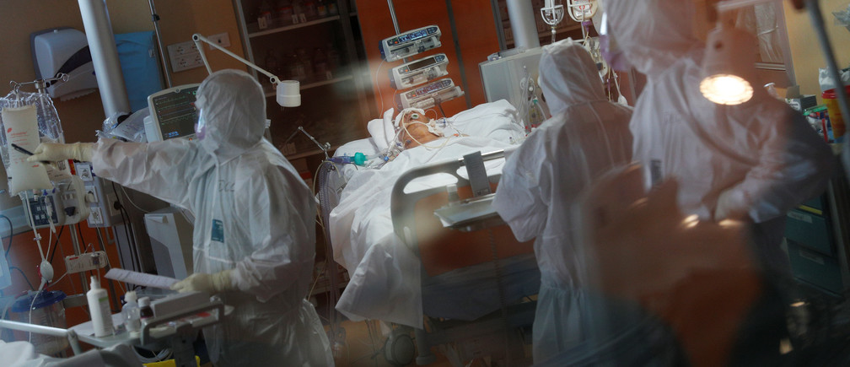
Doctors in make shift hospitals

Slide 9
Use of drones to dispatch/deliver relief materials
As a lot of individuals and health care workers are afraid of delivering health care and carrying out testing, the use of drones can thus be very effective. The advantages of using drones are that drones have the ability to:
Supply health care where humans cannot go to (i.e. the rural communities).
Work for longer hours without rest as they just need human operators.
Supply relief materials without contacting the virus.
Test patients with no fear of contacting the virus.

Slide 10
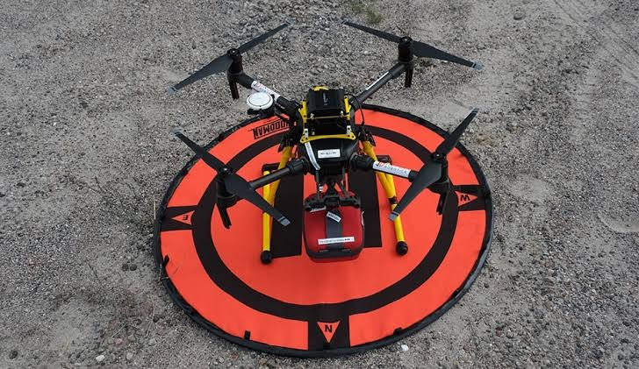
Drone transporting relief materials

Slide 11
Installation of cameras with heat sensors around street corners
As discovered, one of the symptoms that the virus has is high fever. With this discovery, cameras with installed temperature detectors could be invented with a unit in the society solely concentrated on the daily living of individuals. Since these cameras would be monitoring the living of individuals they would make no mistake when scanning the mass and detect those with the stated symptoms

Slide 12
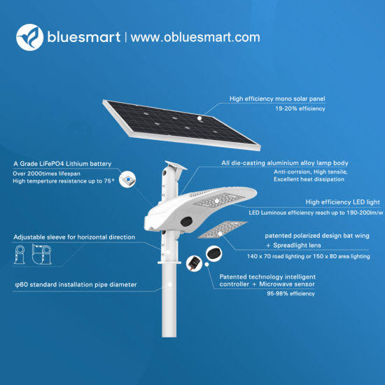
Street cameras with heat sensors and solar power

Slide 13
CHALLENGES THAT COULD BE ENCOUNTERED WITH THESE SOLUTIONS IN NIGERIA
As a third world country, nigeria has a few problems which could also affect the world at large as we are all humans. Some of the challenges that may come up along the way are listed below
Lack of effective management: Effective management of the devicees invented is key and necessary for effective eradication of the virus. If the equipments are not managed properly managed there the cost of management increases thus reducing the amount iof generated income.
Lack of properly skilled labourers: those handling the equipmen need a sufficient knowledge on how to operate the devices and systems they are on charge of if ot the operation of the devices woud be poor and could thus lead to a malfunction in the systems. Gthe solution is to provide a training programe for thise that would be in charge of handling the equipent.
Bad economy and infrastructures
Lack of proper maintenance of equipment
Poor quality of equipment: if the quality of the equipment made is poor, the operation of the equipment would beterrible and thus a poor performance.
Negligence
Unplanned or emergency maintenance to fix equipment breakdowns or other urgent work as it comes up
Planned or preventative maintenance to keep systems/equipment running in peak condition
Forecast and Prediction
Contingency management , e.t.c.

Slide 14
CONCLUSION
In conclusion, engineers can effectively provide help to the world at large by providing inventions such as
Make shift hospitals
Applications for online studies
Sensor carmeras
Applications to handle bulk of data in the society
As mentioned above, enginners are problem solvers and this pademic is aproblem that could be solved through enginneering solutions but we all have to work together to get throuht the pandemic.

Slide 15
THANK
YOU

