Slide 1
ENGINEERING LAW AND MANAGERIAL ECONOMICS FOR INFRASTRUCTURAL DEVELOPMENT IN NIGERIA: CHALLENGES AND WAY FORWARD
PREPARED BY Achonwa njemanze chukwuma, 17/ENG03/003

Slide 2
WHAT EXACTLY IS INFRASTRUCTURE?
Infrastructure can be defined as the basic physical and organizational structures and facilities(e.g. buildings, roads, power supplies) needed for the operation of a society or enterprise.
The term typically refers to the technical structures that support a society, such as roads, water supply, sewers, electrical national grids, telecommunications, and so forth, and can be defined as "the physical components of interrelated systems providing commodities and services essential to enable, sustain, or enhance societal living conditions" (Fulmer, 2009).

Slide 3
DIFFERENCE BETWEEN GOOD AND POOR INFRASTRUCTURAL FACILITIES
The Infrastructural report of Nigeria just like any third world country is nothing to write home about. The housing situation is in a sorry state both quantitatively and qualitatively (Agbola, 1998; Ajanlekoko, 2001; Nubi, 2000; Onibokun, 1996 Oyedele, 2006). Most infrastructures are now decayed and need repair, rehabilitation or replacement. Government is the system that plans, organizes, controls and supervises the people who are live in an area in other for all to have a conducive environment for living and a sense of belonging. Governments have the power to put in place all measures that will make an environment beneficial for living for everybody.

Slide 4
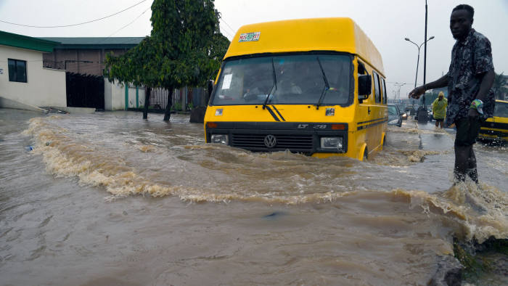
EXAMPLES OF SUCH FACILITIES; a flooded street in Lagos

Slide 5
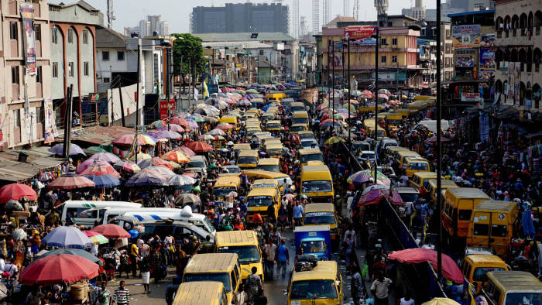
Vendors displaying goods for sale while contesting for space with public transport vehicles

Slide 6
THE BENEFITS OF INFRASTRUCTURE IN NATIONAL DEVELOPMENT
Infrastructure can help solve four problems: social; health and environment; development; and, economics. A region's infrastructure network, broadly speaking, is the very socio-economic climate created by the institutions that serve as conduits of trade and investment. Some of these institutions are public, others private. In either case, their roles in the context of integration are transformative, helping to change resources into outputs or to enhance trade by removing barriers. Therefore, an improvement in regional infrastructure is one of the key factors affecting the long-term economic growth of a region.

Slide 7
THE BENEFITS OF INFRASTRUCTURE IN NATONAL DEVELOPMENT
The linkages between infrastructure and economic growth are multiple and complex. Not only does infrastructure affect production and consumption directly, it also creates many direct and indirect externalities. It also involves large flows of expenditure, thereby creating additional employment. Studies have shown that infrastructure can have a significant impact on output, income, employment, international trade, and quality of life. Infrastructure development can reduce stress and promote good health. It will also reduce crime level.

Slide 8
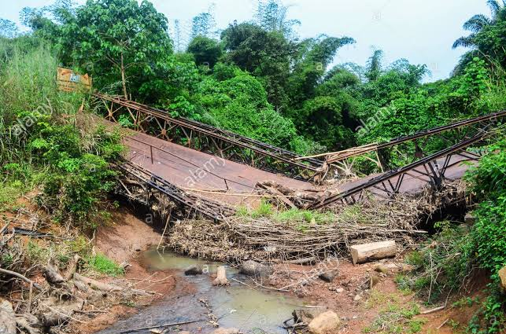
VISUAL REPRESENTATION OF THE DIFFERENCE BETWEEN GOOD AND POOR INFRASTRUCTURE
Bad infrastructure

Slide 9
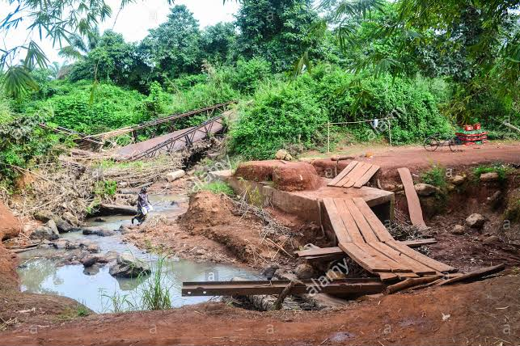

Slide 10
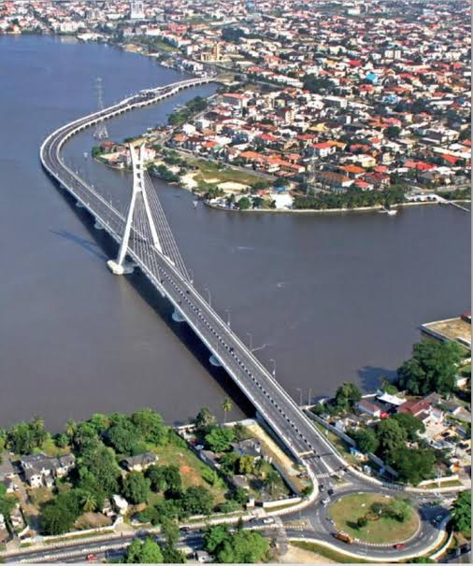
Good Infrastructures

Slide 11
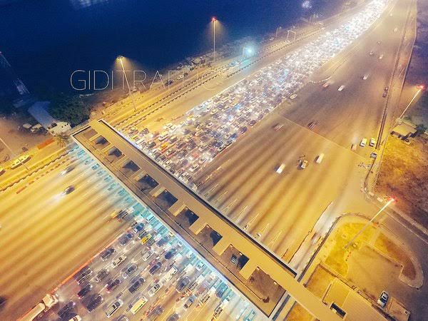

Slide 12
THE CHALLENGES OF INFRASTRUCTURE DEVELOPMENT IN NIGERIA
- Lack of Visionary Leaders: Visionary leaders are the builders of a new dawn, working with imagination, insight, and boldness. They present a challenge that calls forth the best in people and brings them together around a shared sense of purpose
- Demand and supply: Due to poor performances of most past leaders in the area of infrastructure provision, the desire for infrastructure development overwhelms the provision. Unfortunately, over 70% of the federal roads are in bad state of repair. In the area of housing, Nigeria requires about 17 million housing units and 60 trillion naira in order to meet its housing needs.

Slide 13
THE CHALLENGES OF INFRASTRUCTURE DEVELOPMENT IN NIGERIA
- PESTLES Analysis: The challenges of infrastructural development in Nigeria can be discussed under PESTLES Analysis. Challenges infrastructural development can be: political, economic, social, technology, legal, environmental and safety.
- Procurement Method: The procurement methods being adopted are prone to criticisms. The Public Finance Initiatives, especially the Concession Method and Public/Private Partnership (PPP) are questionable and seems to mortgage others who are not part of the arrangement to the scheme’s future.
- Corruption: Corruption does not only raise the price of infrastructure, it can also reduce the quality of, and economic returns from, infrastructure investment. The corruption in Nigeria is very high and unbearable for effective infrastructural development.

Slide 14
WAYS TO AID INFRASTRUCTURAL DEVELOPMENT IN NIGERIA
Better project planning: Robust and diligent project planning is usually perceived by project sponsors to be an expensive undertaking. However, the shortcuts sometimes taken by sponsors consistently results in very expensive project failures, as well as improperly structured or poorly executed capital projects. These have signiﬁcant unfavourable implications for the sponsors, investors, and ﬁnanciers of such projects, and the infrastructure sector track record in Nigeria as a whole.
Stronger technical partnerships and commitment to knowledge transfer: Infrastructure projects typically require a broad mix of diverse skills and competencies for successful delivery. The level of competence required for successful and timely execution of these projects is usually built over several years of successful project design, development, and delivery.

Slide 15
WAYS TO AID INFRASTRUCTURAL DEVELOPMENT IN NIGERIA
Mobilising the “right” equity for infrastructure projects: Many project sponsors sometimes underestimate the quantum of equity required for infrastructure projects and look for ways to seek short-term returns or save on project developments costs. This usually ends up being detrimental to project viability, quality of delivered assets and project completion timeline.
Innovative funding arrangements: The Nigerian economy is dominated by short-term ﬁnancing of three to ﬁve years terms, traditionally provided by domestic commercial banks. However, a limited number of deals in the market have been funded with seven to ten year loan tenors usually with participation from international banks and development ﬁnance institutions, and in some cases with risk guarantees from multilateral organisations like the World Bank.

