Slide 1
ASSESSMENT OF OCCUPATIONAL HAZARDS AND DEVELOPMENT OF ENGINEERING EQUIPMENT TO SUPPORT HEALTH WORKERS AGAINST COVID-19
BY BAKARE SHARAFADEEN OMOGBOLAHAN 17/ENG04/014

Slide 2
Coronaviruses are a family of viruses that cause illnesses ranging from the common cold to more severe diseases such as severe acute respiratory syndrome (SARS) and the Middle East respiratory syndrome (MERS). These viruses were originally transmitted from animals to people. SARS, for instance, was transmitted from civet cats to humans while MERS moved to humans from a type of camel. Several known coronaviruses are circulating in animals that have not yet infected humans.

Slide 4
In January 2020 the World Health Organization (WHO) declared the outbreak of a new coronavirus disease in Hubei Province, China to be a Public Health Emergency of International Concern. WHO stated there is in high risk of the 2019 coronavirus disease (COVID-19) spreading to other countries around the world.
WHO and public health authorities around the world are taking action to contain the COVID-19 outbreak. However, long term success cannot be taken for granted. All sections of our society – including businesses and employers – must play a role if we are to stop the spread of this disease.

Slide 5
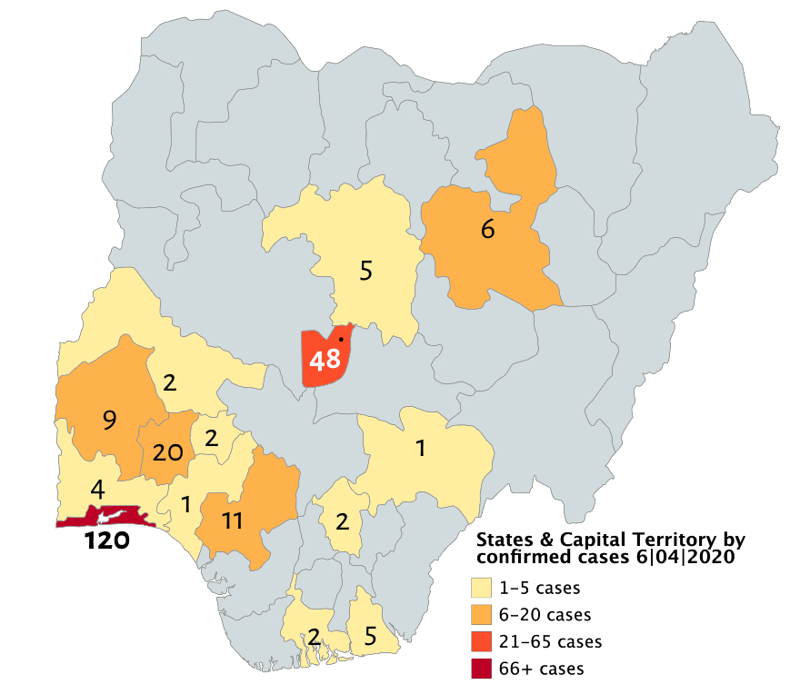

Slide 6
How COVID-19 spreads
When someone who has COVID-19 coughs or exhales they release droplets of infected fluid. Most of these droplets fall on nearby surfaces and objects - such as desks, tables or telephones. People could catch COVID-19 by touching contaminated surfaces or objects – and then touching their eyes, nose or mouth. If they are standing within one meter of a person with COVID-19 they can catch it by breathing in droplets coughed out or exhaled by them.

Slide 7
In other words, COVID-19 spreads in a similar way to flu. Most persons infected with COVID-19 experience mild symptoms and recover. However, some go on to experience more serious illness and may require hospital care. Risk of serious illness rises with age: people over 40 seem to be more vulnerable than those under 40. People with weakened immune systems and people with conditions such as diabetes, heart and lung disease are also more vulnerable to serious illness.

Slide 8
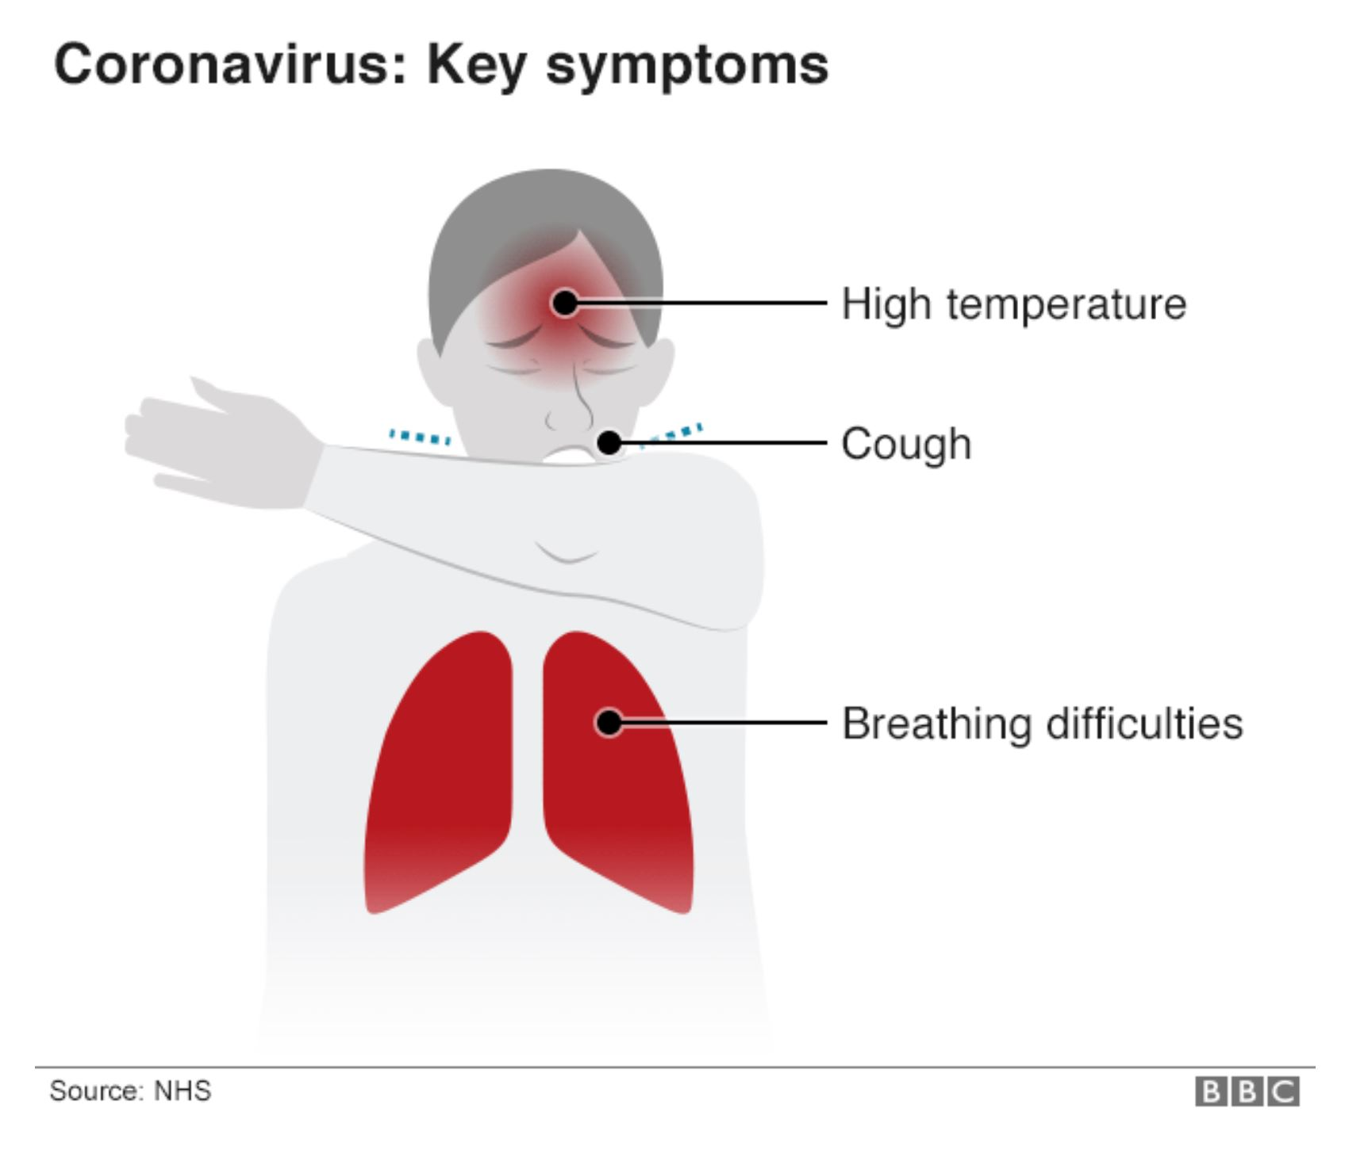

Slide 9
CHALLENGES
1. A lack of access to healthcare and paid sick leave are among the concerns.
2. Job losses are set to exceed predictions of 25 million worlwide.
3. Only 21% of countries are providing sick leave for all or some workers. The countries polled represent a swathe of the world's most powerful economies, including 28 out of 36 OECD countries and fifteen G20 countries.

Slide 10
5. It's a challenge now to manage, a global office of people in their own homes. The technology we have now really does play up the opportunities, but it also highlights the costs and potential risks of people being atomized from their place of work.
6. And for people with young children, this is an incredibly difficult time. Balancing work and family is a whole new realm of challenges. So from a personal point of view and from an economic point of view, this is nothing short of potentially disastrous for people's livelihoods and indeed for stable economies.

Slide 11
7. there are many businesses who have simply taken an opportunity to lay off staff. In some cases, they are taking government support and still laying off staff, where the factories and retail outlets and services are shutting down, people often have far too little sick pay, if any at all. Wage and job guarantees are lacking. The International Labor Organization (ILO) says we could lose up to 25 million jobs worldwide – and depending on the timeframe, it could be worse than that.
8. Only 50% of countries are providing free public healthcare – that is a glaring gap. And if that's the case in the richer world, then in developing economies where the virus is only just starting to spread, the health fallout could be disastrous.

Slide 12
RECOMMENDATIONS
1. Familiarize personnel with technical updates on COVID-19 and provide appropriate tools to assess, triage, test and treat patients and to share infection prevention and control information with patients and the public;
2. As needed, provide with appropriate security measures for personal safety and provide a blame-free environment for workers to report on incidents, such as exposures to blood or bodily fluids from the respiratory system or to cases of violence, and to adopt measures for immediate follow-up, including support to victims;

Slide 13
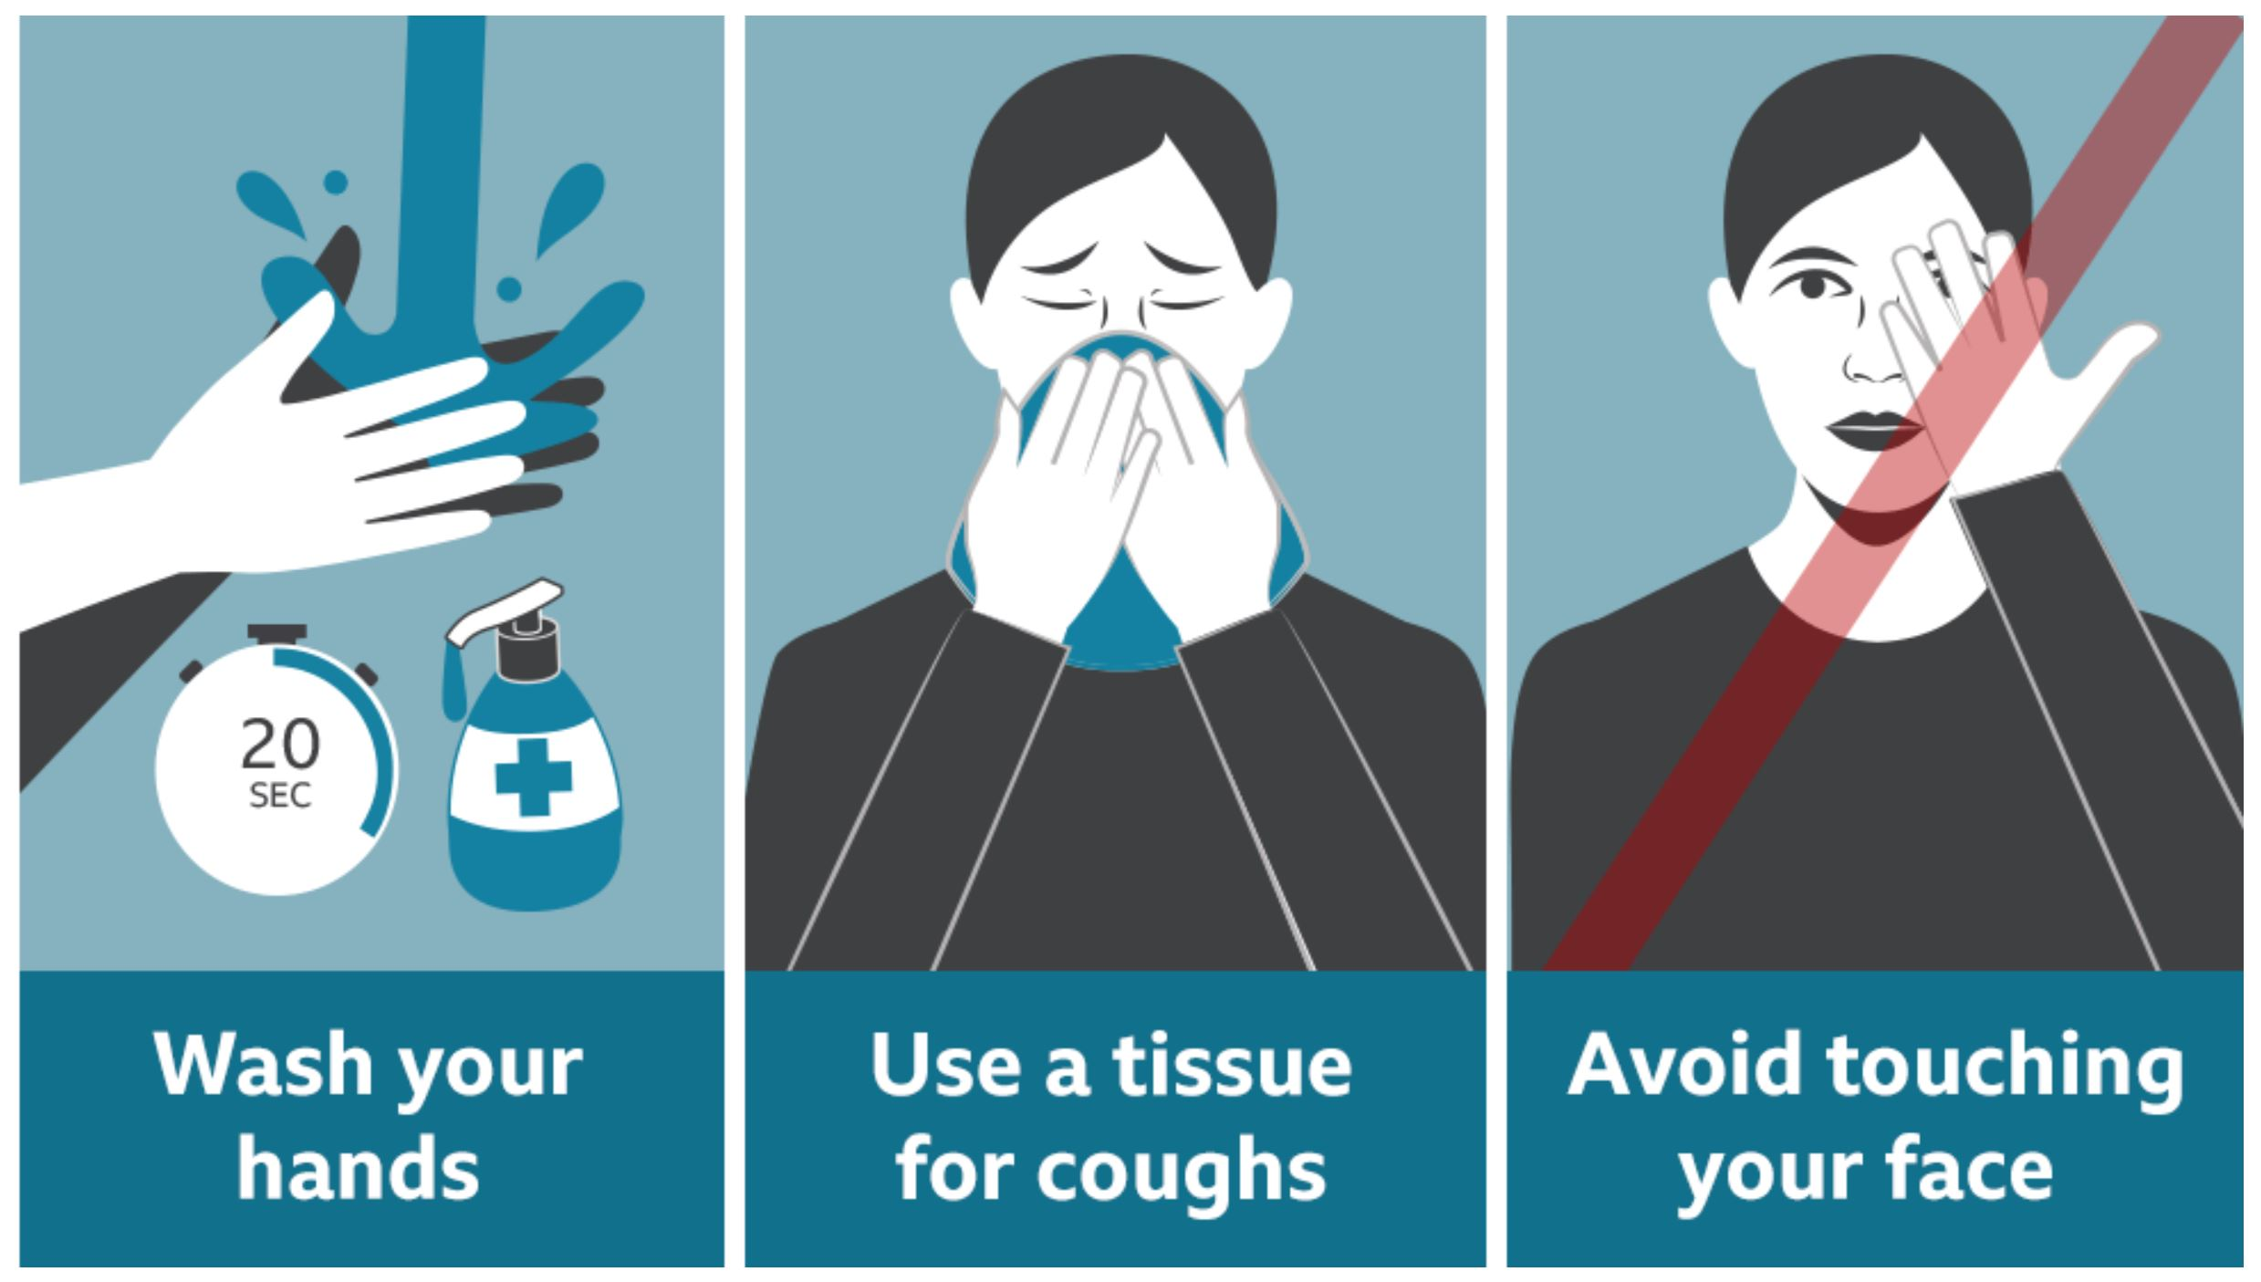

Slide 14
3. Advise workers on self-assessment, symptom reporting and staying home when ill, maintain appropriate working hours with breaks, consult with health workers on occupational safety and health aspects of their work and notify the labour inspectorate of cases of occupational diseases.
4. Workers are not be required to return to a work situation where there is continuing or serious danger to life or health, until the employer has taken any necessary remedial action.

Slide 15
5. Allow workers to exercise the right to remove themselves from a work situation that they have reasonable justification to believe presents an imminent and serious danger to their life or health. When a health worker exercises this right, they shall be protected from any undue consequences.
6. Honour the right to compensation, rehabilitation and curative services if infected with COVID-19 following exposure in the workplace. This would be considered occupational exposure and resulting illness would be considered an occupational disease,

Slide 16
CONCLUSION
This study showed that majority of the government health workers had high occupational hazard risk, poor compliance to occupational safety measures despite high awareness of OHS. Clinical health workers and health workers with more than 10 years experience had better awareness of OHS.

