Slide 1
ENGINEERING LAW AND MANAGERIAL ECONOMICS FOR INFRASTRUCTURAL DEVELEOPMENT IN NIGERIA: MAJOR CHALLENGES AND WAY FORWARD
By
Eguakun Joshua Osadebawmen
16/eng03/021

Slide 2
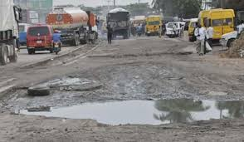
Challenges
Poor funding of infrastructure

Slide 3
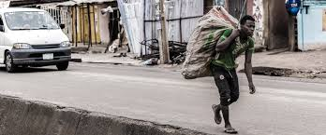
Poor governance

Slide 4
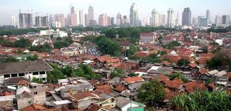
Neglect of urban and regional planning

Slide 5
Way-forward
Adequate Funding and Greater Private Sector Involvement

Slide 6
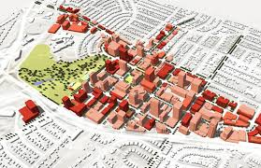
The Need for Physical Planning

Slide 7
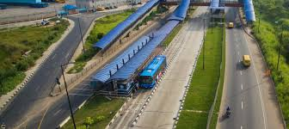
GOOD BYE

