Slide 1
Operation ,management and maintenance for engineering equipment for sustainable development in Nigeria
By
Akporuere david
17/eng03/010
Civil engineering

Slide 2
CONTENTS
INTRODUCTION
ENGINEERING EQUIPMENTS
MAINTENANCE TIPS TO EXTEND ENGINEERING EQUIPMENT LIFE
HOW TO MANAGE ENGINEERING EQUIPMENT FOR SUSTAINABLE DEVELOPMENT IN THE COUNTRY
CONCLUSION

Slide 3
INTRODUCTION
The present state of engineering affairs in the country today gives rises for the review for the maintenance , operation and management of engineering equipment to develop our country.
Nowadays we use unqualified personnel to handle the job of maintenance of engineering equipments in the country and it will obviously have a bad effect on the equipments . This is a situation that needs to be resolved in the country so that we can use the engineering equipment for sustainable development in the country.

Slide 4
ENGINEERING EQUIPMENT
Engineering is the application of economic, social, scientific, and practical principles to invent, build, design, maintain, and otherwise improve machines, devices, materials, systems, and processes. Engineering is an important field of work, especially in our company, so we can keep ahead of the design and machining curve.
The engineering department at Phoenix Specialty Manufacturing is small, but powerful. We have a three-person team with a combined work experience of over 80 years. Our engineers use a variety of controls, software, and concepts to effectively install new equipment, as well as enhance our manufacturing processes.

Slide 5
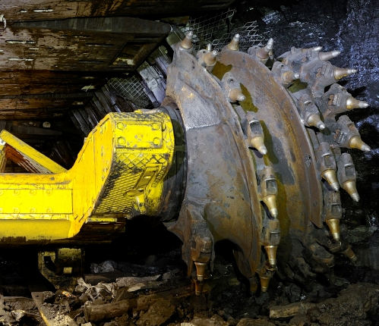
MAINTENANCE TIPS TO EXTEND ENGINEERING EQUIPMENT

Slide 6
Stay on top of large machinery operator training
. Add and test lubricants frequently
Check for signs of wear
Keep large machinery clean, and maintain a clean environment
Have a maintenance and repair schedule, and keep good records

Slide 7
HOW TO MANAGE ENGINEERING EQUIPMENT FOR SUSTAINABLE DEVELOPMENT IN THE COUNTRY
The government should employ educated and qualified people to operate and take charge of the engineering equipment.
The engineering equipment should be changed or replaced when old.
The engineering equipment should undergo servicing regularly.
Amateurs should not be allowed to operate ant engineering equipment except gone for proper training.

Slide 8
CONCLUSION
Based on the previous findings above on how to operate, maintain and manage the engineering equipment for sustainable development in the country it has improved the strength of the equipment, facilities and machines over a long run.
I also believe that engineering equipment that have served for long should be change.

Slide 9
THANK YOU FOR LISTENING

