Slide 1
DEVELOPMENT OF ENVRONMENTAL HEWLTH ENGINEERING FACILITIES, EQUIPMENT, SENSORS AND PUBLIC HEALTH SYSTEMS FOR TACKLING COVID-19 PANDEMIC
PREPARED BY
OMOJOLA TEMILOLUWA OLUWATOMISIN
17ENG04/058
ELECTRICAL/ELECTRONICS ENGINEERING

Slide 2
This presentation focuses on how engineers can help in developing more health aiding equipment and facilities that will tackle pandemics like COVID-19 and will also help contain the viruses.

Slide 3
Understanding COVID-19
Coronaviruses are a large family of viruses which may cause illness in animals or humans. In humans, several coronaviruses are known to cause respiratory infections ranging from the common cold to more severe diseases such as Middle East Respiratory Syndrome (MERS) and Severe Acute Respiratory Syndrome (SARS). The most recently discovered coronavirus causes coronavirus disease COVID-19.
The most common symptoms of COVID-19 are fever, tiredness, and dry cough. Some patients may have aches and pains, nasal congestion, runny nose, sore throat or diarrhea. Older people, and those with underlying medical problems like high blood pressure, heart problems or diabetes, are more likely to develop serious illness.

Slide 4
HEALTH DEVELOPMENT AND ENGINEERING

Slide 5
Healthcare Engineering is expected to play a role of growing importance as healthcare continues to be one of the world's largest and fastest-growing industries where engineering is a major factor of advancement through creating, developing, and implementing cutting-edge devices, systems, and procedures attributed to breakthroughs in electronics, information technology, miniaturization, material science, optics, and other fields, to address challenges associated with issues such as the continued rise in healthcare costs, the quality and safety of healthcare, care of the aging population, management of common diseases, the impact of high technology, increasing demands for regulatory compliance, risk management, and reducing litigation risk. As the demand for engineers continues to increase in healthcare, Healthcare Engineering will be recognized as the most important profession where engineers make major contributions directly benefiting human health.

Slide 6
HOW WILL ENGINEERING HELP TACKLE COVID-19?
Engineers all over the world are working double time to help the world population and protect them from the virus.
They have invented some devices and upgraded already existing devices to prevent spread of the virus.
Some of these inventions and innovations include:

Slide 7
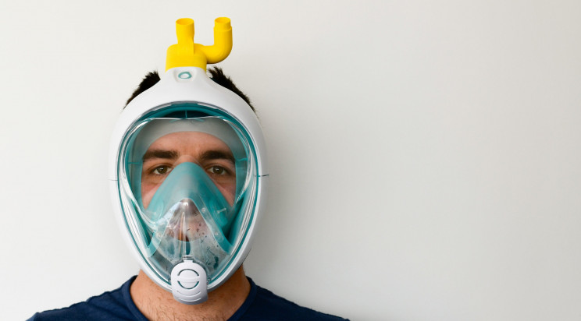
The snorkeling mask ventilator
Only a few days after helping an Italian hospital by playing their part in fixing the broken supply chain for ventilators, the same group of engineers shared a 3D printed design for an adapter that converts snorkel masks into ventilators.

Slide 8
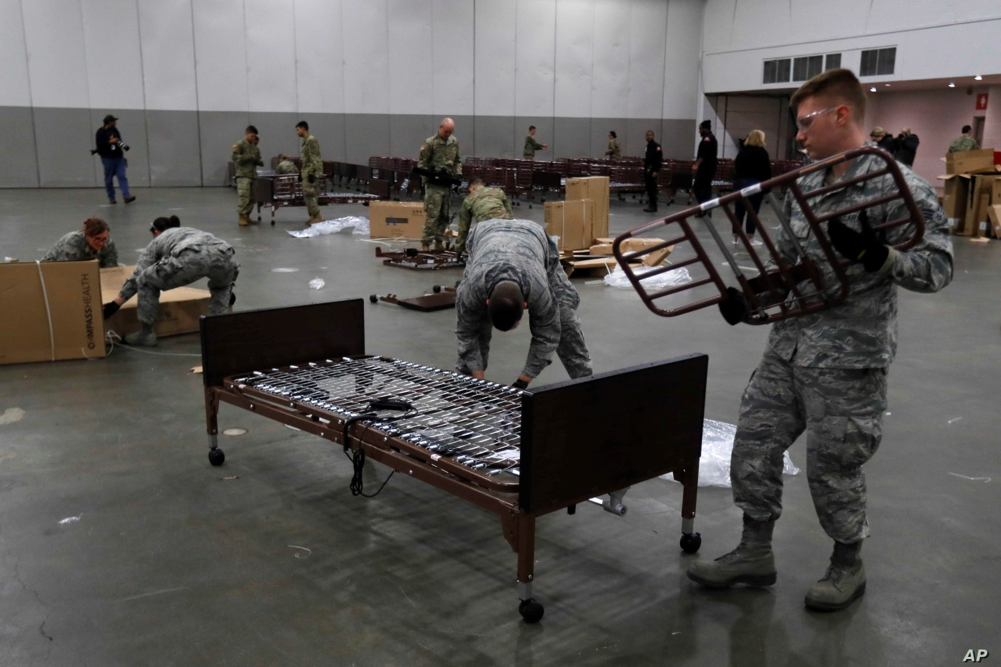
U.S. army corps engineers convert buildings to provide 10,000 new beds
Confirmed cases of the coronavirus have surged in New York in the last week. With over 25,000 cases and 210 deaths at the time of writing, it has become the epicenter of coronavirus cases in the U.S.

Slide 9
Completed isolation area built by the Army soldiers

Slide 10
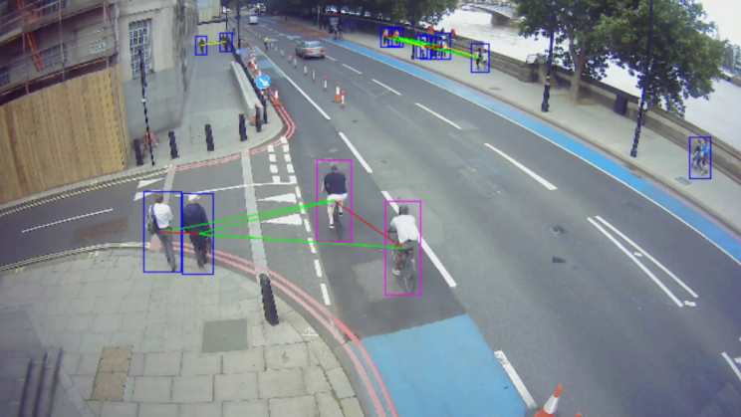
Artificial intelligence used to analyze self-isolation habits
Some countries have taken longer than others to announce police-enforced lockdowns. In the United Kingdom, for example, the decision was only enforced yesterday. According to research Vivacity labs, a startup that makes camera-based traffic sensors, the enforcement was severely needed.

Slide 11
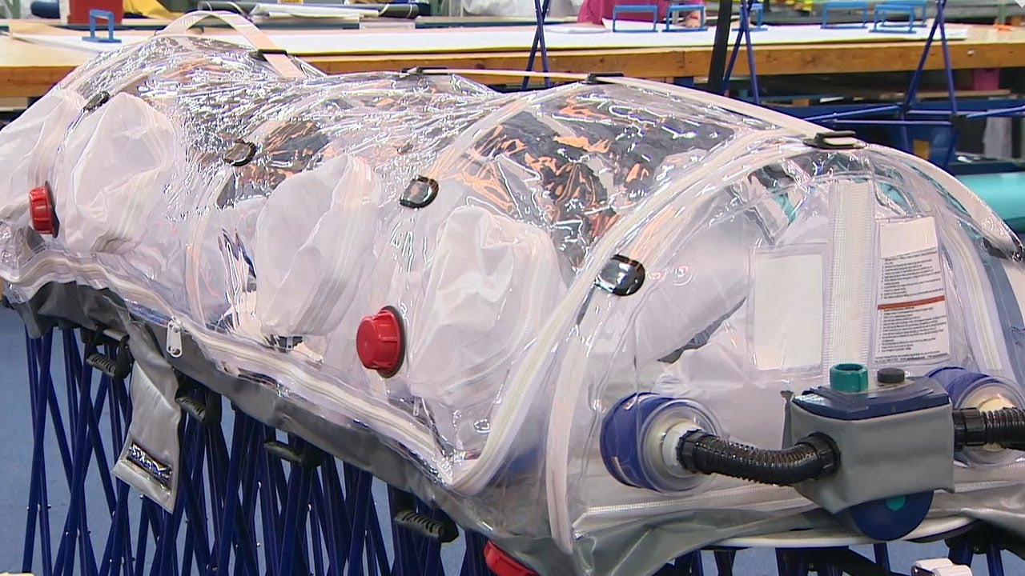
Coronavirus isolation pods made by Mexican engineer
Special fully-sealed isolation pods were recently created by Mexican engineer Fernando Aviles for safely transporting COVID-19 patients. The specially-designed pods are equipped with air pumps that create a negative pressure within the sealed space.

Slide 12
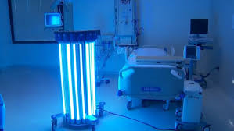
UV light-emitting disinfection robots
UV light disinfectant robots weren't specifically developed for the COVID-19 pandemic and they haven't been definitively proven to be effective at eradicating the virus (SARS COV-2) from surfaces — and yet, demand has skyrocketed to the point that companies are sending truckloads of the machines to different countries worldwide.

Slide 13
Three things that engineering companies can do to help fight COVID-19
Engineering companies are gearing up to help tackle the pandemic, and while we have seen all kinds of creative solutions to key problems, here are just three:
Design and manufacture respiratory equipment
As shown in the previous slides, the need for respiratory ventilators is rapidly increasing as more and more hospitals find themselves without the resources to cope with a huge number of COVID-19 cases.
In fact, these lifesaving pieces of equipment are so essential right now that the government has issued a plea for companies who can supply ventilators or ventilator components to offer their services.

Slide 14
Provide personal protective equipment (PPE)
The doctors and nurses are on the frontline of this battle, so it's absolutely crucial that they have the right personal PPE to keep them safe from the virus while assisting those suffering from the symptoms of COVID-19.
This has created an immediate demand for medical equipment, including N95 fluid-resistant face masks, disposable gloves, and surgical gowns and aprons that can help to limit the spread between doctors and coronavirus patients. In fact, these are considered so crucial in protecting healthcare professionals from contracting the virus themselves that GPs are beginning to call for the same protective measures to be brought into place rather than PPE just being offered to hospital staff.

Slide 15
Build temporary hospitals or donate materials
We seem to be following Wuhan's pattern of infection and the lifespan of the coronavirus, so it's expected that we will very shortly reach a peak where temporary hospitals are going to have to be built to cope with the rising number of cases. And, while NHS Nightingale has already been built in London to cope with the demand for care, there are still other things we can be doing to maximize the number of people getting access to treatment.
For example, donating any empty shipping containers to the healthcare system can mean there are many more temporary intensive care units (ICUs) for patients in life-threatening states to be treated. Along with this, being able to offer any other helpful materials and manpower to help make these will be appreciated.

Slide 16
Amidst reports of cases rising worldwide and widespread uncertainty over when and how the pandemic will be controlled, it is encouraging to see scientific and engineering communities come together to save lives by tackle the COVID-19 pandemic head-on.
We as engineers are encouraged to use our knowledge to find more effective solutions to the pandemic.

