Slide 1
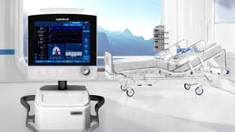
ENGINEERING STRATEGIES FOR HANDLING COVID-19 FOR ENVIRONMENTAL HEALTH AND ECONOMIC DEVELOPMENT
BY
AKUMA SUNNY 17/ENG04/009

Slide 2
This presentation aims to explain the need for ENGINEERING STRATEGIES FOR THE HANDLING OF COVID-19 FOR ENVIRONMENTAL HEALTH AND ECONOMIC DEVELOPMENT

Slide 3
THE FUTURE WITHOUT ENGINEERS

Slide 4
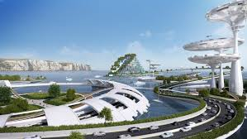
THE FUTURE WITH ENGINEERS

Slide 5
ENVIRONMENTAL HEALTH AND ECONOMIC SUSTAINABILITY
Environmental health can be integrated into economic sustainability by;
Improving environmental quality for the poorest populations with the greatest burden of environmental diseases, by reducing exposures to air pollution in homes and villages from biomass burning, and providing

Slide 6
clean water and sanitation.
Identifying efforts to address environmental problems that can also provide health benefits. For example, creating environments that encourage biking and walking for transportation reduces greenhouse

Slide 7
gas and toxic air pollution emissions(environmental benefit) and increases physical activity (health benefit).

Slide 8
Recognizing that some policies, practices, and technologies designed to promote economic sustainability may have unintended adverse environmental health effects, and attempting to prevent or mitigate these before they are implemented.

Slide 9
CASE STUDY
Over these years engineers have played a vital role in helping the economy. So they should be able to bring out strategies to help curb or contain the virus. This virus has affected us in the following ways:
Depreciation in the economy
No source of income
No education

Slide 10
ENGINEERING STRATEGIES FOR HANDLING COVID-19
Help build hospital ventilators: Currently there’s a shortage of ventilators for corona virus patients and engineering companies, no matter how big or small, engineers have a role to provide more of these facilities to help out.

Slide 11
Equipment for healthcare staff: Hospital staff around the world are putting themselves on the front line to help treat patients with corona virus. But, unfortunately, there’s currently a shortage of these equipment to help keep medical staff safe. That’s why engineering companies should offer their expertise and facilities to help out.

Slide 12
Innovative ideas and design: The internet have made billions of lives easy, it has become and important factor since we are not allowed to go outside due to the pandemic. Engineers should use this opportunity to announce their designs and production of medically approved visors and release their designs online so other engineering and manufacturing companies can follow suit.

Slide 13
Conclusion
Conclusively, it shows that engineers can still play a vital role in the economy by usings their acquired skills to help curb or contain the covid-19. And in doing so will help maintain environmental health and economic development.

