Slide 1
DEVELOPMENT OF ENVIRONMENTAL HEALTH ENGINEERING FACILITIES, EQUIPMENT, SENSORS AND PUBLIC HEALTH SYSTEMS FOR TACKLING COVID-19 PANDEMIC
BY
AHANA MICHEAL
17/ENG04/004

Slide 2
COVID-19 is an acute respiratory illness caused by a novel human coronavirus (SARS-CoV-2, called COVID-19 virus), which causes higher mortality in people aged ≥60 years and in people with underlying medical conditions such as cardiovascular disease, chronic respiratory disease, diabetes and cancer.

Slide 3
The SARS virus, or severe acute respiratory syndrome, which first occurred in the Guangdong province in southern China. COVID-19 symptoms range from mild to severe. It takes 2-14 days after exposure for symptoms to develop. Symptoms may include: fever, cough and shortness of breath.
The COVID-19 virus can be spread through contact with certain bodily fluids, such as droplets in a cough. It might also be caused by touching something an infected person has touched and then touching your hand to your mouth, nose, or eyes.

Slide 4
Those with weakened immune systems may develop more serious symptoms, like pneumonia or bronchitis. You may never develop symptoms after being exposed to COVID-19. So far, most confirmed cases are in adults, but some children have been infected. There is no evidence that children are at greater risk for getting the virus. Humans first get a coronavirus from contact with animals. Then, it can spread from human to human. Health officials do not know what animal caused COVID-19.

Slide 5
The basic health elements that apply in everyday life are even more applicable in healthcare facilities. We still need ample natural light exposure and regular airflow to minimise the risk of infections spreading. This makes architectural designs that consider these factors an excellent long-term investment.
Natural air flow is vital to improving a patient’s recovery and mental well-being.

Slide 7
Ventilators are key in cases of severe treatment of coronavirus infections. Coronavirus attacks people’s lungs and can cause especially people with pre-existing respiratory conditions severe shortness of breath, that require them to be put on a ventilator.

Slide 8
Ventilator machines mechanically move air in and out of a patient's lungs, keeping them alive when the patient’s body can no longer do it on its own. Since the ventilators first usage in the 1950s, it has become a key medical device for hospitals, where startups continue to tackle this opportunity to come up with smaller and easier to use devices. Ventilators are crucial to fight the COVID 19, but they are in a huge shortage in the US. The ventilator to critical patient ratio is estimated to 1:10.

Slide 9
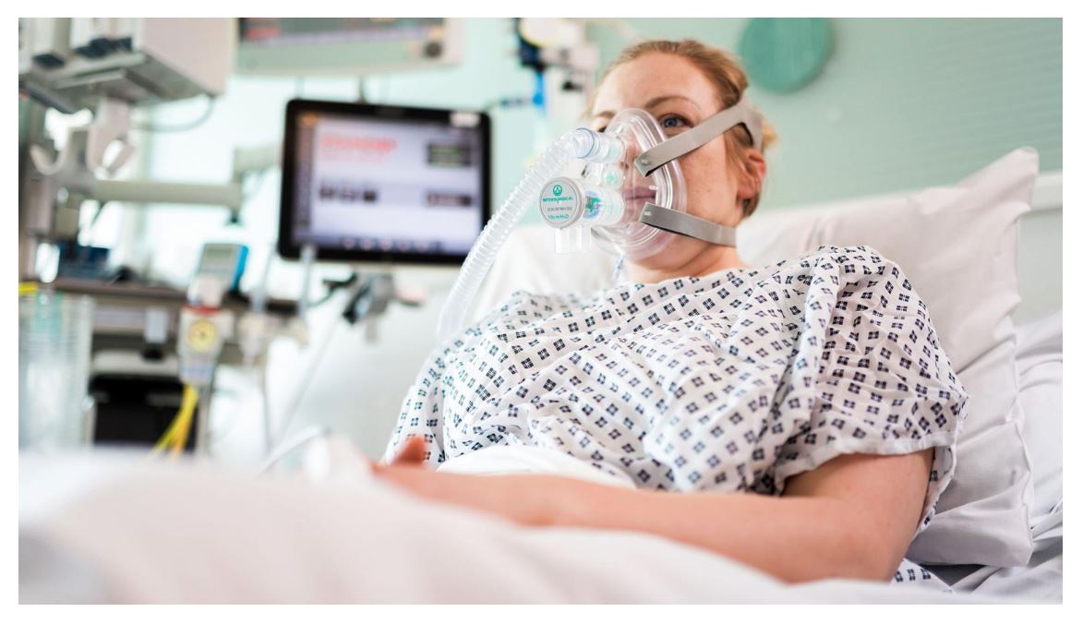
Ventilator In Use In A Hospital

Slide 10
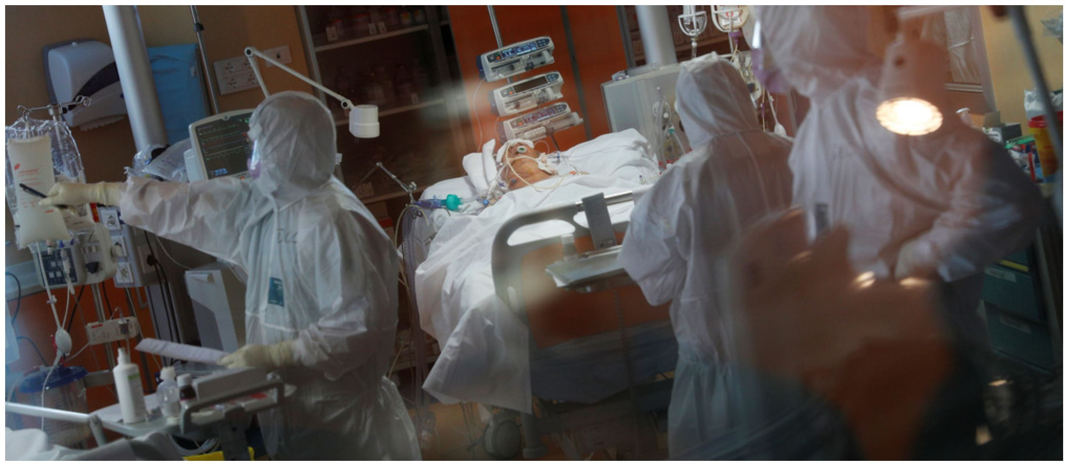
CHALLENGES

Slide 11
1. The current stockpile of PPE is insufficient, particularly for medical masks and respirators; the supply of gowns and goggles is soon expected to be insufficient also. Surging global demand − driven not only by the number of COVID-19 cases but also by misinformation, panic buying, and stockpiling − will result in further shortages of PPE globally. The capacity to expand PPE production is limited, and the current demand for respirators and masks cannot be met, especially if widespread inappropriate use of PPE continues.

Slide 12
2. Surgical site infections: Surgical site infections are also frequent: the incidence varies from 0.5 to 15% depending on the type of operation and underlying patient status. The main risk factor is the extent of contamination during the procedure (clean, clean contaminated, contaminated, dirty), which is to a large part dependent on the site of surgery, length of the operation, and the patient’s general condition.

Slide 13
3. Infection may occur at the skin entry site of the intravascular device, or in the subcutaneous path of the catheter (tunnel infection).It is considerably dependent on how lines are handled and duration of lines. Even peripheral lines are a potential source of line related infections.

Slide 14
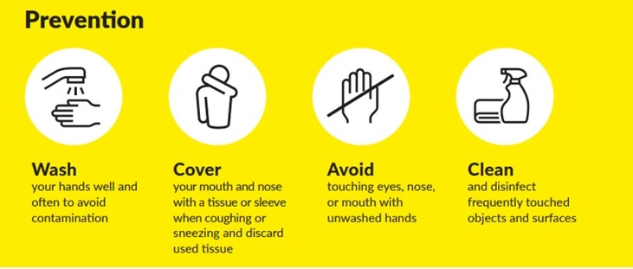
RECOMMENDATIONS

Slide 15
Administrative controls include ensuring resources for infection prevention and control (IPC) measures, such as appropriate infrastructure, the development of clear IPC policies, facilitated access to laboratory testing, appropriate triage and placement of patients, adequate staff-to-patient ratios, and training of staff.
Environmental and engineering controls aim at reducing the spread of pathogens and the contamination of surfaces and inanimate objects. They include providing adequate space to allow social distance of at least 1 m to be maintained between patients and between patients and health care workers and ensuring the availability of well-ventilated isolation rooms for patients with suspected or confirmed COVID-19.

Slide 16
3. Wearing a medical mask if you have respiratory symptoms and performing hand hygiene after disposing of the mask;
4. maintaining social distance (a minimum of 1 metre) from persons with respiratory symptoms.
5.using PPE appropriately; this involves selecting proper PPE and being trained in how to put on, remove, and dispose of it.

Slide 17
CONCLUSION
The development of environmental health engineering facilities, equipment, sensors and public health systems such as ventilators for tackling the coronavirus pandemic will help to quickly eradicate the spread of the virus.

