Slide 1
ENGINEERING STRATEGIES FOR HANDLING COVID 19 FOR ENVIRONMENTAL HEALTH AND ECONOMIC SUSTAINABILITY

Slide 2
INTRODUCTION
My name is Yahya fawaz olawole
I am studying Electrical Electronic Engineering
With the matric no 17/eng04/075
My lecturer is Engr Oyebode

Slide 3
TABLE OF CONTENT
INTRODUCTION
COVID 19
STRATEGIES TO HANLDLE COVID 19
RESULT ANALYSIS
CONCLUSION
RECOMMENDATION

Slide 4
COVID 19
Coronavirus disease 2019 (COVID-19) is an infectious disease caused by severe acute respiratory syndrome coronavirus 2 (SARS-CoV-2).
).The disease was first identified in December 2019 in Wuhan, the capital of China's Hubei province, and has since spread globally, resulting in the ongoing 2019-2020 pandemic. As of 6 April 2020
The virus is mainly spread during close contact and by small droplets produced when those infected cough, sneeze or talk
People may also become infected by touching a contaminated surface and then their face

Slide 5
TRANSMISSION
The virus can survive on surfaces for up to 72 hours It is most contagious during the first three days after onset of symptom
. The time from exposure to onset of symptoms is typically around five days, but may range from two to 14 days.
The WHO and CDC say it is primarily spread during close contact and by small droplets produced when people cough, sneeze or talk
The WHO and CDC say it is primarily spread during close contact and by small droplets produced when people cough, sneeze or talk

Slide 6
PREVENTIVE MEASURES
The CDC recommends covering the mouth and nose with a tissue when coughing or sneezing and recommends using the inside of the elbow if no tissue is available

Slide 7
ELECTRICAL ELECTRONICS STRATEGIES
More accurate diagnosis and treatment
CONSTANT SUPPLY OF STABLE ELCTRICITY
EFFECTIVE COMMUNICATION
DATA ANALYSIS

Slide 8
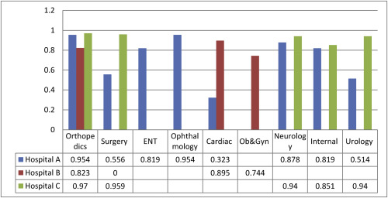

Slide 9
RESULT ANALYSIS
Taking a look at the progression of activities and the increasing daily awareness of the society to the covid 19 disease, it could be said that at the targeted year 2021 environmental health should have been achieved, if not whole, at least to a reasonable degree.
As we can see, efforts are being made towards this as we draw closer to the target day by day electrical electronics engineers alongside others directly or indirectly.

Slide 10
CONCLUSION
In conclusion to defeat covid 19 we have to follow the health measures i.e social distancing, wearing of gloves and mask… along with the engineering strategies of the engineers.

Slide 11
RECOMENDATION
Higher institutes of learning should consequently develop new perspectives in teaching electrical electronics engineers the required knowledge aligned with health care service in achieving sustainable development in whatever environment the students is position in future and must be contingent upon the ability to adapt to threats to sustainability and engaged oneself within the progression of the world. A debateable and project familiarize with teaching and a good learning foundation or core should be marked in outline, which present the prospective essentials and important proficiency for inexperienced and blooming engineers.

Slide 12
APPRECIATION
SPECIAL THANKS TO ENGR OYEBODE

