Slide 1
GEY202 ASSIGNMENT
BEKEFULA EBIFIE
18/SCI14/005

Slide 2
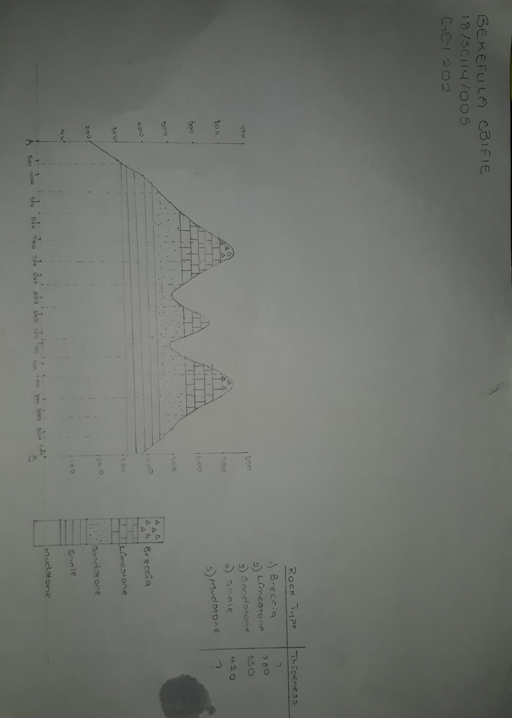

Slide 3
