Slide 1
ENGINEERING LAW AND MANAGERIAL ECONOMICS FOR INFRASTRUCTURAL DEVELOPMENT IN NIGERIA: CHALLENGES AND WAY FORWARD
BY USORO ANDIDIONG INEMESIT
17/ENG05/041
MECHATRONICS ENGINEERING

Slide 3
INTRODUCTION
Engineering law (or law in engineering) is the empirical study of the application of laws and legal strategy in engineering. Law can be defined as those rules and regulations, backed by sanctions when flouted, which guide the conduct and behaviour of members of a community or society, and which they accept and consider as binding.

Slide 4
The knowledge of engineering law is important to every engineer as we are involved in construction, contracts, consultancy services on capital projects, design, analysis, fabrications, adjudication of tender, bill of engineering measurements and evaluation. It does not mean that the legal profession plays a part in every contract; the majority of contracts are executed with both parties satisfied with their involvement and these never come to the court.

Slide 5
Managerial economics is the science of directing scarce resources to manage cost effectively.
Nearly every organization in our society—whether it is a business, non-profit entity, orgovernmental unit—can be viewed as providing a set of goods, services, or both. The responsibility for overseeing and making decisions for these organizations is the role of executives and managers. In today’s competitive world of business it has become essential that engineers should practice financial project analysis for engineering projects and make rational decisions.

Slide 6
LITERATURE REVIEW
Critical to Nigeria’s economic development is the engineering sector, which has long stood as a major driver of growth and an essential solution in addressing the country’s infrastructural deficiencies. The aim for Nigerian policymakers, as is the case with many other emerging markets, is to capitalise on the opportunities that have come as a result of rapid economic growth and focus first on improving the building blocks on which long-term prosperity depends.

Slide 7
Our laws embody the basic moral values of our society. They impose limits on the conduct of individuals in order to promote the greater good and to make our communities safe places to live. It is against the law to steal, to be involved in drug abuse, to injure another person, to drive recklessly or to pollute the environment, to name just a few of the countless ways the law is designed to protect us. We are said to be ruled by law, not by those who enforce the law or wield government power. No one in the country is above the law. Everyone, no matter how wealthy or how powerful they are, must obey the law or face the consequences.

Slide 8
Managerial economics has been generally defined as the study of economic theories, logic and tools of economic analysis, used in the process of business decision making. It involves the understanding and use of economic theories and techniques of economic analysis in analyzing and solving business problems.
It is a general knowledge that there exists a gap between theory and practice in the world of economic thinking and behaviour. By implication, a theory which appears logically sound might not be directly applicable in practice.

Slide 9
The purpose of managerial economics is to provide a systematic framework for problem analysis and solution. The pluses and minuses of various decision alternatives must be carefully measured and weighed. Costs and benefits must be reliably measured; time differences must be accurately reflected. The collection and characterization of relevant information is the most important step of this process. After all relevant information has been gathered, managers must accurately state the goal or goals that they seek to achieve. Without a clear understanding of managerial objectives, effective decision making is impossible.

Slide 10
The discovery of managerial economics as a separate course in management studies has been attributed to three major factors:
1. The growing complexity of business decision-making processes, because of changing market conditions and the globalization of business transactions.
2. The increasing use of economic logic, concepts, theories, and tools of economic
analysis in business decision-making processes.
3. Rapid increase in demand for professionally trained managerial manpower.

Slide 11
CHALLENGES
1. Corruption: most engineering projects in the country is carried out using the fifty percent (50%)
rule, thereby eating the capital and not the profit. That is, contractors giving even more than fifty
percent of the total cost of a project to some corrupt government officials and politicians before
actually embarking on a project and in most cases, since the remaining part of the money will not
be enough to do the job, the project may not be carried out and if it is carried out at all, it is usually
sub-standard or abandoned.

Slide 12
2. Engineers being all in all: In most government and private establishments in Nigeria, engineering personnel are assuming to know all. A civil engineer can be employed to do the work of an electrical engineer, chemical engineer, Mechanical Engineer etc.t the same time. instead of seeking the services of engineering professionals in these other areas of engineering.

Slide 13
5. Existing engineering facilities and infrastructures not being upgraded: most engineering
establishment ever since they were commissioned have not been upgraded, thereby not able to
meet up with the present-day demand.
6. Non-adherence to workshop sections in conferences: most engineering conferences do not adhere
to workshop sections, usually after technical paper presentation, then, it is all over.

Slide 14
RECOMMENDATION
1. Different engineering personnel in various fields should be employed in all engineering departments in both government and private establishments, so that specific jobs can be given to an engineer in his/her chosen area of specialization. That is, there should be division of labor.
2. The pay package of engineers in Nigeria should be commensurate with their counterparts in Europe and America, so that they will not be tempted to eat the capital of any project.

Slide 15
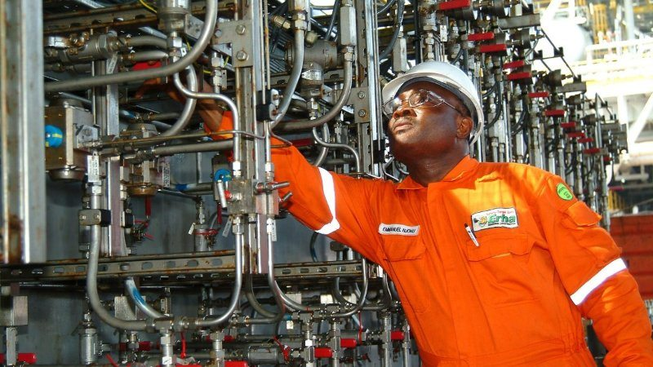
Engineer working in a plant.

Slide 16
3. Just as the office of the Attorney General is occupied by a lawyer, the offices of the ministers and commissioners of Energy, Works and Housing, Environment and Transport should be specially for engineers.
4. Existing engineering facilities and infrastructures should be upgraded with the present-day state of the art facilities in order to meet up with the present-day demand.

Slide 17
CONCLUSION
Engineering is a double-edged sword. It is both the cause of many environmental, social, economic and political problems faced by man and also a key to solving them. It is now recognized that engineers need considerable support in their attempts in various walk of life to promote sustainable development

Slide 18
There is no doubt that a lot has been achieved by the Nigerian engineers in this respect, but our unsatisfactory performance so far is a principal challenge for us to preserve the conditions for life and welfare of mankind, today and in the future. Even though our submissions here may not be all inclusive, it is our candid opinion that if the opinion given above are adhered to, and the engineer upholds the values of truth, honesty and trust-worthiness, human life will be safeguarded.

