Slide 1
ENGINEERING STRATEGIES FOR HANDLING COVID-19 FOR ENVIRONMENTAL HEALTH AND ECONOMIC SUSTAINABILITY IN NIGERIA
BY
AREMU FAWAZ BABAJIDE
17/ENG05/008
MECHATRONICS ENGINEERING

Slide 2
Table of contents
Title page
Table of contents
Introduction
the symptoms of coronavirus
Causes of COVID-19
The Risk Factor of COVID-19
Preventive measures for COVID-19 disease for environmental health and economic sustainability
The effect of covid-19 on nigeria’s economic stability
Recommendations on how to stabilize the economy
Conclusion
References

Slide 3
Introduction
Coronavirus disease (COVID-19) is an infectious disease caused by a newly discovered coronavirus.
Most people infected with the COVID-19 virus will experience mild to moderate respiratory illness and recover without requiring special treatment. Older people, and those with underlying medical problems like cardiovascular disease, diabetes, chronic respiratory disease, and cancer are more likely to develop serious illness.
The best way to prevent and slow down transmission is be well informed about the COVID-19 virus, the disease it causes and how it spreads. Protect yourself and others from infection by washing your hands or using an alcohol based rub frequently and not touching your face.

Slide 4
Symptoms
Signs and symptoms of COVID-19 may appear two to 14 days after exposure and can include:
Fever
Cough
Shortness of breath or difficulty breathing
Other symptoms can include:
Tiredness
Aches
Runny nose
Sore throat
Some people have experienced the loss of smell or taste.
The severity of COVID-19 symptoms can range from very mild to severe. Some people may have no symptoms at all. People who are older or who have existing chronic medical conditions, such as heart disease, lung disease or diabetes, or who have compromised immune systems may be at higher risk of serious illness. This is similar to what is seen with other respiratory illnesses, such as influenza.
provide updated information as soon as clinical findings become available

Slide 6
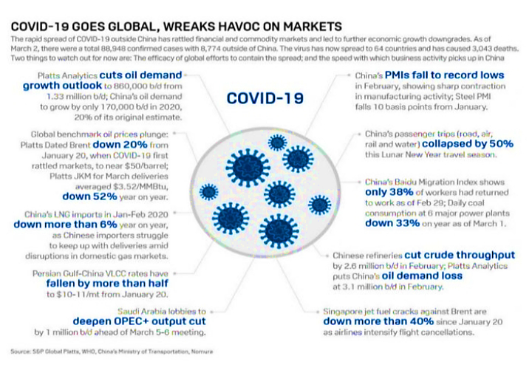

Slide 7
Causes
Infection with the new coronavirus (severe acute respiratory syndrome coronavirus 2, or SARS-CoV-2) causes coronavirus disease 2019 (COVID-19).
It's unclear exactly how contagious the new coronavirus is. Data has shown that it spreads from person to person among those in close contact (within about 6 feet, or 2 meters). The virus spreads by respiratory droplets released when someone with the virus coughs, sneezes or talks.
It can also spread if a person touches a surface with the virus on it and then touches his or her mouth, nose or eyes.
Risk factors
Risk factors for COVID-19 appear to include:
Recent travel from or residence in an area with ongoing community spread of COVID-19 as determined by CDC or WHO
Close contact with someone who has COVID-19 — such as when a family member or health care worker takes care of an infected person

Slide 8
Preventive measures for COVID-19 disease for environmental health and economic sustainability
Based on the available evidence, the COVID-19 virus is transmitted between people through close contact and droplets, not by airborne transmission. The people most at risk of infection are those who are in close contact with a COVID-19 patient or who care for COVID-19 patients.
Preventive and mitigation measures are key in both healthcare and community settings. The most effective preventive measures in the community include:
performing hand hygiene frequently with an alcohol-based hand rub if your hands are not visibly dirty or with soap and water if hands are dirty;
avoiding touching your eyes, nose and mouth;
practicing respiratory hygiene by coughing or sneezing into a bent elbow or tissue and then immediately disposing of the tissue;
wearing a medical mask if you have respiratory symptoms and performing hand hygiene after disposing of the mask;
maintaining social distance (a minimum of 1 m) from individuals with respiratory symptoms.

Slide 9
THE EFFECT OF COVID-19 ON NIGERIA’S ECONOMIC STABILITY
The Coronavirus (COVID-19) has resulted in mass production shutdowns and supply chain disruptions due to port closures in China, causing global ripple effects across all economic sectors in a rare “twin supply-demand shock”. With South Africa having just reported its first cases of COVID-19, Africa is beginning to feel its full impact and plans to control and manage the humanitarian challenges of the virus are underway across the continent. Economically, the effects have already been felt – demand for Africa’s raw materials and commodities in China has declined and Africa’s access to industrial components and manufactured goods from the region has been hampered. This is causing further uncertainty in a continent already grappling with widespread geopolitical and economic instability.

Slide 10
RECOMMENDATIONS ON HOW TO STABILIZE THE ECONOMY
1. Perhaps most importantly, there is a need to address the biggest elephant in the room: Nigeria’s reliance on the sale of crude oil as the major source of the nation’s foreign exchange earnings. There is a need to diversify the nation’s economy away from a reliance on crude oil.
2. Adequately support the healthcare system: Prior to COVID-19, healthcare institutions were already overburdened with many ailments given poor medical supplies, shortage of medical workers and poor infrastructure.

Slide 11
3. Provide incentives and safety nets to the most affected: Through targeted tax incentives, social transfers, and regulatory support, the Nigerian government could help minimize the impact of COVID-19 on the most vulnerable businesses and citizens.

Slide 12
CONCLUSION
A big problem in developing and implementing sustainable economic policies is poor awareness. It is difficult to drive a concept that is not well understood bythe citizens and government workers of the country. This probably explains why sustainable development is not a core element in the mission statement of most governmental organizations surveyed. Another factor militating against the development and implementation of economic stability is poor support from the government in driving the sustainability agenda.

Slide 13
This is evident in the absence of relevant laws and regulations to drive sustainability especially in the construction sector. Inadequate support for sustainable construction by leaders of construction organizations also militates against the development and implementation of sustainable construction. This could be because the concept is not well understood. The major perceived benefit of sustainable construction is that sustainable construction improves organizations’ environmental sustainability. Respondents view sustainability more in terms of environmentally sustainability.

Slide 14
References
https://www.who.int/health-topics/coronavirus?fbclid=IwAR3iZ5pr4MHevxFmNBBKwfu4Szh5N8-n_pmao_4iexoFfaeEuj3Aahs64bk
https://openwho.org/courses/COVID-19-IPC-EN
https://www.cdc.gov/coronavirus/2019-ncov/index.html?CDC_AA_refVal=https%3A%2F%2Fwww.cdc.gov%2Fcoronavirus%2Findex.html

