Slide 1
TECHNICAL REPORT
ON
DESIGN OF INNOVATIVE AND AUTOMATED RESPIRATORY BUILDINGS FOR PATIENTS AND HEALTH WORKERS AGAINST CORONAVIRUS DISEASE OUTBREAK
PREPARED BY
ORILADE EMMANUEL OLUWATOMISIN
17/ENG05/037
SUBMITTED TO
THE COLLEGE OF ENGINEERING
AFE BABALOLA UNIVERSITY, ADO-EKITI, EKITI STATE, NIGERIA.
IN PARTIAL FULFILMENT OF REQUIREMENTS FOR THE AWARD OF BACHELOR OF ENGINEERING (B.ENG) DEGREE IN MECHATRONICS ENGINEERING.
APRIL, 2019.

Slide 2
INTRODUCTION
There are a lot of diseases, illnesses and other conditions that can lead to severe respiratory complications. Some of these include; Asthma, Chronic Bronchitis, Emphysema, Drowning, Obstruction in the trachea, Weakness of breathing muscles, Damage to the bones and tissues of the chest, Lung cancer, Pleural Effusion, and the resent global viral outbreak Coronavirus (Covid-19).
As a result of these respiratory complications, patients would have difficulty breathing and as such, they are hooked up to mechanical/electromechanical devices known as ventilators, which are to aid their respiration.
In order to proceed with the design of these respiratory buildings, we need to know how the process of respiration takes place and to do this, we need to firstly understand the concept of respiration.

Slide 3
WHAT IS RESPIRATION AND HOW DOES IT WORK?
When we hear the word 'respire', we probably think of breathing. When you breathe, you are taking in oxygen with each inhale and releasing carbon dioxide with each exhale. This gas exchange is important for respiration, but while breathing is a physical process, respiration can be thought of as more of a chemical process. Respiration refers to the utilization of oxygen and removal of carbon dioxide by the body as a whole, or by individual cells in cellular respiration.
Lack or shortage of oxygen, can result in damage of vital organs including the heart and brain.
In general, respiration entails two basic processes, namely; Inhalation and Exhalation.

Slide 4
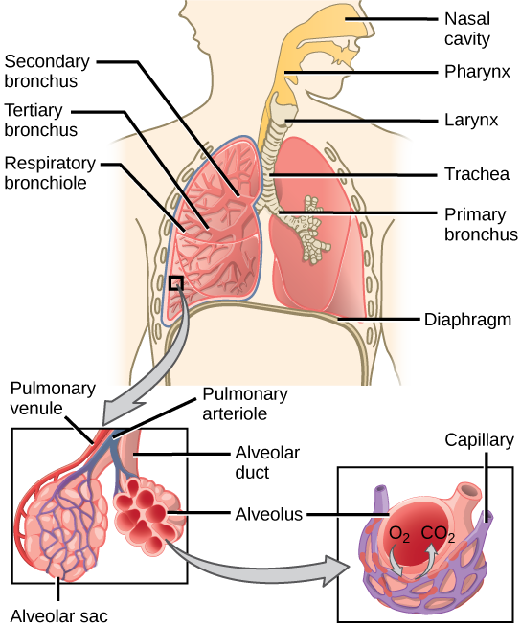
Fig 1.1: Diagram of the human Respiratory System

Slide 5
DESIGN OF THE AUTOMATED RESPIRATORY BUILDINGS
Before, discussing on the designing of the respiratory buildings, we are to understand firstly the purpose of these systems.
The main aim of the respiratory building, is to aid the breathing in people who have illnesses or other conditions, which affect their respiration. These systems must have the ability to pump in oxygen, and remove carbon dioxide, and this process must be done with great precision and everything in the right proportion.

Slide 6
CONSTRUCTION OF THE SYSTEM
Now, let us go into the construction of this system. Let us note that this system is a prototype, and we would be improvising materials, which are not available.
Remote Control and/or Voltage Regulator: The Respiratory system/ventilator will be controlled manually by a remote and a voltage controller switch. This remote will be used to control the rate at which the inhale and exhale valve transport oxygen and remove carbon dioxide from the body. It will also be used to control the displays on the breathing rate monitor. In an event where this remote has any fault, a manual voltage regulator, will be used to perform those functions.

Slide 7
LED indicators: These LED’s will be used to indicate the power state of the system. It will also be used to indicate the present conditions of the patient (either stable or unstable).
Microcontroller: A microcontroller will be required to program the systems sensors and actuators.
An Oscilloscope: This will be connected to the ECG sensors, to monitor the heartrate. It will serve as the breathing rate monitor.

Slide 8
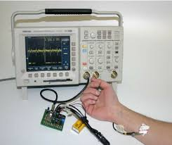
Fig 2.3: An Oscilloscope connected to and ECG sensor

Slide 9
THE CONSTRUCTION
An oxygen tank/cylinder, will be connected to a circuitry, which will be responsible for the regulation of oxygen flow. That circuitry, will be further connected to an inbuilt humidifier in the ventilatory system, which would warm and moisten the air. From here, the warm moist air will be connected to the the inhale valve, for the transportation of O₂ and an exhale valve will be attached for the removal of CO₂. The oscilloscope will then be connected to the ECG sensors on the patients’ body which will monitor the patients’ heart and breathing rate.
For the inhale valve, a fluid hose can used.

Slide 10
What are the new features of this design that makes it special?
Unlike other designs, this new design will be integrated into the structure of the hospital buildings. It will be done in such a way that the ventilators hose will be at several outlets of the Intensive Care Units (ICU’S) walls, and it can be connected to the patient in need. This will eradicate the need for many ventilators because the design will be like a very big ventilator, serving multiple patients.

Slide 11
CONCLUSION
In concluding this report, I will like to discuss possible challenges that might be encountered in the process of carrying out this project.
Some of these possible challenges that might be encountered include;
Lack of funds
Unavailability of resources
Shortage of manpower to carry out this project
Unconducive working environment
Faulty working equipments

Slide 12
Some recommended solutions to help curb these challenges include;
Sponsorship and support from the school and the government
Encouraging students to signup and participate in projects like this
Provision of conducive working environments
Assistance / contribution from staff

Slide 13
In this closing remark, I would love to thank the management and staff of this college for their relentless effort in ensuring that we are the best amongst our peers. I also want to appeal to the college authorities to make group projects like this compulsory for every department at the end of every academic session. It will boost our academic performance in both theory and practical aspects.
It will also equip us with a lot of skills and as such, we would be able to give a lot back to our community, society, the country and the world at large.

Slide 14
THANK YOU!!!

