Slide 1
WORLD CULTURAL/ SPORT FESTIVAL AND HOLIDAYS

Slide 2
CULTURE IN EXPRESSION
Culture is an expression of how people eat, behave and think. Its often reflected in symbols.
SYMBOLS: can be defined as an object that signifies something or stands for something

Slide 3
DEFINITION OF CULTURE
Culture are the customs, traditions, beliefs and values that a group of people share
It includes language, way of life, eat, make, believe and how they dress
ELEMENTS OF CULTURE
Symbols, language, values and norms

Slide 4
CULTURAL DIVERSITY
This is the existence of a variety of cultural or ethnic groups

Slide 5
CIVILISATION AND CULTURE
Civilization is a society that has highly developed technology and culture.
A civilization’s culture impacts people’s morals and values
CULTURE REGION
A cultural region is an area that comes together unified as a result of a common cultural traits or characteristics. E.g Mexico, central America and South America form the cultural trait of Latin America

Slide 6
SOCIAL GROUPS
In social groups, geographers study the rich, middle class and the poor people
They may look at age and gender
They study different ethnic groups or common language, religion, history and physical characteristics

Slide 7
LANGUAGE
It’s a local form of dialect that differs from the main language that people speak
RELIGION
Its helps people answer basic questions about life’s meaning
There are various religious beliefs which has resulted in a lot of conflict and struggles based on religious differences.

Slide 8
DAILY LIFE
Daily life means different things. It could include how we eat, greet, prepare etc.
Types or shapes of houses
Routines being followed

Slide 9
HISTORY
This shapes the world how people see them
Many cultures celebrate holidays that honor their heroes and heroines due to the history that has been learnt
A culture is remembered by how it recognizes it successes as well as its disasters and threats, it has faced over the years

Slide 10
ARTS
Culture can be expressed through art e.g. painting, sculpturing, architecture, dance and music
GOVERNMENT
Democracy is government for the people, herein, the government lies with the people of the nation
Types of government can reflect a country’s culture
Some government are led by individuals
In dictatorship, dictators control and rule as they wish

Slide 11
Government
In a monarchy, kings and queens inherit the power to rule e.g the queen of England
THE ECONOMY
This system determines what goods and services to exchange and set rules to be followed

Slide 12
UNUSUAL HOLIDAYS

Slide 13
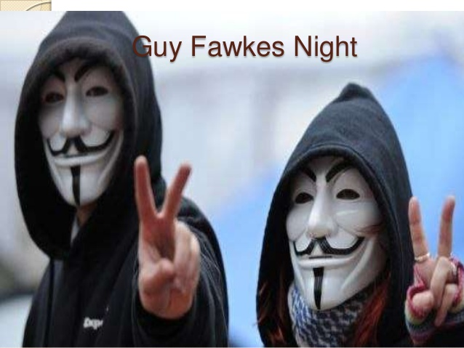
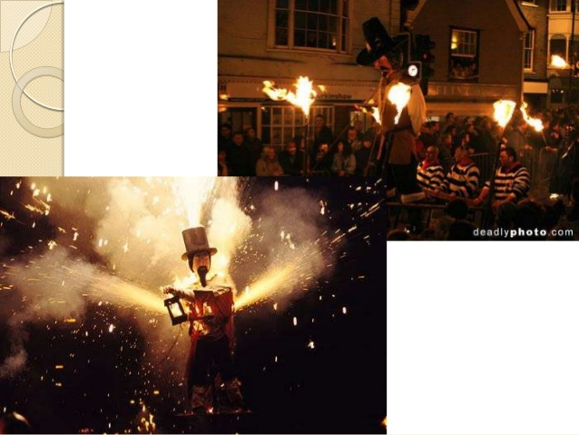
UNUSUAL HOLIDAY AND TRADITIONS

Slide 14
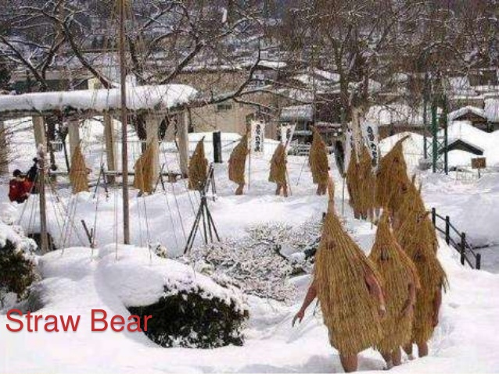
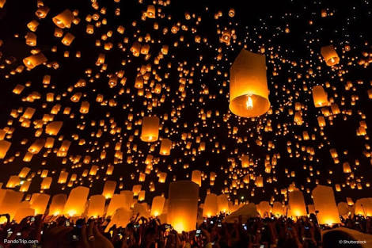
UNUSUAL HOLIDAYS AND TRADITIONS

Slide 15
TURKEY
The republic of Turkey is an Eurasian country that stretches across the Anatolian Peninsula in western Asia and Thrace in the Balkan region of south Eastern Region
LANGUAGE: Turkish
RELIGION: Muslim, Sunni, Alevi and Christians
DANCES: Horon and Kasik Oyunu, Whirling Dervishes Sufi
ART: Hacivat and Karagoz

Slide 16
NEW ZEALAND
LOCATION: oceania island in the south pacific of Australia
CAPITAL: wellington
NATURAL RESOURCES: Natural gas, iron ore, coal, gas, timber.
AGRICULTURE: wheat, Barley, potatoes, fruits e.t.c
RITUALS: Powhiri, Maori culture
GREETINGS: Hongi
ART: Ta Moko

Slide 17
INDIA
RELIGION: Hinduism, Buddhism, Jainism, Sikkhism
LANGUAGE: Hindu, English
PERFORMING ARTS: Bhangra of Punjab, Bihu of Assam, Chau of Jarkhand, odisi of Orissa
DRESSING: Sari for women, Lungi for men

Slide 18
GLOBAL CULTURE
CHINA:
OFFICIAL NAME: People’s Republic of China
CAPITAL: BEIJING
BIGGET CITY: SHANGHAI
RELIGION: Taiost, Buddhist, Christian and Muslim
HOLIDAYS: Chinese New Year
FOOD: Steamed Dumplings
DANCE: Lively Dragon and Lion Dance

Slide 19
ISTANBUL PALACE

Slide 20
AUSTRALIA
LANGUAGE: Australian English
ARTS: Film, music, painting, theatre, dance and crafts
DRESSING: no official designated dressing but there is bush wear and surf wear
SPORT: Cricket, Football and Rugby League
ATTRACTIONS: Uluru, Barossa Valley, Flinders Rangers, Freycinet Peninsula, Kakadu National Park, Snowy mountains

