Slide 1
DESIGN OF INNOVATIVE AND AUTOMATED RESPIRATORY BUILDINGS FOR PATIENTS AND HEALTH WORKERS AGAINST CORONAVIRUS DISEASE OUTBREAK
BY
UWAZIE PRECIOUS NKEMAKOLAM
17/ENG01/032

Slide 2
INTRODUCTION
With the rapid spread of severe acute respiratory syndrome coronavirus 2 (SARS-CoV-2) that results in coronavirus disease 2019 (COVID-19), corporate entities, federal, state, county and city governments, universities, school districts, places of worship, prisons, health care facilities, assisted living organizations, daycares, homeowners, and other building owners and occupants have an opportunity to reduce the potential for transmission through built environment (BE) mediated pathways

Slide 4
LITERATURE REVIEW
The World Health Organisation’s research paper ‘Natural Ventilation for Infection Control in Healthcare Settings’ specifies how important ventilation is in controlling the spread of germs in medical facilities. A proper flow of air through treatment and recovery spaces helps reduce the growth of infectious illnesses while also stimulating the natural recovery process.
This makes structural principles that incorporate natural airflow in perfect healthcare facility design vital. We took an in-depth look into this building trend, known as ‘breathing architecture’ to determine why this design principle contributes to a more effective medical space.

Slide 5
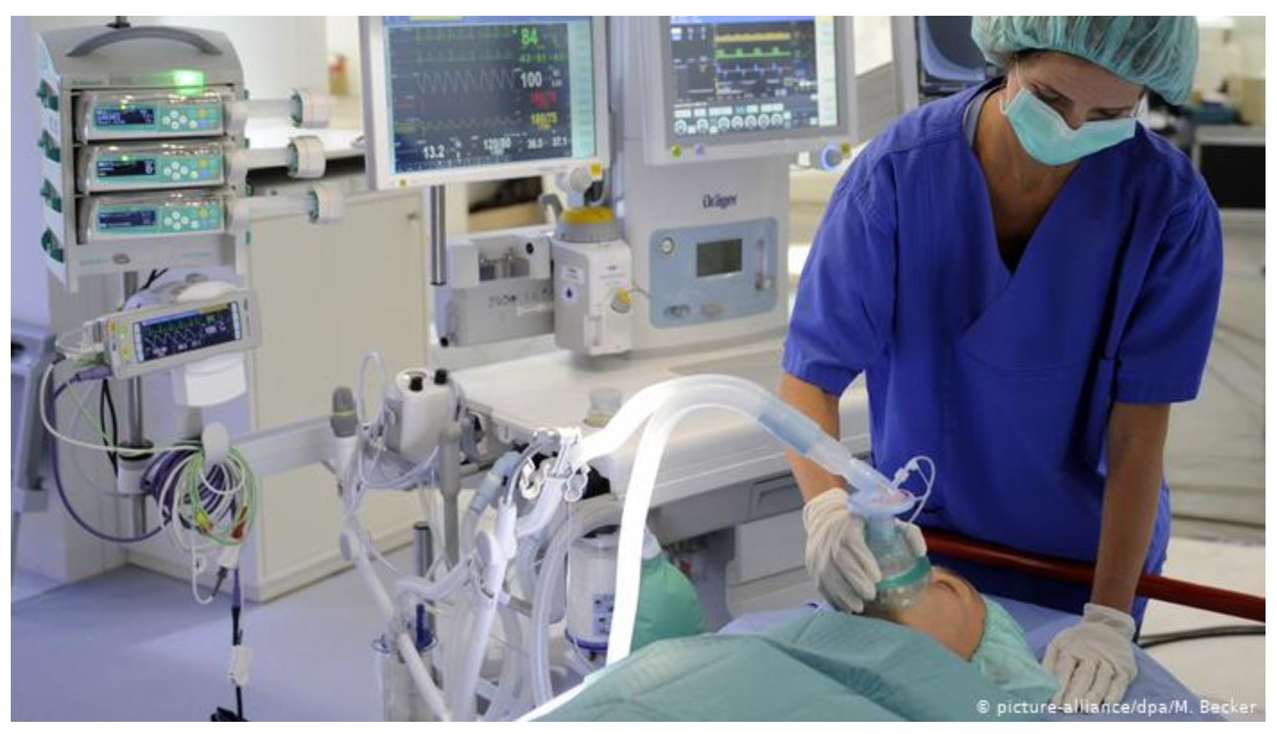

Slide 6
It may seem unusual, but even the most minor architectural elements of your medical facility can contribute to faster patient recovery time, and improved mental and physical well-being. The basic health elements that apply in everyday life are even more applicable in healthcare facilities. We still need ample natural light exposure and regular airflow to minimise the risk of infections spreading. This makes architectural designs that consider these factors an excellent long-term investment.

Slide 7
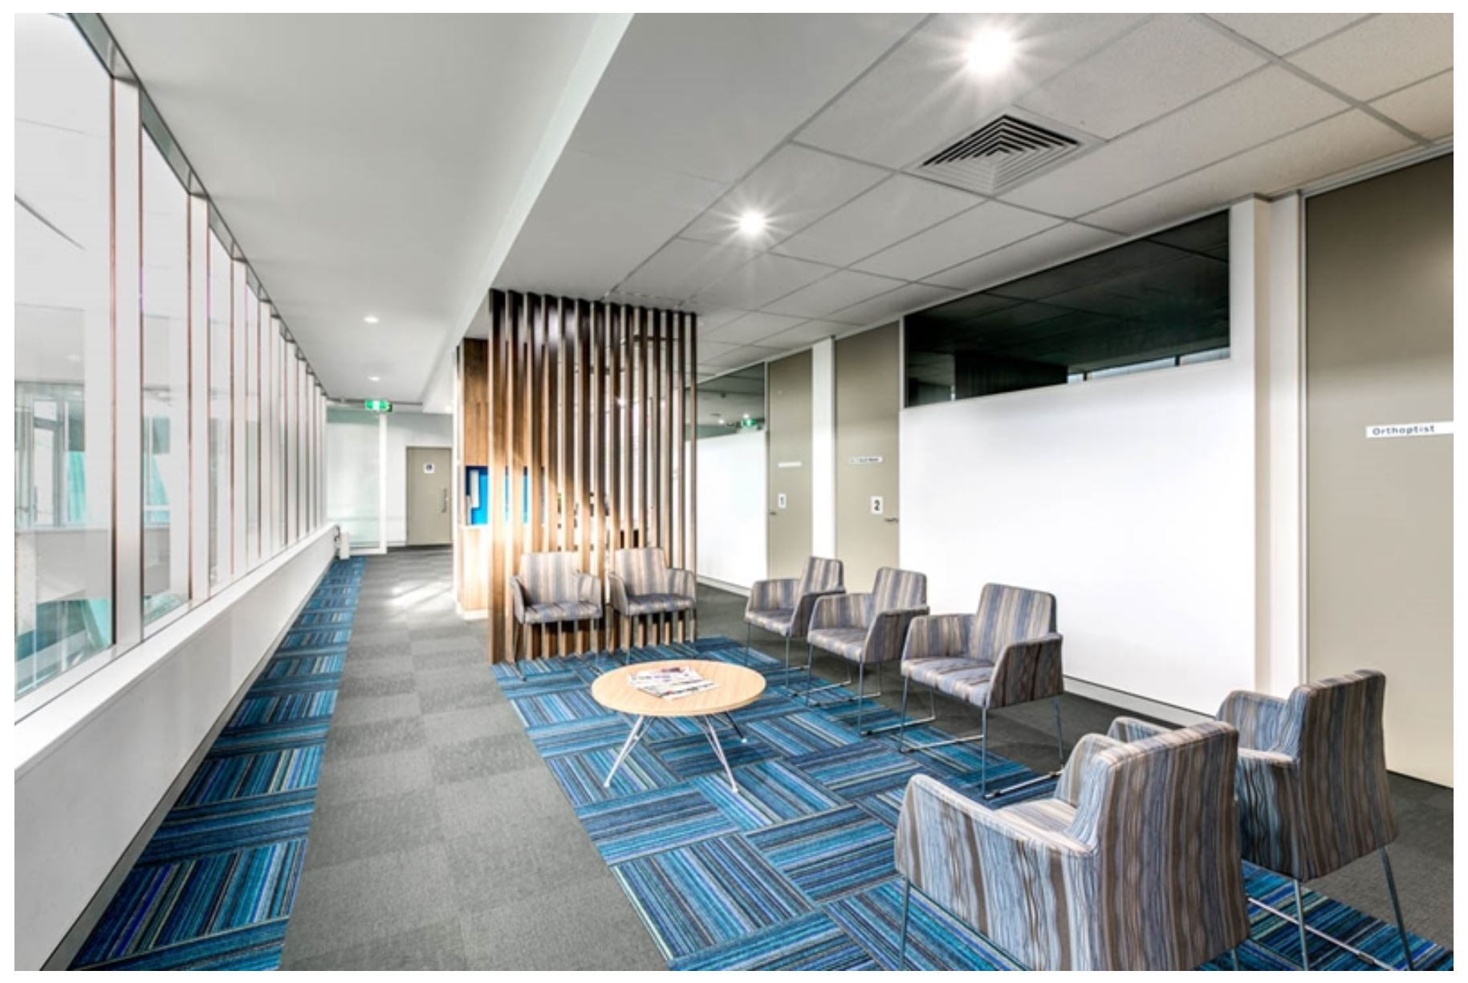
A Well Ventilated respiratory buliding

Slide 8
Natural air flow is vital to improving a patient’s recovery and mental well-being.
What is breathing architecture and why is it a positive influence on patient health?
Breathing architecture is a principle that employs structural and aesthetic strategies to maximise the flow of natural air and improve mechanical ventilation for better indoor air quality. These practices contribute to beautiful buildings with a more ‘open’ feel and improved breathability.

Slide 9
The positive influences of breathing architecture to maximise airflow and ventilation include:
Breathing architecture helps to dilute or remove other air pollutants from high-traffic areas, as well as naturally reduce the risk of infections spreading.
Breathing architecture incidentally also considers natural light as an important design element.

Slide 10
challenges
1. The lack of adequate infrastructure to create automated respiratory buildings for Nigerian patients diagnosed with COVID-119.
2. The lack of funding by both the private sector and the federal government to achieve this goal.
3. Nigeria doesn’t have the industry that can manufacture these equipments therefore the country has to import them leading to continual reliance on foreign countries.

Slide 11
4. Difficulties In Ventilators Supply
As intensive care units overcrowd and doctors must care for more patients, the reliability of the machines cannot be in question. But the only way to make them reliable is extensive testing, and that takes time – up to two years of testing, for commercial manufacturers. This is an extremely long period under the circumstances. Many more ventilators are needed now, not later. And scientists have calculated that the development of a vaccine against Covid-19 could take up to 18 months.

Slide 12
RECOMMENDATIONS
1. Designing spaces with fewer walls, pillars and other hindrances to airflow.
2 Incorporating more windows and access points to the outside in the building plans.
3. Analysing natural windflow tunnels in the early facility design phase and arranging your floor plan to place areas that require high airflow the most around these spaces. For example, locating patient recovery rooms here would be more advantageous than incubators or laboratories that require stable environmental conditions.

Slide 13
4. Respiratory Protective Devices
Respiratory protective equipment is not something that people use very often. But it is a very important measure for protection to a person, particularly during a pandemic outbreak in order to prevent the transmission of infectious diseases. Similar to SARS, COVID-19 is an extremely contagious respiratory disease that has a significant effect on society. Accordingly, COVID-19 has increased the usage of masks and caused a global shortage of supply. However, there are alternatives to masks that could protect people from deadly airborne pathogens that are worth considering.

Slide 14
5. Point of Care Diagnostics
Point of Care Diagnostics becomes ever more important as the numbers of those diagnosed with COVID-19 increase every day. A pandemic outbreak leads to an exponential growth rate for as long as the uninfected and the infected continue to interact and there are still large numbers of uninfected people running the risk of getting infected.

Slide 15
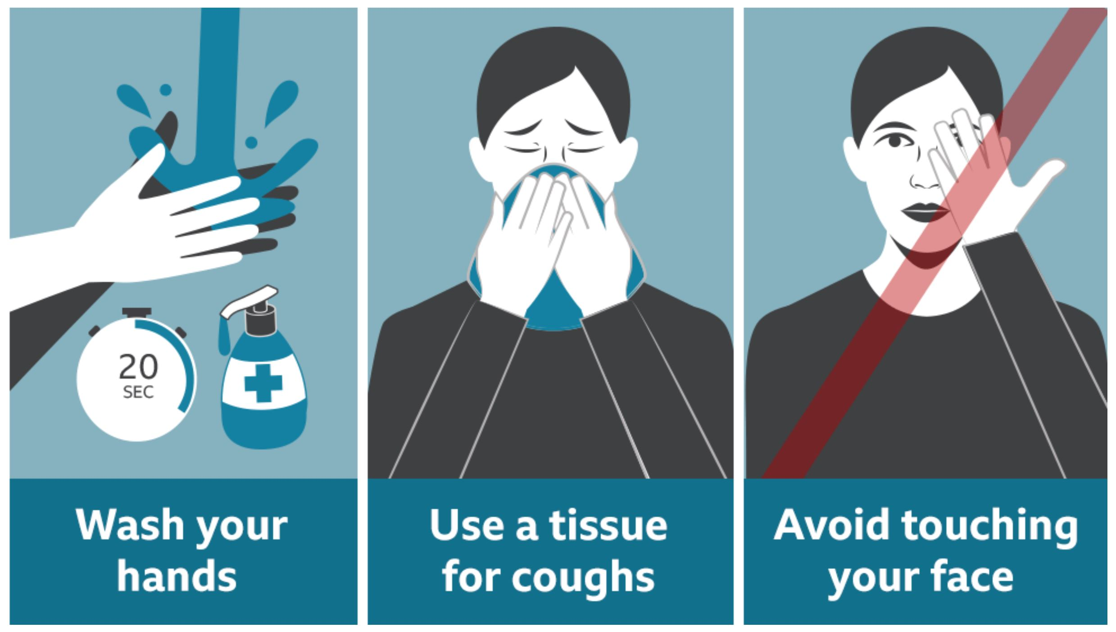
6. Precautions for people in prevention of the virus

Slide 16
CONCLUSION
In conclusion, the design of innovative and automated respiratory buildings for patients and health workers against coronavirus outbreak would be very important in the process of eradicating the virus from our Nigerian society and the world at large.

