Slide 1
ANA 210
BY
SAKA O. S

Slide 2
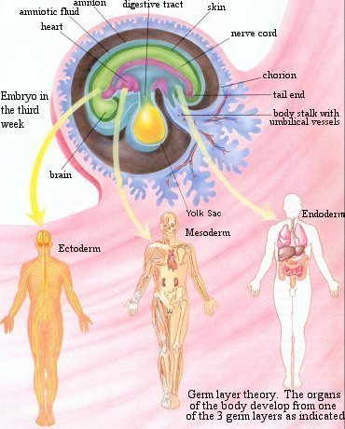
Normal Embryology

Slide 3
The Primitive Gut
The primitive gut forms during the 4th week of gestation when the flat embryonic disc folds in median and horizontal planes to form a tubular structure that incorporates part of the yolk sac into the embryo
Ventral folding of lateral sides forms the midgut
Ventral folding of cranial and caudal ends (head and tail folds) form the foregut and the hindgut

Slide 4
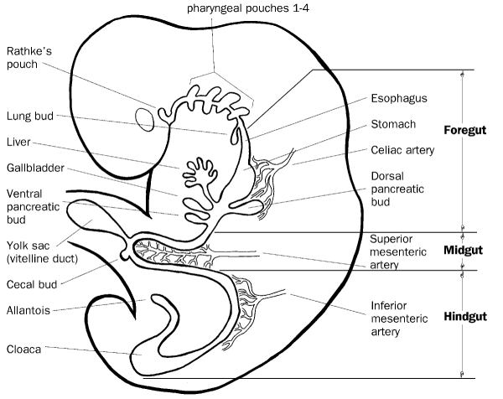
Normal Embryology
Primitive Gut Tube –
Incorporation of the yolk sac during craniocaudal and lateral folding of the embryo.
Foregut
Midgut
Hindgut

Slide 5
The Primitive Gut
The Primitive gut tube develops in weeks 3-4 by incorporating the yolk sac during the craniocaudal and lateral folding of the embryo.
The tube is divided into 3 distinct sections; foregut, midgut and hindgut.
Foregut gives rise to the esophagus, stomach, liver, gallbladder, bile ducts, pancreas and proximal duodenum.
The midgut develops into the distal duodenum, jejunum, ileum, cecum, appendix, ascending colon, and proximal 2/3 of transverse colon.
The hindgut becomes distal 1/3 of the transverse colon, descending colon, sigmoid colon and the upper anal canal.

Slide 6
Canalization
Canalization
Week 5 - Endoderm portion of GI tract proliferates
Week 6 - Occlusion of the lumen
Week 8 - Recanalization due to cell degeneration
Abnormalities in this process
Stenosis/Atresia
Duplications

Slide 7
Foregut
Foregut gives rise to:
Esophagus
Stomach
Liver
Gallbladder and bile ducts
Pancreas
Upper Duodenum

Slide 8
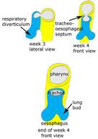
Foregut
Esophagus – The tracheoesophageal septum divides foregut into the esophagus and trachea
Clinical Correlation
Esophageal atresia
Tracheoesophageal fistula

Slide 9
Foregut
Lateral grooves invaginate during week 4 on each side of the proximal foregut and fuse creating the Tracheoesophageal septum.
The septum separates the respiratory and digestive tracts with the ventral portion developing into respiratory system and dorsal into gastrointestinal tract.
The esophageal lumen is re-established during the 10th week.
By week 16 the esophagus is lined with stratified squamous epithelium and swallowing can be appreciated.

Slide 10
Clinical Correlation
Failure of the Tracheoesophageal septum to fully develop results in Tracheoesophageal fistula (TEF) and or esophageal atresia.

Slide 11
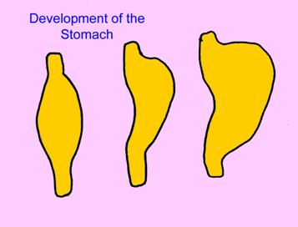
Foregut
Stomach – A fusiform dilation in the foregut occurring during the 4th week. 90 degree clockwise rotation, creates the lesser peritoneal sac.

Slide 12
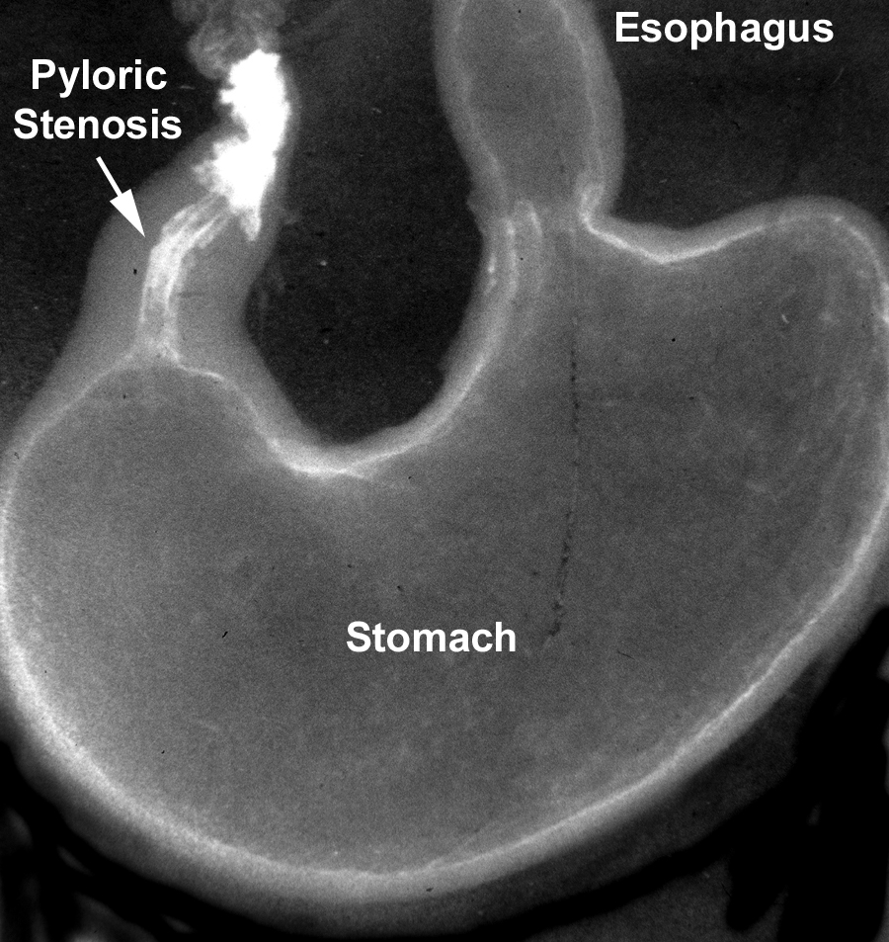

Slide 13
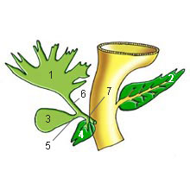
Foregut
Liver – Develops from an endodermal outgrowth at cranioventral portion of the foregut (hepatic diverticulum).
Mesoderm surrounds the diverticulum (septum tansversum).

Slide 14
Foregut
Hepatic cells (hepatoblasts) migrate into the septum tansversum.
The migrating cells are both hematopoietic and endothelial precursors.
The hepatic cells surround the endothelial precursor cells, vitelline veins, to form the hepatic sinusoids.

Slide 15
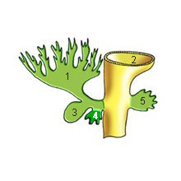
Foregut
Gallbladder and bile ducts –
Cystic diverticulum develops into gallbladder and cystic duct.

Slide 16
Clinical Correlation
-Congenital absence of gall bladder is caused by failed development of cystic diverticulum. It may be associated with congenital heart disease, situs inversus, polysplenia, asplenia, biliary atresia (splenic malformation syndrome).
-Choledochal cyst anomalies result when the cystic duct and the common bile duct do not fuse appropriately.
-Abnormal development of intrahepatic bile ducts due to ductal plate malformations are likely the underlying cause of congenital hepatic fibrosis with cystic kidney disease, ciliopathies - Joubert syndrome, Meckel-Gruber and Ivemark syndrome.

Slide 17
Foregut
Pancreas – Develops from 2 pancreatic buds (weeks 4-5).
Ventral pancreatic bud forms the uncinate process and the head of the pancreas.
The larger dorsal pancreatic bud forms the remaining head, body and tail.

Slide 18
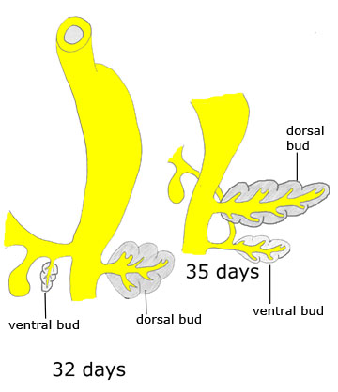
Foregut
Pancreas continued
The ventral pancreatic bud rotates clockwise with the rotation of the duodenum. During 7th week the 2 buds fuse.
Clinical Correlation:
Failure of this rotation
and fusion results in
pancreas divisum.

Slide 19
Midgut
Lower Duodenum – Cranial portion of the midgut.
Jejunum, ileum, cecum, appendix, ascending colon, and proximal 2/3 of transverse colon – Develop as the midgut loop herniates through the primitive umbilical ring during umbilical herniation at week 6.
The loop then rotates 270 degrees counterclockwise around the superior mesenteric artery and returns to the abdominal cavity.

Slide 20
The Midgut Rotation
The midgut forms a U-shaped loop that herniates into the umbilical cord during the 6th weeks of gestation
While in the umbilical cord, the midgut loop rotates 90 degrees
During the 10th week of gestation, the midgut loop returns to the abdomen, rotating an additional 180 degrees

Slide 21
Midgut Anomalies
Clinical correlation –
Duodenal atresia is due to failed canalization.
Omphalocele results from failure of the midgut loop to return to the abdomen.
Meckel’s diverticulum occurs when a remnant of the yolk sac (Vitelline duct) persists.
Malrotation occurs if the midgut does not complete the rotation prior to returning to the abdomen.

Slide 22
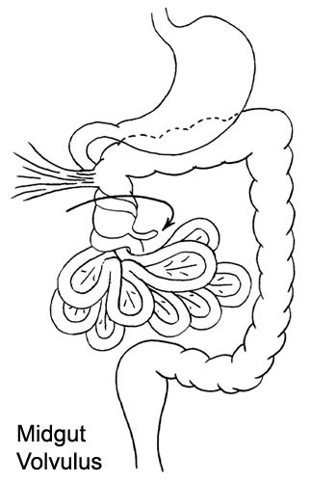
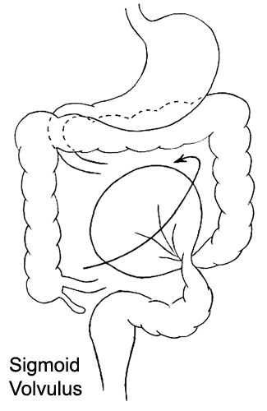
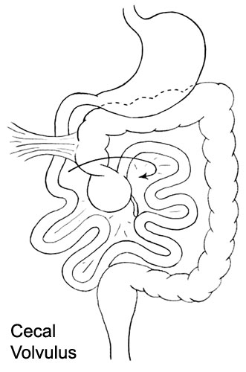
Malrotation

Slide 23
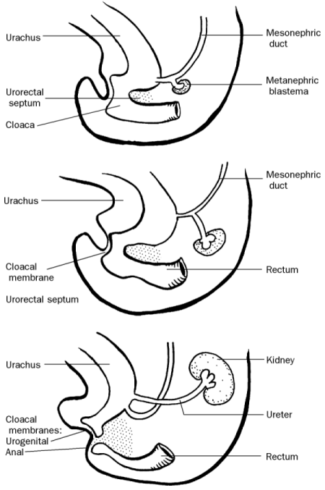
Hindgut
Distal 1/3 of the transverse colon, descending colon and sigmoid colon develop from the cranial end of the hindgut.
Upper anal canal develops from the terminal end of the hindgut with the urorectal septum dividing the upper anal canal and the urogenital sinus.

Slide 24
Hindgut Anomalies
Clinical Correlation
Anorectal agenesis occurs if the urorectal septum does not develop appropriately.
VACTERL Association
Vertebral anomalies, anal defects, cardiac defects, Renal and Limb defects
Hirschsprung disease – failure of the neural crest cells to form the myenteric plexus.

Slide 25
The Development of the Nervous System
20–23 days
Somites appear on either side of the notochord
A neural plate is formed
A crease develops along the length of the neural plate
The edges of the crease are the neural folds
The neural folds “fold” to form a tube (neural tube)
The neural tube becomes the CNS
Axons extending from the neural tube become the PNS

Slide 26
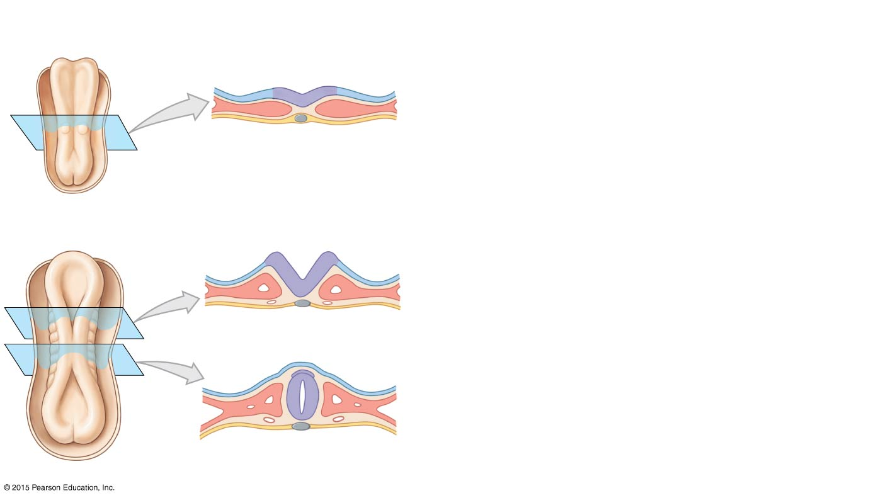
The Development of the Nervous System
Neural plate
Neural plate
After two weeks of development, somites are appearing on either side of the notochord. The ectoderm near the midline thickens, forming an elevated neural plate. The neural plate is largest near the future head of the developing embryo.
Notochord
Somite
20 DAYS
Neural groove
Neural fold
A crease develops along the axis of the neural plate, creating the neural groove. The edges, or neural folds, gradually move together. They first contact one another midway along the axis of the neural plate, near the end of the third week.
Neural tube
Where the neural folds meet, they fuse to form a cylindrical neural tube that loses its connection with the superficial ectoderm. The process of neural tube formation is called neurulation; it is completed in less than a week. The formation of the axial skeleton and that of the musculature around the developing neural tube were described on pages 768–769 and 772.
21 DAYS

Slide 27
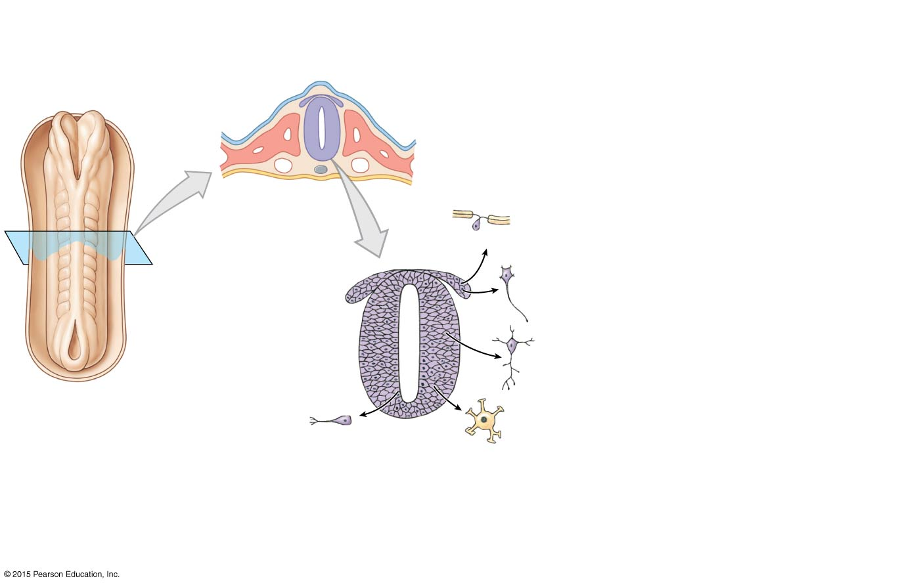
The Development of the Nervous System
Neurocoel
Head
Cells at the tips of the neural folds do not participate in neural tube formation. These cells of the neural crest at first remain between the dorsal surface of the neural tube and the ectoderm, but they later migrate to other locations. The neural tube becomes the CNS. Axons from neurons within the neural tube and the axons of neural crest cells form the PNS.
Neural crest
Schwann cell
Sensory neurons
Autonomic motor neurons
The first cells to appear in the mantle differentiate into neurons, while the last cells to arrive become astrocytes and oligodendrocytes. Further development of the CNS and PNS will be found in the Embryology Summaries later in this chapter.
Somites
Neural crest
Ependymal layer
Mantle layer
CNS neurons
Marginal layer
23 DAYS
Astrocytes and oligodendrocytes
Ependymal cells
The neural tube increases in thickness as its epithelial lining undergoes repeated mitoses. By the middle of the fifth developmental week, there are three distinct layers. The ependymal layer lines the enclosed cavity, or neurocoel. The ependymal cells continue their mitotic activities, and daughter cells create the surrounding mantle layer. Axons from developing neurons form a superficial marginal layer.

Slide 28
The Development of the Spinal Cord
22–28 days
The neural tube is closed thus producing three layers
Ependymal layer
Mantle layer
Marginal layer
Neurons develop in the mantle layer
Axons grow from the mantle layer to the marginal layer
Axons form bundles, or tracts, in the spinal cord

Slide 29
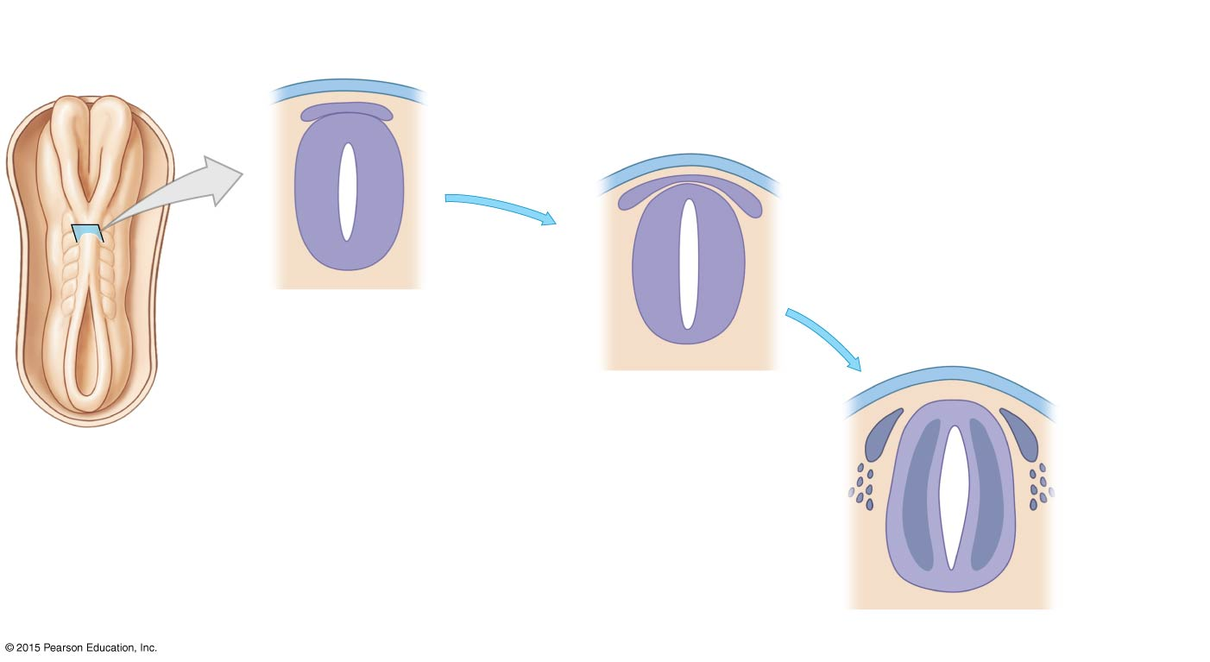
The Development of the Spinal Cord
Ectoderm
Neural crest
Neural tube
Neurocoel
Ependymal layer
Mantle layer
Marginal layer
By the end of the fifth developmental week, the neural tube is almost completely closed. In the spinal cord the mantle layer that contains developing neurons and neuroglial cells will produce the gray matter that surrounds the neurocoel. As neurons develop in the mantle layer, their axons grow toward central or peripheral destinations. The axons leave the mantle layer and travel toward synaptic targets within a peripheral marginal layer.
23 DAYS
Neuroepithelial (ependymal) layer
Eventually, the growing axons will form bundles, or tracts, in the marginal layer, and these tracts will crowd together in the columns that form the white matter of the spinal cord.
22 DAYS
Mantle layer
Marginal layer
28 DAYS

Slide 30
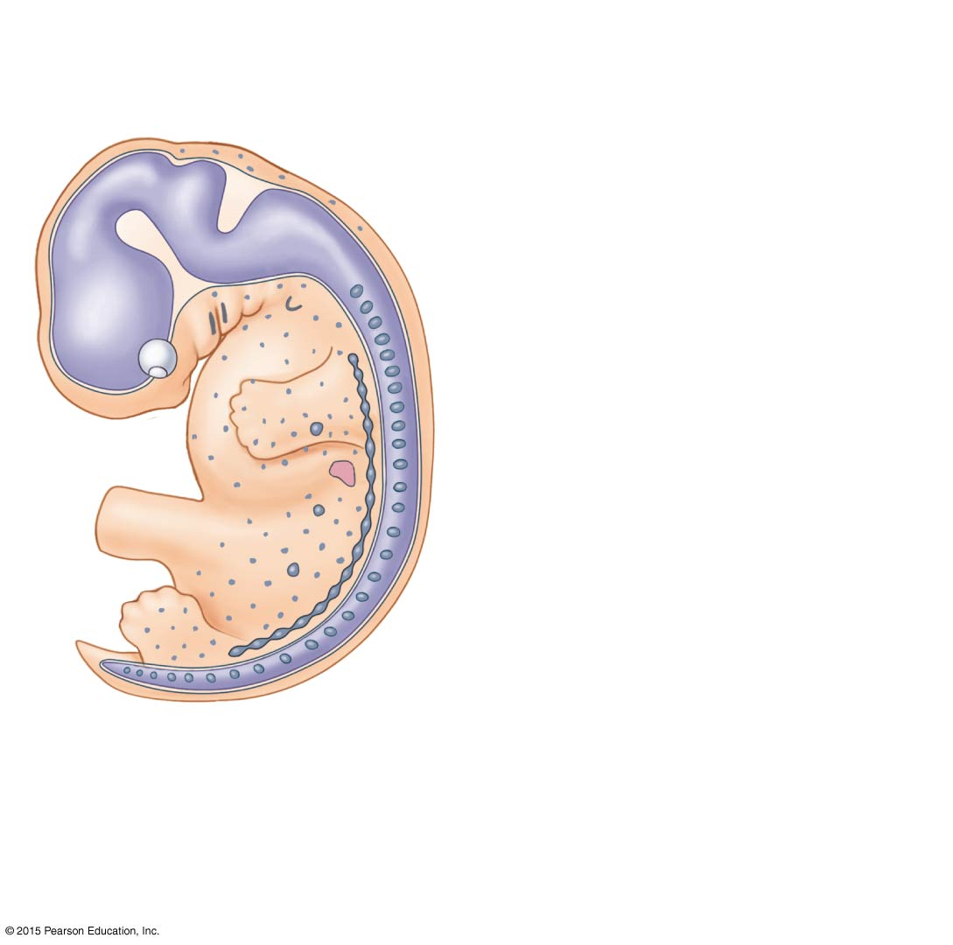
The Development of the Spinal Cord
In addition to forming dorsal root ganglia and associated glial cells, neural crest cells migrate around the central nervous system and develop into the spinal and cranial meninges.
Larynx
Teeth
Dorsal root ganglia
Suprarenal medulla
Meninges
Autonomc ganglia
Melanocytes
7 WEEKS
(Distribution of neural crest cells)
Neural crest cells aggregate to form autonomic ganglia near the vertebral column and in peripheral organs. Migrating neural crest cells contribute to the formation of teeth and form the laryngeal cartilages, melanocytes of the skin, the skull, connective tissues around the eye, the intrinsic muscles of the eye, Schwann cells, satellite cells, and the suprarenal medullae.

