Slide 1
Maths 204
Ajibade Oluwaseyi
18/SCI01/011

Slide 2
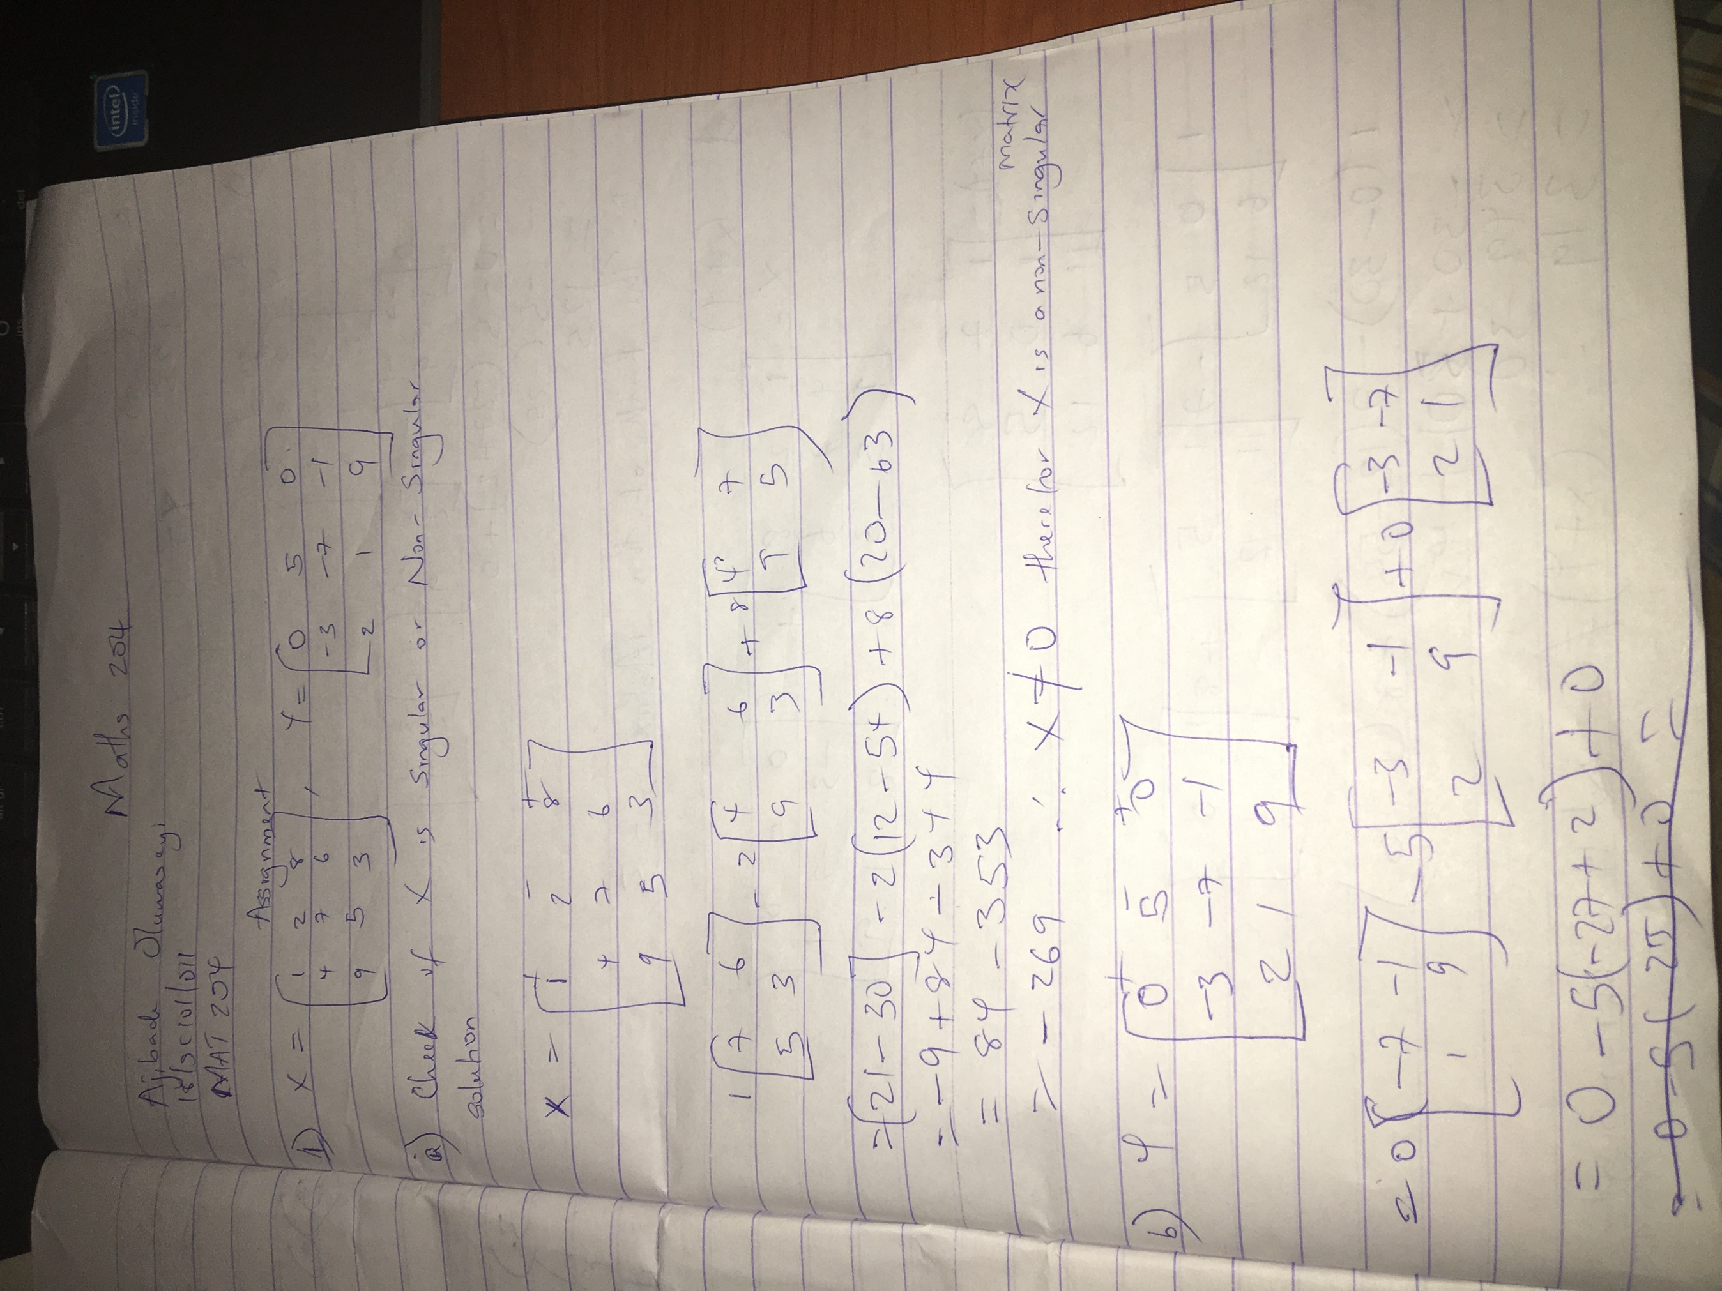

Slide 3
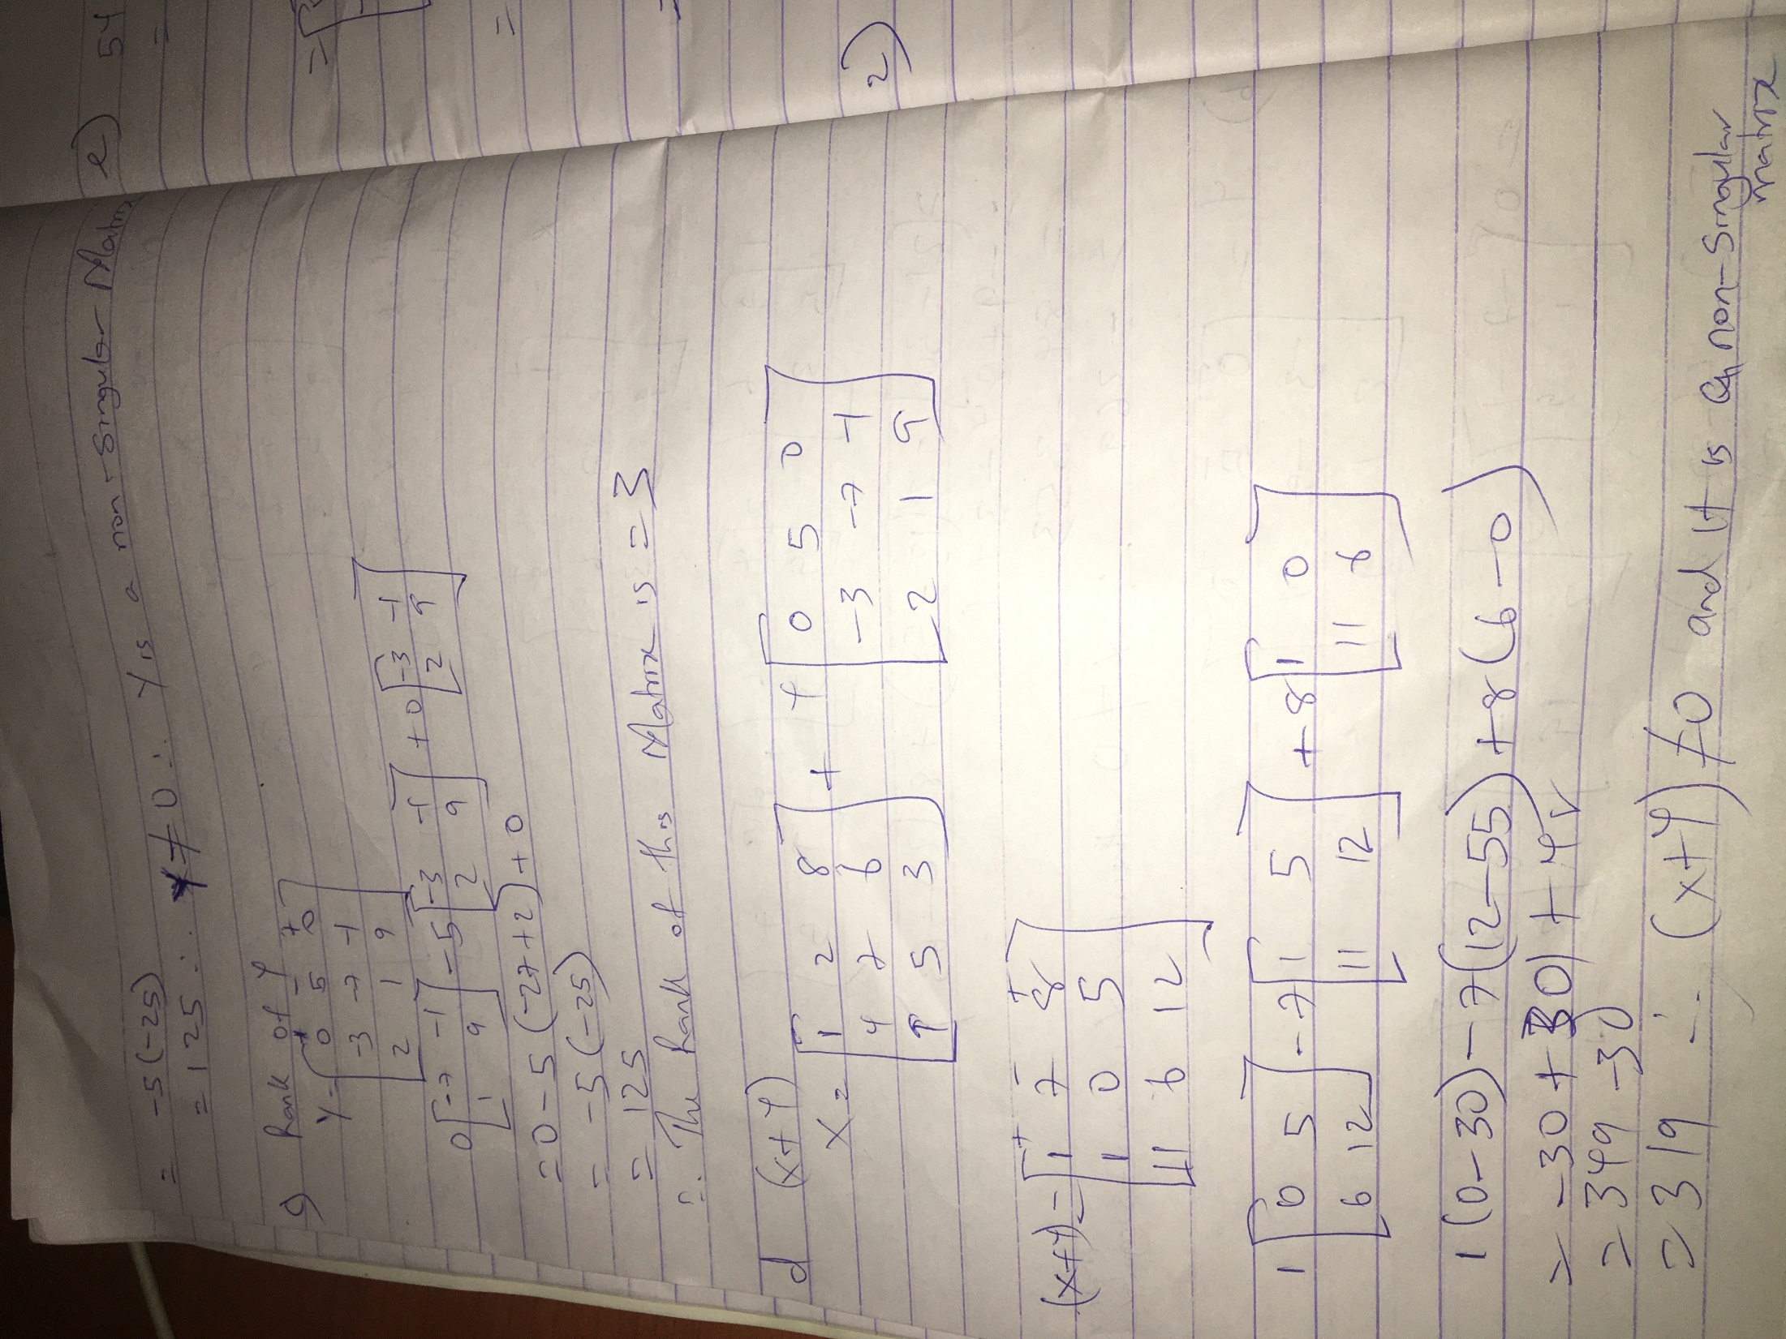

Slide 4
