Slide 1
Presentation on DEVELOPMENT OF AUTOMATED MACHINE AND ELECTRO-MECHANICAL DEVICES FOR PRODUCTION OF INFECTION PREVENTION AND CONTROL (IPC) AND PERSONAL PROTECTIVE EQUIPMENT (PPE) FOR PUBLIC HEALTH AND ECONOMIC GROWTH IN NIGERIA Prepared by NASIR-AMEEN NASIR 17/ENG02/045 COMPUTER ENGINEERING April, 2020

Slide 2
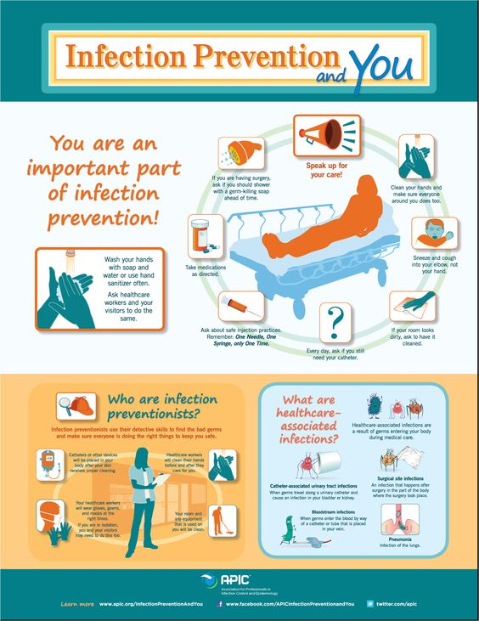
Infection Prevention and Control
Infection prevention and control (IPC) is a scientific approach and practical solution designed to prevent harm caused by infection to patients and health workers. It is grounded in infectious diseases, epidemiology, social science and health system strengthening. IPC occupies a unique position in the field of patient safety and quality universal health coverage since it is relevant to health workers and patients at every single health-care encounter.

Slide 3
COVID-19 PANDEMIC
Coronavirus disease (COVID-19) is an infectious disease caused by a newly discovered coronavirus.
Most people infected with the COVID-19 virus will experience mild to moderate respiratory illness and recover without requiring special treatment. Older people and those with underlying medical problems like cardiovascular disease, diabetes, chronic respiratory disease, and cancer are more likely to develop serious illness.
The best way to prevent and slow down transmission is to be well informed about the COVID-19 virus, the disease it causes and how it spreads. Protect yourself and others from infection by washing your hands or using an alcohol-based rub frequently and not touching your face.

Slide 4
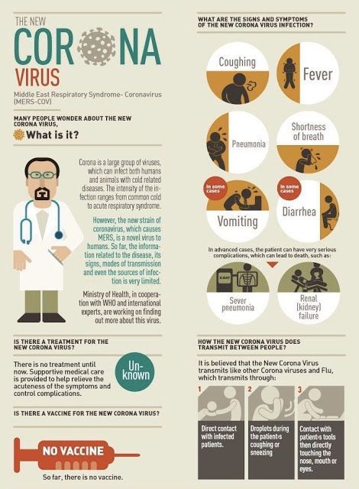
Symptoms of COVID-19
The COVID-19 virus affects different people in different ways
Common symptoms include:
•fever
•tiredness
•dry cough.
Other symptoms include:
•shortness of breath
•aches and pains
•sore throat
•few people will report diarrhoea, nausea or a runny nose.

Slide 5
Prevention
To prevent infection and to slow transmission of COVID-19, do the following:
• Wash your hands regularly with soap and water, or clean them with alcohol-based hand rub.
• Maintain at least 1-metre distance between you and people coughing or sneezing.
• Avoid touching your face.
• Cover your mouth and nose when coughing or sneezing.
• Stay home if you feel unwell.
• Refrain from smoking and other activities that weaken the lungs.
• Practice physical distancing by avoiding unnecessary travel and staying away from large groups of people.

Slide 6
Personal Protective Equipment (PPE)
Personal Protective Equipment (PPE) is protective clothing, helmets, goggles, or other garments or equipment designed to protect the wearer's body from injury or infection. The hazards addressed by protective equipment include physical, electrical, heat, chemicals, biohazards, and airborne particulate matter. Protective equipment may be worn for job-related occupational safety and health purposes, as well as for sports and other recreational activities. Protective clothing is applied to traditional categories of clothing, and protective gear applies to items such as pads, guards, shields, or masks, and others. PPE suits can be similar in appearance to a cleanroom suit.

Slide 7
Types of PPE
Various types of PPE are available for use in the workplace. The Health and Safety Executives. Potential users should be involved in the selection of equipment they will be expected to wear and if possible, more than one model should be made available to them.
The different types of PPE include:
• Head and scalp protection;
• Respiratory protection;
• Eye protection;
• Hearing protection;
• Hand and arm protection;
• Foot and leg protection;
• Body protection;
• Height and access protection.

Slide 8
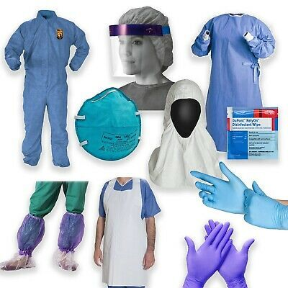
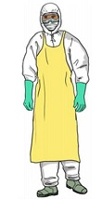
PICTORIAL EXAMPLES OF PPE
Fig.1: Removable Anti-droplet Cap Fig.2: Fully Protected Health Wor

Slide 9
Availability of PPE and Medical Supplies to Public Health
Manufacturers and supply chains across the country should be mobilized to produce more personal protective equipment (PPE) and medical devices needed in the fight against COVID-19.
Ventilators, face shields and masks are among the most critical supplies needed by hospitals and health care providers, along with hospital gowns, gloves, hand sanitizer.
So far, the federal government is projecting a stimulus package of 1 trillion naira ($2.7 billion) will be provided for the purchase of PPE and medical supplies from Local and International suppliers.
Central Bank of Nigeria will provide 100-billion naira for businesses to retool their manufacturing operations for COVID-19 equipment.

Slide 10
Digital Transformation in Health Care
The spread of COVID-19 is stretching operational systems in health care and beyond. We have seen shortages of everything, from masks and gloves to ventilators, and from emergency room capacity to ICU beds to the speed and reliability of internet connectivity. The reason is both simple and terrifying: Our economy and health care systems are geared to handle linear, incremental demand, while the virus grows at an exponential rate. Our national health system cannot keep up with this kind of explosive demand without the rapid and large-scale adoption of digital operating models.
Digital transformation in health care has been lagging other industries. Our response to COVID-19 today has shown the importance of adopting and scaling of virtual and AI tools.

Slide 11
Better integration of Artificial Intelligence into the public health response should be a priority.
The Nigerian government should as well employ such technological advances to help curb the spread of COVID-19 Virus. With the lockdown ongoing, engineering firms in fields ranging from; Computer, Electrical Electronics and Mechatronics Engineering should be charged with the development of such systems. Firms that would be involved in the design and production should also do so following strict HSE measures to ensure maximum safety and avoid the risk of contracting the COVID-19 virus.
An ERDF-funded project is helping to tackle the COVID-19 crisis in Italy. New sensors created by the project allow healthcare staff to monitor patients suffering from the disease at a distance.

Slide 12
The biosensors, created by the MEDIWARN project, can monitor a patient’s vital signs such as heartbeat, respiratory rate, blood pressure and body temperature. It is difficult and dangerous for medical and nursing staff to monitor COVID-19 patients in person. Patients infected and symptomatic need to be isolated in rooms with negative pressure. The new sensors allow staff to more easily monitor such patients from another room.
A similar project can be started in Nigeria by the Federal Government in collaboration with the private sector for the same purpose. Such a project would make it is easier for the Public Health system to carry out their duties at low risk of contracting the virus at hand. Also, the sensors can be exported to neighboring countries to counter-balance the rate of imports against exports in the country.

Slide 13
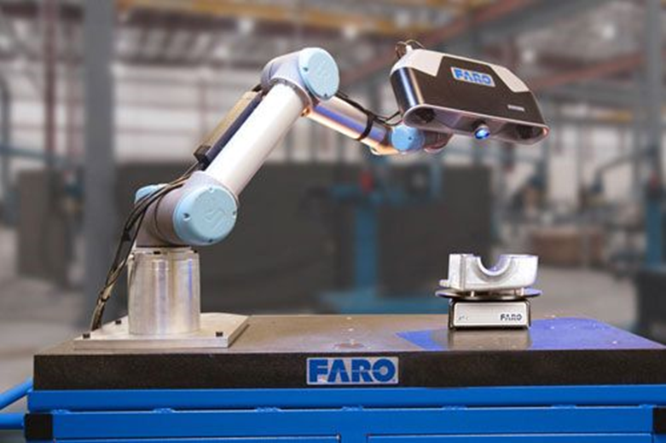
FACTORY AUTOMATION
Recent advances in the internet of things (IoT) have resulted in an explosion of new products and applications for automation, including smart homes and cities, autonomous vehicles, fastening solutions, remote security and surveillance systems, wearables and other healthcare devices, and smart factories.
Some of the enabling technologies include ultra-high bandwidth Wi-Fi; Bluetooth and other wireless technologies; artificial intelligence and machine learning; efficient and high-density power sources; advanced or miniaturized sensors; and high-precision actuation devices. In an industrial environment, manufacturing engineers are faced with myriad choices for new and emerging robotic products and technologies that provide various degrees of automation.

Slide 14
Benefits of Factory Automation
There are several good reasons for introducing automation into the manufacturing process. Although automation can result in numerous benefits, there are usually one or two compelling reasons that drive the decision-making process that should be well understood at the outset.
One of the best arguments for the introduction of factory automation is to improve workplace safety. Certain assembly or machining operations cannot be safely accomplished for a variety of reasons. Some manufacturing operations require operation at extreme temperatures or in the presence of hazardous chemicals. Other operations may require workers to lift or handle heavy or large parts or use hazardous tools. Because of limited space on the factory floor, some operations may require work in confined spaces or in the presence of moving mechanical assemblies. Automation has the power to eliminate personnel from hazardous situations.

Slide 15
Analysis of big data relating to citizens' movement, disease transmission patterns and health monitoring could be used to aid prevention measures.
Cities across the world have made infrastructure innovation a priority to safeguard their physical systems so they can stay robust and antifragile during natural disasters such as earthquakes, tsunami and hurricanes. But pandemics have shown that these methods aren’t enough when it comes to ensuring connectivity and accessing our society during biological disasters.
The primary challenge now, at the time of this crisis, is to integrate and streamline digital infrastructure at various stages of the public health response, particularly in the context of epidemic forecasting and decision-making. In the years since SARS, a new age digital era has emerged; artificial Intelligence and the Internet of Things (IoT) could be instrumental in keeping this new virus within reasonable limits.

Slide 16
HIGHLIGHT OF RECOMMENDATIONS FOR BETTER DEVELOPMENT OF PPE AND EFFECTIVE HEALTH SYSTEM
Better integration of Artificial Intelligence into the public health response should be a priority.
Factory Automation
Analysis of big data relating to citizens' movement, disease transmission patterns and health monitoring could be used to aid prevention measures.
A new mathematical model uses information theory to improve epidemiological predictions
App-based contact tracing may significantly reduce the pandemic spread in many countries
A pandemic drone can be designed to monitor people with infections could limit fatality in hotspots
Experimental Artificial Intelligence tool predicts which patients develop respiratory disease
Digital Transformation in Health Care System

