Slide 1
USES OF MEDICAL IMAGING TECHNIQUES IN DRUG DEVELOPMENT
BY GROUP 5
17/MHS01/174 KWAME-OKPU E.A OGHENEOVU
17/MHS01/159 IMOYIN-OMENE EMUOBONUVIE
17/MHS01/026 AFENO-EBOH VOKE
17/MHS03/007 AYEMOBUWA OMOTAYO
17/MHS07/005 BELLO AISHA

Slide 2
INTRODUCTION TO MEDICAL IMAGING 17/MHS01/17 KWAME-OKPU E.A OGHENEOVU

Slide 3
INTRODUCTION
Medical imaging is the technique and process of creating visual representations of the interior of a body for clinical analysis and medical intervention, as well as visual representation of the function of some organs or tissues (physiology). Medical imaging seeks to reveal internal structures hidden by the skin and bones, as well as to diagnose and treat disease. Medical imaging also establishes a database of normal anatomy and physiology to make it possible to identify abnormalities. Although imaging of removed organs and tissues can be performed for medical reasons, such procedures are usually considered part of pathology instead of medical imaging.

Slide 4
TYPES OF MEDICAL IMAGING TECHNIQUE
Radiography: Two forms of radiographic images are in use in medical imaging. Projection radiography and fluoroscopy, with the latter being useful for catheter guidance. These 2D techniques are still in wide use despite the advance of 3D tomography due to the low cost, high resolution, and depending on the application, lower radiation dosages with 2D technique
Fluoroscopy produces real-time images of internal structures of the body in a similar fashion to radiography, but employs a constant input of x-rays, at a lower dose rate. Contrast media, such as barium, iodine, and air are used to visualize internal organs as they work. Fluoroscopy is also used in image-guided procedures when constant feedback during a procedure is required. An image receptor is required to convert the radiation into an image after it has passed through the area of interest.

Slide 5
Projectional radiographs, more commonly known as x-rays, are often used to determine the type and extent of a fracture as well as for detecting pathological changes in the lungs. With the use of radio-opaque contrast media, such as barium, they can also be used to visualize the structure of the stomach and intestines – this can help diagnose ulcers or certain types of colon cancer.

Slide 6
Magnetic resonance imaging: A magnetic resonance imaging instrument (MRI scanner), or "nuclear magnetic resonance (NMR) imaging" scanner as it was originally known, uses powerful magnets to polarize and excite hydrogen nuclei (i.e., single protons) of water molecules in human tissue, producing a detectable signal which is spatially encoded, resulting in images of the body.
Nuclear medicine: Nuclear medicine encompasses both diagnostic imaging and treatment of disease, and may also be referred to as molecular medicine or molecular imaging and therapeutics. Nuclear medicine uses certain properties of isotopes and the energetic particles emitted from radioactive material to diagnose or treat various pathology. Different from the typical concept of anatomic radiology, nuclear medicine enables assessment of physiology

Slide 7
Diagnostic ultrasound sonography/ Medical ultrasound; uses high frequency broadband sound waves in the megahertz range that are reflected by tissue to varying degrees to produce (up to 3D) images. This is commonly associated with imaging the fetus in pregnant women. Uses of ultrasound are much broader, however. Other important uses include imaging the abdominal organs, heart, breast, muscles, tendons, arteries and veins. While it may provide less anatomical detail than techniques such as CT or MRI
A CT scan, or computed tomography scan is a medical imaging procedure that uses computer-processed combinations of many X-ray measurements taken from different angles to produce cross-sectional (tomographic) images (virtual "slices") of specific areas of a scanned object, allowing the user to see inside the object without cutting.

Slide 8
Medical imaging can help answer key questions that arise during the drug development process. The role of medical imaging in new drug clinical trials includes identification of likely responders; detection and diagnosis of lesions and evaluation of their severity; and therapy monitoring and follow-up. Nuclear imaging techniques such as PET can be used to monitor drug pharmacokinetics and distribution and study specific molecular endpoints. In assessing drug efficacy, imaging biomarkers and imaging surrogate endpoints can be more objective and faster to measure than clinical outcomes, and allow small group sizes, quick results and good statistical power. Imaging also has important role in drug safety monitoring, particularly when there is no other suitable biomarkers available. Despite the long history of radiological sciences, its application to the drug development process is relatively recent. This review highlights the processes, opportunities, and challenges of medical imaging in new drug development.

Slide 9
Müller, H., Kalpathy-Cramer, J., Demner-Fushman, D., & Antani, S. (2012, February). Creating a classification of image types in the medical literature for visual categorization. In Medical Imaging 2012: Advanced PACS-based Imaging Informatics and Therapeutic Applications (Vol. 8319, p. 83190P). International Society for Optics and Photonics.
Mahesh, M. (2001). Fluoroscopy: patient radiation exposure issues. Radiographics, 21(4), 1033-1045.
Rowland, D. J., & Cherry, S. R. (2008, May). Small-animal preclinical nuclear medicine instrumentation and methodology. In Seminars in nuclear medicine (Vol. 38, No. 3, pp. 209-222). WB Saunders
Wang, Y. X., & Deng, M. (2010). Medical imaging in new drug clinical development. Journal of thoracic disease, 2(4), 245.

Slide 10
Role of Nuclear Medicine in Drug development

Slide 11
Nuclear medicine encompasses both diagnostic imaging and treatment of disease, and may also be referred to as molecular medicine or molecular imaging and therapeutics. Nuclear medicine uses certain properties of isotopes and the energetic particles emitted from radioactive material to diagnose or treat various pathology. Different from the typical concept of anatomic radiology, nuclear medicine enables assessment of physiology. This function-based approach to medical evaluation has useful applications in most subspecialties, notably oncology, neurology, and cardiology. Gamma cameras and PET scanners are used in e.g. scintigraphy, SPECT and PET to detect regions of biologic activity that may be associated with a disease. Relatively short-lived isotope, such as ^{99m}Tc is administered to the patient. Isotopes are often preferentially absorbed by biologically active tissue in the body, and can be used to identify tumors or fracture points in bone. Images are acquired after collimated photons are detected by a crystal that gives off a light signal, which is in turn amplified and converted into count data.

Slide 12
NUCLEAR MEDICINE
SCINTIGRAPHY
Single-photon emission computed tomography
(SPECT)
Positron emission tomography
(PET)
DIVISIONS OF NUCLEAR MEDICINE

Slide 13
Scintigraphy is a form of diagnostic test wherein radioisotopes are taken internally, for example, intravenously or orally. Then, gamma cameras capture and form two-dimensional images from the radiation emitted by the radiopharmaceuticals.
SPECT is a 3D tomographic technique that uses gamma camera data from many projections and can be reconstructed in different planes. A dual detector head gamma camera combined with a CT scanner, which provides localization of functional SPECT data, is termed a SPECT-CT camera, and has shown utility in advancing the field of molecular imaging. In most other medical imaging modalities, energy is passed through the body and the reaction or result is read by detectors. In SPECT imaging, the patient is injected with a radioisotope, most commonly Thallium 201TI, Technetium 99mTC, Iodine 123I, and Gallium 67Ga. The radioactive gamma rays are emitted through the body as the natural decaying process of these isotopes takes place. The emissions of the gamma rays are captured by detectors that surround the body. This essentially means that the human is now the source of the radioactivity, rather than the medical imaging devices such as X-ray or CT.

Slide 14
Positron emission tomography (PET) uses coincidence detection to image functional processes. Short-lived positron emitting isotope, such as ¹⁸F, is incorporated with an organic substance such as glucose, creating F18-fluorodeoxyglucose, which can be used as a marker of metabolic utilization. Images of activity distribution throughout the body can show rapidly growing tissue, like tumor, metastasis, or infection. PET images can be viewed in comparison to computed tomography scans to determine an anatomic correlate. Modern scanners may integrate PET, allowing PET-CT, or PET-MRI to optimize the image reconstruction involved with positron imaging. This is performed on the same equipment without physically moving the patient off of the gantry. The resultant hybrid of functional and anatomic imaging information is a useful tool in non-invasive diagnosis and patient management.

Slide 15
Application of scintigraphy in Drug Development

Slide 16
Introduction
Scintigraphy (from Latin scintilla, "spark"), also known as a gamma scan, is a diagnostic test in nuclear medicine, where radioisotopes attached to drugs that travel to a specific organ or tissue (radiopharmaceuticals) are taken internally and the emitted gamma radiation is captured by external detectors (gamma cameras) to form two-dimensional images in a similar process to the capture of x-ray images. In contrast, SPECT and positron emission tomography (PET) form 3-dimensional images, and are therefore classified as separate techniques to scintigraphy, although they also use gamma cameras to detect internal radiation. Scintigraphy is unlike a diagnostic X-ray where external radiation is passed through the body to form an image.
Gamma scintigraphy is a non-invasive technique with applications in the development of drug products and the assessment of pharmacodynamic effects in humans. It enables the assessment of critical performance parameters that in vitro techniques attempt, but often fail, to predict. Quantification of pharmacodynamic effects (eg gastrointestinal transit; gall bladder emptying; lung mucociliary clearance) provides insights into the mode of action of drug candidates.

Slide 17
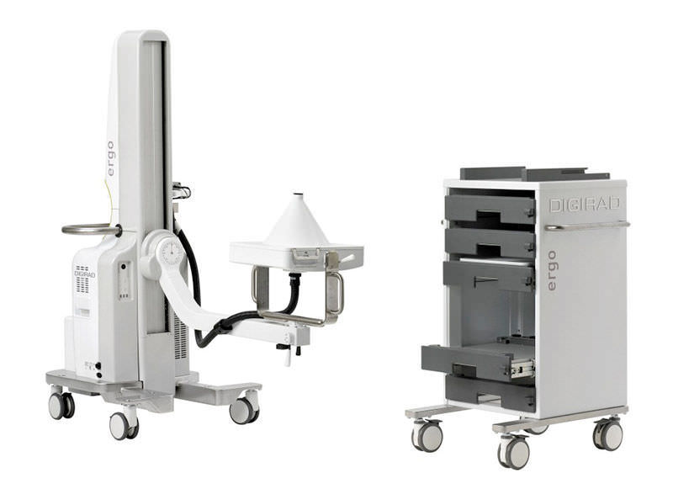
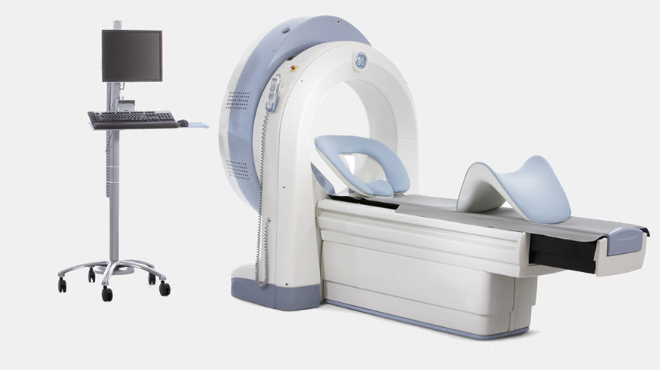
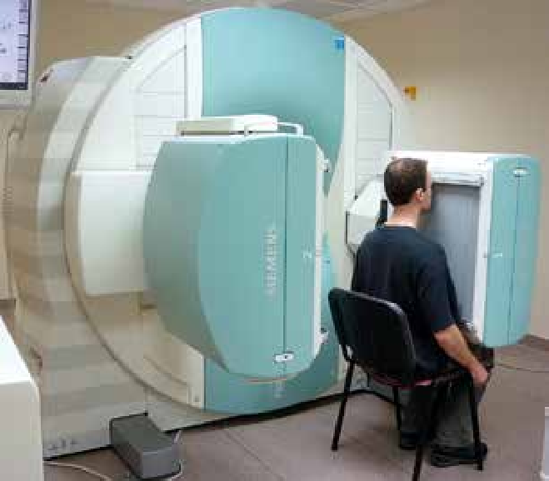
SMALL-FIELD GAMMA CAMERA FOR THYROID SCINTIGRAPHY / FOR CARDIAC SCINTIGRAPHY / FOR MAMMOSCINTIGRAPHY
SOURCE: https://www.medicalexpo.com
SPECT GAMMA CAMERA FOR CARDIAC SCINTIGRAHY
SOURCE: https://www.medicalexpo.com
GAMMA CAMERA CONFIGURED FOR ESOPHAGEAL SCINTIGRAPHY
SOURCE: https://www.researchgate.net

Slide 18
Methodology
Gamma scintigraphy is an imaging technique that enables the direct visualisation and quantification of events occurring in vivo, in real time. Initially introduced as diagnostic tool, the potential of this method was quickly realised within the pharmaceutical industry. Gamma scintigraphy was first reported for the measurement of transit times in 1966 (gastric emptying) followed swiftly by the assessment of drug product performance in 1976 (capsule disintegration).
Visualisation is achieved by the incorporation of short half-life gamma emitting radionuclides, eg technetium-99m (99mTc),The chosen radionuclide is used to label the drug product or, for pharmacodynamic investigations, the component of interest (eg food or fluid for gastrointestinal transit; inhaled particles for mucociliary clearance). The radiation dose to the subject is minimal – often not exceeding that received from a single X-ray. A gamma camera is used to detect the gamma rays and record these as primary counts which are represented as an image.

Slide 19
https://www.ddw-online.com/

Slide 20
ROLES OF SCINTIGRAPHY IN DRUG DEVELOPMENT
The cost of developing a new drug product is now estimated to cost over millions, This, coupled with the threat from generic competition, has resulted in a drive for reinvention of the pharmaceutical industry. A more efficient, cost-effective model is being implemented with the aim of increasing the number of drug candidates available for development, and simultaneously reducing late stage attrition, This strategy hinges on the use of innovative clinical protocols in early development to enable detailed, scientifically-driven investigation of product performance. The development team needs access to a full range of tools that can be integrated into routine early development studies, enhancing the data obtained.Gamma scintigraphy is one such tool. It provides the means to assess critical-to-performance parameters, which in vitro methods attempt but often fail to predict. It also provides a gold standard method for the direct quantification of pharmacodynamic effects, providing insight into mode of action of drug candidates.

Slide 21
Gamma scintigraphy Use in Development of Oral Drugs
The gastrointestinal tract is usually the preferred site of absorption for most therapeutic agents, as seen from the standpoints of convenience of administration, patient compliance and cost. In recent years there has been a tendency to employ sophisticated systems that enable controlled or timed release of a drug, thereby providing a better dosing pattern and greater convenience to the patient. Although much about the performance of a system can be learned from in vitro release studies using conventional and modified dissolution methods, evaluation in vivo is essential in product development. The non-invasive technique of gamma-scintigraphy has been used to follow the gastrointestinal transit and release characteristics of a variety of pharmaceutical dosage forms. Such studies provide an insight into the fate of the delivery system and its integrity and enable the relationship between in vivo performance and resultant pharmacokinetics to be examined (pharmacoscintigraphy).

Slide 22
Gamma scintigraphy in the evaluation of pharmaceutical dosage forms.
Gamma-scintigraphy is applied extensively in the development and evaluation of pharmaceutical drug delivery systems. It is used particularly for monitoring formulations in the gastrointestinal and respiratory tracts. The radiolabelling is generally achieved by the incorporation of an appropriate technetium-99m or indium-111 labelled radiopharmaceutical into the formulation. In the case of complex dosage forms, such as enteric-coated tablets, labelling is best undertaken by the addition of a non-radioactive tracer such as samarium-152 oxide or erbium-170 oxide followed by neutron activation of the final product.

Slide 23
Systems investigated include tablets and multiparticulates for oral administration, enemas and suppositories, metered dose inhalers and nebulisers, and nasal sprays and drops. Gamma-scintigraphy provides information on the deposition, dispersion and movement of the formulation. The combination of such studies with the assay of drug levels in blood or urine specimens, pharmacoscintigraphy, provides information concerning the sites of drug release and absorption. Data acquired from the scintigraphic evaluation of pharmaceutical dosage forms are now being used increasingly at all stages of product development, from the assessment of prototype delivery systems to supporting the product licence application.

Slide 24
Gamma scintigraphy in development of Oral inhaled products
The success of an orally inhaled product is a combination of the device, the formulation and the patient’s technique. As with oral formulations, development starts in the laboratory and the performance of prototypes is measured via particle size distribution (PSD) testing. While attempts continue to use PSD profiles as a predictor of in vivo deposition, the reality is that there is no direct correlation between individual or grouped stages and the anatomy of the lungs .
Scintigraphic data are most commonly used to quantify the initial deposition pattern providing a measure of how efficiently the device delivers the formulation, to which anatomical regions and the extent of lung penetration.

Slide 25
Scintigraphy in development of Nasal products
Nasal administration is used for delivery to the systemic circulation (large surface area, non-invasive delivery) or for local delivery . Delivery via the nasal cavity has been explored to deliver drug to the sinuses, and also to the olfactory region to achieve delivery to the brain. Consequently, drug products are often designed to target delivery to specific regions of the nasal cavity.
Scintigraphic images co-registered with an MRI scan of the head can be used to quantify the amount of drug formulation delivered to target sites. Specific anatomical regions can be identified, or the cavity can be divided into zones such as upper:lower:inner:outer . Further, scintigraphic imaging can provide evidence to support statements to the regulators that nasal delivery results in no deposition to the lungs.

Slide 26
Use of Gamma scintigraphy in Locally acting drug molecules
The quantification of the availability of the active moiety at the site of action, ie the measurement of bioavailability, is a fundamental element of pharmaceutical development. For molecules which reach their site of action via the systemic circulation, pharmacokinetic parameters are an accepted surrogate measure and these data underpin the majority of safety, efficacy and bioequivalence assessments. However, for molecules that do not rely on systemic availability, this raft of assessments can be challenging to complete.

Slide 27
Bioavailability may be assessed by ‘measurements intended to reflect the rate and extent to which the API becomes available at the site of action’ (17,18). Traditionally, for locally acting drugs these measurements have been limited to pharmacodynamic assessments, and large clinical trials to confirm efficacy. For locally acting molecules delivered via the oral inhaled route, the use of in vitro assessments and the quantification of lung deposition via imaging are already recognised as supporting data – although pharmacokinetic data are still deemed to be advantageous (19,20).
The regulators now also recognise that the use of comparative clinical trials is inefficient and prohibitively expensive for locally acting molecules delivered to the gastrointestinal tract. As part of the FDA Critical Path Initiative, in vivo imaging has been suggested as a method to directly assess the rate of drug release at the target site (21). Scintigraphic data provides a measure of both the location and rate of drug release, and comparative assessments of innovator versus test product can be performed.

Slide 28
In Conclusion
Gamma scintigraphy is an in vivo imaging tool with many applications within the pharmaceutical industry. It is recognised as the gold standard technique and is routinely used as the benchmark, which alternative methods have to meet. For drug product development, it is the only direct method of assessment of critical-to-performance parameters which in vitro methods attempt but often fail to predict.
It also permits direct quantification of pharmacodynamic effects, providing insight into mode of action of drug candidates and essential biomarker data. The data generated are accurate, detailed, comprehensive and clinically relevant, resulting in greater confidence in decision making leading to more effective drug product development.

Slide 29
Scintigraphic imaging is a tool that every pharmaceutical scientist and clinical pharmacologist should have access to in order to improve early development productivity.

Slide 30
REFERENCE
Connor, A. Enabling Technologies.
Santoro, M. A., & Gorrie, T. M. (2005). Ethics and the pharmaceutical industry. Cambridge University Press.
Davis, S. S., Hardy, J. G., Newman, S. P., & Wilding, I. R. (1992). Gamma scintigraphy in the evaluation of pharmaceutical dosage forms. European journal of nuclear medicine, 19(11), 971-986.
Wilding, I. R., Coupe, A. J., & Davis, S. S. (2001). The role of γ-scintigraphy in oral drug delivery. Advanced drug delivery reviews, 46(1-3), 103-124.

Slide 31
APPLICATION OF SINGLE-PHOTON EMISSION COMPUTED TOMOGRAPHY (SPECT) IN DRUG DEVELOPMENT

Slide 32
INTRODUCTION
Single-photon emission computed tomography (SPECT, or less commonly, SPET) is a nuclear medicine tomographic imaging technique using gamma rays.It is very similar to conventional nuclear medicine planar imaging using a gamma camera (that is, scintigraphy),but is able to provide true 3D information. This information is typically presented as cross-sectional slices through the patient, but can be freely reformatted or manipulated as required.
The technique needs delivery of a gamma-emitting radioisotope (a radionuclide) into the patient, normally through injection into the bloodstream. On occasion, the radioisotope is a simple soluble dissolved ion, such as an isotope of gallium(III). Most of the time, though, a marker radioisotope is attached to a specific ligand to create a radioligand, whose properties bind it to certain types of tissues. This marriage allows the combination of ligand and radiopharmaceutical to be carried and bound to a place of interest in the body, where the ligand concentration is seen by a gamma camera.

Slide 33
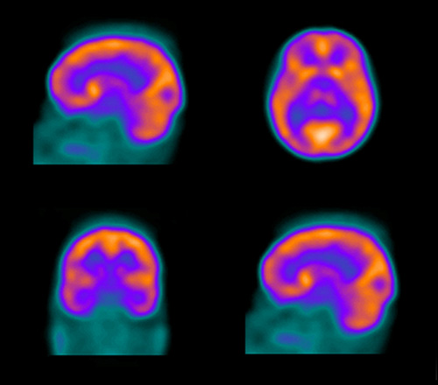
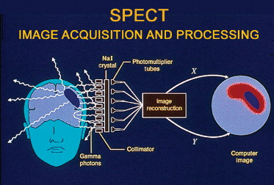
A SPECT SCAN OF THE BRAIN
SOURCE: https://medicine.utah.edu
OVERVIEW OF THE SPECT IMAGE ACQUISITION AND PROCESSING
SOURCE: https://www.sciencedirect.com/

Slide 34
ROLES OF SPECT IN DRUG DEVELOPMENT
Molecular imaging techniques are increasingly being used as valuable tools in the drug development process. Radionuclide-based imaging modalities such as single-photon emission computed tomography (SPECT) have proven to be useful in phases ranging from preclinical development to the initial stages of clinical testing. The high sensitivity of these imaging modalities makes them particularly suited for exploratory investigational new drug (IND) studies as they have the potential to characterize in vivo pharmacokinetics and biodistribution of the compounds using only a fraction of the intended therapeutic dose (microdosing). This information obtained at an early stage of clinical testing results in a better selection among promising drug candidates, thereby increasing the success rate of agents entering clinical trials and the overall efficiency of the process. In this article, we will review the potential applications of SPECT imaging in the drug development process with an emphasis on its applications in exploratory IND studies.

Slide 35
single photon emission computed tomography (SPECT) are noninvasive molecular imaging techniques that can be used to provide functional information in the living human body. They use radiolabeled compounds that bind to specific sites on a biological target, known as radiotracers, enabling us to visualize and characterize specific aspects of a biological process. This chapter describes these techniques and how they can be utilized in the drug development process.

Slide 36
The discovery and development of new drugs is a long, costly and risky process. More and more, non-invasive imaging techniques are becoming an important tool in reducing these factors. Among these techniques, we can mention single-photon emission computed tomography (SPECT). Due to their sensitivity and specificity, SPECT imaging techniques proved to be quite advantageous in the development and research of new drugs SPECT has been used as a complement in preclinical, clinical and microdosing studies, this being of great help to research and medicine, and particularly in the specific areas of oncology, neurology and cardiovascular diseases. In general, we can define three different approaches that can be followed when using such techniques for the development of new drugs: using the radiolabeled candidate drug (evaluation of biodistribution and pharmacokinetics); using a radioligand with known affinity concerning the target pursued by the candidate drug (evaluation of the pharmacodynamic properties), and using a biomarker for evaluating the effectiveness of the candidate drug.

Slide 37
REFERENCE
Gomes, C. M., Abrunhosa, A. J., Ramos, P., & Pauwels, E. K. (2011). Molecular imaging with SPECT as a tool for drug development. Advanced drug delivery reviews, 63(7), 547-554.
Willmann, J. K., Van Bruggen, N., Dinkelborg, L. M., & Gambhir, S. S. (2008). Molecular imaging in drug development. Nature reviews Drug discovery, 7(7), 591-607.

Slide 38
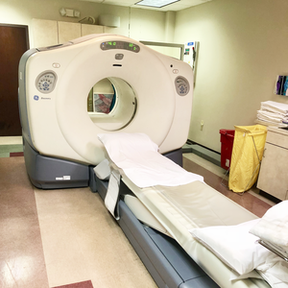
APPLIICATION OF NUCLEAR MEDICINE ON DRUGS DEVELOPMENT
IMOYIN-OMENE EMUOBONUVIE
17/MHS01/159

Slide 39
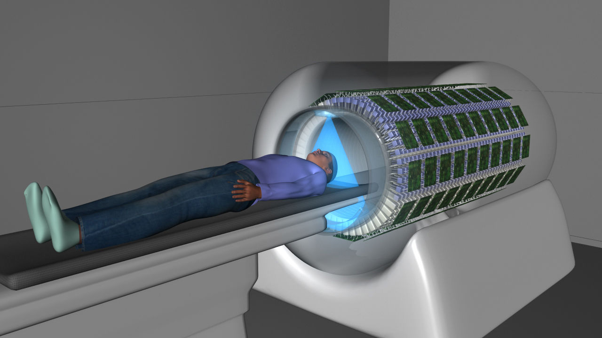
Nuclear medicine is a specialized area of radiology that uses very small amounts of radioactive materials,or radioactive tracers or radiopharmapharmaceuticals,to diagnose a wide range of conditions ,treating certain illnesses ;these include many types of cancers(hyperthyroidism,thyroid cancer,lymphomas and bone pain from some type of cancers),heart disease,gastrointestinal,endocrine or neurological disorders and other abnormalities and to examine organ function and structure.Nuclear medicine imaging is a combination of many different disciplines.(SM Moriguchi,2013)
However,too much radiation can potentially damage organs or tissues or increase the risk of cancer.When used for diagnosis,the level of radiation exposure is around the same as a person receives during a routine chest x-ray or a CT scan.

Slide 40
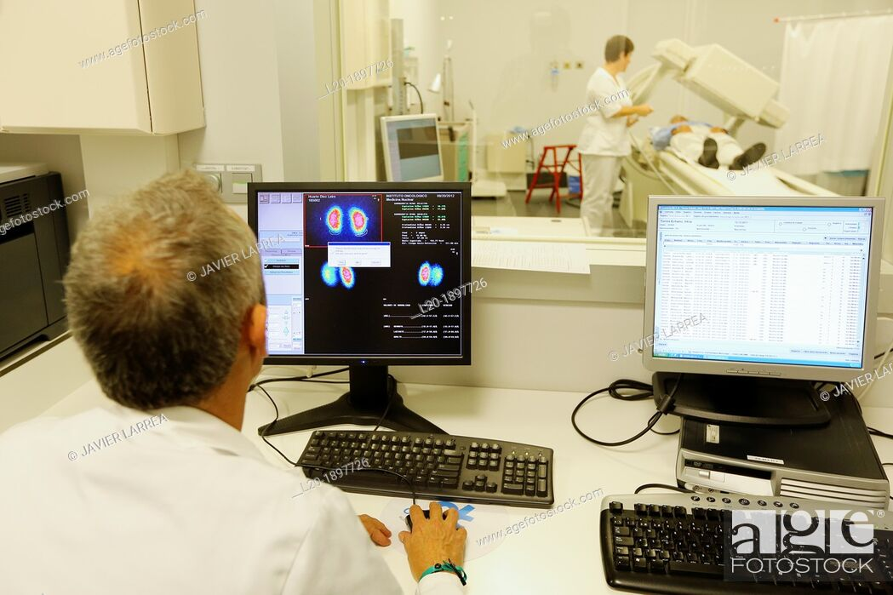
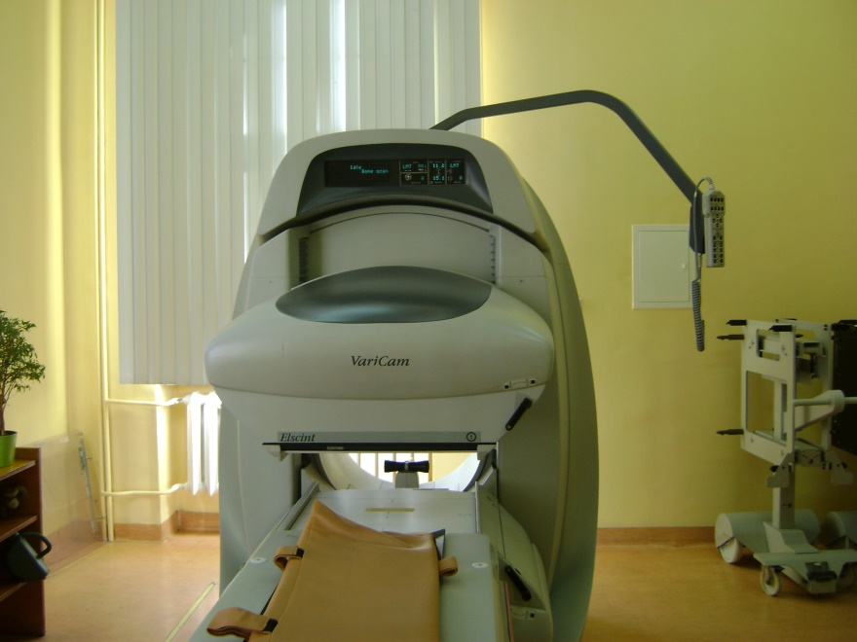
PET
PET stands for ‘’positron emission tomography’’.It is a clear medicine imaging test in which a small amount of liquid radioactive material is injected into the body and is used to diagnose a variety of diseases Including many types of cancers,and brain and heart disease.The scan uses a special dye containing radioactive tracers.These tracers are either swallowed,inhaled,or injected into a vein in your arm depending on what part of the body is being examined.The most commonly used tracer is called FDG(fluorodeoxyglucose).(AA Lammertsma,2004)
A PET exposes you to about 25mSv of radiation which is equal to about 8years of average background radiation exposure.(JR linder,2018)

Slide 41
APPLICATIONS
Pharmacokinetic and pharmacodynamic profiling is a critical process in understanding drug dosing,toxicity,and likelihood for therapeutic success.In particular PET has been as a major force clearly useful for temporarlly evaluating whole-body biodistribution of therapeutic candidates that can be labeled without changing their properties and administered for intravenous route.In neurological diseases,(PM Matthews,2012).PET have been used to evaluate transport of drugs across the blood brain barrier and have been paired with drug tracers including 123lioflupane,11C-raclopide.(W C Eckelman,2005)
PET is the most selective ,sophisticated and sensitive method for measuring molecular pathways and interactions in vivo.(S Bhattacharyya,2012)Within the area of drug development,PET can be used in several ways like to quantify cellular events such as cell trafficking,receptor binding and gene expression.The drug itself can be labelled with a positron emitter.This enables direct PET measuements of tissue drug concentrations allowing for an assessment as to whether these concentrations are high enough for therapeutic purposes.
A second application is the measurement of perfusion or metabolism during or following treatment.The best known example is the measurement of tumour metabolism as a marker of response to chemotherapy (J Wang,2005)
Finally,mechanism of action can be measured using established radioligands for the molecular targets under investigation.

Slide 42
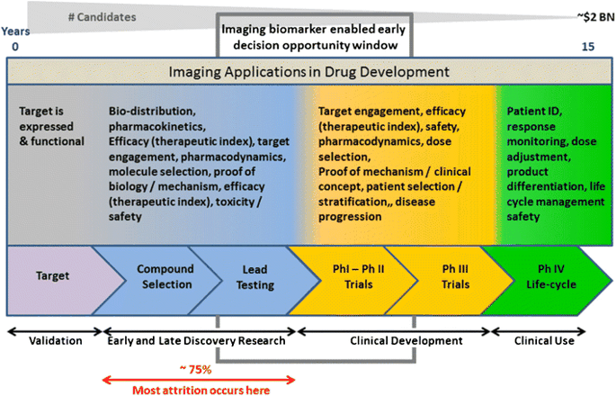
Occupancy can be measured as a function of both administered dose and time after drug administration allowing for optimal dose and dosing regimens to be determined based on only a small number of subjects.PET studies in experimental animals open up further possibilities.By using appropriate models of disease,effects due to regression of disease and those due to acute or chronic therapy can be studied separately even in the same animal.

Slide 43
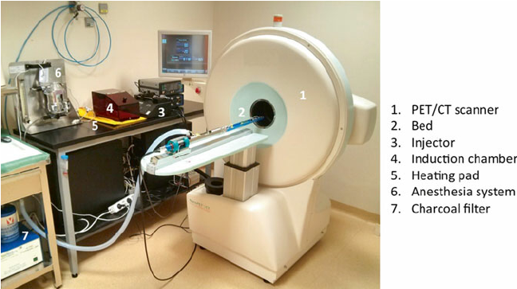
conclusion
Spanning a wide range,these applications demonstrat the versatility of PET and how it can be used to accelerate drug discovery and development.The PET can be used in drug development at several stages to accelerate the process and reduce the cost.The molecular imaging technique have een developed for clinical diagnostiics have successfully been retasked to understand efficacy of candidate therapeutics in preclinical and even in early clinical studies.The lack of history using molecular imaging as a surrogate clinical end point for drug approval; in cardiovascular medicine has not however dampened the prospects of using it to make go or no-go decisions early in cardiovascular clinical trials or for assessing dosing strategies.Finally, the advantages and limitations of PET and how it can be used in the future to minimize risks of drug development are discussed,

Slide 45
APPLICATIONS OF PET IN DRUG DEVELOPMENT

Slide 46
References
www.sciencedirect.com
www.researchgate.com
https://www.ncbi.nlm.nih.gov>pmc
https://linkspringer.com>book
www.ahajournals.org www.medicalnewstoday.com
www.radiology info.org
www.hopkinsmedicine.org
www.intechopen.com

Slide 47
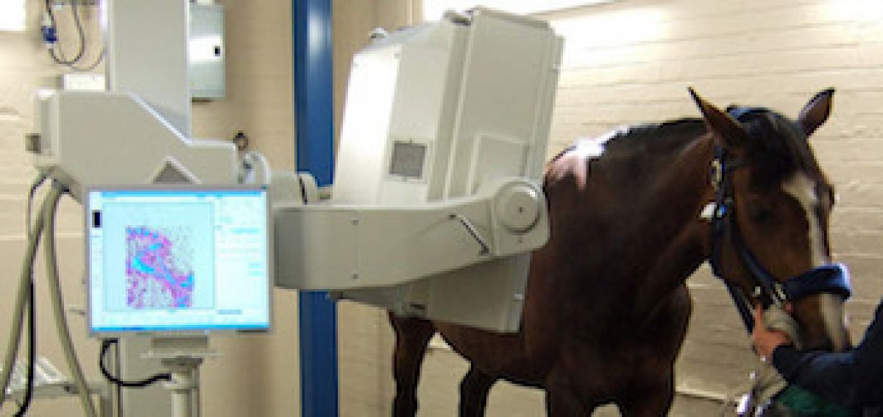
APPLICATION OF SCINTIGRAPHY ON DRUGS DEVELOPMENT
BY IMOYIN-OMENE EMUOBONUVIE
17/MHS01/159

Slide 48
SCINTIGRAPHY
Scintigraphy is a painless diagnostic test in which a two-dimensional picture of a body,the radiation source is obtained through the use of radioisotopes.(Shiel Jr. 2018)
It is also called scintiscanning or gamma scan,the radioisotope is usually technetium per technetate,a gamma emitter with a short half-life.
It provides a rapid evaluation of the total skeleton but,the appearances are non-specific.(Ignac Fogelman,2005)
The key roles of Scintigraphy in osteoporosis,osteomalacia,hyperthyroidism,paget disease,and primary hyperthyroidism,The technique helps in identification of fractures,causes of pain and co-existent pathology in Osteoporosis.
There are specific pharmaceuticals for each organ E.g MDP,DTPA,senstamibi,etc,thus making it possible to perform bone,renal or cardiac scintigraphy respectively.

Slide 49
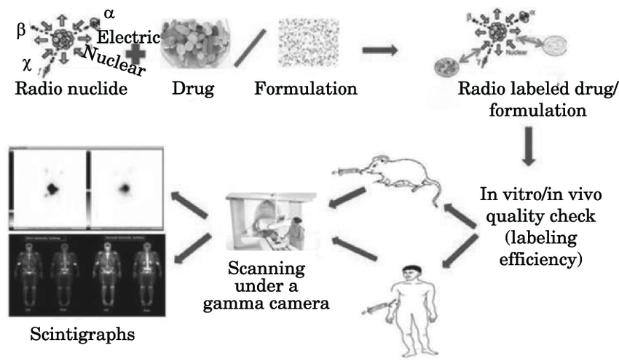
The main characteristic of Scintigrams is that they provide information on the functioning and metabolism of organs and structures.Hence,they differ from other imaging methods such as ultrasound,CT scans or MRI,which are anatomical,and thus complement the diagnostic investigation.(Moriguchi,Togni,dos Santos,2013).Diagram shows the principle of gamma scintigraphy.

Slide 50
Gamma scintigraphy in evaluation of drug delivery systems
Gamma-scintigraphy is applied extensively in the development and evaluation of pharmaceutical delivery system particularly for monitoring formulations in the gastrointestinal and respiratory tracts.The radiolabelling is generally achieved by the incorporation of an appropriate radionuclide such as technetium-99 or indium-111 into the formulations or by addition of a non-radioactive isotope such as Samarium -152 followed by neutron activation of the final product.Its combined knowledge with physiologic and dosage form design can help to identify some of these variables(phase 1 clinical evaluation)(Shahhosseini,2003). With over 25years of experience in the design,conduct and reporting of Scintigraphic studies,helping customers understand the impact of formulation composition,patient factors and human physiology on clinical outcomes.

Slide 51
It is also used in the study of pharmacodynamics of new chemical entities.Concomitant administration of radio-labelled food or placebo systems with clinical formulations can alow the observation and quantification of pharmacologic effects.Gamma scintigraphic assessment can be included with a standard phase 1 clinical protocol abd combined with standard safety,pharnacokinetics and pharmacodynamic endpoints.
Data acquired from the scintigraphic evaluation of pharmaceutical dosage forms are noe being used increasingly at all stages of product development from the assessment of prototype delivery systems to supporting the product license application(Davis,1992).

Slide 52
Statistics and Scintigraphs:Our scintigraphic analyst provide expert review and interpretation of scintigraphic data,providing both qualitative and quantitative analysis of drug product performance and pharmacodynamic effects during a study.Quotient has designed,delivered and reported)100 scintigraphy studies across a range of drug products.Low levels of gamma-emitting isotope are included in the formulation during product manufacture to allow real tie observation of clinical performance following dosing in human subjects(oral drug product performance,inhaled drug product performance).

Slide 53
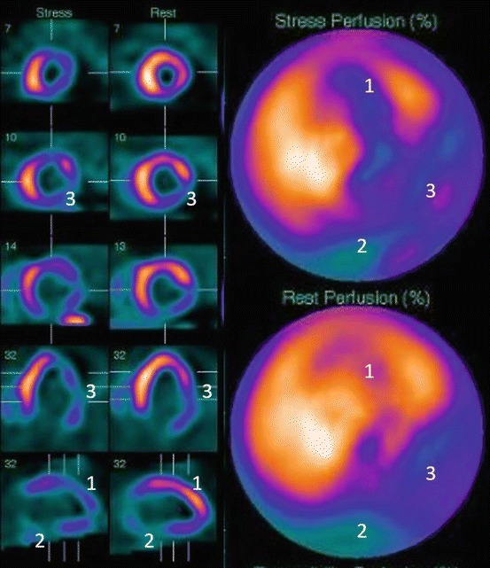
CONCLUSION
In conclusion,the information about the nuclear medicine applications,based on metabolic and functional evaluations,make this method a co-adjuvant of the others anatomic exams on investigation of many pathologies,without competition with them and being preferred on the functional lesion follow up,metastasis screening and viable tumor issue.
Diagram is showing myocardial pe
rfusion scintigraphy.

Slide 54
Renal scintigraphy

Slide 56
Bone scintigraphy

Slide 57
references
https://www.cancer.gov>def en.m,wikipedia.org
https:www.science direct.com>topics
https://www.medicinenet.com>art
https://www,ncbiin/m.nih.gov
www.quotientsciences.com
Irjnm.tums.ac.ir>article 431
Department of medicinal chemistry,faculty of pharmacy,shahid beheshti university of medicinal sciences,tehran,iran
Research institute for nuclear medicine,tehran university of medical sciences,tehran,iran.
Nuclear medicine textbook(volume 11,issue 2-serial number 19 summer and autumn 2003(page21-23))
NCI dictionary of cancer terms
Clinical applications of nuclear medicine,medical imaging in clinical practice by Okechukwu felix Erondu,Intechopen.

Slide 58
Application of Magnetic Resonance Imaging In drug development 17/MHS01/026 AFENO-EBOH VOKE

Slide 59
Introduction
MRI is widely used for clinical diagnosis as well as in research areas such as preclinical drug discovery, clinical development and also in therapy monitoring. MRI allows non-invasive acquisition of tomographic images of soft tissue with high resolution and contrast. Furthermore, its ability to assess organ function in a broad sense renders this technique to a versatile tool to answer specific scientific questions such as drug actions in disease models. Imaging of patho-physiological mechanisms and molecular processes are primarily in the focus of MRI in drug research.

Slide 60
In drug discovery, MRI is contributing to the profiling of drug candidates by investigating pathological processes in animal disease models and the effect of drugs there on. Furthermore, MRI, being fully translational, can also contribute to drug development by introducing and validating imaging biomarkers for later clinical trials.
In general, MRI is used to assess the impact of drug treatment on the morphology, structure, metabolism or function of (diseased) organs in tailored animal models or patients.( Mansfield and maudsley,1976).

Slide 61
Limitation of MRI in drug development
It is an insensitive technique. This often limits spatial and/or temporal resolution of images and image series obtained from small laboratory animals.
Furthermore, MRI read-outs are similarly to other imaging techniques often indirect with respect to the investigated underlying biological processes and have thus to be thoroughly validated on a case by case basis.
Finally, MRI is expensive and sophisticated. Having said this, one has to bear in mind that MRI is in competition with other well established and often less costly non-imaging techniques. Altogether, superiority over alternatives in at least one of the following aspects is a prerequisite for successful MRI applications in drug research: translatability to clinical trials, non-invasiveness allowing time course studies and thus reducing the number of animals per study, and assessment of functional and morphological parameters.

Slide 62
Translational imaging
A straightforward translational read-out appears to be size assessment of tumours in animal models since RECIST (Response Evaluation Criteria In Solid Tumors4) is well established in the clinic to assess anti-tumour treatment effect.
The aim of antiangiogenic therapy is to suppress the essential process of blood vessel formation and maturation for growing tumours. Quantification of angiogensis by dynamic contrast enhanced MRI (DCE-MRI) and hence its inhibition by pharmacological treatment is well established in pre-clinical as well as in clinical research(Padhani and leach,2005).
This technique is meanwhile a well-accepted biomarker for drug efficacy of anti-angiogenic or vascular disrupting agents also in many clinical trials.( O’Connor et al., 2007).

Slide 63
Time course studies
A strong argument in favour of MRI is its non-invasive nature allowing time course (longitudinal)
Besides humans, prostate hyperplasia occurs in very few animal species. One of these is the dog, which thus represents an ideal animal model for drug characterisation. Dogs, on the other hand, can only be utilised in very small numbers for pharmacological studies and noninvasive read outs are thus predestined. So the effect of 5α reductase inhibitor treatment of prostate hyperplasia in dogs (Hausler et al., 1996) could be successfully monitored during a 12week treatment and an eight week wash-out period. Figure 4 shows the excellent delineation of a hyperplasic prostate in a T2-weighted MR image.

Slide 66
Multimodal imaging of pathophysiological events
The full potential of MRI in drug research lays in the non-invasive investigation of pathophysiological events and the effect of drug treatment thereon. The comprehensive assessment of patho-physiological cascade of cerebral stroke with various MRI techniques is described in Figure 5 ( Weber et al.,2006)
Cerebral ischemia is induced by occlusion of the middle cerebral artery (MCAO) which is immediately visualised by MR angiography (MRA). The threedimensional time-of-flight (TOF) technique visualises non-invasively the cerebral vasculature of the rat without the use of contrast aagent (Reese et all., 1999). It is applicable to investigate therapeutic interventions such as thrombolytic treatments. The MCAO results in a massive ischemic area as seen in the perfusion weighted image.

Slide 67
Conclusion
The above described examples give just a tiny glimpse to the wealth of potential MRI applications in preclinical research. MRI, when used appropriately, can answer important biological questions in the context of many projects. Furthermore, MRI by its translational nature can also link preclinical and clinical research. Altogether, it has the potential to contribute substantially to the drug finding process in pharmaceutical industry.

Slide 68
References
Padhani AR, Leach MO. Antivascular cancer treatments: functional assessments by dynamic contrast-enhanced magnetic resonance imaging. [Review] [146 refs]. Abdominal Imaging 2005.
Reese T, Bochelen D, Sauter A, Beckmann N, Rudin M. Magentic resonance angiography of the rat cerebrovascular system without the use of contrast agent. NMR Biomed 1999.
O’connor JP, Jackson A, Parker GJ, Jayson GC. DCE-MRI biomarkers in the clinical evaluation of antiangiogenic and vascular disrupting agents. [Review] [42 refs]. British Journal of Cancer 2007
Hausler A, Allegrini PR, Biollaz M, Batzl C, Scheidegger E, Bhatnagar AS. Cgp 53153 – a new potent inhibitor of 5- alpha-reductase. Journal of Steroid Biochemistry & Molecular Biology 1996.
Weber R, Ramos-Cabrer P, Hoehn M. Present status of magnetic resonance imaging and spectroscopy in animal stroke models. [Review] [101 refs]. Journal of Cerebral Blood Flow & Metabolism 2006.
Mansfield P, Maudsley AA. Line scan proton spin imaging in biological structures by NMR. Physics in Medicine & Biology 1976.

Slide 69
USE OF RADIOLOGY OR X-RAY PHOTOGRAPHY IN DRUG DEVELOPMENT.
BY
17/MHS03/007
AYEMOBUWA OMOTAYO
ANA 302

Slide 70
INTRODUCTION
X- ray photography is used for drug production in a process called X- ray crystallography (XRC).
X-ray crystallography is the experimental science determining the atomic and molecular structure of a crystal (such as salts, metals, minerals, semiconductors, as well as various inorganic, organic, and biological molecules), in which the crystalline structure causes a beam of incident X-rays to diffract into many specific directions.
By measuring the angles and intensities of these diffracted beams with some wizardry mathematics, a crystallographer (a person skilled in crystallography) can produce a three-dimensional picture of the density of electrons within the crystal. From this electron density, the mean positions of the atoms in the crystal can be determined, as well as their chemical bonds, and various other information.

Slide 71
HOW IS X-RAY CRYSTALLOGRAPHY CARRIED OUT?
.What they do is to start by taking a tiny sample of the crystal and put it into a machine called a Weissenberg X-ray camera and have an X-ray go through the X-ray crystallography camera and down a tube where it would hit the crystal. Photographic film would have been put into the canister on the machine. Light would be reflected off the crystal onto the X-ray film. The canister containing the film can be moved in lots of different directions and the machine has a motor that can oscillate the crystal back and forth around an axis so as to collect as much data as possible from the crystal and hoe the light moves through it
From that data, the crystallographer will then do amazing mathematical wizardry and end up being able to reverse-engineer what the crystal would look like using a benzel atom model made by Kathleen Lonsdale Dees and that would finally be the end product of the whole process.

Slide 72
A Weissenberg X-ray camera from the mid twentieth century.
Source: Pinterest

Slide 73
X-Ray crystallography scientific equipment. Image Credit: Gregory A. Pozhvanov / Shutterstock

Slide 74
SETBACKS OF X-RAY CRYSTALLOGRAPHY.
However, X-ray crystallography on its own, like all analytical methods, does have some drawbacks, and therefore must be used in conjunction with other methodologies and technologies
Sometimes, crystallographic data may mislead drug discovery especially when using structures that have been deposited in the Protein Data Bank (PDB), it must be remembered that some of these may be of poor quality. Therefore, these must be excluded.
There can also be bias in interpretation of the macromolecular structure from the electron density map, and bias can also be introduced by the resolution of phases in the diffraction data.

Slide 75
X-ray crystallography can only be used as part of a suite of tools and methods. To achieve desirable results and the development of more promising compounds, structural, functional, and bioinformatics data must be utilized if methods of action are to be understood better.
Finally, as much raw data as possible must be retained, as this can clarify contradictory results and/or disputable interpretations.

Slide 76
THE FUTURE OF X-RAY CRYSTALLOGRAPHY IN DRUG DEVELOPMENT.
X-ray crystallography on its own only supplies part of the solution, and as such its potential as an application for structure-based drug development is limited. Future challenges lie in fields such as data validation, mining, and management. Big Data paradigms are required for the processing of structural information, which must be combined with functional, experimental, and bioinformatics data.
As new technologies are developed and current ones refined, X-ray crystallography will continue to play an important part in pharmaceutical drug development.

Slide 77
REFERENCES
Zheng, H et al. (2014) The future of crystallography in drug discovery, Expert Opin Drug Discov. 2014 Feb; 9(2): 125–137. https://www.ncbi.nlm.nih.gov/pmc/articles/PMC4106240/
Zheng, H et. al (2015), X-ray crystallography over the past decade for novel drug discovery – where are we heading next? Expert Opinion on Drug Discovery, Volume 10, Issue 9 www.tandfonline.com/.../17460441.2015.1061991
Blundell, T.L, Patel. S (2004), High-throughput X-ray crystallography for drug discovery, Current Opinion in Pharmacology, Vol. 4 Issue 5 pages 490-496 https://www.sciencedirect.com/science/article/pii/S1471489204001225
Yuan Yao et al.(2019), Discovery, X-ray Crystallography and Antiviral Activity of Allosteric Inhibitors of Flavivirus NS2B-NS3 Protease, J. Am. Chem. Soc. 2019 141176832-6836 https://pubs.acs.org/doi/abs/10.1021/jacs.9b02505
RSCB PDB: Homepage www.rcsb.org/

Slide 78
PRESENTATION ON Application of Ultrasonography on drugs development BY BELLO AISHA 17/MHS07/005

Slide 79
Application of Ultrasonography on drugs development
Diagnostic sonography (ultrasonography) is an ultrasound-based diagnostic imaging technique used to visualize subcutaneous body structures including tendons, muscles, joints, vessels and internal organs for possible pathology or lesions (Chowdhury et al., 2017)
ultrasound and microbubble (USMB) mediated cavitation generates transient or permanent pores in the walls of blood vessels and can significantly enhance extravascular delivery of therapeutics in the region of interest (Delalande et al., 2013)
This paper is intended mainly to review the applications of ultrasound in the field of pharmaceutics, as drug dispensation, formulation, its delivery etc
Various areas have been identified for their great potential for future development e.g., removal, decomposition, irradiation, degradation, crystallization, drying, extraction, filtration, homogenization, synthesis, freezing etc (Farrah and Liang, 2009)

Slide 80
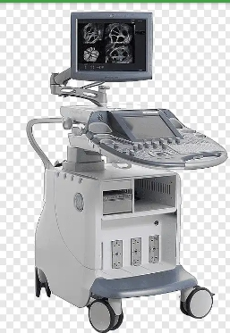
ROLE OF ULTRASOUND IN DIFFERENT PROCESSES OF EXTRACTION
Ultrasonic Chemical Extraction
Analyte Extraction Using Ultrasonic Techniqu
To extract nicotine from the pharmaceutical formulations, the ground chewing gum sample, or small pieces of transdermal patch was placed in 15mL glass vial containing 10mL heptane and sonicated for 20, 40 and 60 min at 37°C in the ultrasonic bath.
The complete extraction of nicotine was obtained in less than 20 min from the transdermal patch and 60 min from the chewing gum.
Ultrasonic extraction reduced the extraction time from 24 h to less than 20 min. in comparison with the use of conventional cold extraction technique.(Yuegang et al., 2004)
In the conventional method each extraction step takes up to 24 h whereas with the ultrasonic extraction method, it took less than 20 min to achieve the same extraction efficiency. (Yuegang et al., 2004)

Slide 81
AN ULTRASONIC DRIVEN POWDER TRANSPORT SYSTEM
Very accurate mixing process in chemical, pharmaceutical and food industries demand for an exact control of powder feeding.
An ultrasonic driven powder transport system was developed; in which the wave stimulation and expansion in pipes, constructed from relatively strongly absorbing materials, are used.
The experimental investigations of this prototype for ultrasonic powder feeding showed that it is possible to feed small amounts of powder with extremely high quantitative accuracy (Kanbe et al., 1993)

Slide 82
APPLICATION OF ULTRASOUND IN TRANSDERMAL DRUG DELIVERY
Transdermal drug delivery offers several advantages over traditional drug delivery systems such as oral delivery and injections.
( Mitragotri et al., 1995) reported in vitro permeation enhancement of several low-molecular weight drugs under the same ultrasound conditions

Slide 83
Clinical applications of therapeutic microbubble delivery systems.

Slide 84
Thrombolysis.
A persistent target for therapeutic ultrasound is that of thrombolysis. (Birnbaum et al., 1998) demonstrated the administration of albumin microbubbles associated with transcutaneous ultrasound potentiated arterial thrombolysis without the additional use of tissue plasminogen activator (tPA).
In a subsequent study, the authors reported the use of therapeutic ultrasound for thrombolysis using nontargeted versus platelet-targeted microbubbles (platelet targeting ligand in the shell of the microbubble) in combination with brief, high mechanical index power to induce thrombolysis within the left anterior descending artery.
. In addition, using a ﬁbrinolytic agent, (Lainga et al., 2012) compared the administration of Alteplase, a tPA, alone or mixed with a phospholipid-shelled UCA versus a similarly loaded liposome.

Slide 85
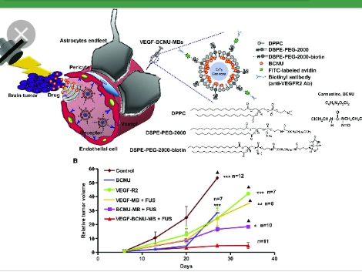
Chemotherapy
While a signiﬁcant focus of ultrasounddirected therapy has been on applications for cardiovascular diseases, numerous studies have emerged for the treatment of cancer.
The well-recognized adverse systemic effects associated with the use of chemotherapeutic agents presents an ideal opportunity for the introduction of ultrasound-directed therapies.
Consistent with this concept, (Heath et al.,2012) delivered cisplatin and cetuximab coupled with microbubbles to xenografts in immunodeﬁcient mice.
They reported a signiﬁcant reduction in tumor size compared with the controls; histological analysis conﬁrmed increased numbers of apoptotic cells following treatment with ultrasound-directed therapies and microbubbles compared with chemotherapeutic agents used alone.

Slide 86
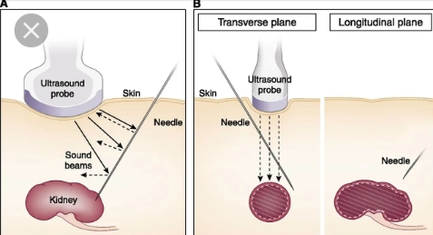
Renal therapy
Renal function is often a target of end-organ damage associated with diabetes and hypertension.
Previous work has demonstrated that microbubbles bind to activated leukocytes (senior et al., 2009).
While interactions between lipid shells and leukocytes are mediated by serum compliment, albumin shell interaction is the result of leukocyte 2-integrins (Lindner et al., 2000).
These differences may provide an advantage for renal therapeutics. If the microbubble and associated drug/gene payloads are preferentially retained within the kidney, perhaps vasodilators and related anti-inﬂammatory agents will provide a novel therapeutic approach while reducing systemic effects of therapy.

Slide 87
Blood-brain barrier
Successful treatment of brain glioma is limited because of the difﬁculty of providing a therapy that is capable of crossing the blood-brain barrier (BBB).
Ultrasound-directed therapies have the potential to achieve increased brain tissue delivery yields.
successfully delivered the chemotherapeutic 1,3-bis(2-chloroethyl)-1-nitrosourea using microbubbles and focused ultrasound (FUS) to successfully cross the BBB (Ting et al., 2012).

Slide 88
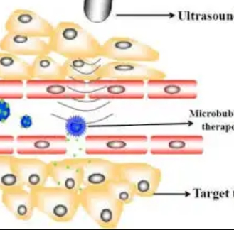
Gene therapy
In addition to delivering small molecules via ultrasound-directed therapies, signiﬁcant progress has been made in delivering plasmid DNA products.
Because of insertional genome issues associated with viral-mediated plasmid therapies (Atkinson and Chalmers, 2010)delivery of naked plasmids using ultrasound directed therapy appears to be promising without the accompanying limitations associated in earlier viral methods. (Danialou et al., 2002)
investigated the use of external ultrasound therapy without microbubbles to increase uptake of plasmid DNA coded for LacZ in wild-type and dystrophic mice.
No response was observed in the ultrasound-only treatment group; however, a 3-fold transfection of the gene and a 22-fold increase in level of expression was noted in animals treated using ultrasound and microbubble therapies.

Slide 89
CONCLUSION
There is ample evidence that ultrasound-mediated gene delivery in the presence of microbubbles is effective; however, there is much work to be done in demonstrating mechanisms of action. If sonoporation were the only means of gene delivery, only the cells of the vessel endothelium in close proximity to the microbubbles would be transfected. Unlike the case of sonothrombolysis, therapeutic effects requiring transfection following vascular administration would seemingly require the participation of delivery mechanisms other than, or in addition to, mechanical perturbation.

Slide 90
REFERENCES
Atkinson H, Chalmers R (2010). Delivering the goods: viral and non-viral gene therapy systems and the inherent limits on cargo DNA and internal sequences. Genetica 138: 485–498.
Birnbaum Y, Luo H, Nagai T, Fishbein MC, Peterson TM, Li S, Kricsfeld D, Porter TR, Siegel RJ (1998). Noninvasive in vivo clot dissolution without a thrombolytic drug recanalization of thrombosed iliofemoral arteries by transcutaneous ultrasound combined with intravenous infusion of microbubbles. Circulation 97: 130–134, .
Chowdhury SM, Lee T, Willmann JK (2017). Ultrasound-guided drug delivery in cancer. Ultrasonography.;36(3):171-184.
Danialou G, Comtois Dudley RW, Nalbantoglu J, Gilbert R, Karpati G, Jones DH, Petrof BJ (2002). Ultrasound increases plasmid-mediated gene transfer to dystrophic muscles without collateral damage. Mol Ther 6: 687–693.
Delalande A, Kotopoulis S, Postema M, Midoux P, Pichon C(2013). Sonoporation: mechanistic insights and ongoing challenges for gene transfer. Gene ;525:191-199.
Floros, J.D. and H.H Liang, 1994. Acoustically assisted diffusion through membranes. Food Technol., pp: 79-84.
Heath CH, Sorace A, Knowles J, Rosenthal E, Hoyt K (2012). Microbubble therapy enhances anti-tumor properties of cisplatin and cetuximab in vitro and in vivo. Otolaryngol Head Neck Surg 146: 938–945.

Slide 91
REFERENCES
Kanbe, N., T. Takano, Y. Tomikawa and K. Adachi, 1993. Analysis of axisymmetric waves propagating along a hollow cylindrical ultrasonic transmission line. J. Acoust. Soc. Am., 93: 6.
Lainga ST, Moodya MR, Kima H, Smulevitza B, Huanga S, Hollandb CK, McPhersona DD, Klegerman ME (2012). Thrombolytic efficacy of tissue plasminogen activator-loaded echogenic liposomes in a rabbit thrombus model. Thromb Res 130: 629–635.
Lindner JR, Coggins MP, Kaul S, Klibanov AL, Brandenburger GH, Ley K (2000). Microbubble persistence in the microcirculation during ischemia/ reperfusion and inflammation is caused by integrin-and complementmediated adherence to activated leukocytes. Circulation 101: 668–675.
Mitragotri, S., D. Edwards, D. Blankschtein and R. Langer, 1995. A mechanistic study of ultrasonically enhanced transdermal drug delivery. J. Pharm. Sci., 84: 697-706.
Senior R, Becher H, Monaghan M, Agati L, Zamorano J, Vanoverschelde JL, Nihoyannopoulos P (2009). Contrast echocardiography: evidencebased recommendations by European Association of Echocardiography. Eur J Echocardiogr 10: 194–212.
Ting CY, Fan CH, Liu HL, Huang CY, Hsieh HY, Yen TC, Wei KC, Yeh CK (2012). Concurrent blood-brain barrier opening and local drug delivery using drug-carrying microbubbles and focused ultrasound for brain glioma treatment. Biomaterials 33: 704–712.
Yuegang, Z., Z. Liliang, W. Jingping, W. Fritz Johnathan, M. Suzanne and R. Christopher, 2004. Ultrasonic extraction and capillary gas chromatography determination of nicotine in pharmaceutical formulations. Anal. Chim. Acta, 525: 35-39

