Slide 1
Achonwa-Njemanze Joshua 19/eng07/001
Petroleum engineering

Slide 2
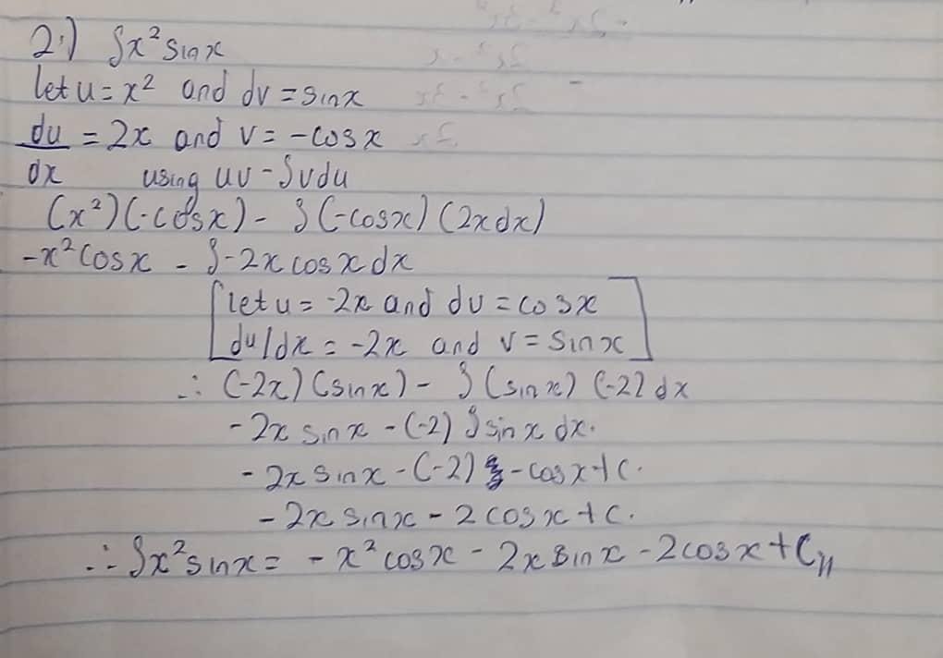

Slide 3
