Slide 1
ARTIFICIAL CARDIAC PACEMAKERS
BY
ODAFEJIROROSUA IROROGHENE WILLIAM
15/ENG04/038

Slide 2
OUTLINE
INTRODUCTION
CLINICAL NEED
HISTORICAL DEVELOPMENT
TYPES
MANUFACTURED DEVICES
ETHICS
STANDARDS
REGULATORY BODIES
WORKING PRINCIPLE
CONCLUSION
REFERENCES

Slide 3
INTRODUCTION
Arrhythmia is a heart condition whereby the heart is unable to beat at a regular rhythmic pattern; sometimes too slow and sometimes too fast.
Since the heart is the ‘powerhouse’ of the body, it would be risky to not do anything about a faulty heart. Hence, measures have been put in place in order to manage this condition and allow the patient continue their normal lifestyle.
A pacemaker is therefore needed since the SA node (natural pacemaker) is no longer working.

Slide 4
INTRODUCTION cont’d
The pacemaker is a medical device that is used to stabilize the rate at which the heart beats whenever it becomes irregular (i.e. too fast or too slow).
This pacemaker that is being presented is called an Artificial Cardiac Pacemaker because there is a natural pacemaker present in the human heart known as the SA node which is responsible for sending electrical impulses which causes contraction and allows blood to be pumped from the atrium to the ventricle.
There are basically two types of Artificial Cardiac Pacemakers; the external and the internal which is otherwise referred to as Implantable Cardiac Pacemaker which is the focus of this preentation.

Slide 5
CLINICAL NEED
According to World Health Organization (WHO), 30% of deaths around the world are caused by Cardiovascular diseases. Most of them could have been prevented by pacing the heart to correct heart rate.
The application of Artificial Cardiac Pacemakers can be found in the Heart and specifically in correcting heart rates. It is used in Third degree AV blocks to normalize the patient’s heart rate, increase the low blood pressure and stabilize the blood dynamics.

Slide 6
CLINICAL NEED
Although, it can also be used in second degree AV block but the Third Degree AV is a more critical condition since the nerve impulse generated at the SA node in the Atrium cannot propagate to the Ventricles, thus the need for a pacing device.

Slide 7
HISTORICAL DEVELOPMENT
It was invented by John Alexander Hopps, a Canadian Electrical Engineer a year after he successfully restarted the heart of a dog with his first invention; the cardiac defibrillation machine although, it was too large to be used internally.
In 1958, Rune Elmqvist., an American Electrical Engineer developed the first Implantable Artificial Cardiac Pacemaker but it only lasted for two days but in 1960, Wilson Greatbatch developed it into a longer lasting device with lithium batteries.

Slide 8
HISTORICAL DEVELOPMENT cont’d
The implantable pacemaker was only capable of pacing the Ventricle (Lower chamber) and it was a Single Chamber Pacemaker but this created a need for the one that could pace both the Atrium (Upper Chamber) and the Ventricle (Lower Chamber).
In 1962, the Double Chamber (Dual Chamber) pacemaker solved the problem of the single chamber but it had the challenge of not being able to pace the heart rate with response to the activity being undertaken by the patient; it produced a fixed heart rate.

Slide 9
HISTORICAL DEVELOPMENT cont’d
The problem discovered from the usage of the Double Chamber Pacemaker was solved by the Rate-Responsive Pacemaker by using a piezoelectric crystal that bends according to body activity and sends an electrical signal that allows the pacemaker pace according to the activity. Modern Rate-Responsive Pacemakers have replaced the piezoelectric crystal with an accelerometer for more accurate pacing.
By default, the pacemakers pace only one ventricle but sometimes, the heart’s function is so decreased that both ventricles must be paced which led to the development of a Bi-ventricular Pacemaker.

Slide 10
TYPES
There are basically three types of pacemakers
Single Chamber Pacemaker.
Double Chamber Pacemaker.
Rate-Responsive Pacemaker.
Biventricular Pacemaker.

Slide 11
TYPES cont’d
SINGLE CHAMBER PACEMAKER
This type of pacemaker has one lead that connects the pulse generator to the right ventricle. It basically controls heartbeat pace.

Slide 12
TYPES cont’d
DOUBLE CHAMBER PACEMAKER
This pacemaker has two leads that connects to both chambers on the right side of the heart. It is programmed to allow both chambers work in harmony with each other.

Slide 13
TYPES cont’d
RATE-RESPONSIVE PACEMAKER
This pacemaker has a pulse generator that is capable of sensing changes in body activity and breathing rate in order to allow the pacemaker reduce or increase the heart rate accordingly.

Slide 14
TYPES cont’d
BIVENTRICULAR PACEMAKER
This pacemaker is also known as a cardiac resynchronization therapy (CRT) device, has three leads connected to the right atrium and both ventricles. It is used to treat people with arrhythmias. Patients suffering from arrhythmias have a problem with both ventricles working in harmony that is why this type of pacemaker is existing.

Slide 15
MANUFACTURED DEVICES
There are basically three main manufacturers, they are;
Medtronic
Abbot Laboratories
Boston Scientific

Slide 16
MANUFACTURED DEVICES
MEDTRONICS
Medtronics is one of the top pacemaker manufacturing companies and they have manufactured at total of eleven pacemaker models at the time of preparing this presentation. They include;

Slide 17
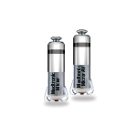
MANUFACTURED DEVICES
MEDTRONICS
Micra Transcatheter Pacing Systems: According to their website, it is self-contained in the heart, it does not require a lead, it leaves no chest scar and no bump under the skin. They have model numbers MC1AVR1 and MC1VR01.
FIG. 1: MICRA by Medtronics

Slide 18
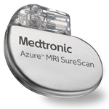
MANUFACTURED DEVICES
MEDTRONICS
Azure: According to their website, it is equipped with BlueSync technology and is compatible with MyCareLink Heart mobile app for remote monitoring. It is wirelessly and securely tranfers heart device information to the clinic. They have model numbers W1DR01, W1SR01, W3DR01, W3SR01.
FIG. 2: Azure by Medtronics

Slide 19
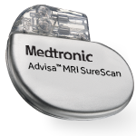
MANUFACTURED DEVICES
MEDTRONICS
Azure MRI: It has the same features as the Azure but is capable of operating in MRI environments when specific conditions are met. They have model numbers A2DR01, A3SR01.
FIG. 3: Azure MRI by Medtronics

Slide 20
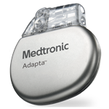
MANUFACTURED DEVICES
MEDTRONICS
Adapta: According to their website, it waits for the heartbeat of the patient before it paces to avoid unnecessary pacing and they are completely automatic, constantly adjusting settings to meet patients need. They have model numbers ADDR01, ADDR03, ADDR06, ADDRL1, ADDRS2.
FIG. 4: Adapta by Medtronics

Slide 21
MANUFACTURED DEVICES
MEDTRONICS
Revo MRI™ SureScan™.
Sensia™.
Versa™.
EnRhythm™.
Sigma™.
Kappa™ 400.

Slide 22
MANUFACTURED DEVICES
The other manufacturers have similar products with similar features, hence there is no unique feature that makes any manufacturer different. It is only a matter of choice or cost.

Slide 23
ETHICS
Patient privacy and confidentiality of information is paramount and all existing remotely-transferrable patient information pacemakers ensure that the patients information is securely transmitted to the hospital, cyber security is taken into consideration.
Both the doctor and the patient can decide to take off the pacemaker for reasons of futility or autonomy.

Slide 24
STANDARDS
EN 50061: Safety of Implantable Cardiac Pacemakers.
ISO 5841-1:1989: Cardiac pacemakers — Part 1: Implantable pacemakers.

Slide 25
REGULATORY BODIES
UNITED KINGDOM (UK): Medicines and Healthcare products Regulatory Agency (MHRA).
UNITED STATES OF AMERICA (USA): Food and Drug Administration (FDA).
NIGERIA: National Agency for Food and Drug Administration and Control (NAFDAC).

Slide 26
WORKING PRINCIPLE
There are different types of pacemakers but the most prominently used is the dual chamber pacemaker. It requires two pacing leads; both place on the right hand side of both chambers. It monitors electrical activity in the atrium and/or the ventricle to see if pacing is needed and when needed, the pulses are timed to mimic the way the heart pumps naturally.

Slide 27
WORKING PRINCIPLE
It comprises primarily of three parts:
Electrical pulse generator.
Power source (battery).
Electrode (lead) system.
The electrical pulse generator consists of the following components:
Sense amplifier circuit.
Timing control circuit.
Output driver circuit.

Slide 28
WORKING PRINCIPLE cont’d
The electrodes measure the electrical activity of the heart, amplifies the signal and compares the signals received to the reference voltage. If the signal received is the same as that of the reference voltage, then the heart is normal and no signals are sent but if it is low or high, then the pulse generator starts sending signals till the heart’s activity returns to normal. A timing control is needed to control the time difference between the pulses to the SA node and AV node which is 0.2 sec.

Slide 29
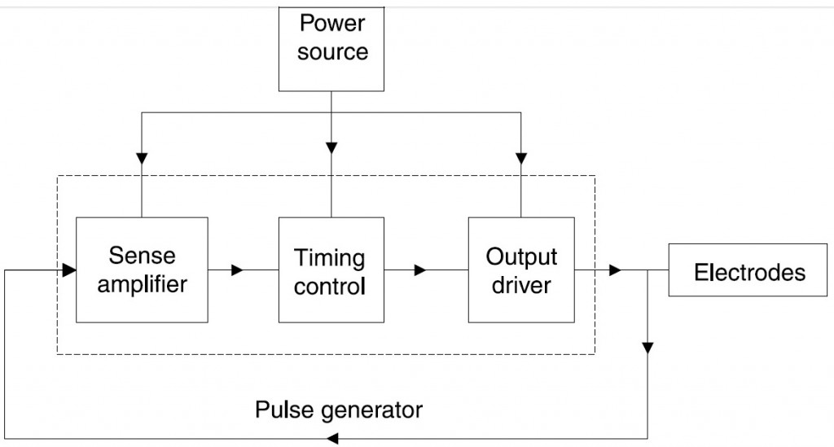
WORKING PRINCIPLE cont’d
FIG. 5: THE BLOCK DIAGRAM OF A PACEMAKER

Slide 30
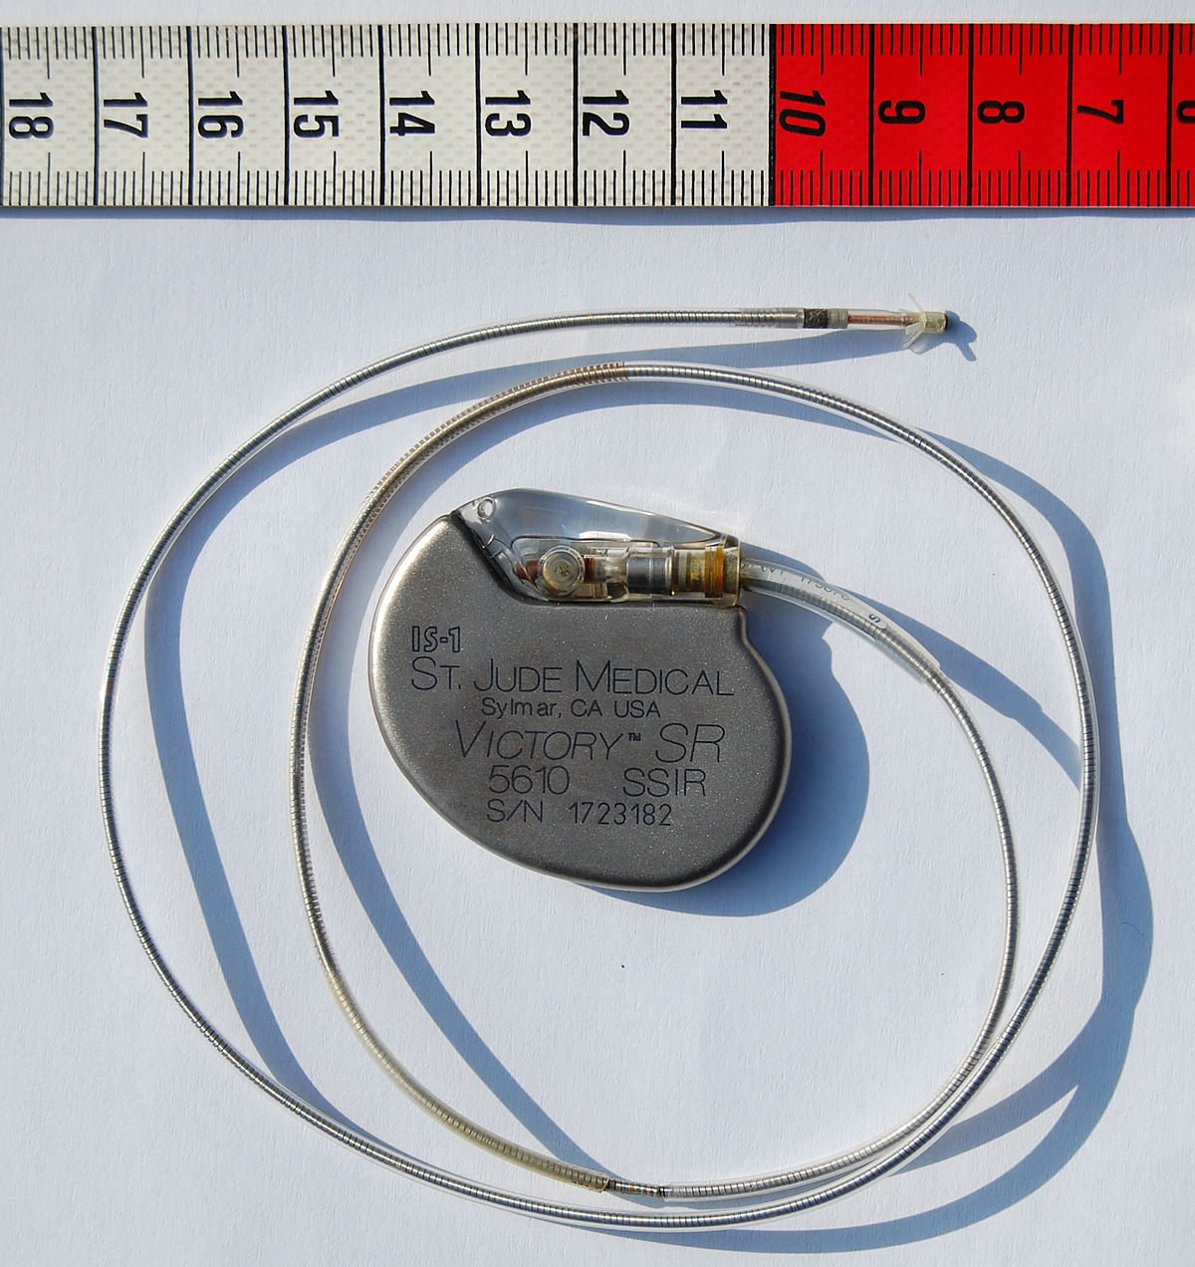
WORKING PRINCIPLE cont’d
FIG. 6: DIAGRAM OF AN IMPLANTABLE ARTIFICIAL CARDIAC PACEMAKER (Credit: Steven Fruitsmaak)

Slide 31
CONCLUSION
A lot of advancements have been made in pacemakers technology. Most manufacturers now include IoT to enable the patient monitor the pacemaker from a mobile application and transmit data securely and wirelessly to the clinic in any critical situation. One of the researches that is worthy of mention is the elimination of leads in the pacemakers, thus leadless pacemakers. At the time at which this presentation was prepared, it was still being developed with only the single chamber leadless pacemaker already available which would not be helpful for all cases of Arrhythmia.

Slide 32
REFERENCES
Arrhythmia | Irregular heartbeat | MedlinePlus. (n.d.). MedlinePlus - Health Information from the National Library of Medicine. https://medlineplus.gov/arrhythmia.html
Pacemakers and defibrillators save lives in different ways. (2019, December 10). Health Essentials from Cleveland Clinic. https://health.clevelandclinic.org/pacemakers-defibrillators-save-lives-in-different-ways-video/
ECG learning center. (n.d.). ECG Learning Center - An introduction to clinical electrocardiography. https://ecg.utah.edu/lesson/6#Complete
Heart block. (2017, October 23). nhs.uk. https://www.nhs.uk/Conditions/Heart-block/Pages/Introduction.aspx
Development of the cardiac pacemaker. (n.d.). ari.info. https://www.animalresearch.info/en/medical-advances/timeline/cardiac-pacemakers/
Hopps, John A. (1981-01-01). "The Development of the Pacemaker". Pacing and Clinical Electrophysiology. 4 (1): 106–108. doi:10.1111/j.1540-8159.1981.tb03682.x. ISSN 1540-8159.
Pacemaker history and development - Inova heart & vascular institute northern Virginia - Inova. (n.d.). World-class heart and vascular care for Northern Virginia and Washington, DC metro area - Inova. https://www.inovaheart.org/heart-care/pacemaker/history

Slide 33
REFERENCES
Inventor of pacemaker dies at 92. (2011, September 30). BBC News. https://www.bbc.com/news/world-us-canada-15085056
Types. (n.d.). Stanford Health Care (SHC) - Stanford Medical Center | Stanford Health Care. https://stanfordhealthcare.org/medical-treatments/p/pacemaker/types.html
Medtronic. (n.d.). Medtronic pacemakers. Medical Technology, Services, and Solutions Global Leader | Medtronic. https://www.medtronic.com/us-en/patients/treatments-therapies/pacemakers/our.html
What are the different types of pacemakers? (n.d.). WebMD. https://www.webmd.com/heart-disease/qa/what-are-the-different-types-of-pacemakers
Pacemakers. (n.d.). National Heart, Lung, and Blood Institute (NHLBI). https://www.nhlbi.nih.gov/health-topics/pacemakers
How a pacemaker works. (2019, October 15). Durofy. https://durofy.com/how-a-pacemaker-works
The ethics of implantable devices. (2007, October 1). ResearchGate. https://www.researchgate.net/publication/6078171_The_ethics_of_implantable
Simulation of an artificial cardiac pacemaker * BENG 122 a : Biosystem and controls. (n.d.). Semantic Scholar | AI-Powered Research Tool. https://www.semanticscholar.org/paper/Simulation-of-an-Artificial-Cardiac-Pacemaker-*-122-Ong-Nacinopa/f9622d1060fddfc5b385d9dc06a1f7c5ba0c9b13/figure/18

