Slide 1
OPAFUNSO ESTHER OLUWASEUN
CHM 102 ASSIGNMENT IN CARBOXYLIC ACID
19/MHS11/120
COLLEGE:MHS

Slide 2
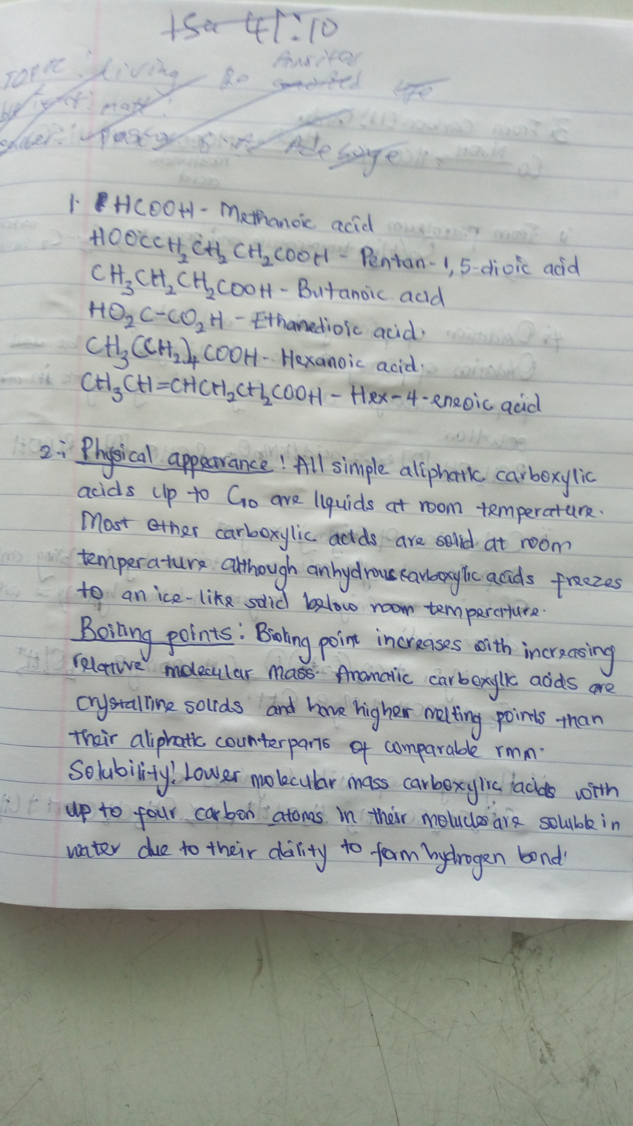

Slide 3
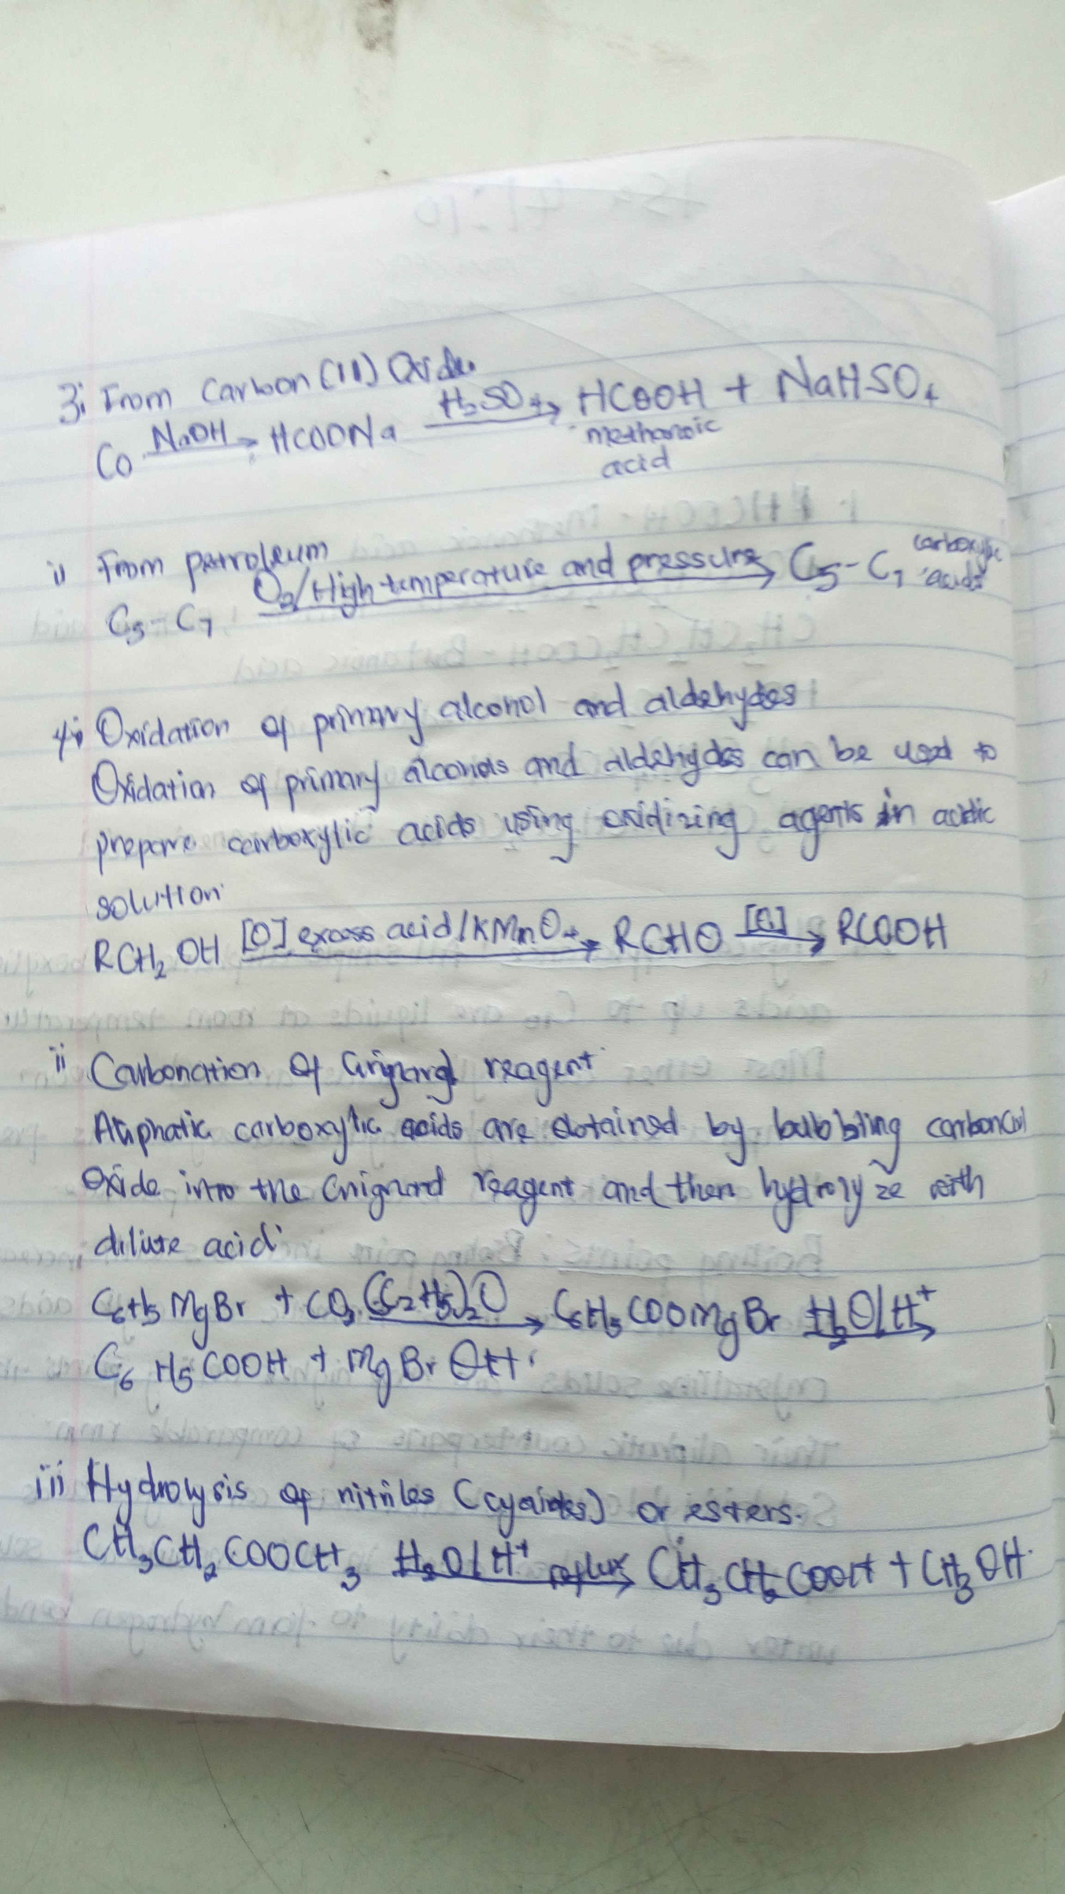

Slide 4
