Slide 1
OPAFUNSO ESTHER OLUWASEUN
19/MHS11/120
CHM 102 ASSIGNMENT ON ETHERS
COLLEGE MHS

Slide 2
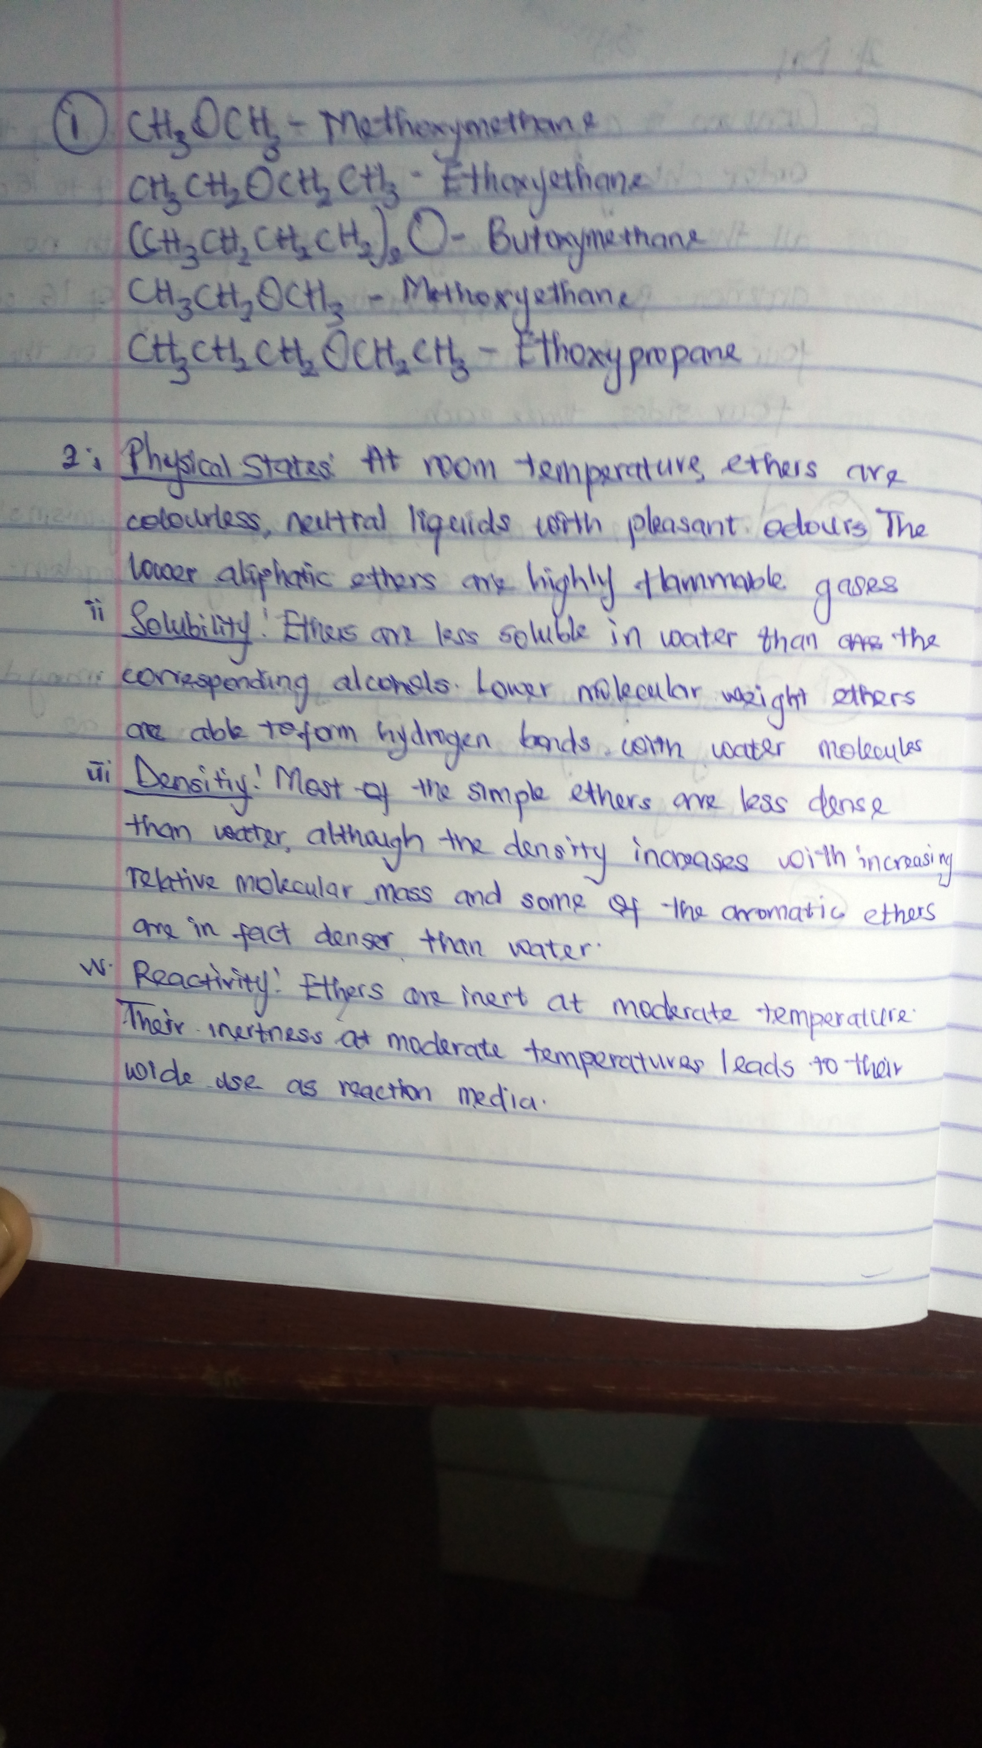

Slide 3
