Slide 1
Types of photography

Slide 2
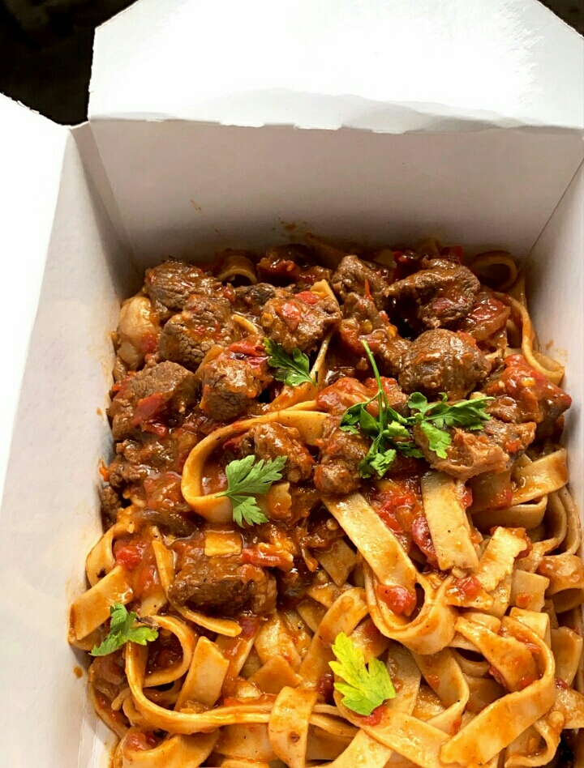
Food photography

Slide 3
Fashion photography

Slide 4
Nature photography

Slide 5
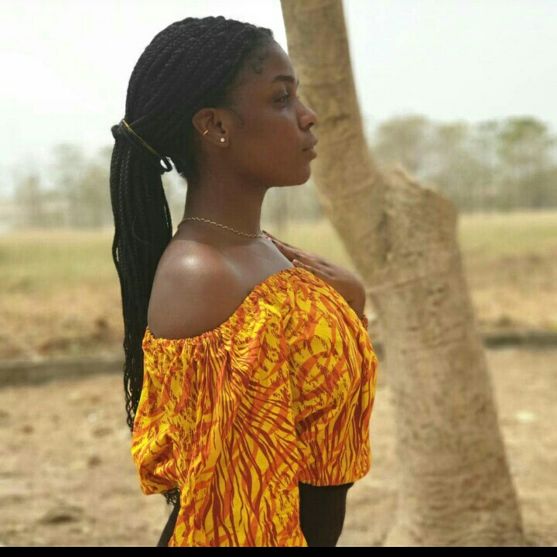
Model photography

Slide 6
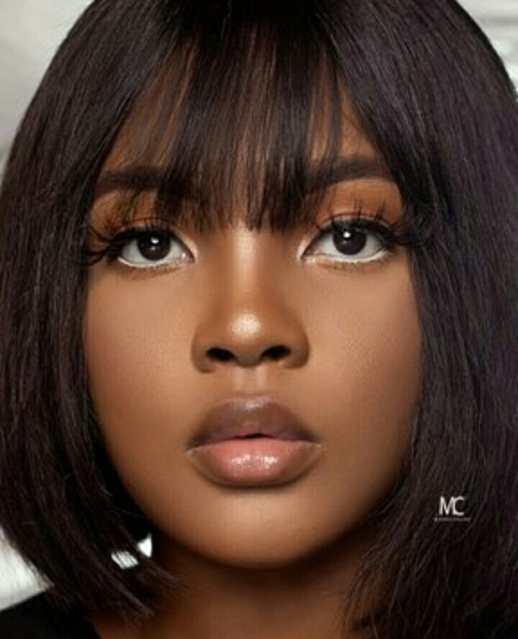
Studio photography

