Slide 1
STUDENTS INDUSTRIAL WORK EXPERIENCE SCHEME (SIWES)
AT
PHAMATEX INDUSTRIES LIMITED LAGOS.
BY
EKAM KARO CHRIS
17/MHS07/008
SUBMITTED TO
DEPERTMENT OF PHARMACOLOGY AND THERAPEUTICS
MAY 2020
1.INTRODUCTION
2.QUALITY ASSURANCE
3.QUALITY CONTROL
4.MAJOR QUALITY ANALYSIS
4.1. WATER ANALYSIS
.2 PRODUCT PHYSICAL PARAMETERS
4.3 RAW MATERIAL ANALYSIS
4.4 ASSAY USING UV AND HPLC
4.5 RINSE WATER ANALYSIS.
5. EQUIPMENTS.
6. CONCLUSION/RECOMENDATION

Slide 2
BRIEF HISTORY OF THE COMPANY
Phamatex Industry Limited is a member of the Phamatex Group and was founded by two Entrepreneurs whose dreams became synergistically realised. The Phamatex Industries Limited was incorporated on 29th of July, 2010.It became a child of necessity as a result of NAFDAC regulations to stop importation of certain Generics and over the counter (OTC) Medicines.
Located in the heart of Amuwo-Odofin Industrial Layout, is a world-class state of the Art Manufacturing Complex to cater for quality healthcare through the innovation .

Slide 3
INTRODUCTION
Pharmaceutical Industry discovers, develops, produces and markets drugs or Pharmaceutical drugs for use as medications to be administered [or self administered] to patients, with the aim to cure them, vaccinate them, or alleviate the symptoms.
Pharmaceutical companies may deal in generic or brand medications and medical devices. They are subject to a variety of laws and regulations that govern the patenting, testing, safety, efficacy and marketing of drugs.

Slide 4
PRODUCTION
Production department operates in critical awareness of cleanliness and in accordance with recommended procedure and specification from dispensing of material, through granulation, blending, compressing, coating, blistering, packaging and repackaging, labeling to completion of the finished product. In producing drugs, we have two types of raw materials they are; API and Excipients.
The API is the active pharmaceutical ingredient for production.
Some of the API and the tablets via phamatex include;
SOME ACTIVE PHARMACEUTICAL INGREDIENTS
API PHAMATEX
Metronidazole Famagyl
Paracetamol Paratex
Ibuprofen Pilprofen
Lumenfantrine&artemether Lumapil
Albendazole Wormout
Vitamin B1& vitamin B6 Neurotex forte etc
EXCIPIENT: Pharmaceutical excipients are substances other than the pharmacologically active drugs which are include in the manufacturing process or are contained in the finished prodage form. Excipients supports transporting of the active drug to its target site in the body where the drug is intended to exert its action, they also keep the drug from releasing too early in the assimilation process in places where it could damage tender tissues and create gastric irritation or stomach upset, various excipients have specific or numerous functions.

Slide 5
Classes Of Excipient
Binders
lubricants
Disintegrants
Glidants
Anti-adherent
Fillers or diluents

Slide 6
PRODUCTION OF FAMAGYL (METRONIDAZOLE) TABLET 200mg
THEORY: Metronidazole is an antibiotics and anti-protozoan medication. it is used either alone or with other antibiotics to treat pelvic inflammatory disease, endocarditis and bacterial vaginosis famagyl tablet is an oral consumption drug.
RAW MATERIAL
API EXCIPIENTS
METRONIDAZOLE
LACTOSE
CORN STARCH
SODIUM STARCH
POVIDONE
MAGNESIUM STEARATE
AEROSIL
WATER

Slide 7
STAGES OF THE PRODUCTION
STEP 1: DESPENSING OF RAW MATERIAL FROM THE DESPENSING ROOM
STEP 2: GRANULATION: The API and the excipient appear in a powdered form which it must go through different stages and granulation is one of stages of production.
firstly, the powdered raw materials were brought into the granulation room, before granulation take place the powdered raw materials were sifted in the vibrosifter to get a uniform texture. Some of the raw material which are large and cannot pass through the vibrosifter were milled using the multi miller machine, after this, they were added into RMD Rapid mixer and granulator to form granules.
STEP 3: MIXING and DRYING: Load the granules into Rapid mixer granulator and mix for 30 minutes with impeller at slow speed and chopper off Add the additional amount of purified water (if required) and record in BMR .Unload under high-speed mixer and granulator on into the FBD bowl.

Slide 8
STEP 4: ANALYSIS OF GRANULES BY QUALITY CONTROL (LAB)
RESULT: COMPLIES (QUALITY IS WITHIN SPECIFICATION)
STEP 5: BLENDING: Granules are blended in a cage blender with addition of some of the blending materials like sodium starch glycolate, maize starch and aerosil.
STEP 6: COMPRESSION: When the granules was added into a hopper the lower and upper punches comes together in the die cavity and forms a tablets, the control panel controls the compressor machine, suction pipe sucks the granules into a hopper while the de-duster removes dust from the tablet after which the cleanliness of the machine, hopper and de duster checked Ensuring the removal of all the material.
At the start of the compression, the appearance, average weight, friability, Thickness, hardness, diameter, disintegration time and uniformity of weight of the tablets were recorded and approval to continue the compression was giving by from QA staff.
The tablets were stored in low density polythene bag in air tight plastic containers.
Quality Assurance personnel draw samples for analysis to ensure compliance with specification.

Slide 9
STEP 7: BLISTERING: The tablets were blistered in the blistering machine.
STEP 8 : ANALYSIS OF FINISHED PRODUCT:
Appearance : White circular biconvex uncoated tablets with Phamatex on lower punches and metro with break line on upper punches... COMPLIES
Average Weight/Tablet :500mg ± 5% (475mg – 525mg) = COMPLIES
Weight of 10 Tablets :5.00g ± 3% (4.85g – 5.15g) = COMPLIES
Diameter :11.0 mm ± 0.1 mm = COMPLIES
Hardness :NLT 40N = COMPLIES
Thickness :(4.7 mm to 5.0mm) = COMPLIES
Friability :NMT 1.0% = COMPLIES
Disintegration Test :NMT 15 minutes = COMPLIES
STEP 9: PACKAGING AND DISPOSAL: the finished goods were packed and approval label pasted on them by the QA personnel and stored in the warehouse.

Slide 10
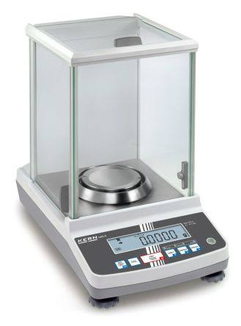
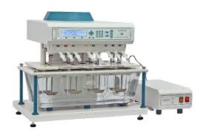
EQUIPMENTS
1. Analytical weighing balance
2. Dissolution tester

Slide 11
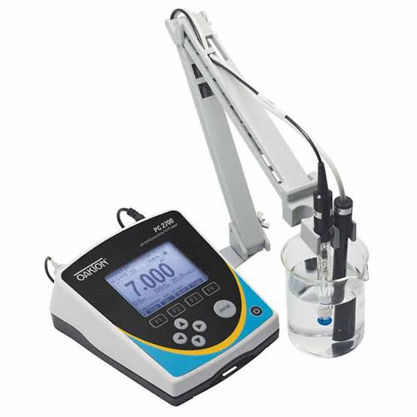
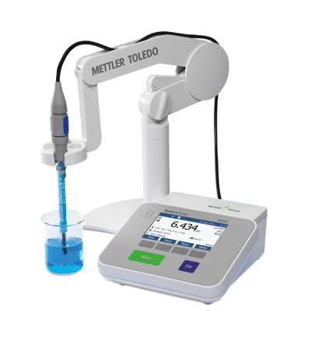
3. Conductivity Meter
4. pH Meter

Slide 12
CONCLUSION
pharmaceutical production is a very crucial and critical one as carefulness is taken in every step of production even to the final consumers, this is because it involves the care of lives and so The production of famagly (metronidazole) followed every critical step. Pharmaceutical production is better than traditional drugs because pharmaceutical product follows a very crucial and carefulness steps .

Slide 13
THANK YOU

